Slide 1

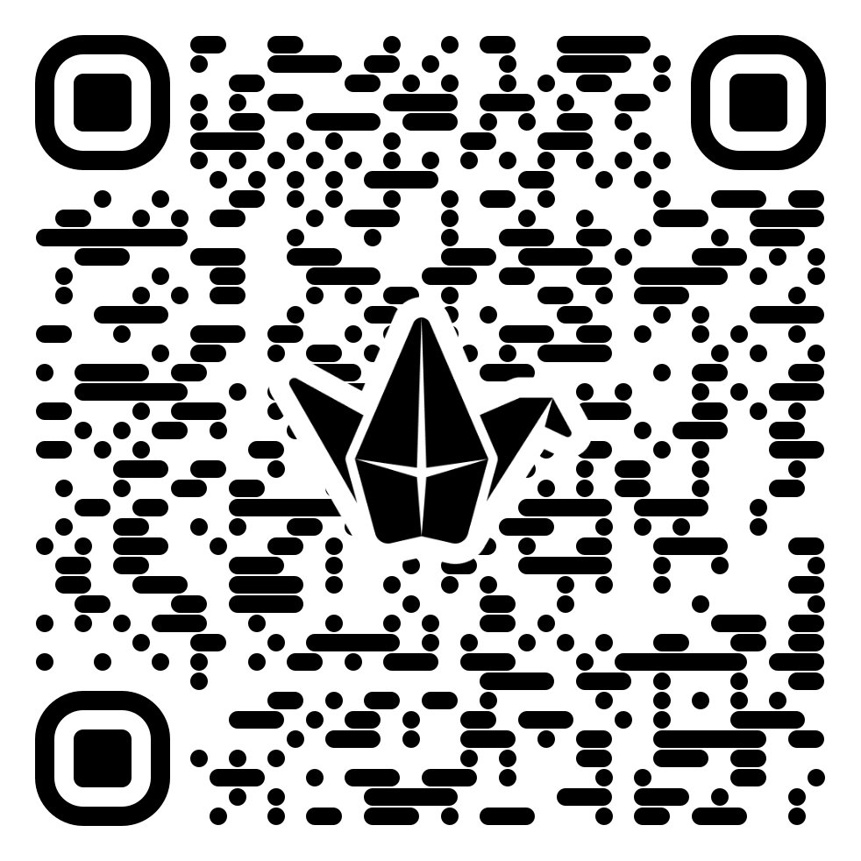
Faculty Ready. Institution Not.
Alexei Kolesnikov · Samuel Collins · Alissa Harrington
Towson University, Maryland
NAIRR Pilot · Classroom Expansion Conferences — Research Emerging (Large)
Notes:
Link to Padlet https://padlet.com/TUFACET/NAIRRPilot26

Slide 2

Get ChatGPT.
Our provost said:

Slide 3



AI pilot readiness
THE PILOT
Competitive application
Faculty applied for a seat in the ChatGPT EDU pilot.
Faculty proposed real projects
Use cases came from faculty, not a mandate.
Clear goals for AI use
Each participant set concrete aims for the tool.

Slide 4
Everything was Ready.
Community space launched
Faculty came together
Momentum was building.

Slide 5
And we waited…
THE WAIT
Procurement, access, and the gap between a tool and a working environment.

Slide 6
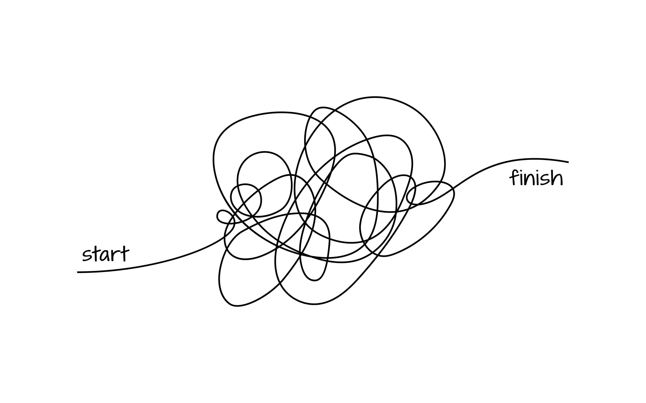
Procurement process
THE WAIT
From green-light to access: a long, nonlinear path.

Slide 7

12+
MONTHS
to access the tool

Slide 8
Access was Limited.
300
TOTAL LICENSES
~200 FACULTY
~100 IT & GRAD STUDENTS
1,000+ FACULTY ON CAMPUS

Slide 9

Momentum lost before work begins.

Slide 10





Not the tool they were expecting
THE REALITY
It's a constrained version.
Limited sharing
No integration into research workflows
No access to the broader ecosystem
No connectors

Slide 11
The tool is here.
But the ecosystem isn't.

Slide 12
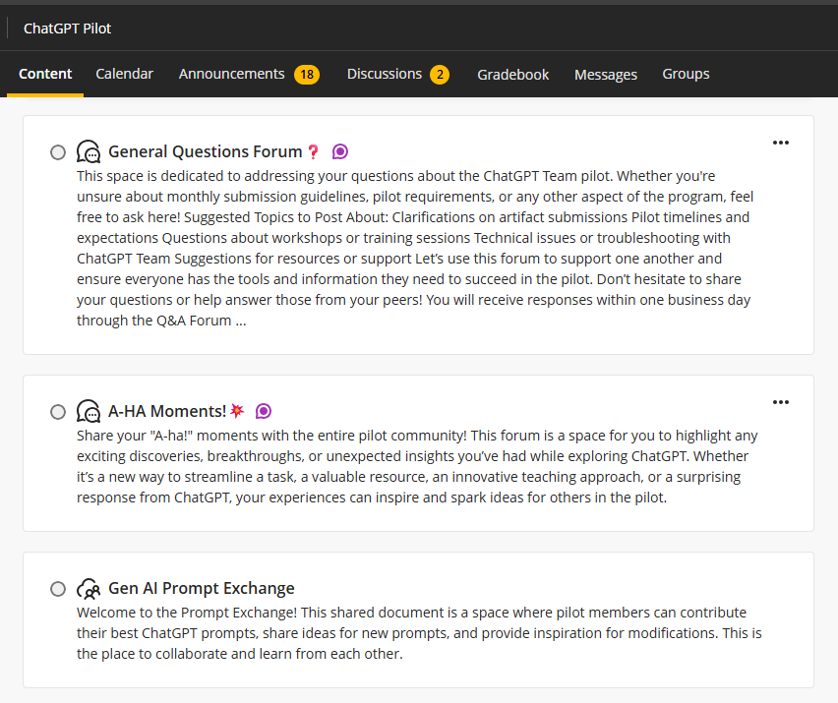


Low pilot-community engagement
WHAT WE SAW
~25%
Engaged in discussions
~30%
Submitted updates
Forum activity was quiet — which turned out to be the wrong place to look.

Slide 13
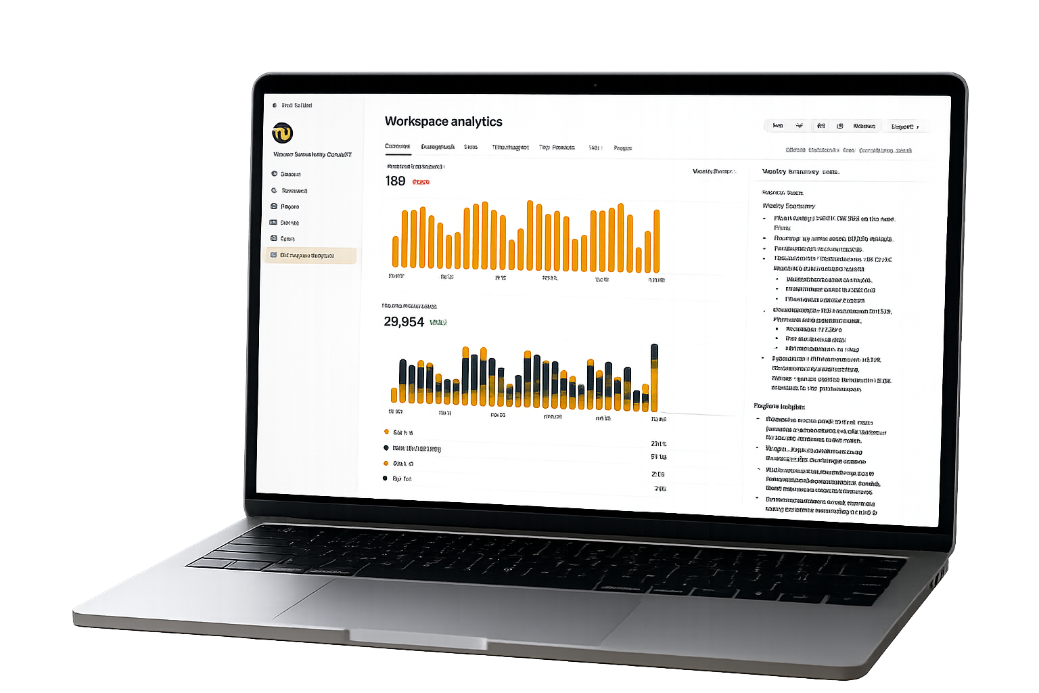


Workspace data told a different story
WHAT WE SAW
~200,000
Interactions
500+
Structured projects
Active use
Across disciplines
TU ChatGPT EDU workspace analytics — community formed in the work, not the LMS.

Slide 14

The impact survey confirmed it
WHAT WE SAW
60%
Teaching + research
Real outcomes
Response rate
Where faculty applied it
Faculty reported concrete results

Slide 15
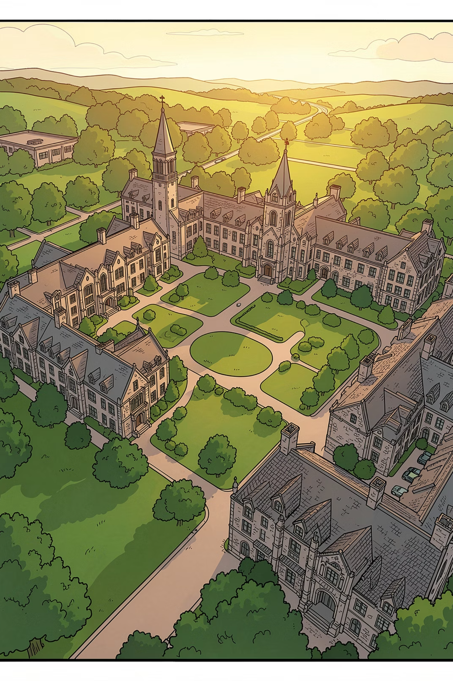
Proposed projects in the arts, humanities & social sciences
FACULTY DEMAND
Faculty have proposed AI-infused projects that imply real computational and infrastructural needs.

Slide 16


Medieval Village Detection in Ireland
FACULTY DEMAND
Training AI on drone/aerial imagery to detect medieval village settlements, with crowdsourced validation through an app interface.
Drone capture
ML training
Crowdsource validation
Aerial field photography across candidate sites.
A model learns to detect settlement patterns.
Community verifies and labels findings.

Slide 17




Jazz Melody Recognition Archive
FACULTY DEMAND
A melody-recognition system over a large digital archive of jazz recordings — query-by-humming and motif search for scholars.
Melody extraction
Pattern matching
Scholarly access
Pulling melodic lines from polyphonic, improvised recordings.
Query-by-humming and motif search across thousands of tracks.
Opening a closed archive to musicologists and the public.

Slide 18



Imperial-Era Japanese Archive
FACULTY DEMAND
Training OCR and handwritten-text-recognition (HTR) systems on an imperial-era Japanese archive.
Script complexity
Model training
Digital access
Classical kana, kanji variants, and mixed printed/handwritten documents that defeat standard OCR.
Custom HTR models fine-tuned on annotated archive samples.
Transcribed texts made searchable and linkable for new research.

Slide 19
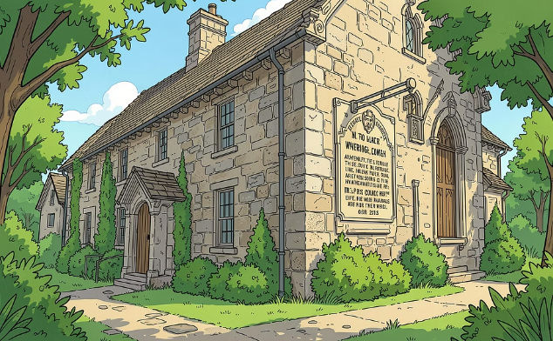
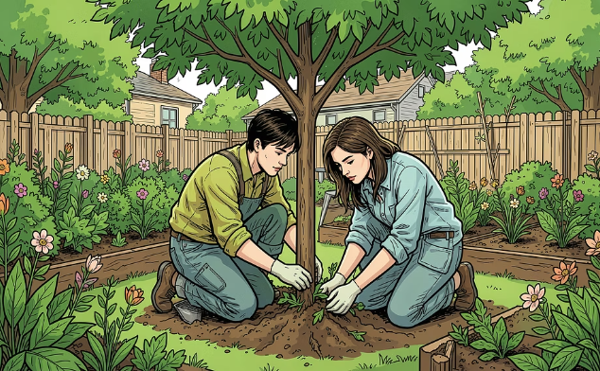
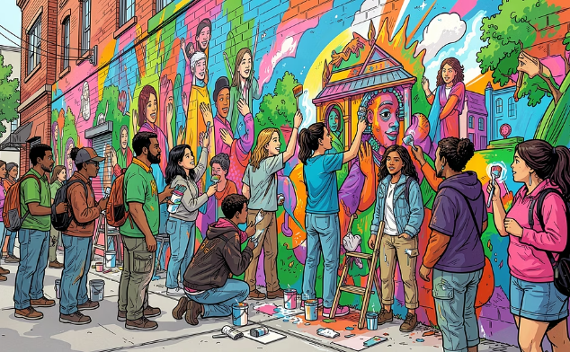
Community-Designed Apps for Culture & Environment
FACULTY DEMAND
Collaboratively designed apps built with communities, not just for them — with real back-end infrastructural support.
Historical
Environmental
Cultural
Map heritage sites, collect oral histories, connect communities with cultural legacy.
Pollution monitoring, tree-canopy and heat-island tracking across Baltimore.
Documenting and enabling art interventions — murals and AR projects.

Slide 20
Recognizing heterogeneity.
THE INSTITUTIONAL RESPONSE
From a self-selected fifth to a coordinated, federated response.

Slide 21
What you just saw is a self-selected fifth.
THE INSTITUTIONAL RESPONSE · DIAGNOSIS
The pilot's movers are there. The design problem is supporting them while engaging everyone else.
The movers
The silent majority
~1/5 of faculty
not on a maturity gradient, heterogeneous in kind
Opted in. Experimenting across a widening range of tools.
What they need is room to run: fewer constraints, not more persuasion.
Some haven't engaged yet.
Some have principled or labor-based reasons not to.
A legitimate position to answer, not convert.
A coordinated response has to hold both groups at once.

Slide 22

You can't impose one posture on a divided faculty. So we federate.
THE INSTITUTIONAL RESPONSE · THE MODEL
Each tier owns its own engagement with AI. The institute coordinates and resources, it does not mandate.
Faculty FACET AI Hub
Community of practice. Pioneered faculty AI support since 2022.
College-level Disciplinary integration
Still emerging, and this will be a sizeable resource draw.
Institutional Towson AI Institute
Coordinates strategy, resources, partnerships across the three areas.
Network National alliances · NAIRR
Where the top tier reaches outward. (Next: the NAIRR ask.)

Slide 23
What we would ask of a shared national resource.
THE NAIRR LAYER
The compute is real. Getting faculty to it is an open problem.

Slide 24

The intake is a capacity filter.
THE NAIRR LAYER · DIAGNOSIS
WHO WINS IN MARYLAND
15 of 17
Feasibility of the technical approach
presumes someone who can scope a compute job
Maryland NAIRR allocations went to the state's four R1 / very-high-research institutions.
Need for the computing resources
presumes a sized, justified request
The only two exceptions — Morgan State and St. Mary's College — came via the lighter Start-Up and Classroom tracks, never the main research call.
Knowledge & experience of the team
presumes a prior AI-research track record
Four of the six scored review criteria reward capacity an institution must already have.
Estimated resource requirements
presumes GPU-hour / node-hour estimation
Source: NAIRR Pilot public allocations list (708 awarded projects), as of June 2026. PI-institution count; directional, not a controlled comparison.

Slide 25


Don't teach the tool. Match the problem.
THE NAIRR LAYER · WHAT WOULD HELP
The way in today rewards people who already know what to ask for. Our faculty come with a problem first.
How it works now
What faculty actually need
Capable resources, reachable by researchers sophisticated enough to map their own work onto them.
Someone who takes the problem they walk in with
and finds whether a resource fits.

Slide 26
The resources are there. The access, not yet.
THE NAIRR LAYER
NAIRR has the compute. We are missing the help that turns a faculty member's problem into something that matches the capacity. This has to happen close to the faculty.
Faculty
level
Institutional
(AI Institute)
Network
(NAIRR · CAA)
College level
(emerging)

Slide 27
Where this goes next.
LOOKING FORWARD
Discussion: We started with our story, let’s hear yours

