Slide 1


Slide 2

Designing AI-Integrated Assignments That Still Assess Learning
Dr. Venkataramani Kumar
Assistant Professor (Tenure-track)
Department of Computer Science and Engineering (CSE)
Email: venkataramani.kumar@upr.edu
June 18-19, 2026
Orlando, Florida

Slide 3
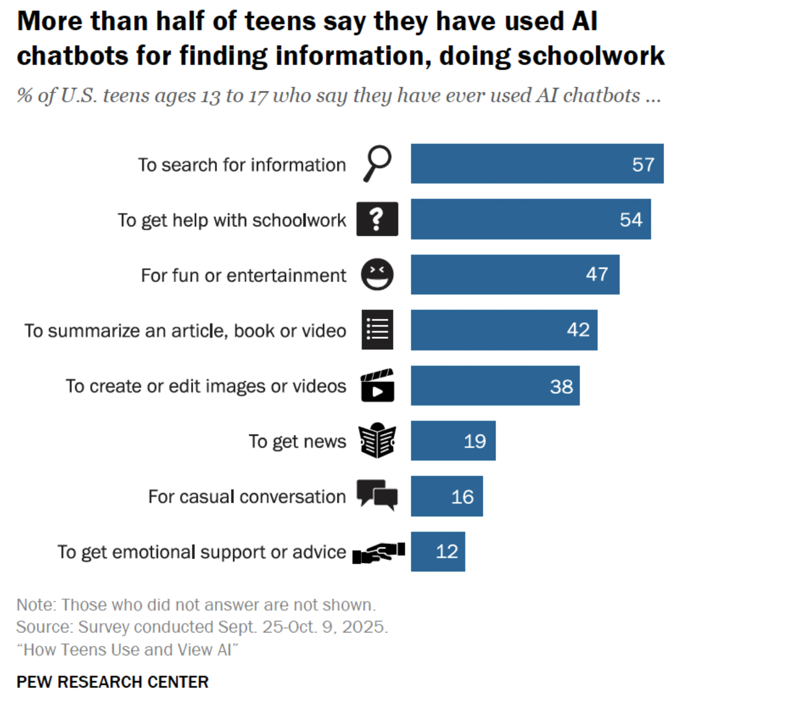
The Challenge: AI and Student Learning
Increasing use of Gen AI tools for traditional assessments
Instructors grapple with distinguishing between AI generated work, and genuine student work
Most cases traditional assessments emphasize the final outputs
Educational approaches/strides must be taken to enable them use AI responsibly and ethically
Current focus: Did students use AI?; New Focus should be: How can students demonstrate they learned concepts despite using AI?

Slide 4
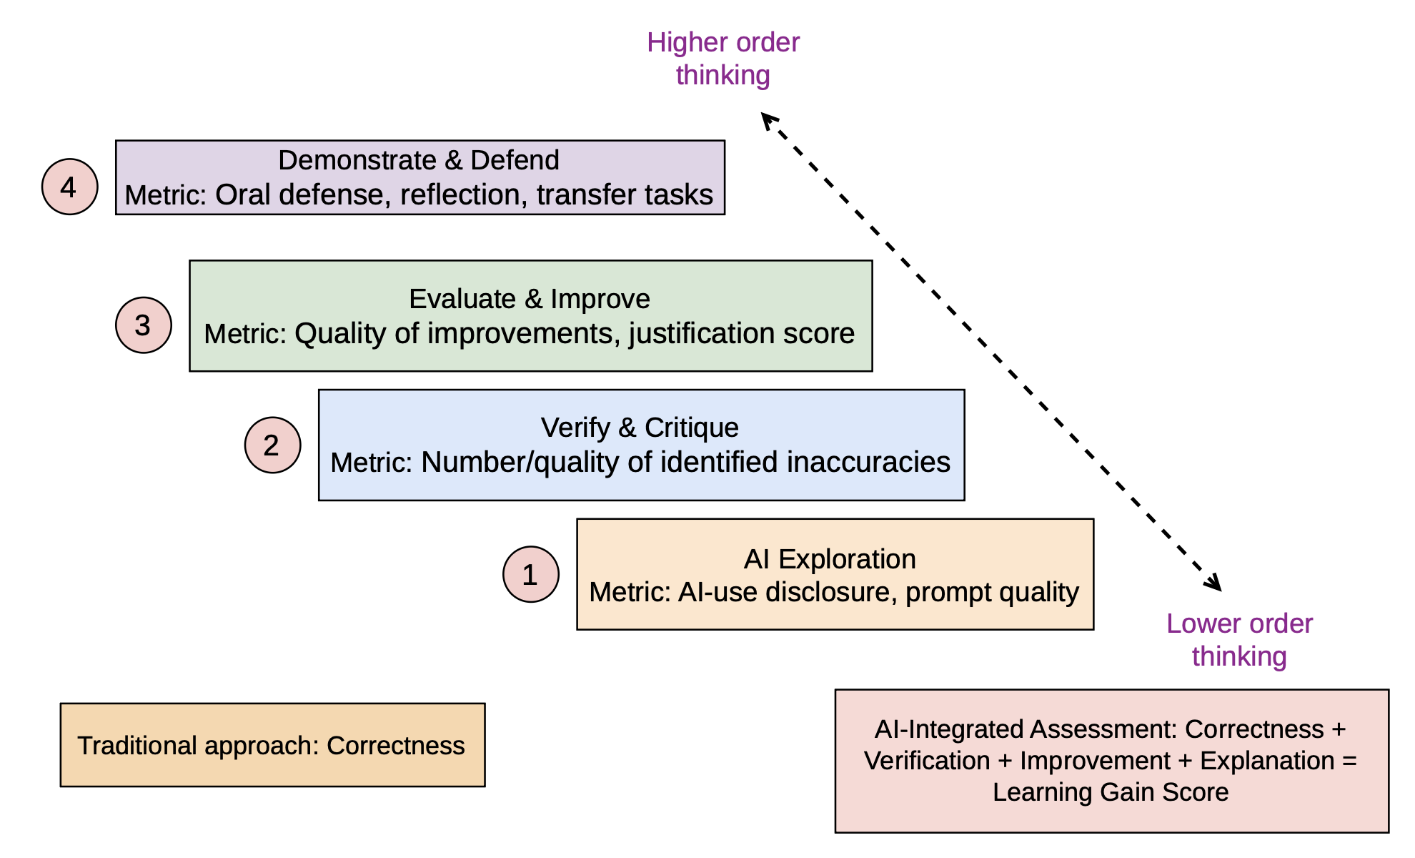
A Framework for AI-Integrated Assessment

Slide 5
Classroom Examples
AI Generates
Traditional Assessment:
Explain how cross-scripting (XSS) attack works.
Initial Solutions
AI-Integrated Assessment
Use AI to generate explanation for XSS
Verify the explanation using course materials
Identify missing attacks/scenarios & mitigations
Improve the explanation & justify the changes
Learning is focused on critical thinking!
Student verifies
Learning Evidence:
Error detection
Security reasoning
Technical justification
Student improves
Demonstrates learning

Slide 6
Assessment Strategies
Reflection and critique: Emphasis on critical thinking
Oral explanations and demonstrations: Direct evidence of understanding
Design justification and decision making: Focus on reasoning and technical judgement
AI-use disclosure: Promotes responsible AI use

Slide 7
Lessons learned & Recommendations to Instructors
Personal recommendations
Lessons learnt!
Reasoning/design based projects
Greater emphasis on the process instead of products
AI literacy should be considered as learning curve
What went well?
Challenges encountered
Student Engagement and learning opportunities
Goal: Maximize AI-integrated learning

Slide 8
Future Directions
AI-Integrated Curriculum: Develop course activities, and assignments with AI tools being made as a central learning module
Opportunities for research emerging institutions: AI-based learning expands the curriculum, and resources available to the educational institutions resulting in support of diverse student populations
Build AI ready graduates along side maintaining academic rigor: Students are equipped with next-generation AI based technology & tools!
Question is no longer if student will use AI or not. Bigger challenge is to design educational experiences that transforms AI into measurable/quantifiable learning!

Slide 9
Questions?
Thank you!
Dr. Venkataramani Kumar
Email: venkataramani.kumar@upr.edu

Slide 10

Stay Connected!
Follow CRA on social media

