Slide 1
Scaling Neural Networks Education with NAIRR and AI-Assisted Assignments
Edgar Lobaton, PhD
Professor, Electrical and Computer Engineering Dept.
Director, Applied AI Initiative, College of Engr.

Slide 2

Target: Undergrads and Grads
Departments: 50% CSC, 40% ECE, 10% Other
Neural Nets and Deep Learning
Prerequisites: Python, Linear Algebra, Vector Calculus, Probability and Statistics
Topics Covered: Techniques for the design of neural networks for machine learning. An introduction to deep learning. Emphasis on theoretical and practical aspects including implementations using state-of-the-art software libraries.
Goal: Student should learn fundamental about techniques and how to apply them.

Slide 3
Assignments
Assignments:
Programming Assignments
Competition Project
Final Project
Challenges:
How do we scale infrastructure? Going beyond Google Colab.
How do we scale higher-order activities?
How do we scale tutoring?

Slide 4
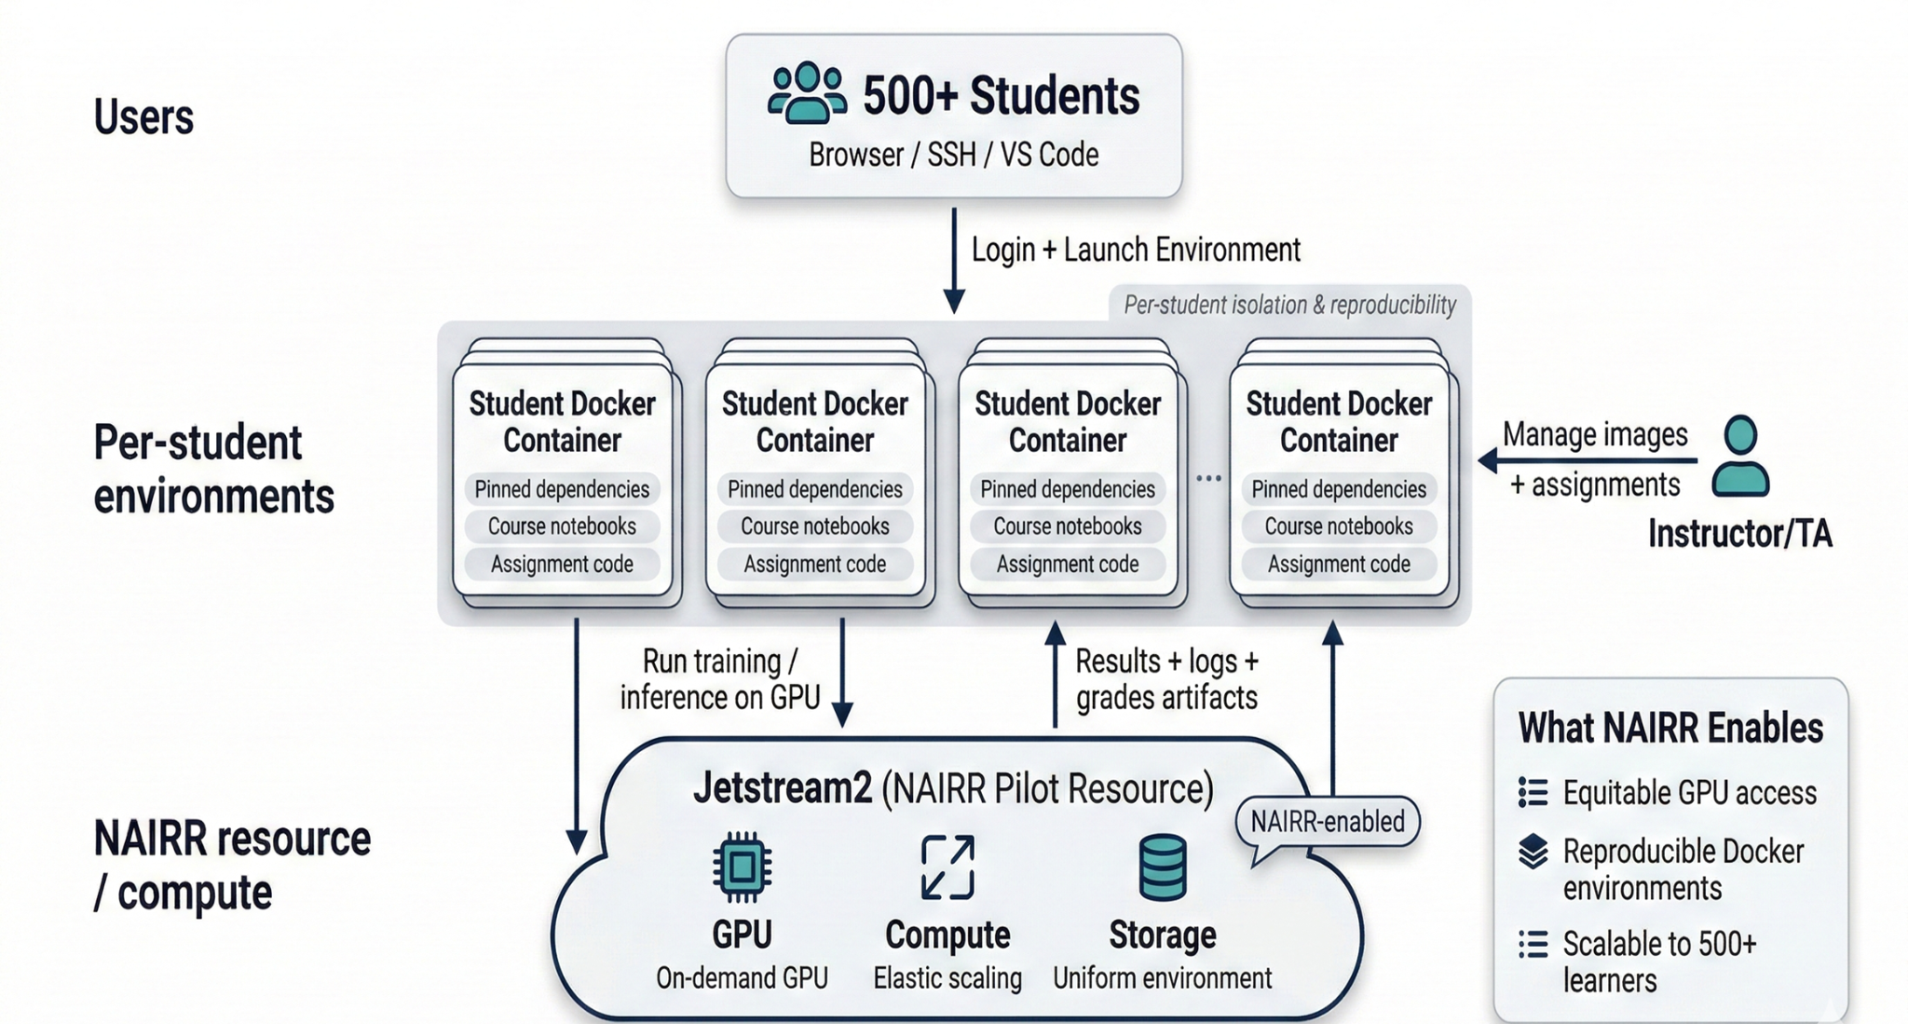
Addressing Infrastructure
Year 1: GitHub Classroom
Year 2: GitHub Org + Local Server for Grading

Slide 5
Addressing Higher-Order Thinking
We focused on final project activities, e.g., the proposal.
Structure of Proposal (500 words):
Introduction and Motivation
Problem Statement and Objectives
Methodology
Expected Outcomes and Impact
Peer-Review Rubric:
Introduction and Motivation Content
Problem Statement and Object Content
Methodology Content
Expected Outcomes and Impact Content
Writing Clarity and Organization
Originality and Creativity

Slide 6
Addressing Higher-Order Thinking
Year 1 – Peer Review + Unmonitored AI
Challenges
Wide-Range of Student Expertise in the Physical Domain (Depth and Breadth)
How do we monitor the use of AI tools?
How do we ensure that the AI tools are not overused?
Can we decouple knowledge gained from expertise gained in interacting with AI?
Year 1.5 – Peer Review + Constrained AI

Slide 7
AI as a Constrained Guide*
PHASE 1
GUIDED
Pre-Proposal
→
Constrained AI
Start of semester, before core instruction. Students draft a 500-word physics-aware proposal.
Assistant gives only structure, critique, definitions & clarification — never solutions.
Measurement Framework
Kritik Platform
Quality (Q)
Technical Depth
Feasibility
Structure
* Md H. Mondol, C. Marette, E. Lobaton, “AI as a Constrained Guide: Measuring Knowledge Transfer in a Graduate Engineering Course,” ASEE 2026.

Slide 8
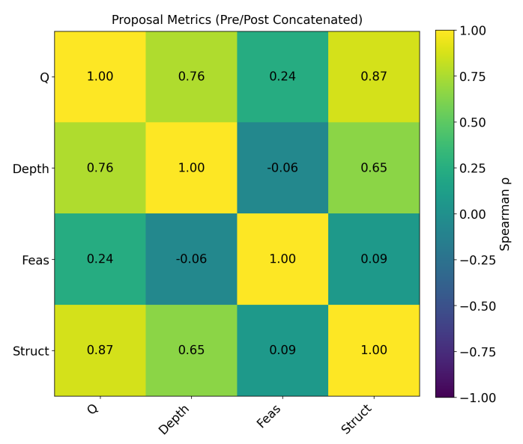
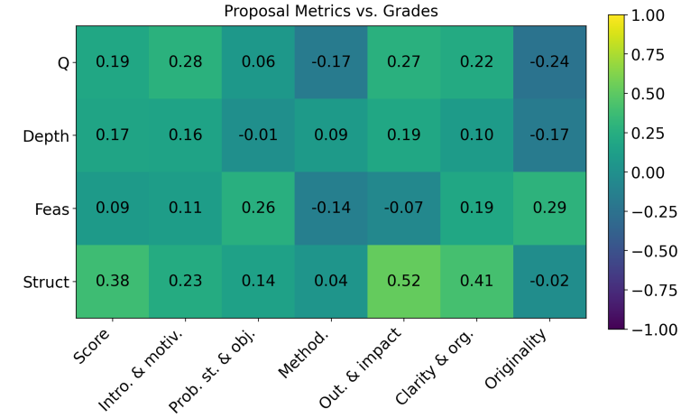
What do the Metrics Reveal?
Strongest Correlations:
Structure is the strongest predictor of perceived quality — and most tied to Outcomes & Impact

Slide 9
What do Students Think?
“Helpful for brainstorming, clarifying concepts, and organizing arguments.”
“Good for clarifying concepts without giving away answers.”
“Too constrained when I lacked background knowledge.”
Year 2 - Hybrid Approach
IDEATION PHASE
METHODOLOGY PHASE
Unrestricted AI
Constrained AI
Explore unfamiliar domains, surface background, identify applications.
Reinforce concepts, structure plans, and critique reasoning.

Slide 10
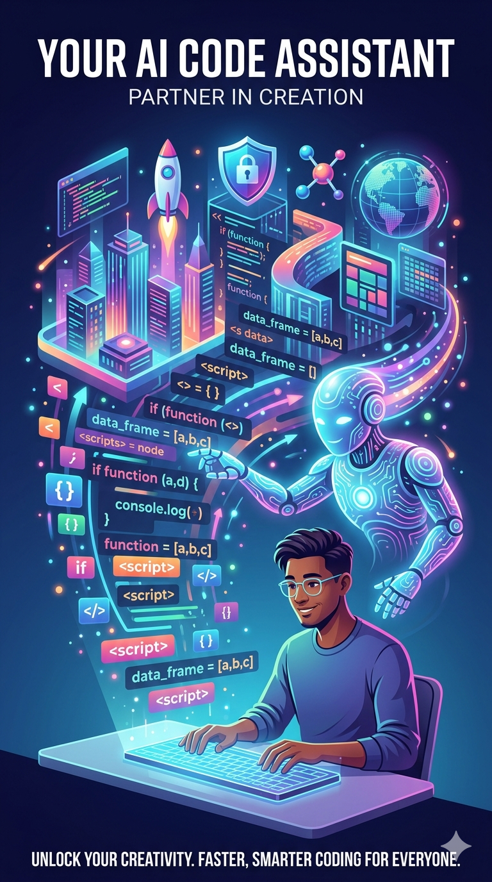
What about Addressing Personalized Tutoring?
Goal: Expand existing infrastructure to accommodate AI tutors for scientific and engineering coding.
Going beyond a standard deployment by adding pedagogical behavior to the agents based on context and rules set by the instructor.
Personalization and scalability beyond single courses.
AI code assistants are a sageway to other agentic tutors, e.g., robotic applications.

Slide 11
AI Coding Tutors
Conversational AI vs Agentic AI
LLMs are conversational bots not actionable agents.
Code assistants are agents that can produce source code but also create files, run scripts, install packages, and much more.
We must consider safety / privacy and how to restrict code assistants.

Slide 12
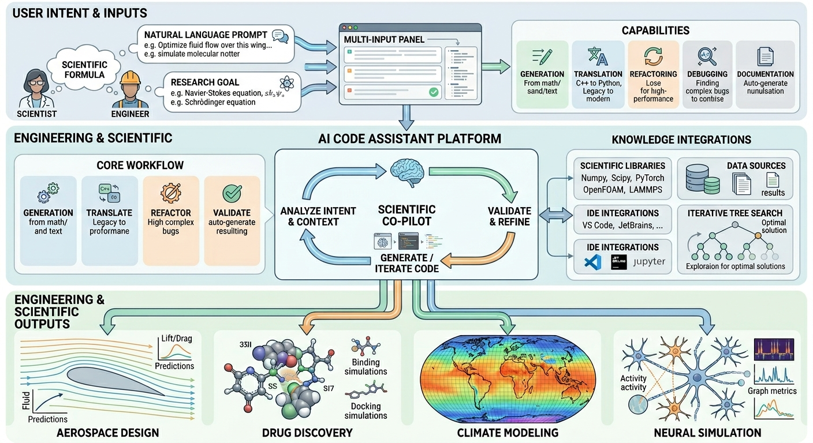

Slide 13
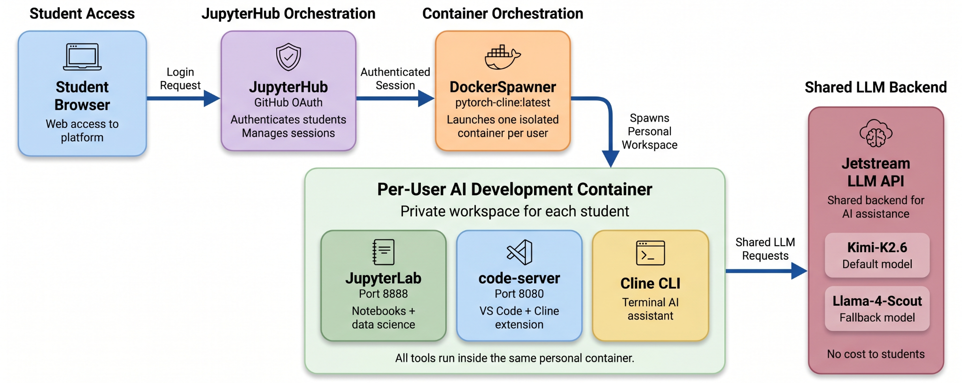
AI Coding Tutors - What is Needed?
VLM and agentic backends
Sandboxed environments
Customization and personalization of agents
Evaluation mechanisms of usage and outcomes
AI frontend interface for instructors and AI backend for analytics
* Support from Sustainable Research Pathways (SRP) Program and NAIRR

Slide 14

… El Fin
Edgar Lobaton, PhD
Edgar.Lobaton@ncsu.edu

