Slide 1
AI Tools, Undergraduate Student Teams, and Production Code:
Navigating Student Development at Teaching-Focused Institutions
Daniel Pittman and Alyssa Williams
Metropolitan State University of Denver
Friday, June 19, 2026

Slide 2
Community Centered Computing (C3) Lab
At C3 Lab, we design and deploy computing systems that empower communities by improving access to information, strengthening decision-making, and enabling human-centered interaction with data and AI tools.
MSU Denver is an open-enrollment, primarily undergraduate, teaching-focused university. Research is not our primary mission, yet undergraduates (many barely past their second year) are building production-deployed, grant and university-funded systems.
We work with 15 to 20 undergraduate student developers working alongside coursework, co-directed by Dr. Daniel Pittman and Dr. Ranjidha Rajan.
Our standing challenge is that teams turn over every semester, so we live with one persistent question: how do you keep code quality, knowledge continuity, and real learning alive on production systems when the team is always changing?
AI is now central. Tools like Claude Code are part of the daily workflow for code review, pair programming, and onboarding, which expands what a small student team can accomplish (and raises the questions we are here to discuss).

Slide 3
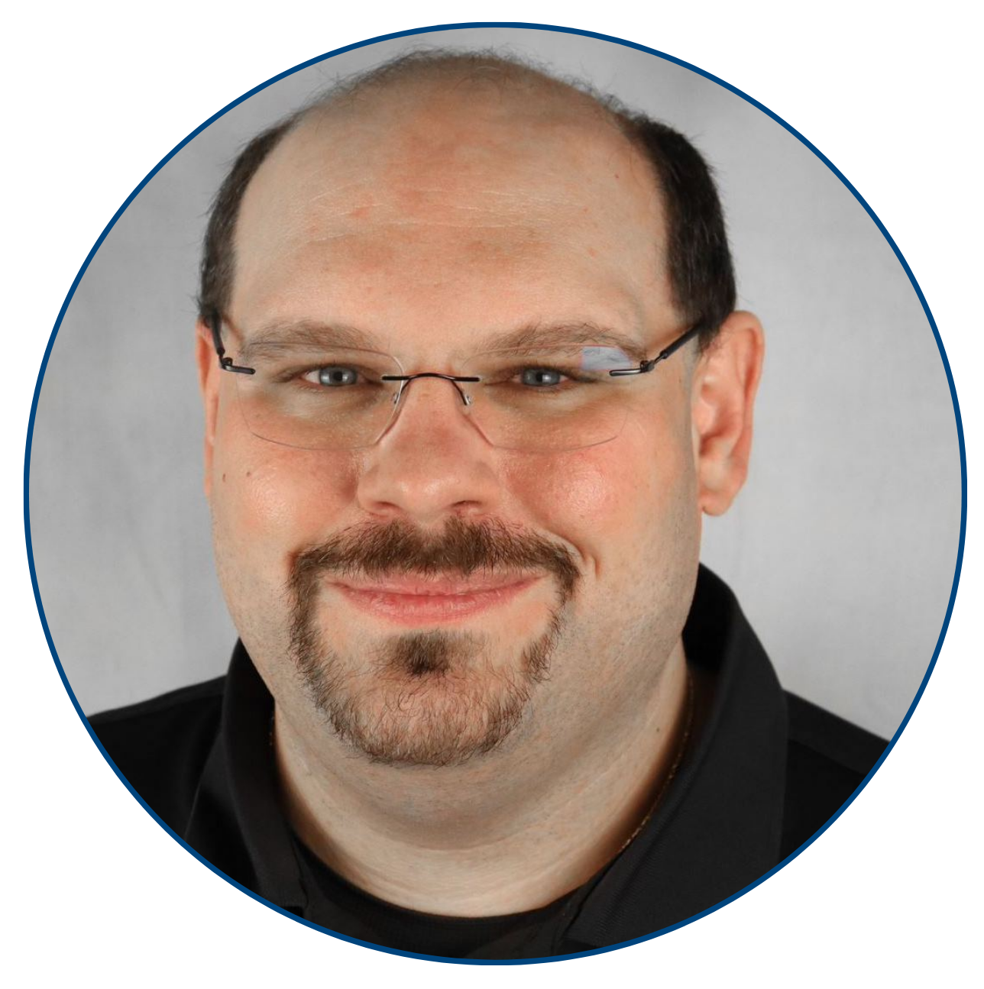
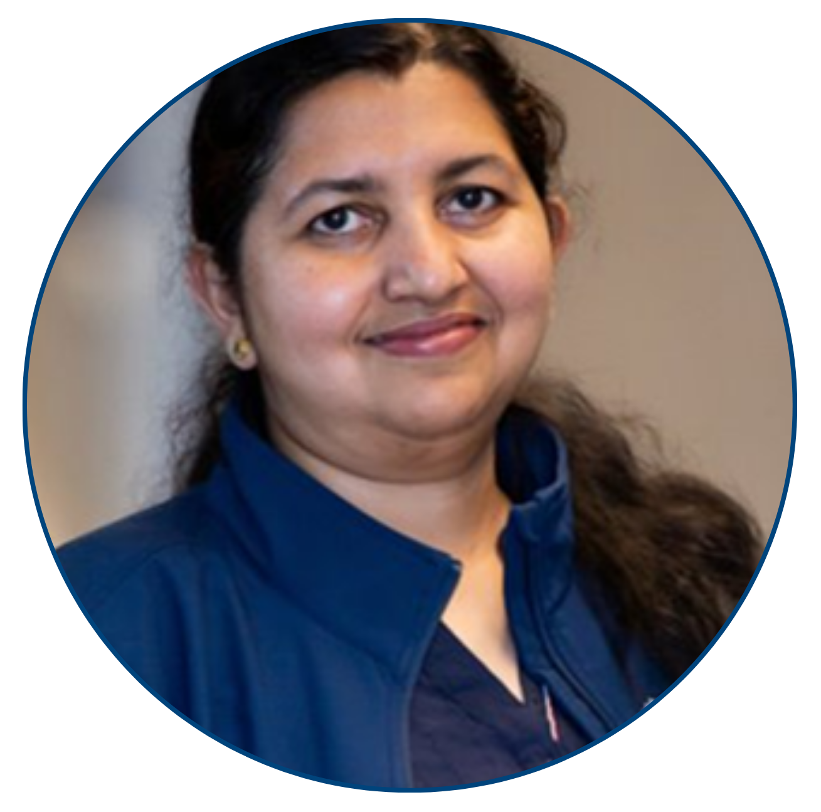
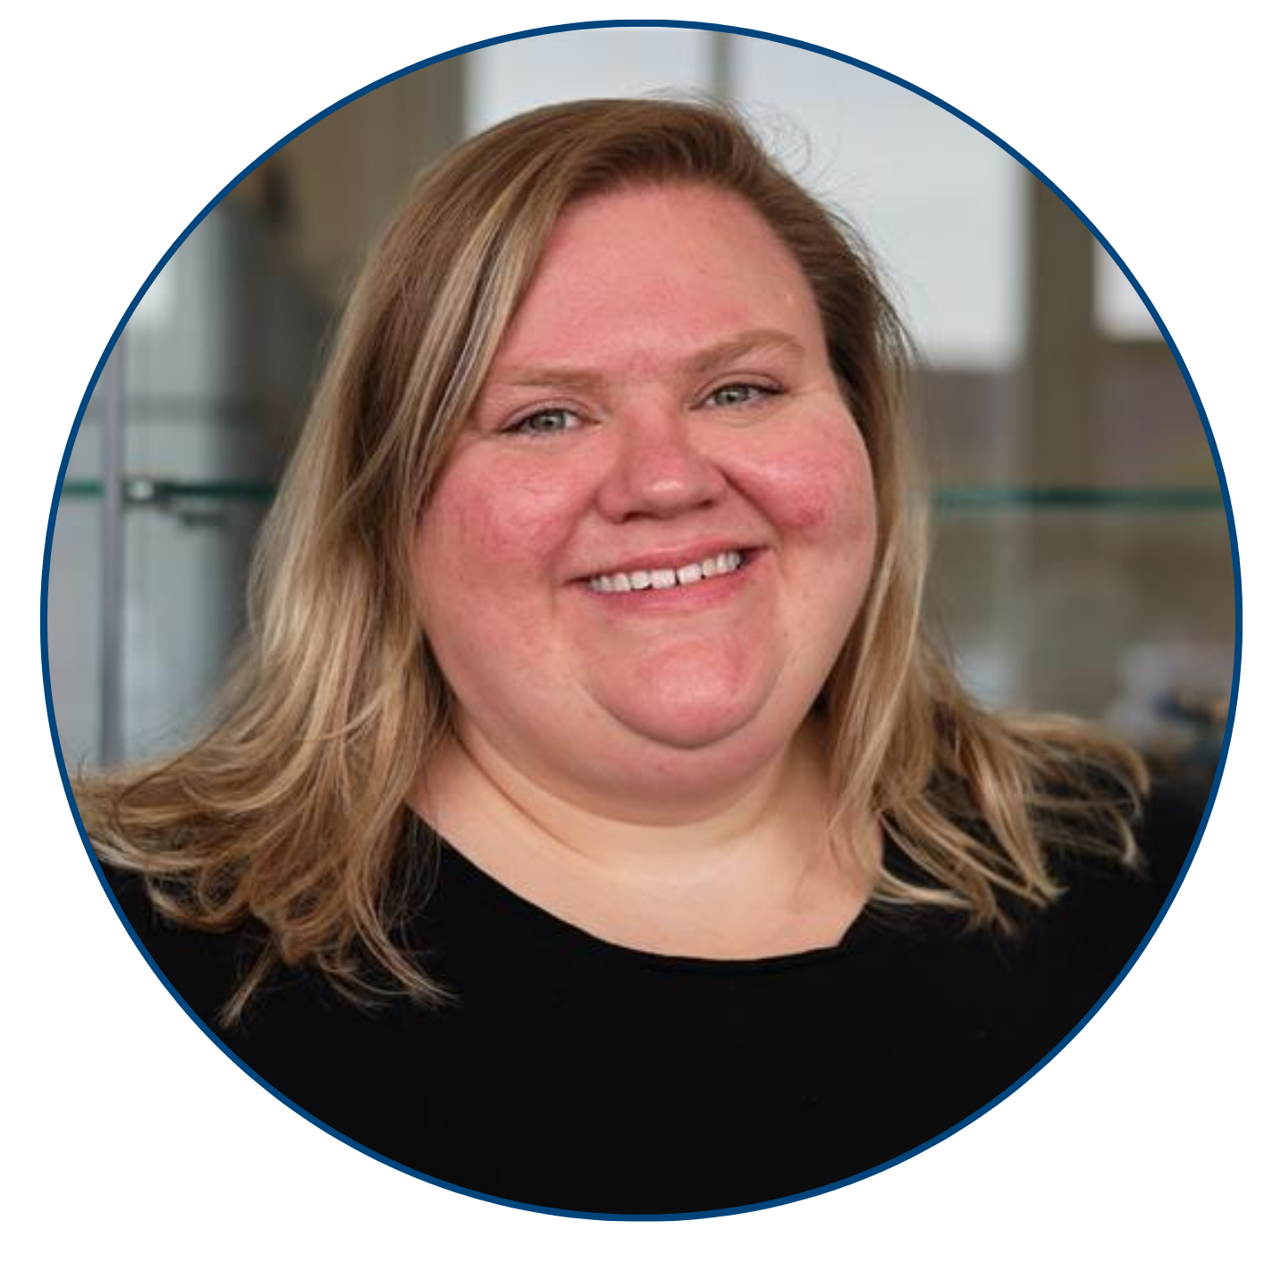
C3 Lab Leadership
Dr. Daniel Pittman
Co-Director
Associate Professor Computer Sciences
dpittma8@msudenver.edu
Dr. Ranjidha Rajan
Co-Director
Assistant Professor Computer Sciences
rranjidh@msudenver.edu
Alyssa Williams
Technical Project Manager
Staff Computer Sciences
awill157@msudenver.edu

Slide 4
Current Projects
Sustainability Hub - NSF-funded statewide platform integrating AI, geospatial systems, and natural language interaction to make Colorado's sustainability data accessible to all.
RILE Connect - SIPA-funded statewide STEM ecosystem platform connecting K-12 schools, higher education institutions, nonprofits, and industry partners across Colorado to strengthen STEM education and workforce development.
Roadrunner Connect - Mobile application enhancing broader denver area community engagement at MSU Denver through gamified through gamified campus exploration and event discovery.
Peer Support Hub - Unified platform for coordinating Supplemental Instruction, Teaching Assistant, and Learning Assistant peer support programs at MSU Denver, streamlining faculty applications and improving equitable distribution of peer support resources across departments

Slide 5
Today’s Discussion Questions
How are you integrating AI tools into student development work, and what guardrails are in place?
How do you balance AI-assisted productivity with ensuring students can read, explain, and defend their code?
What expectations are you setting for students around AI use, and how do you hold them accountable without discouraging adoption?
What project management or operational models have you adapted for student research teams?

Slide 6
Keep in touch!
Website - c3-lab.org
Alyssa Williams, TPM - awill157@msudenver.edu
Daniel Pittman, Co-director - dpittma8@msudenver.edu
Ranjidha Rajan, Co-director - rranjidh@msudenver.edu

