Slide 1

Developing Core AI Competencies
Through Sensor Data and Large Language Models
Dr. Abdur Rahman Bin Shahid
Assistant Professor & Director, SHIELD Lab | School of Computing, SIUC
shahid@cs.siu.edu | shieldlab.info

Slide 2
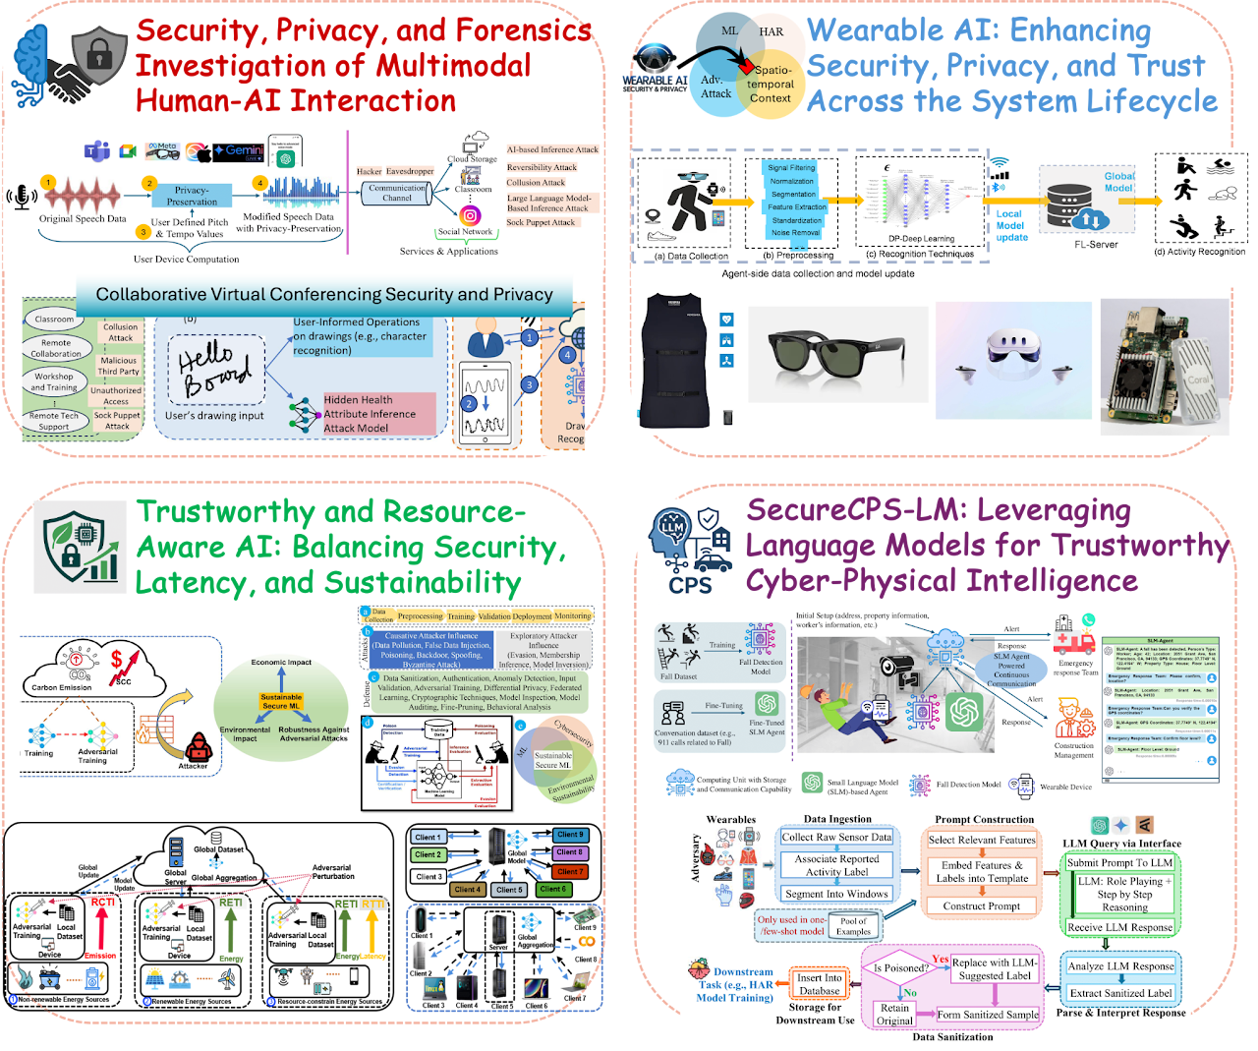
How to make AI systems useful in real-world settings while ensuring that they remain secure, privacy-preserving, reliable, and efficient?
Dr. Abdur Rahman Bin Shahid
Assistant Professor
Director, SHIELD Lab
School of Computing, SIUC
shahid@cs.siu.edu
shieldlab.info
Notes:
These projects collectively advance the SHIELD Lab’s vision of building secure, private, trustworthy, and resource-aware intelligent systems for real-world human-AI and cyber-physical environments.
The first project investigates security, privacy, and forensic risks in multimodal human-AI interaction, including speech, sketch, virtual collaboration, and generative AI systems.
The second project focuses on wearable AI, studying security and privacy across the system lifecycle from sensing and data collection to federated learning and activity recognition.
The third project develops trustworthy and resource-aware AI methods that balance security, latency, robustness, and sustainability in distributed and edge-AI systems.
The fourth project explores the use of large and small language models for trustworthy cyber-physical intelligence, including fall detection, emergency response, sensor-data reasoning, and poisoning detection and sanitization.
Together, these projects address a common challenge: how to make AI systems useful in real-world settings while ensuring that they remain secure, privacy-preserving, reliable, and efficient.

Slide 3
What We Cover in the CPS Course
An applied course at the School of Computing, SIUC — bridging embedded systems, AI, and the physical world.
1. CPS Foundations
Embedded systems, IoT, sensing, communication, and physical-cyber interaction
2. Sensors and Real-World Data
Accelerometer, gyroscope, GPS, motion sensing, wearable and smartphone-based sensing
3. CPS Applications
Smart health, smart homes, transportation, agriculture, smart grids, robotics, and human activity recognition
4. CPS Security and Trust
False data injection, DoS/DDoS, man-in-the-middle attacks, cyber-physical attacks, and system resilience
5. AI for CPS
Machine learning, HAR, AI-assisted sensing, LLM reasoning, and trustworthy AI systems

Slide 4
The Teaching Challenge
How Do We Introduce CPS + AI Without Full Physical Infrastructure?
The Problem
CPS is naturally physical — students should ideally work with real sensors, devices, actuators, and infrastructure
Common Barriers in Many Teaching Settings
Full CPS testbeds are often unavailable or expensive to set up
Hardware configuration takes significant time away from learning
Students have varying programming backgrounds and comfort levels
Public datasets are useful, but hide how real data is actually generated
Key Question
How can we help students experience the full AI-CPS pipeline — not just download a dataset and run a model?

Slide 5
From Running Code to Solving Real-World Problems
The Educational Shift
Traditional Student Experience
Download dataset → Run code → Train model → Report accuracy
What We Want Instead
Observe a real-world problem and understand why it matters
Collect sensor data using tools students already own
Clean and interpret noisy real-world signals
Apply AI and LLMs thoughtfully to analyze the data
Evaluate results against ground truth and real-world context
Reflect on reliability, privacy, and safety implications
AI education should teach students how to use AI to solve real-world problems — not just build a model.

Slide 6
Many Students Are Still Developing Programming Confidence
Diverse Skills in a CPS/AI Classroom
Student Profiles We Encounter
Strong programmers comfortable with Python and implementation
Conceptual learners who understand ideas but struggle with code
Students new to sensor data or time-series signals
Students who have used ChatGPT/Claude for writing but not for data analysis
Key Insight
Students are already familiar with LLMs — but most do not know how to use LLMs to reason about real-world sensor data.
This creates a unique teachable moment: we can meet students where they are and build upward from their existing familiarity with AI tools.

Slide 7
Everyone Already Carries a Sensor-Rich CPS Device
Smartphones as Low-Cost Cyber-Physical Learning Platforms
Sensors Available on Most Smartphones
Accelerometer and Gyroscope — motion, orientation, and activity
Magnetometer — direction and compass data
GPS / Location — position and movement tracking
Barometer — altitude and air pressure changes
Proximity and Ambient Light sensors
Microphone, Camera, and Touchscreen
Step Counter, Bluetooth signals, and WiFi signals
A smartphone is not just a communication device — it is a low-cost cyber-physical sensing platform that students already own.
No hardware purchases. No lab setup time. Students can start collecting real sensor data on day one.

Slide 8
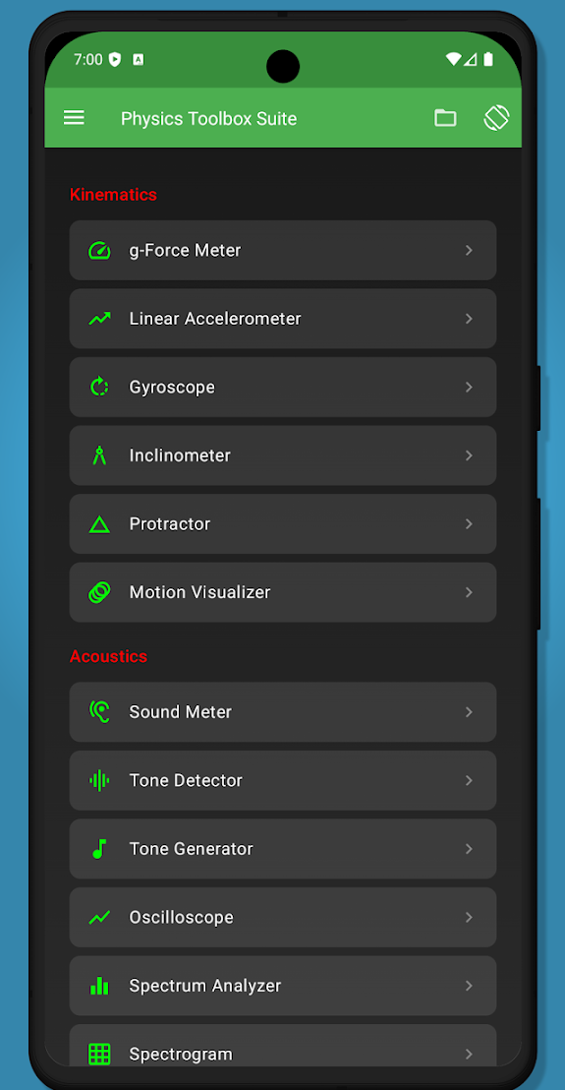
Smartphone Sensor Data + LLMs for AI-CPS Learning
My Teaching Approach
Use smartphones to collect real-world sensor data, then use AI and LLMs to analyze, interpret, explain, and evaluate that data.
The Learning Pipeline
1. Identify a real-world activity or problem
2. Collect sensor data using a smartphone
3. Process or summarize the sensor data
4. Use ML or rule-based methods when appropriate
5. Use LLMs for interpretation, explanation, coding support, and reflection
6. Evaluate whether the AI output is useful, reliable, and trustworthy
This gives students an end-to-end view of AI-CPS systems — from physical sensing to trustworthy AI evaluation.
Physics Toolbox
https://play.google.com/store/apps/details?id=com.chrystianvieyra.physicstoolboxsuite&hl=en_US
https://apps.apple.com/us/app/physics-toolbox-sensor-suite/id1128914250

Slide 9
Core AI Competencies Developed
What Students Learn from This Approach
1. Data Literacy
Understanding how real-world data is generated, noisy, incomplete, and context-dependent
2. Sensor and Time-Series Reasoning
Understanding motion, activity, signal patterns, and feature extraction
3. Machine Learning Basics
Training, testing, classification, accuracy, confusion matrix, and model limitations
4. LLM Literacy
Prompting, summarization, explanation, structured reasoning, and hallucination checking
5. Responsible AI
Privacy, safety, reliability, false alarms, and human-centered impact
6. Problem-Centered AI Thinking
Starting from a real-world need rather than starting from a model or dataset

Slide 10
Pilot Projects
Wearable Data Chatbot — students build a conversational agent that answers questions about wearable sensor datasets (activity patterns, sleep, movement trends)
Smartphone-Based Activity Recognition (HAR) — using accelerometer, gyroscope, and step counter to classify activities like walking, running, sitting, standing, and stair climbing
Personal Activity Notebook via LLMs — collecting motion data, generating structured summaries (step count, motion intensity, inactive periods), then using an LLM to produce a natural-language daily activity report
Data Quality, Noise, and Reliability — collecting sensor data under different phone placements (hand, pocket, backpack) to study how context and noise affect data and AI interpretation
Fall Detection — designing a safety-critical system using accelerometer and gyroscope signals, with explicit attention to false positives and false negatives and their real-world consequences

Slide 11
Project Theme 1: Conversational AI for Wearable Datasets
Wearable Data Chatbot
Students build a chatbot that answers questions about wearable sensor data and human activities.
Example Interactions
Daily activity pattern questions (How active was I today?)
Sleep behavior summaries and trend interpretation
Exercise and movement analysis across different days
Health-monitoring scenarios and personal activity explanations
AI Competency Developed
Students learn how LLMs can interact with structured CPS data — not just plain text. They practice prompt engineering and output verification against real sensor summaries.

Slide 12
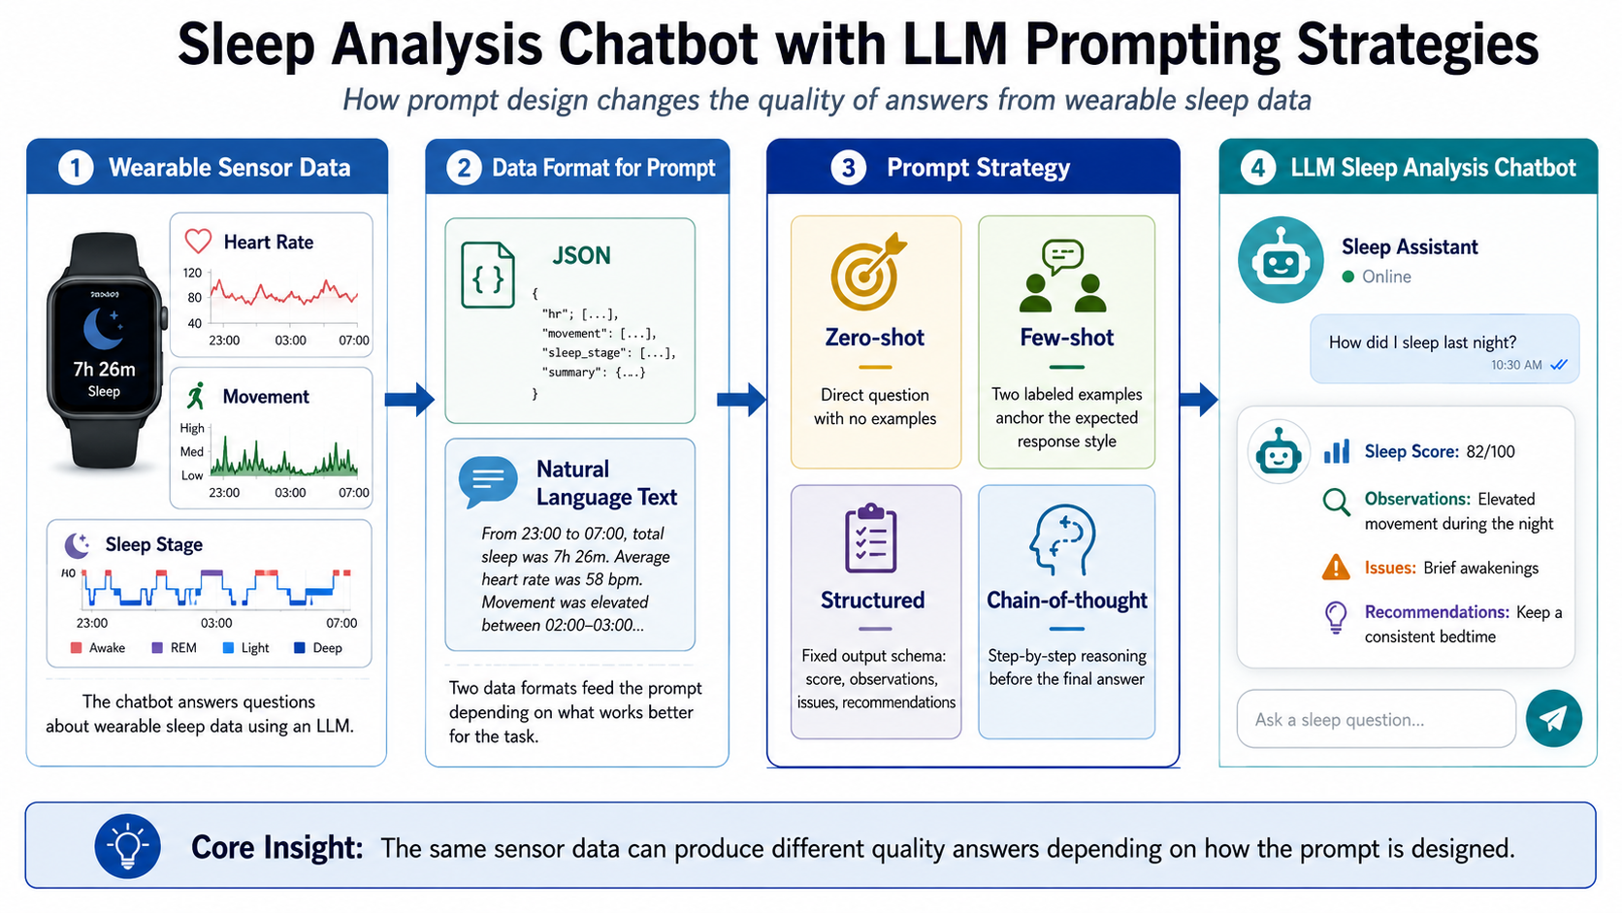

Slide 13
Project Theme 2: Smartphone-Based Activity Recognition
From Phone Sensors to Human Activity Recognition (HAR)
Students use smartphone sensors — accelerometer, gyroscope, step counter — to detect everyday activities.
Target Activities
Walking, Running, Sitting, Standing, Climbing stairs
Data Sources
UCI HAR Dataset for training and benchmark validation
Students collect small personal datasets for testing or comparison
What Students Do
Explore how sensor signals differ across activities and individuals
Train and evaluate a classifier on real data
Use LLMs to explain classification decisions and model behavior
AI Competency Developed
Students learn how HAR systems are developed from sensor data — not only how to run a classifier on a pre-packaged dataset.

Slide 14
Project Theme 3: Personal Activity Notebook via LLMs
LLM-Assisted Interpretation of Personal Sensor Data
Students collect motion data during daily activities and transform raw signals into structured summaries, then use an LLM to generate a digital activity report.
Phase 1: Collect and Summarize
Step count, motion intensity, activity duration, inactive periods
Statistical summaries of movement patterns across time
Phase 2: LLM Interpretation
Generate a natural-language activity notebook entry
Explain behavior patterns in plain language
Compare activities across different days or conditions
Phase 3: Verification
Check whether LLM-generated explanations match actual sensor behavior
Identify where the LLM hallucinated, over-generalized, or was accurate
AI Competency Developed
Students learn how LLMs can explain structured sensor summaries — and how to critically verify those explanations.

Slide 15
Project Theme 4: Data Quality, Noise, and Reliability
Real-World Sensor Data Is Messy
Students collect sensor data under different placement conditions and analyze how context and noise affect data quality and AI interpretation.
Experimental Conditions
Phone in hand vs. pocket vs. backpack
Walking, running, standing, or mixed activities
What Students Analyze
How device placement creates different signal profiles for the same activity
How noise, vibration, and environmental factors affect sensor readings
How AI model performance varies across clean vs. noisy data
Why the same model can succeed in one context and fail in another
AI Competency Developed
Students learn that AI performance depends heavily on data quality, sensing context, and collection conditions — not just model architecture.

Slide 16
Project Theme 5: Fall Detection
AI-CPS for Safety-Critical Applications
Students design a simple fall detection system using smartphone accelerometer and gyroscope signals.
System Components
Acceleration magnitude and sudden motion spikes
Orientation change and impact intensity
Rule-based or ML-based event classification
LLM-generated explanation of why an event may be a fall
Critical Design Consideration
False positives and false negatives both have real-world consequences in safety-critical systems. Students must reason about the human impact of AI errors.
AI Competency Developed
Students connect sensor AI to a real-world safety problem where model reliability directly impacts human lives — introducing responsible AI in a concrete and memorable context.

Slide 17
LLMs as Learning Partners, Not Automatic Answers
How LLMs Are Used in the Course
LLMs serve as active learning partners throughout the course — supporting code, explanation, and critical reflection.
LLM Uses
Code generation support, debugging, and visualization help
Data interpretation and explanation of sensor patterns
Prompt-based analysis of sensor summaries
Comparing different AI-generated interpretations of the same data
Reflecting on privacy, security, and responsible use implications
Important Teaching Point
Students are NOT asked to blindly trust LLMs. They must verify all LLM outputs against actual data, plots, metrics, and real-world context.
This trains the habit of critical evaluation — a core skill for working with any AI system in professional or research settings.

Slide 18
Scaling AI Learning at Research-Emerging Institutions
Why This Matters for NAIRR and AI Capacity Building
This Model Aligns Well with NAIRR Because
It lowers the entry barrier for AI education — students use devices they already own
It supports hands-on learning without requiring expensive physical CPS labs
It can scale from small local datasets to larger NAIRR-supported shared datasets
NAIRR resources can support notebooks, model experiments, LLM analysis, and classroom modules
It helps faculty develop reusable, portable AI-CPS teaching modules
It bridges the gap between isolated AI assignments and scalable, evidence-based learning experiences
Key Message
NAIRR can help research-emerging institutions move from isolated AI assignments to scalable, hands-on AI learning experiences that develop genuine competency.

Slide 19
Lessons Learned
Main Takeaways
1. CPS is a strong entry point for teaching real-world AI.
2. Smartphone sensors make CPS learning accessible to every student.
3. Students need to understand how data is created — not just how to use it.
4. LLMs can support students with coding, explanation, and interpretation when used critically.
5. The real educational value comes from connecting data, models, physical context, and responsible AI.
6. This creates a practical pathway for developing core AI competencies at research-emerging institutions.
Goal: Help students move from being users of AI tools to becoming developers and evaluators of trustworthy AI systems grounded in real-world data.
Dr. Abdur Rahman Bin Shahid | shahid@cs.siu.edu | shieldlab.info

Slide 20

Stay Connected!
Follow CRA on social media

