Slide 1

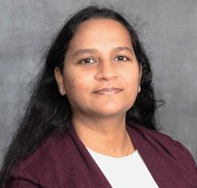
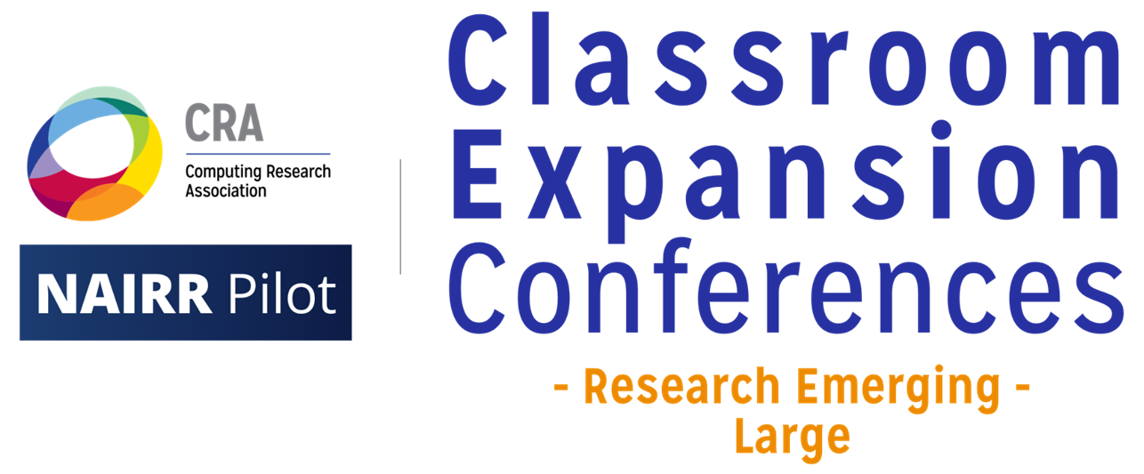
CHAI With NLP: Connecting Humanities and AI Through Text Mining
June 19, 2026
Vandana Srivastava
AI/Data Science Specialist
University Libraries

Slide 2
ABOUT MYSELF
Work Experience (~15 years)
Education
AI/Data Science Specialist | 2024 - Present
Digital Research Services, University Libraries
University of South Carolina
Co-founder | 2019 - 24
ViSER, an educational services company, USA
Vice President, Investor Relations | 2016 - 17
Tantiv4, USA
Guest Faculty | 2014 - 16
Indian Institute of Technology (IIT), Delhi, India
Incentive Analyst | 2008 - 09
IBM Corporate Office, Armonk, USA
Lecturer | 2003 - 06
JSS Academy of Technical Education/Amity University, India
PhD Candidate (Computer Science) | 2021 - Present Artificial Intelligence Institute University of South Carolina
MBA (Financial Management) | 2009 Pace University, NY, USA
Master of Natural Science
Computational Mathematics | 2001 Arizona State University, AZ, USA
M.Sc. (Mathematics) | 1997 B.Sc. (Mathematics / Statistics) | 1995 University of Lucknow, India

Slide 3
Outline
1
2
3
Part One
Part Two
Part Three
AI and Text Mining
Background and Motivation for Text Mining Workshops by Libraries
Introduction of first workshop
Issues identified from the first workshop
Revamping the workshops (Phase 1 and Phase 2)
Challenges in using University computing resources
How NAIRR Classroom Resources are helping?
Summary

Slide 4
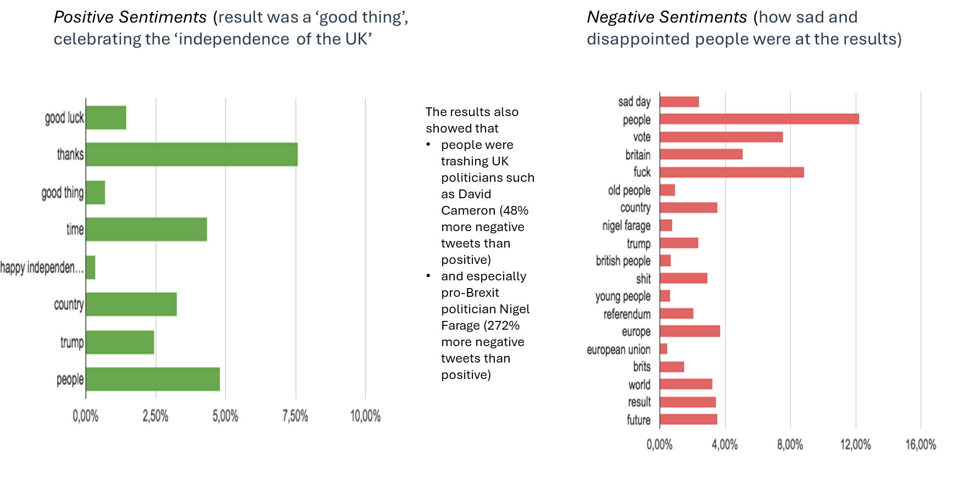
AI and text mining
Text Mining: Also known as “Text Data Mining”, commonly done as part of “Natural Language Processing”
Automated process that is used to find patterns and relationships in unstructured data such as documents, websites, surveys
Using text mining and Machine Learning, systems can extract key entities, interpret sentiment, identify latent themes or classify textual data
Sentiment Analysis of Tweets on Brexit Result

Slide 5
Part 1: background and motivation
Why University Libraries started text mining workshops?
Strong humanities group
Availability of digitized corpora

Slide 6
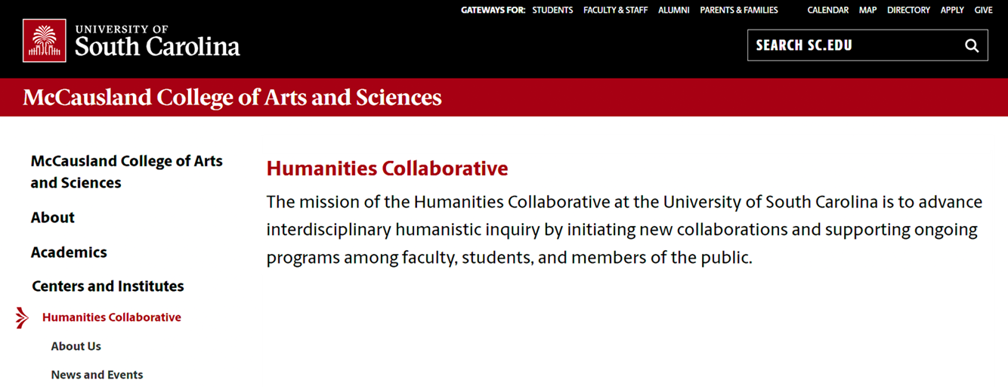
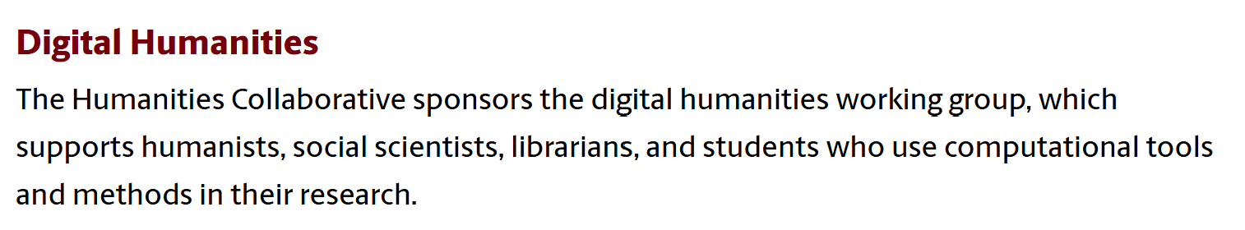
Humanities presence at usc
Humanities research and collaboration center under College of Arts and Science
Humanities Collaborative (HC)
Digital humanities group
Sponsored by HC
Supports research backed by computational methods (example: digitizing collections)
Consists of scholars, researchers and librarians
Strong Research and Collaboration in Humanities Department
https://sc.edu/study/colleges_schools/artsandsciences/centers_and_institutes/humanities_collaborative/index.php

Slide 7
Motivation for text mining workshops
Availability of large corpora of textual data (e.g. SC civil rights collection)
Projects undertaken by other Universities such as UNC
“On the Books” Project by UNC Chapel Hill, University of South Carolina, and University of Virginia
Research funding opportunities for both libraries and humanities by agencies such as National Endowment for the Humanities (NEH) and Mellon Foundation
Faculty/Graduate students’ interest in text mining
Faculty project: analyze Freeland edition of federal income tax books published between 1969 – 2016
Student dissertation: Mining of Brazilian cookbooks for identifying trends in recipes and ingredients over 100 years
Why University Libraries?
It is a research support-hub for the whole University
Experience as a collaborator on “text mining” projects with other libraries
Can reach more patrons including affiliated colleges and other USC campuses
Licensing with various platforms providing text mining support such as Constellate from JSTOR (sunsetted on July 1, 2025) and HathiTrust Research Center
Identified the need to educate humanities faculty and students on text mining to prepare them for emerging trends in AI and digital scholarship
https://analytics.hathitrust.org/ https://labs.jstor.org/projects/text-mining/

Slide 8
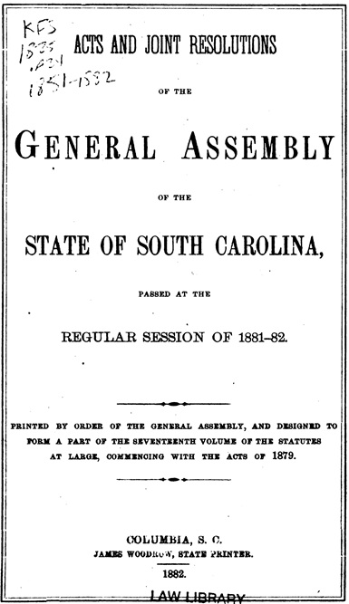
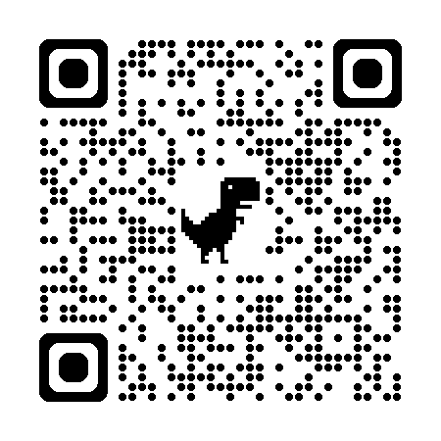
“on the books” Project (2022 – 2024)
Analyzing South Carolina Legislative Acts to predict Jim Crow language from scanned books (1868 - 1968)
OCRed data to generate text files from image files
Created a Machine Learning prediction model to classify Jim Crow sentences
“Jim Crow” represents the legal and cultural practices of racial discrimination and segregation instituted in Southern US following Reconstruction.
On The Books: A joint research project with UNC, USC, and UVA Libraries (Funded by Mellon grant)
Used many text mining concepts
8
https://drsc.usccreate.org/otbsc/lawsintro

Slide 9
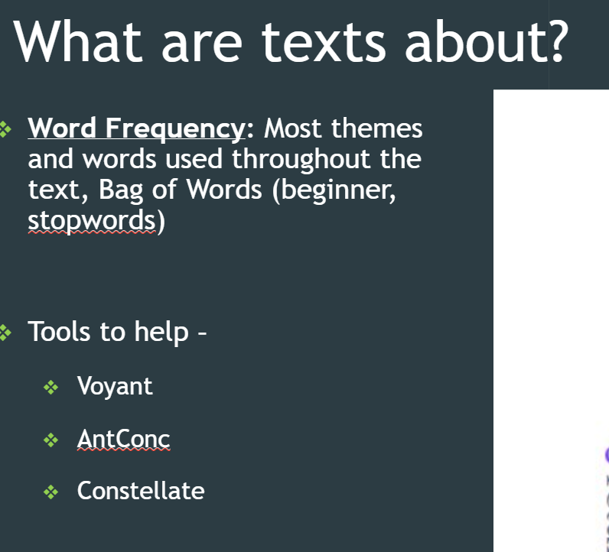
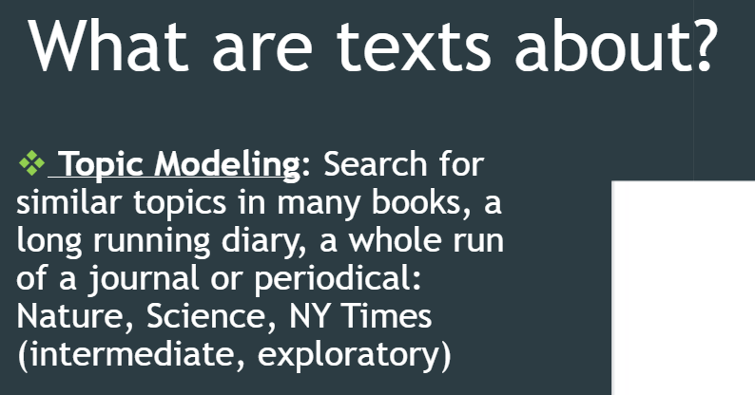
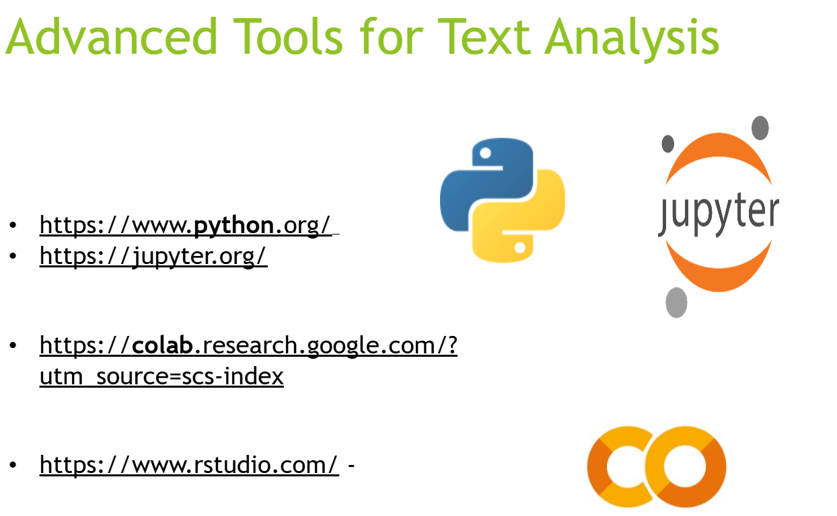
text mining workshops at university libraries
Started in Spring 2024
3 ONLINE workshops per semester
Focused on giving overview of the field
Application areas (reference to research using text mining in diverse domains)
Introduction of basic concepts (word frequency, topic modeling, TF-IDF, collocation, concordance, Named Entity Recognition, sentiment analysis, n-gram)
Data preparation steps (such as, stop words, punctuation, and number removal, tokenization)
Provided online resources (Constellate using python, Voyant online tool, AntConc software)
Low registrations (10 – 12) despite stated interest

Slide 10
Identifying key issues
Registration numbers and feedback from the participants initiated the need for updating the workshops
Key issues identified:
Participants could not relate to the concepts and their significance
How the text mining can be done on real-world datasets?
No technical support after the workshop

Slide 11
Part 2: Revamping the workshops
Phase 1 and Phase 2

Slide 12
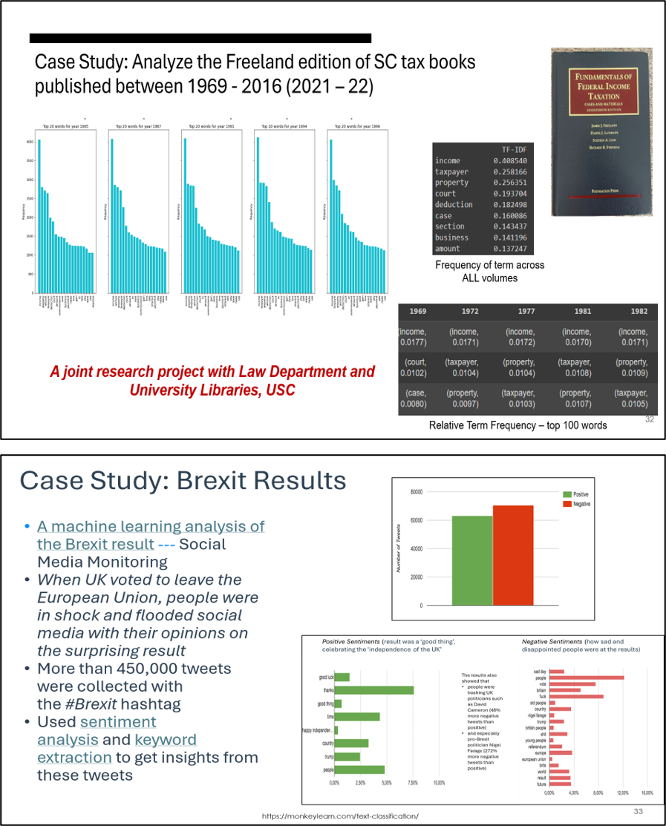
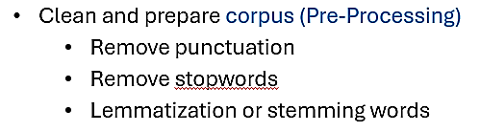
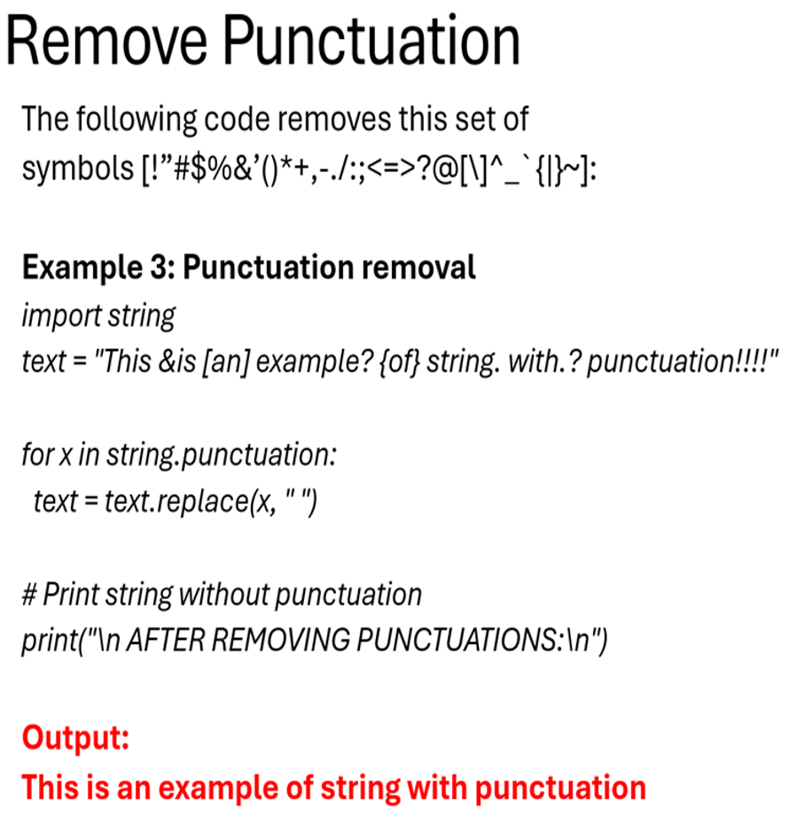
Revamping the workshops – phase 1
Introduced three major changes in Spring 2025
3. Providing technical support AFTER the workshop by having NLP expert
Supplemented by ↓
Workshop registrations increased to 17.
Feedback still reflected the need for relating concepts with text.
Participants unanimously agreed to the importance of text mining
1. Use Cases from real world data
2. Pre-processing steps supplemented by example and python code

Slide 13
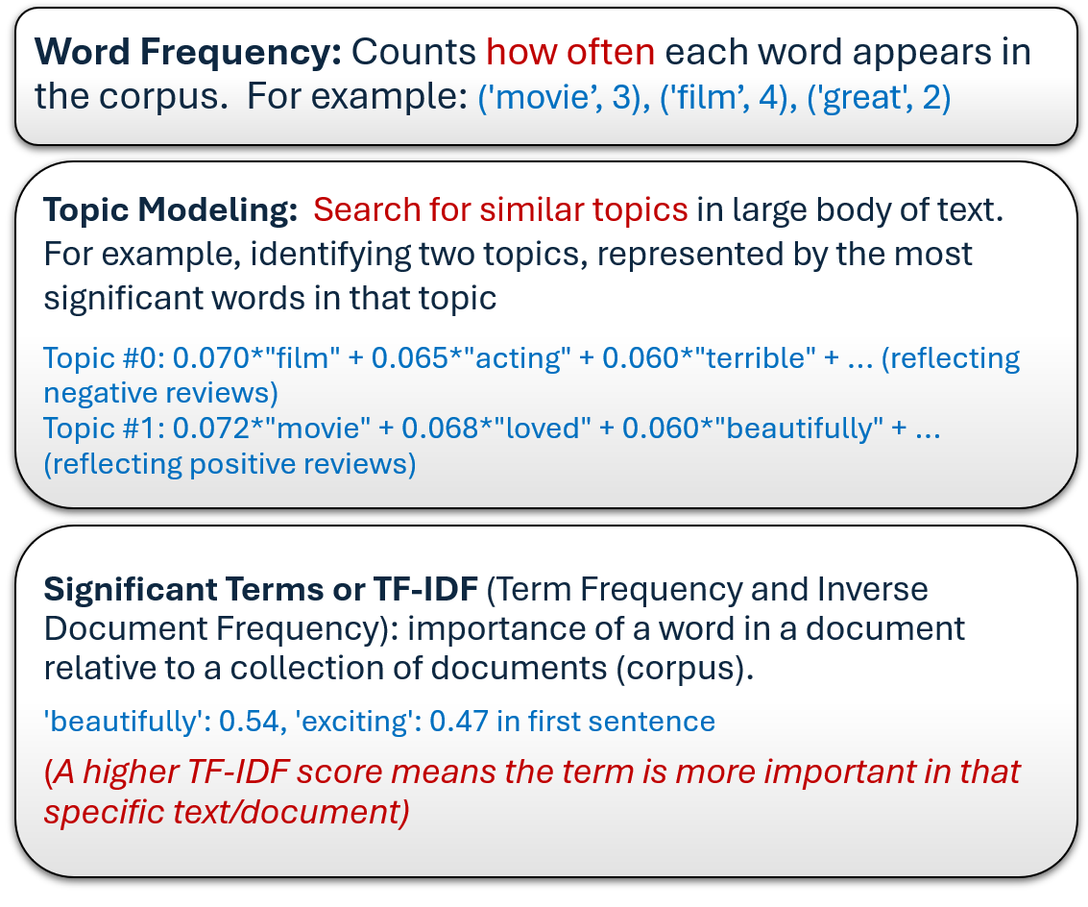
Revamping the workshops – phase 2
Created GitHub webpage for University Libraries with Python and R notebooks in Text mining, Data Analysis, and Machine Learning
Two major additions in Fall 2025
SAMPLE DATA
I watched Inception last night, directed by Christopher Nolan, and set partly in Paris—what an incredible film! I loved the movie. It was fantastic, exciting, and beautifully shot.
The film was terrible. I hated it and would not recommend it to anyone.
An excellent film with brilliant performances and a moving story.
A boring and predictable movie. It lacked originality and emotion.
What a masterpiece! Absolutely gripping from start to finish.
Not my type of movie. Too slow and not engaging enough.
A powerful and inspiring story. Great acting and cinematography.
Terrible plot, bad acting, and poorly written dialogue.
A delightful film that kept me entertained and happy throughout.
It was okay. Not the best, not the worst. Just average.
1. Explaining ALL concepts using the SAME dataset

Slide 14
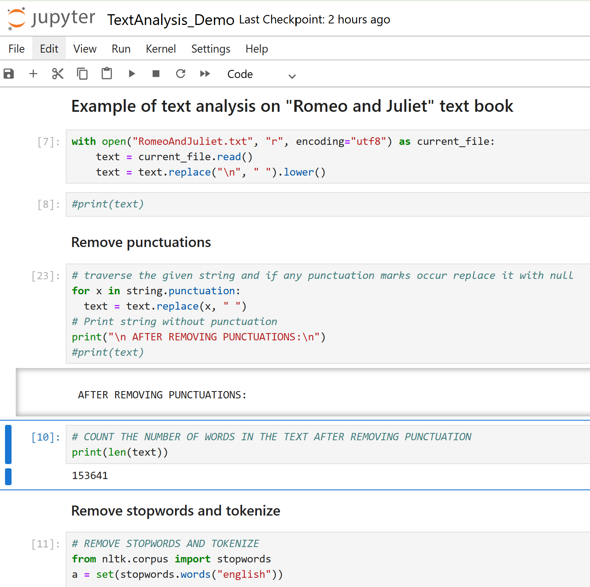
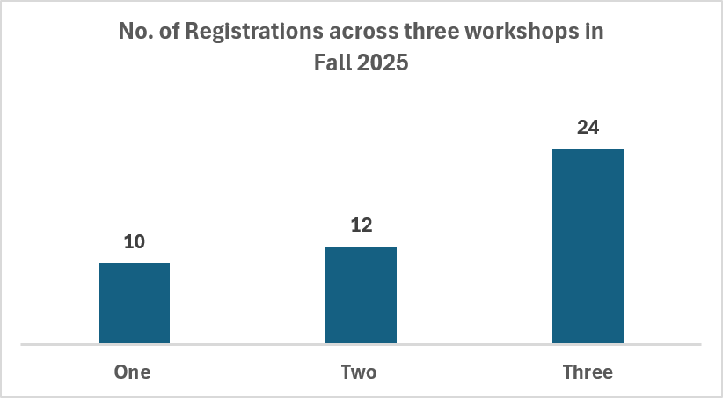
Revamping the workshops – phase 2 contd..
2. Added demo on the “Romeo and Juliet” by Shakespeare from Project Guttenberg
Total registrations increased to 46
Got very positive feedback
Requests for Hands-on experience

Slide 15
Part 3: introduction of hands-on experience in workshops
Challenges in using existing University resources such as high performance computing
Impact of NAIRR Classroom resources

Slide 16
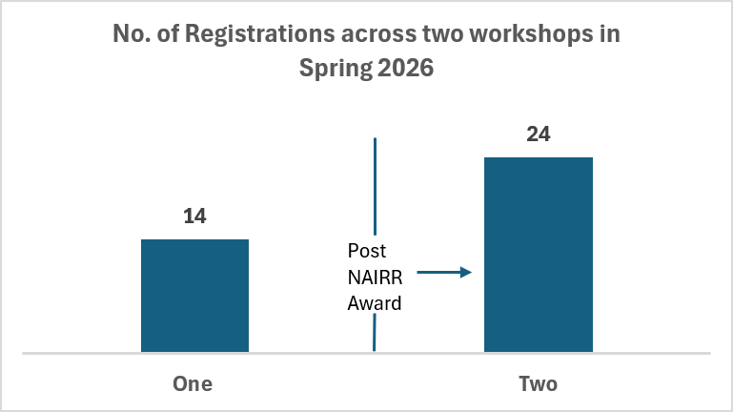
Challenges in using university computing resources
Steep learning curve for participants who were primarily from non-computing background
(a) Python/R programming (b) Using High Performance Computing
Access to dedicated workspace for participants was a multistep process
Request login credentials → create temporary accounts → share login details with participants → monitor workspace (tested for one workshop in collaboration with Research Computing department; decided not to continue)
Applying for NAIRR Pilot Classroom Resources
Resources awarded in March 2026
Conducted one out of two (1/2) Spring 2026 workshops using Vocareum platform

Slide 17
Summary
University of South Carolina has a thriving Humanities research community
Humanities community with support from Libraries identified the need of text mining workshops to prepare faculty and students for emerging AI trends and digital scholarship
Iteratively adapted the workshops using feedback, which led to increase in participation by more than 100%
Adding use cases from our projects, explaining concepts on dummy and real-world dataset, creating GitHub website, showing demo, and providing hands-on experience using NAIRR resources
Using a simple, real-world, and familiar dataset (e.g., Romeo and Juliet) helped in explaining the complex text-mining concepts
NAIRR Resources made our workshops more inclusive with lesser technical barriers and provided continued learning opportunities, even after the workshop ended
FALL 2026: Students can bring their own datasets for practice

Slide 18
Thank you!
Name: Vandana Srivastava
Title: AI/Data Science Specialist
Email: vandana@email.sc.edu

