Slide 1

Bridging Foundational Machine Learning and Modern AI in Graduate Education Jun Wu Assistant Professor Michigan State University https://junwu6.github.io/

Slide 2
AI Education Today
What students learn in machine learning courses
Machine
Learning
Supervised
Learning
Reinforcement
Learning
Unsupervised
Learning
Q-Learning
Classification
Regression
Dimensionality
Reduction
Clustering
Logistic regression
SVM
Perceptron
kNN
Linear regression
Ridge/Lasso
Principal Component Analysis
Autoencoder
K-Means
GMM

Slide 3
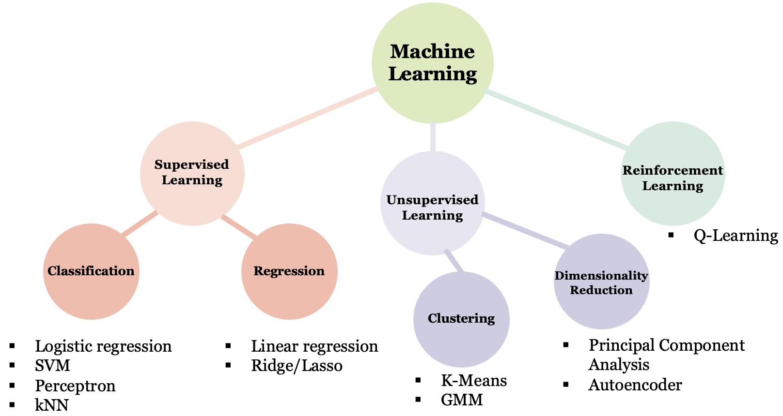




AI Education Today
What students learn in machine learning courses
What students use to study

Slide 4
AI Education Today
What students learn in machine learning courses
What students use to study
Foundational concepts
Magic outputs
Gap: Foundational concepts are the building blocks for modern AI, but students don't see the structure yet

Slide 5
Questions Students Are Asking
In the era of generative AI,
why do we need to learn these basic machine learning methods?
how do they connect to real-world applications?
how do traditional techniques relate to the AI tools I use every day?
more importantly, how should I use and trust AI in my learning?
…

Slide 6
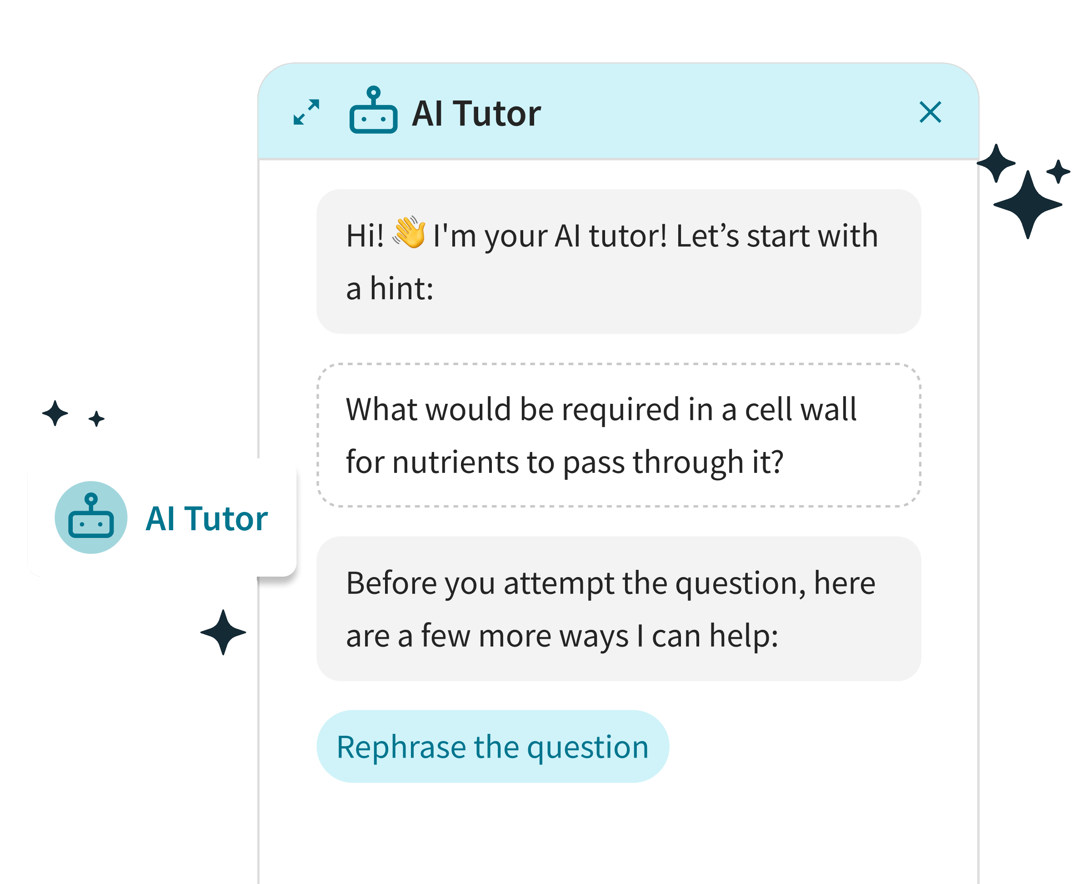
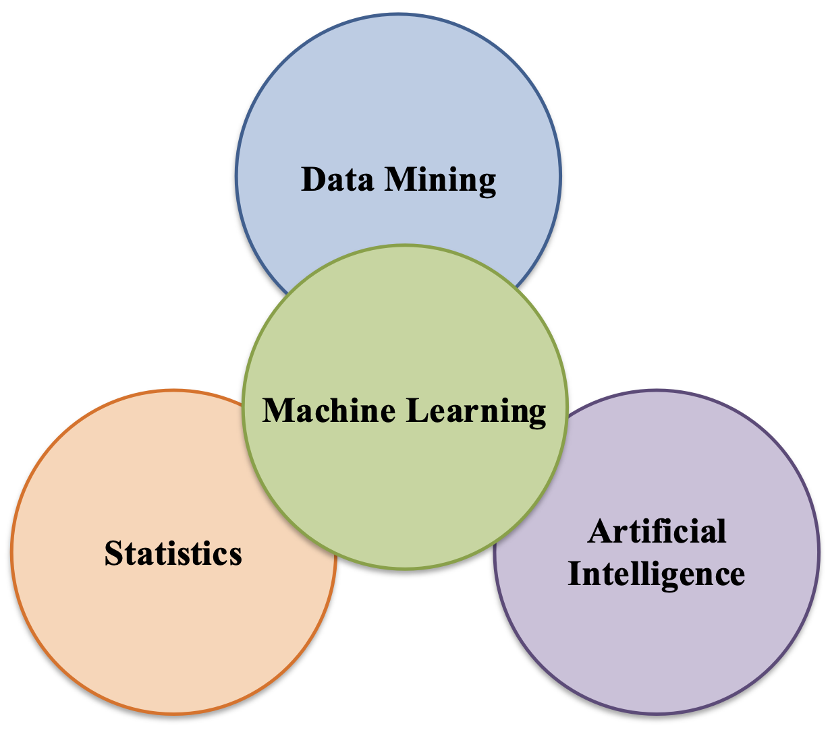
Questions Students Are Asking
What's inside the black box?
Should I trust what comes out?

Slide 7
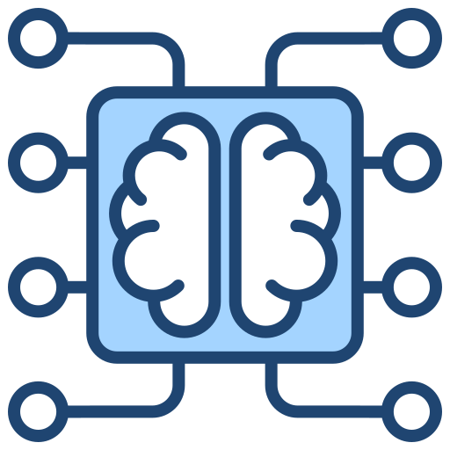






Three Strategies
(1) Trace the Roots: Every modern AI idea has a classical ancestor
(2) Learn Both Ways: Use the course to audit AI, and use AI to understand the course
(3) Question the Magic: Know when, why, and whether to trust AI

Slide 8
Strategy 1: Trace the Roots
Every modern AI idea has a classical ancestor
A clear roadmap to demystify modern AI
Classical ML | Modern AI
Principal Component Analysis | Transformer
Kernel Trick | Attention Mechanism
K-Nearest Neighbors | Retrieval-Augmented Generation
K-Means | Mixture of Experts
Hidden Markov Model | Mamba
Maximum Likelihood Estimation (MLE) | Diffusion Models

Slide 9


Strategy 1: Trace the Roots
Every modern AI idea has a classical ancestor
Principal Component Analysis (PCA)
Autoencoder
$$⋯$$
BERT
Transformer
Seq2seq
$$⋯$$
GPT

Slide 10
Strategy 1: Trace the Roots
Every modern AI idea has a classical ancestor
Nonlinear projection
Principal Component Analysis (PCA)
Autoencoder
Translation
$$⋯$$
BERT
Encoder-only
Self-attention
Transformer
Seq2seq
$$⋯$$
GPT
Decoder-only

Slide 11
Strategy 1: Trace the Roots
Every modern AI idea has a classical ancestor
A clear roadmap to demystify modern AI
Knowing the ancestor reveals the descendant's weaknesses
Build confidence to question AI, not just use it
Foundational ML
Modern AI

Slide 12



Strategy 2: Learn Both Ways
Use the course to audit AI
Use AI to understand the course

Slide 13
Strategy 2: Learn Both Ways
Use the course to audit AI
Course projects that use classical methods to audit AI
"AI model fails in structured predictable ways, and classical ML is exactly the right tool to find them."
1
Design factual probes
4
Apply unsupervised ML
300 structured questions with verifiable ground truth: dates, statistics, authorship, scientific facts.
Cluster errors using K-Means or GMM. Do errors group by domain? By question type? Use PCA to visualize clusters.
2
Query the LLM
5
Apply anomaly detection
Run all 300 probes through an LLM (use NAIRR access). Record answers. Label correct / incorrect / hallucinated.
Train on correct answers, flag anomalies. Does isolation forest catch hallucinations better than a threshold?
3
Build a feature vector per error
6
Report failure taxonomy
Domain, question length, answer confidence (perplexity), topic rarity, numeric vs. textual answer type.
"The model fails systematically on X but not Y." Students write a one-page failure analysis, not just accuracy numbers.

Slide 14
Strategy 2: Learn Both Ways
Use AI to understand the course
"The audit step is non-negotiable. It is what separates learning from copying."
Step 1 — Use AI to get unstuck
Step 2 — Audit the explanation
1. Ask AI to explain the concept (e.g. "explain why PCA maximizes variance")
2. Ask for a concrete example with numbers
3. Ask for an analogy to something familiar
4. Ask: "what are the most common misconceptions about this?"
5. Ask: "give me a question a professor might ask on an exam about this"
1. Reproduce the AI's example by hand or in code
2. Check the math: does the derivation hold?
3. Find one thing the AI said that could be wrong or imprecise
4. Ask a follow-up the AI might get wrong (edge case, failure mode)
5. Write a one-paragraph summary in your own words without looking at the AI's answer

Slide 15

Strategy 2: Learn Both Ways
Use AI to understand the course
"The audit step is non-negotiable. It is what separates learning from copying."
Step 1 — Use AI to get unstuck
Step 2 — Audit the explanation
1. Ask AI to explain the concept (e.g. "explain why PCA maximizes variance")
2. Ask for a concrete example with numbers
3. Ask for an analogy to something familiar
4. Ask: "what are the most common misconceptions about this?"
5. Ask: "give me a question a professor might ask on an exam about this"
1. Reproduce the AI's example by hand or in code
2. Check the math: does the derivation hold?
3. Find one thing the AI said that could be wrong or imprecise
4. Ask a follow-up the AI might get wrong (edge case, failure mode)
5. Write a one-paragraph summary in your own words without looking at the AI's answer
Can I trust AI outputs?

Slide 16
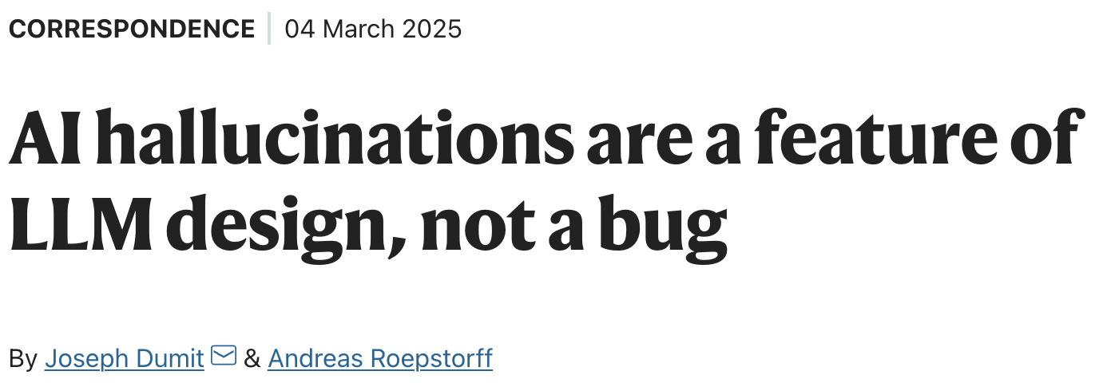
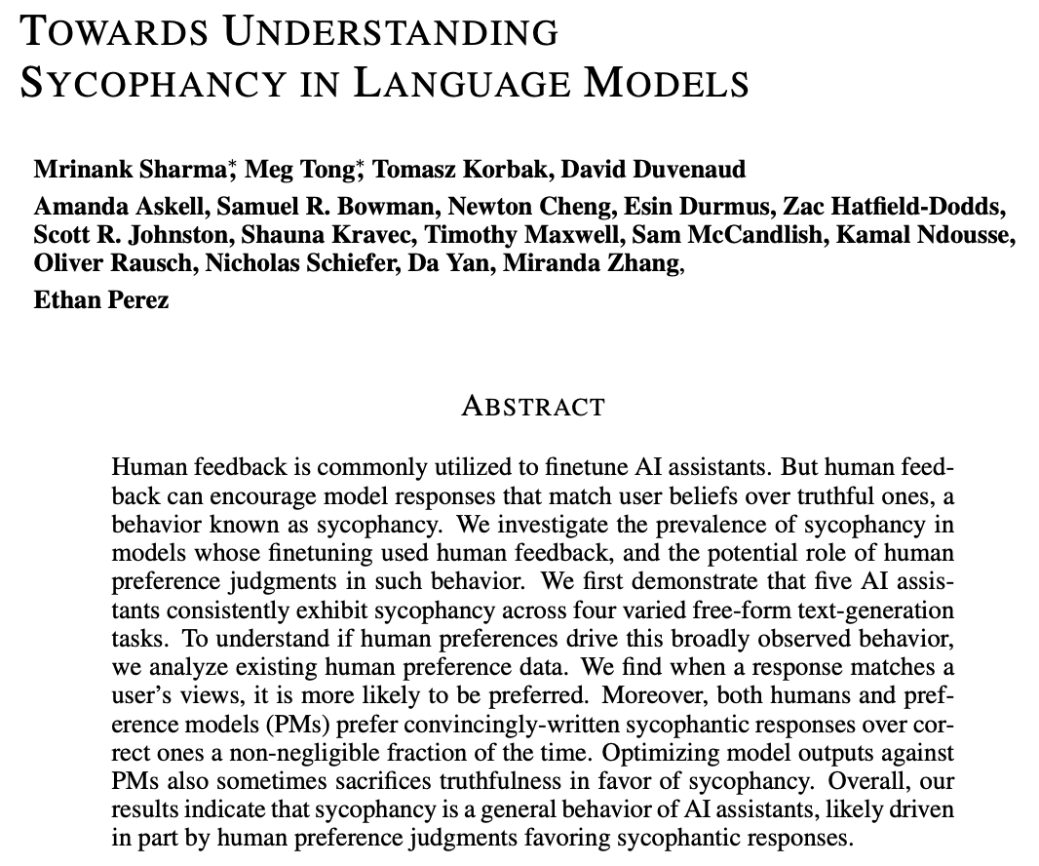
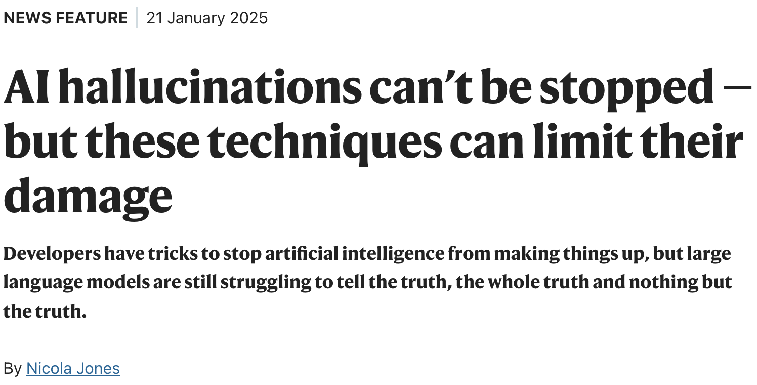
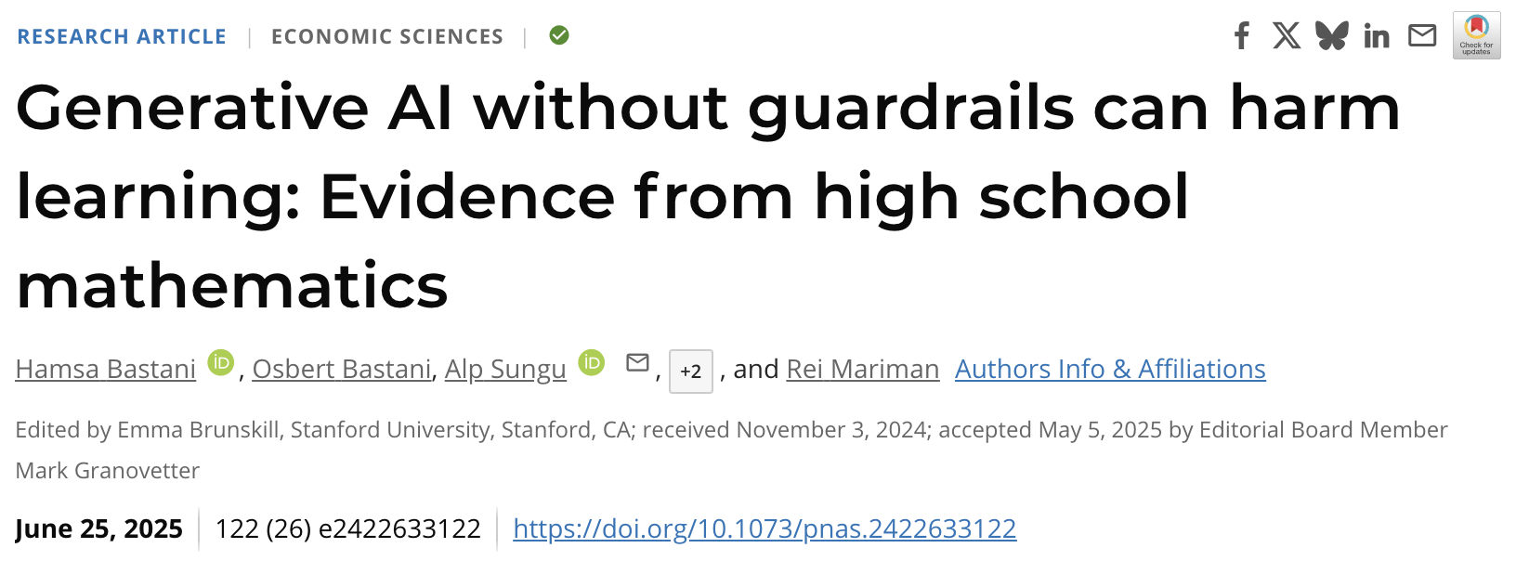
Strategy 3: Question the Magic in AI Outputs
Know when, why, and whether to trust AI

Slide 17
Strategy 3: Question the Magic in AI Outputs
Know when, why, and whether to trust AI
Problem: AI confidently generates unreliable results
Solution: Use the course itself as the grading rubric for AI
Verify with first principles
Test with course edge cases
Paraphrase and compare
e.g. GPT says K-Means always converges to the global optimum.
e.g. Ask AI about a degenerate case you just studied in class.
e.g. Explain the concept yourself first. Then ask AI.
Does it? Prove it using what you learned in the class.
If AI gets it wrong, you now understand why and that is the lesson.
Where do they diverge? The gap is what you need to study.

Slide 18
Strategy 3: Question the Magic in AI Outputs
Know when, why, and whether to trust AI
Problem: AI confidently generates unreliable results
Solution: Use the course itself as the grading rubric for AI
Verify with first principles
Test with course edge cases
Paraphrase and compare
e.g. GPT says K-Means always converges to the global optimum.
e.g. Ask AI about a degenerate case you just studied in class.
e.g. Explain the concept yourself first. Then ask AI.
Does it? Prove it using what you learned in the class.
If AI gets it wrong, you now understand why and that is the lesson.
Where do they diverge? The gap is what you need to study.
Student: I don’t need to distrust AI. I just need to know enough to check it.
Instructor: Every lecture is a verification exercise. The course is the grading rubric for AI.

Slide 19
Strategy 3: Question the Magic in AI Outputs
What students carry beyond this course
Verify before you trust: Don’t take AI outputs at face value. Use what you learned to check them.
Name the failure mode: Saying “the model is overconfident here” is more useful than saying “AI got it wrong”
Know when not to use AI: Some problems need your judgment, not AI’s. Knowing the difference matters.
Communicate AI limitations: The person who can explain why AI failed is the one who gets to fix it

Slide 20
Three Strategies
1
2
3
Trace the Roots
Learn Both Ways
Question the Magic

Slide 21
Three Strategies
1
2
3
Trace the Roots
Learn Both Ways
Question the Magic
Removes
Removes
Removes
Ignorance
Passivity
Blind Trust
Students see how AI works
Students actively engage with AI
Students develop judgment about AI

Slide 22
Three Strategies
1
2
3
Trace the Roots
Learn Both Ways
Question the Magic
Removes
Removes
Removes
Ignorance
Passivity
Blind Trust
Students see how AI works
Students actively engage with AI
Students develop judgment about AI
Goal: Understand AI $⟶$ Use AI $⟶$ Judge AI

Slide 23
Where NAIRR Fits In
NAIRR closes the gap between proving it on the board and running it on real data.
1
2
3
Trace the Roots
Learn Both Ways
Question the Magic
Students need to run both classical and modern models
Projects require API access to real LLMs at scale
Students need access to actual model outputs to verify
The lineage becomes observable, not theoretical
Projects become real experiments, not toy demos
Verification becomes a habit, not a thought experiment

Slide 24
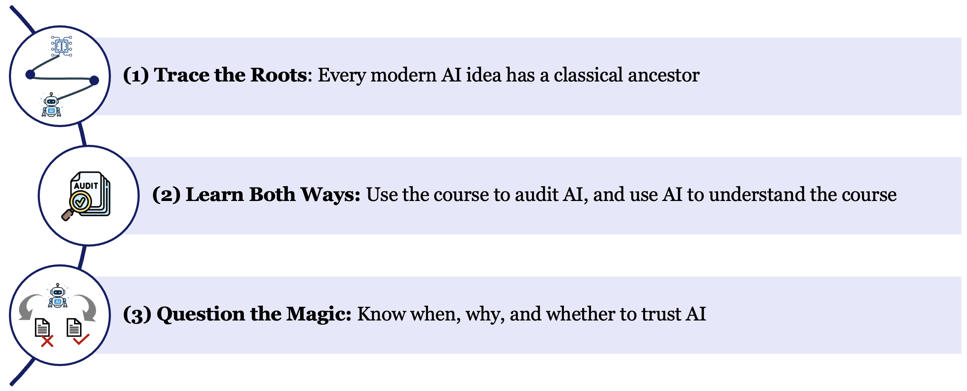
Takeaways
Gap: Foundational ML $⟶$ modern AI
NAIRR Resources: Making the lineage observable, not just theoretical

Slide 25
Thank You!

