Slide 1
Bridging the Compute Divide: Strategies for Implementing an NLP Curriculum at a Regional Teaching Institution
Hong Biao Zeng
Department of Computer Science
Fort Hays State University

Slide 2
Why I am Here
I am excited about NAIRR Pilot Resources. I would like to:
understand how to apply for NAIRR Pilot Resources.
learn from pioneers how to use NAIRR Pilot Resources.
know the difference between the Google Colab free GPU tier and the super-computing power provided by NAIRR Pilot Resources.
Thanks to the NAIRR Pilot Conference Committee, particularly Director Dr. Traian Marius Truta.

Slide 3
What I Need
FHSU’s NLP course launches in Spring 2027. We need:
guidance on the NAIRR education allocation process,
a model for classroom-scale GPU access for 30 students,
connections with faculty who have done similar work.

Slide 4
Current AI Curriculum at FHSU
Fort Hays State University (FHSU) is a teaching-focused, research-emerging institution.
There are two IT related departments at FHSU.
It is in the process of merging into one department
The School granted funding to establish an AI lab about one year ago.
There are only two “super-computers”.
CSCI 785 Introduction to Natural Language Processing was approved by the Graduate Council this April. The course will be first offered in Spring 2027.

Slide 5

CSCI 785 Introduction to NLP
Bridging Disciplines: Connecting classic linguistics with modern AI and machine learning techniques.
Code-first Foundation: Prioritize hands-on Python implementations with industry standard libraries(NLTK, spaCy, and Transformers).
Democratizing Access: Removing barriers for students without formal backgrounds through integrated “Bootcamp” modules.
Linear algebra, vector spaces, and cosine similarity for word embeddings.
Introduction to Machine Learning, gradient descent, and loss functions.
Ethical Awareness: Critical analysis of data bias, ethical implications, and the limitations of generative AI systems.

Slide 6
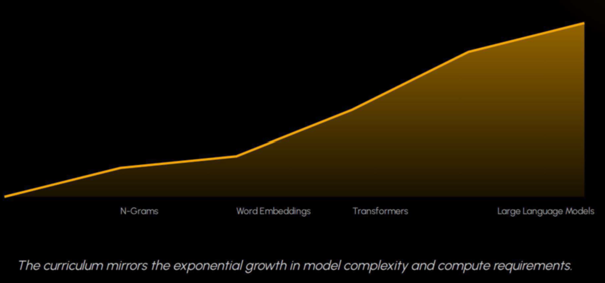
NLP Evolution: N-Grams to LLMs

Slide 7
Responsible use of Supercomputing Power
We do not waste national supercomputing resources on basic Python tokenization or string manipulation in the first half of the semester.
Instead, we use local environments to build foundational skills, and then strategically deploy NAIRR’s massive GPU clusters when students hit the ‘Transformer Wall’ in Week 14 and begin their high-stakes Final Projects.

Slide 8
When Super Computing Power Needed
Fine-tune pre-trained models (like BERT) for downstream tasks
While a tiny BERT model can technically run on a free Colab GPU tier, a standard classroom of 30+ students attempting to run training loops simultaneously will quickly hit free-tier resource limits, causing session timeouts.
Graduate students need to optimize algorithmic and hardware efficiency, which requires access to professional monitoring tools available on dedicated cluster nodes. Target NAIRR cluster nodes with built-in profiling and monitoring tools to track student optimization loops.

Slide 9
Large Language Models
Large Language Models & Retrieval-Augmented Generation (RAG)
When students transition to prompt engineering, tokenization, and vector database retrieval with models like Llama 3, hosting these models locally or managing embedding pipelines requires significant VRAM (Video RAM).
Leveraging NAIRR’s shared Jupyter environments to host a centralized model instance minimizes lag for a classroom of 30 or more concurrent users.

Slide 10
With Help of NAIRR Pilot Resource
Students move beyond theory to practical, high compute application development, preparing them for the modern AI workforce.
Using NAIRR GPU clusters to facilitate transformer fine-tuning and the construction of generative chatbot applications with real-time user interaction.

Slide 11
AI in Practice
I developed the course and this presentation through an iterative process with Gemini.
Transparency: Explicitly disclosing AI collaboration to model ethical use for students
Efficiency: Scaling faculty productivity in “research-emerging” environments.
Refinement: Human-in-the-loop verification ensures academic rigor.

Slide 12
Questions?

Slide 13

Stay Connected!
Follow CRA on social media

