Slide 1


Optimization Models Project Presentation
By Team Alpha 🏴‍☠️ :
Jaladhi Joshi 22B0994
Mrinal Garg 22B0930
Nihar Hingrajia 22B1044
Anirudh Garg 22B1005

Slide 2

Problem Statement
The problem we are addressing is the optimal placement of Instamart in a map for profit maximization subject to budget, installation costs, demand and other constraints.
1
Installation size constraints
The availability of land and its corresponding constraints in each area of the map makes it challenging to optimize.
2
Varying Demand Patterns
Customer demand varies across regions, and product categories, along with efficient inventory management which adds to the complexity of the problem.
3
Cost
Variation in installation and expansion costs while ensuring maximum customer acquisition is crucial for overall profitability.

Slide 3
Methodology
We built our project in the following steps:
1
Covering Problem
Initially we modelled our problem as simply a vertex covering problem with "adjacent" vertex were labelled using a max k-distance rule.The set was generated using an auxiliary code. This was done to observe the number of instamarts installed on complex maps for future models.
2
Basic Profit Maximization
Next we modelled our problem as every node having a cost of installation and demand. We installed instamarts under the constraint of a total budget. We also added the constraint that one node can have at max one instamart "adjacent" to it.
3
Final Destination
We finally added all the demographic factors we could account for. On each node a parameter was set that gave the maximum "size" of instamart that could be installed in that locality. For every node we assigned k variables(belonging to the interval [0,1]), where k represents the inventory size. The variables represent the holding of the particular item with respect to a full-fledged instamart.We added a constraint that the total holding size should not exceed the maximum holding that can be installed in that locality. The cost was split into two factors , one basic and other expansion. We also accounted for the fact that an instamart will supply the minimum of its maximum supply and demand. Lastly, we again removed intersections.

Slide 4

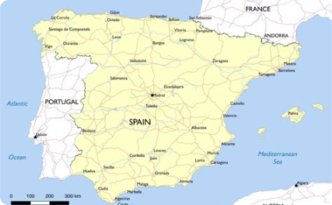
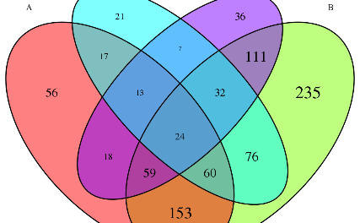
Problems Faced
During the project, we encountered various challenges that required innovative solutions to overcome.
Double Counting
Dataset Generation
Overlap
We were not able to effectively allow the possibility of multiple instamarts being adjacent to a node and still not count the demand multiple times.
Datasets for checking our code were not available online and random datasets were not suitable for our model.
A basic modelling problem was that a household can have some items delivered from one instamart and other from other ones but our model made a node completely dependent on at most one instamart.

Slide 5
Learning Outcomes
Engaging in the Optimization Models Project provided valuable insights and learning experiences.
1
Iterative Formulation
2
Collaboration and Teamwork
Iteratively increasing the complexity of our formulation was much better than going head-on.
Enhanced teamwork skills by working closely with experts from different domains and effectively communicating complex ideas.
3
Familiarity with MIP
4
Real-World Application
Since the problem was of great complexity we really enjoyed brainstorming the formulation and became familiar with mixed integer programming.
Explored the applicability of optimization models in addressing real-world problems, paving the way for future advancements in supply chain logistics.

Slide 6
Thank You Avinash Sir
We appreciate your time and support!

