Slide 1
Recommended Plan for Asphaltene Removal

Slide 2
OUTLINE
Key Information of the Well F18
Recommended Plan
Tools Specification
Hazards of Milling
Benefits of Jetting
Conclusion

Slide 3
1. Key Information of the Well F18
Well Name | F18 | Well Type | Vertical/Production
Depth of Obstruction | 4133 meter | Depth of Min I.D | 4070.52 meter
Min I.D | 2” | Length of Min I.D | 1.21 meter
Formation | Fahliyan Upper | PBTD | 4583.5
Max Reservoir Temperature | 136 ℃ | Reservoir pressure | 9192 Psi
H2S (ppm) | 5,000 | CO2(ppm) | 30,000

Slide 4
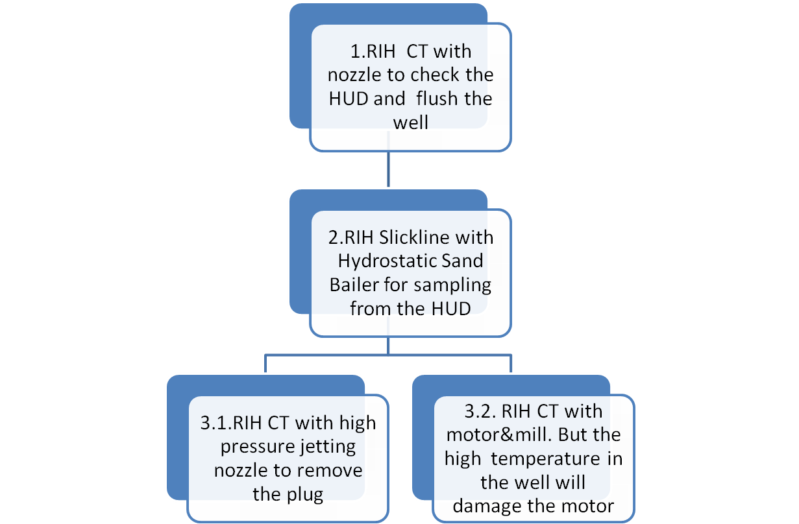
2. Recommended Plan
Higher Risk &Less Success Possibility !!!

Slide 5



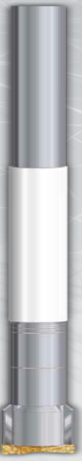
3.1 BHA of Milling
BHA | Name | Length | ID | Comment
 | Roll On Connector | 5cm | 1.69” | Minimum ID is 0.781”
 | Motor Head | 70cm | 1.69” | Fish Neck is 1.38” ID
 | Circulating Sub | 12cm | 1.69” | Rapture Disc. Type
 | Motor | 350cm | 1.69” | Maximum Working Temperature 85℃
 | Mill | 11cm | 1.75”

Slide 6
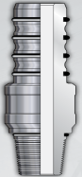
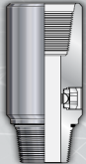
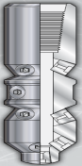
3.2 BHA of Jetting
BHA | Name | Length | OD | Comment
 | Roll On Connector | 5cm | 1.69” | Minimum ID is 0.781”
 | Motor Head | 70cm | 1.69” | Fish Neck is 1.38” ID
 | Circulating Sub | 12cm | 1.69” | Rapture Disc. Type
 | Jetting Nozzle | 10cm | 1.75”

Slide 7
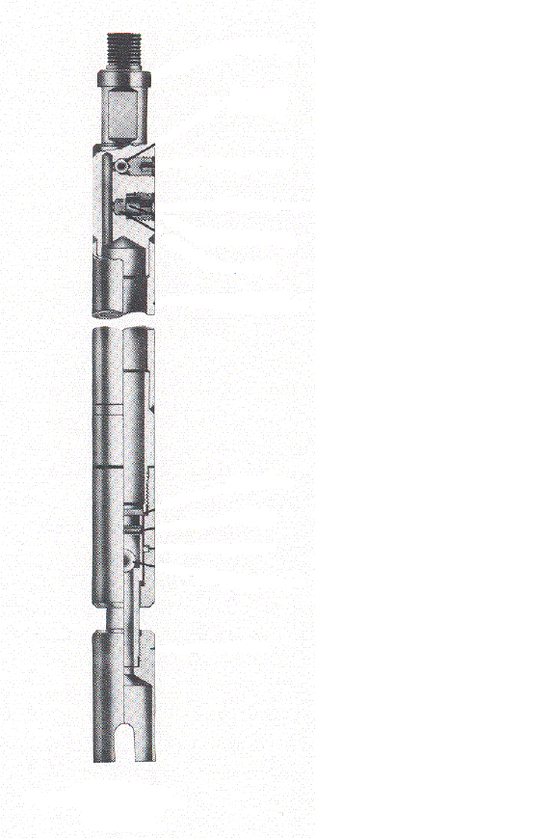
3.3 Introduction of Hydrostatic Sand Bailer
Introduction：
The hydrostatic Bailer is sealed at the surface and
run into the tubing bore with the internal bailer
chamber at atmospheric pressure.
When the bailer reaches the objects to be bailed, a few downward strokes of the wire line jars act to shear a small sealing disc(12000psi) and admit the well pressure and/or hydrostatic head(as well as the junk)into the bailer cylinder. A ball check valve acts to contain the junk as well as the well pressure until the bailer is
retrieved.
Avoid any sample contamination during RIH

Slide 8
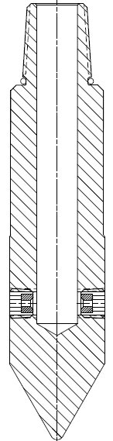
3.4 Specification of Jetting Nozzle
Key features：
1. No moving pats
2. Compatible with any fluid, gas ,or mixture such as nitrogen , water and acid
3. Produces high velocity flow so cleaning efficiency is very high
4. Effectively stimulates the reservoir
Flow Characteristics
Flow Rate(BPM) | Velocity(FT/SEC)
0.4 | 220
0.6 | 329
0.8 | 439
1.0 | 549

Slide 9
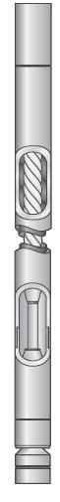
3.5 Specification of Motor
Specification of Motor
OD | 1.69” | Length | 3.5m
Flow Rate | 8-24gpm | Pressure Drop | 580psi
Working Torque | 120N.m | Maximum Torque | 180N.m
Max Drilling Weight | 2700lbs | RPM | 120-360
Horse Power | 1.5-4.5kw | Working Temperature | 85℃
Remark: The motor can be only powered by clean water. The components will be seriously affected by Xylene oil or diesel!

Slide 10
4. Hazards of Milling Compared with High Pressure Jetting
1 | BHA length is 4.4m.Rig up is difficult especially in F18 location full of production pipes
2 | According to minimum ID of tubing, roll-on connector must be used instead of external slips connector(2.125”),lead to low torque resistivity of roll-on connector.
3 | Because of the small annulus between 1.69”motor and the 2”tubing ,the circulation will very difficult and the cutting s of mill can not circulate out of the well.
4 | Due to sticking asphalte , motor most likely will be stalled.
5 | High temperature in the well will damage Motor
6 | According to the Minimum ID 2” we can not add any Centralizer in BHA .It will cause high vibration of BHA and tubing /casing damage.
7 | Motor can only work with water and easily broken by Xylene or Diesel.
8 | BHA is easily stuck by Asphaltene.
9 | When BHA stuck ,it is difficult to disconnect due to the Asphaltene plug will make the disconnecting ball can not drop down.
10 | May confront difficulty in fishing 1.69” motor in case of disconnecting the motor in 4.5” liner
11 | If disconnect sub failed ,the CT should be cut. Then the workover rig operation will be needed.

Slide 11
5. Benefits of High Pressure Jetting Compared to Milling
1 | BHA length is 1m.Rig up is easier
2 | Roll on connector is suitable because there is no rotation parts in BHA
3 | Fluid circulating better because of the higher flow rate. It also lower the risk of Asphalt plug.
4 | The jetting nozzle is not affected by high temperature and compatible with all the fluid
5 | The jetting nozzle will never damage the tubing/casing.
6 | High flow rate of Xylene and diesel lower the risk of BHA stuck
8 | BHA is easily stuck by Asphaltene.
9 | When BHA stuck ,it is easier to drop a ball to disconnect.

Slide 12
6. Conclusion
Compared with Milling ,the High Pressure Jetting is more efficient and compatible. At the same time, it lower the operation risk obviously.
So, the High Pressure Jetting is much more suitable for this job

