Slide 1
Cementing
Published By: Jalal Al Ali

Slide 2
Contents
Portland Cement Composition
Cement Testing
Standard and Nonstandard Drilling Cements
Cement Additives
Cement Placement Techniques
Well Parameters Affecting Cement Design and Operations

Slide 3
Contents
Introduction
Cement Duties
Cement Production Procedure
Cement Chemistry
Cement Classification
Cement Specifications

Slide 4
Cement Classification
API Cement Classification (Standard Cements):
Type “A”
Type “B”
Type “C”
Type “D”
Type “E”
Type “F”
Type “G”
Type “H”

Slide 5
Cement Classification
Other Cements (Nonstandard Cements):
Pozzolan/Portland (Pozmix) Cement
Pozzolan/Lime Cement
Gypsum Cement
Diesel Oil Cement
Resin or Plastic Cement
Microfine Cement
Expanding Cement
High-Alumina Cement
Latex Cement
Cements for Permafrost Environments
Sorel Cement

Slide 6
Cement Types
According to Sulfate- Resistance, The three types specified are:
Ordinary (O)
Moderate Sulfate-Resistant (MSR)
High Sulfate-Resistant (HSR)

Slide 7
Type “A”
Class A
The product obtained by grinding Portland cement clinker, consisting essentially of hydraulic calcium silicates, usually containing one or more forms of calcium sulfate as an interground additive.
Suitable for use from surface to 6000 ft depth.
intended for use when special properties are not required.
Available only in ordinary (O) Grade.
ASTM Type I, called normal, ordinary, or common cement, is similar to API Class A cement.

Slide 8
Type “B”
Class B
The product obtained by grinding Portland cement clinker, consisting essentially of hydraulic calcium silicates, usually containing one or more forms of calcium sulfate as an interground additive.
Suitable for use from surface to 6000 ft depth.
intended for use when conditions require moderate or high sulfate-resistance.
Available in both moderate sulfate-resistant (MSR) and high sulfate-resistant (HSR) Grades.
ASTM Type II, which is modified for moderate sulfate resistance, is similar to API Class B cement.

Slide 9
Type “C”
Class C
The product obtained by grinding Portland cement clinker, consisting essentially of hydraulic calcium silicates, usually containing one or more forms of calcium sulfate as an interground additive.
Suitable for use from surface to 6000 ft depth.
intended for use when conditions require high early strength.
Available in ordinary (O), moderate sulfateresistant (MSR) and high sulfate-resistant (HSR) Grades.
ASTM Type III, called high early strength cement, is similar to API Class C cement.

Slide 10
Type “D”
Class D
The product obtained by grinding Portland cement clinker, consisting essentially of hydraulic calcium silicates, usually containing one or more forms of calcium sulfate as an interground additive.
Further, at the option of the manufacturer, suitable set-modifying agents may be interground or blended during manufacture.
Suitable for use from 6000 to 10000 ft depth.
intended for use under conditions of moderately high temperatures and pressures.
Available in moderate sulfate-resistant (MSR) and high sulfate-resistant (HSR) Grades.

Slide 11
Type “E”
Class E
The product obtained by grinding Portland cement clinker, consisting essentially of hydraulic calcium silicates, usually containing one or more forms of calcium sulfate as an interground additive.
Further, at the option of the manufacturer, suitable set-modifying agents may be interground or blended during manufacture.
Suitable for use from 10000 to 14000 ft depth.
intended for use under conditions of high temperatures and pressures.
Available in moderate sulfate-resistant (MSR) and high sulfate-resistant (HSR) Grades.

Slide 12
Type “F”
Class F
The product obtained by grinding Portland cement clinker, consisting essentially of hydraulic calcium silicates, usually containing one or more forms of calcium sulfate as an interground additive.
Further, at the option of the manufacturer, suitable set-modifying agents may be interground or blended during manufacture.
Suitable for use from 10000 to 16000 ft depth.
intended for use under conditions of extremely high temperatures and pressures.
Available in moderate sulfate-resistant (MSR) and high sulfate-resistant (HSR) Grades.

Slide 13
Type “G”
Class G
The product obtained by grinding Portland cement clinker, consisting essentially of hydraulic calcium silicates, usually containing one or more forms of calcium sulfate as an interground additive.
No additives other than calcium sulfate or water, or both, shall be interground or blended with the clinker during manufacture of Class G well cement.
Suitable for use from surface to 8000 ft depth.
intended for use as a basic well cement.
Available in moderate sulfate-resistant (MSR) and high sulfate-resistant (HSR) Grades.

Slide 14
Type “H”
Class H
The product obtained by grinding Portland cement clinker, consisting essentially of hydraulic calcium silicates, usually containing one or more forms of calcium sulfate as an interground additive.
No additives other than calcium sulfate or water, or both, shall be interground or blended with the clinker during manufacture of Class H well Cement.
Suitable for use from surface to 8000 ft depth.
intended for use as a basic well cement.
Available in moderate sulfate-resistant (MSR) and high sulfate-resistant (HSR) Grades.

Slide 15
Notes on G and H Class Cements
The majority of Oilwell cements are Class G and Class H.
Using G Class is more general.
H Class has bigger grains than G Class.
H Class is more suitable to use in deep wells because it is more compatible with “Retarders”.

Slide 16
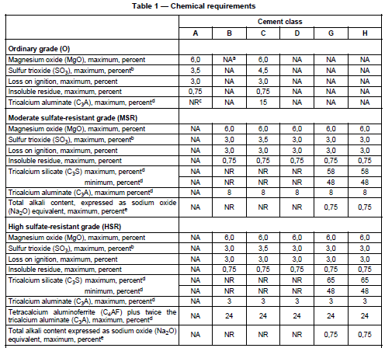
Chemical Requirements

Slide 17
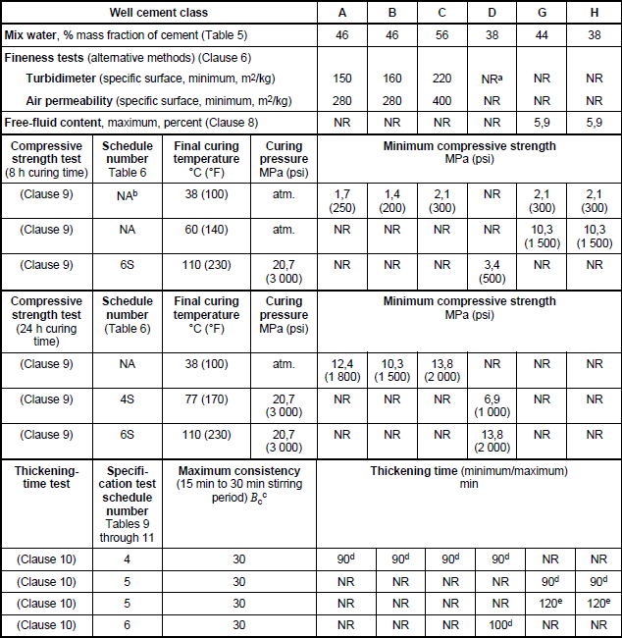
Physical and Performance Requirements

Slide 18
Pozzolan/Portland (Pozmix) Cement
Pozzolanic materials are often dry blended with Portland cements including API, ISO, or ASTM cements to produce “lightweight” (low-density) slurries for well cementing applications.
Typically, pozzolanic materials are categorized as natural or artificial and can be either processed or unprocessed.
Pozzolanic materials are dry blended with Portland cements to produce “lightweight” (low-density) slurries for well cementing applications.
The most common sources of natural pozzolanic materials are volcanic materials and diatomaceous earth.

Slide 19
Pozzolan/Portland (Pozmix) Cement
Artificial pozzolanic materials are produced by partially calcining natural materials such as clays, shales, and certain siliceous rocks, or are more usually obtained as an industrial byproduct.
Artificial pozzolanic materials include metakaolin, fly ash, microsilica (silica fume), and ground granulated blast-furnace slag.
Diatomaceous earth is composed of diatom fossil remains consisting of opaline silica.
the addition of pozzolanic materials to cements (API, ISO, or ASTM (Portland)) reduces permeability and protects cement from chemical attack by corrosive formation waters with the buffered pH found in CO2 injection zones.
pozzolanic materials also can reduce the effect of sulfate attack, dependent on the slurry design.

Slide 20
Pozzolan/Portland (Pozmix) Cement
the addition of pozzolanic materials to cements reduces permeability and protects cement from chemical attack by corrosive formation waters with the buffered pH found in CO2 injection zones.
In most cases, pozzolanic materials also can reduce the effect of sulfate attack, though this is somewhat dependent on the slurry design.

Slide 21
Pozzolan/Lime Cement
Pozzolanic materials include any natural or industrial siliceous or silica-aluminous material, which, though not cementitious in itself, will combine with lime in the presence of water at ambient temperatures to produce strength-developing insoluble compounds similar to those formed from hydration of Portland cement.

Slide 22
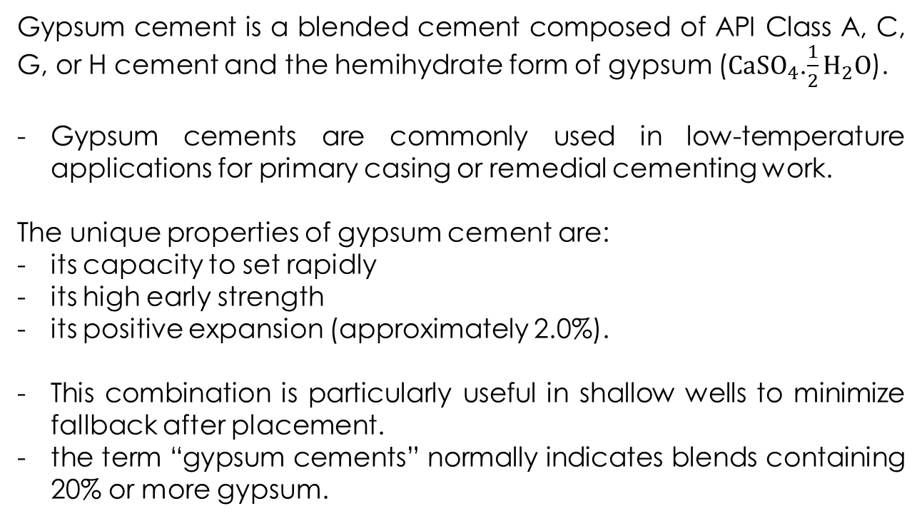
Gypsum Cement
Gypsum cement is a blended cement composed of API Class A, C, G, or H cement and the hemihydrate form of gypsum (${CaSO}_{4}$.$\frac{1}{2}H_{2}O$).
Gypsum cements are commonly used in low-temperature applications for primary casing or remedial cementing work.
The unique properties of gypsum cement are:
its capacity to set rapidly
its high early strength
its positive expansion (approximately 2.0%).
This combination is particularly useful in shallow wells to minimize fallback after placement.
the term “gypsum cements” normally indicates blends containing 20% or more gypsum.

Slide 23
Gypsum Cement
This is caused by the “plaster of Paris” reaction in which the hemihydrate rehydrates to form gypsum.
A cement with high gypsum content has increased ductility and acid solubility.
It is usually used in situations of high lateral stress or in temporary plugging applications.
A 50:50 gypsum cement is frequently used in fighting lost circulation, to form a permanent insoluble plug.
These blends should be used cautiously because they have very rapid setting properties and could set prematurely during placement.
A limitation of gypsum cements is that they are nonhydraulic and are not stable in contact with external water sources, including corrosive formation waters.

Slide 24
Diesel Oil Cement
This cement is a mixture of an API Class cements, Diesel and surfactant.
This cement has unlimited setting-time and set only in proximity of water.
This cement is used specially for sealing water productive zones of the reservoir.

Slide 25
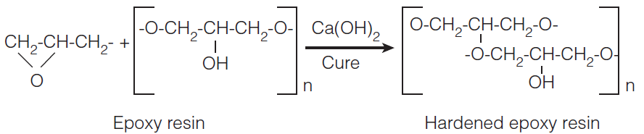
Resin or Plastic Cement
Resin and plastic cements are specialty materials used for:
Selectively Plugging Open Holes
Squeezing Perforations
Primary Cementing of Waste-Disposal Wells
especially in highly aggressive, acidic environments.
These cements may be composed of resins and catalysts alone or contain fillers such as silica sand.
Other systems are mixtures of water, liquid resins, and a catalyst blended with API Class A, B, G, or H cement. For example:

Slide 26
Resin or Plastic Cement
A unique property of these cements is their capability to be squeezed under applied pressure into a permeable zone to form a seal within the formation.
These specialty cements are used in relatively small volumes and are generally effective at temperatures from 60 to 200°F (15 to 93°C).
Some types of resin cements can be applied in wells with higher temperature conditions.

Slide 27
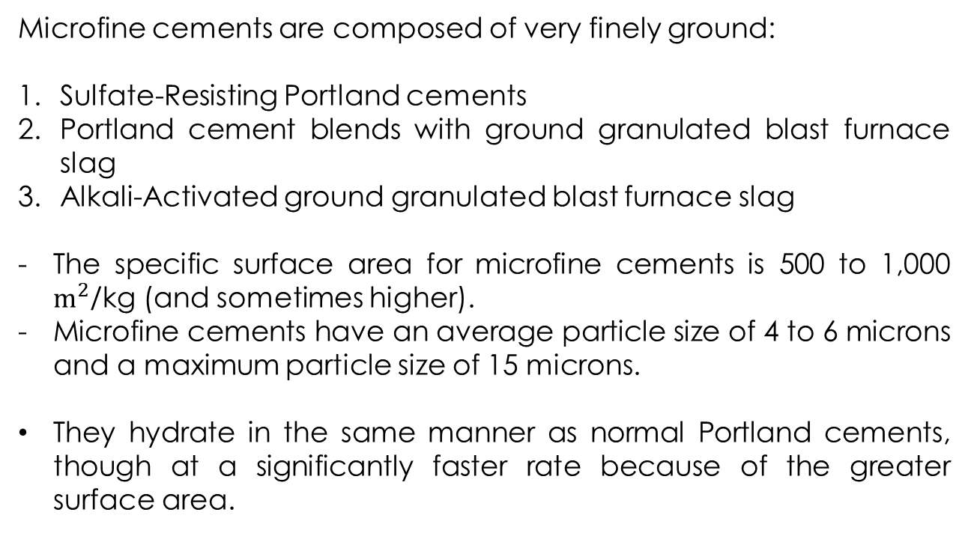
Microfine Cement
Microfine cements are composed of very finely ground:
Sulfate-Resisting Portland cements
Portland cement blends with ground granulated blast furnace slag
Alkali-Activated ground granulated blast furnace slag
The specific surface area for microfine cements is 500 to 1,000 $m^{2}$/kg (and sometimes higher).
Microfine cements have an average particle size of 4 to 6 microns and a maximum particle size of 15 microns.
They hydrate in the same manner as normal Portland cements, though at a significantly faster rate because of the greater surface area.

Slide 28
Microfine Cement
Such cements have a high penetrability and ultra rapid hardening.
Applications for such cements include:
Consolidation of unsound formations
Repair of casing leaks in squeeze operations, particularly “tight” leaks that are inaccessible by conventional cement slurries because of their penetrability.
Ultrafine Alkali-Activated ground blast furnace slag is used in the mud-to-cement technology in which water-based drilling mud is converted to cement.

Slide 29
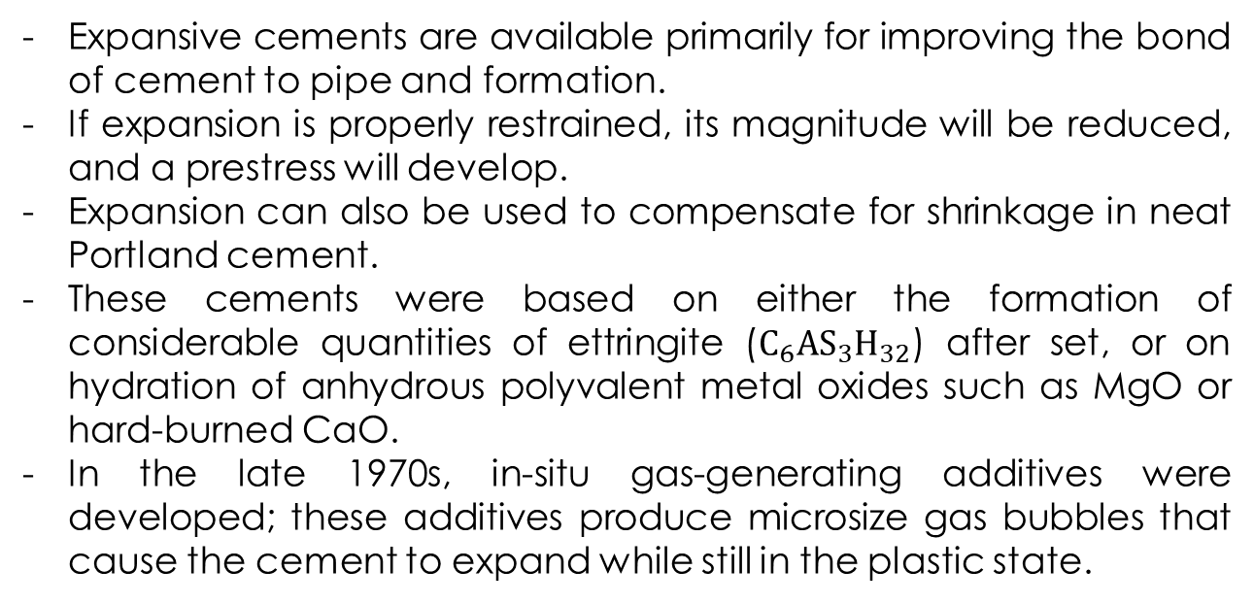
Expanding Cement
Expansive cements are available primarily for improving the bond of cement to pipe and formation.
If expansion is properly restrained, its magnitude will be reduced, and a prestress will develop.
Expansion can also be used to compensate for shrinkage in neat Portland cement.
These cements were based on either the formation of considerable quantities of ettringite ($C_{6}{AS}_{3}H_{32}$) after set, or on hydration of anhydrous polyvalent metal oxides such as MgO or hard-burned CaO.
In the late 1970s, in-situ gas-generating additives were developed; these additives produce microsize gas bubbles that cause the cement to expand while still in the plastic state.

Slide 30
Expanding Cement
Other formulations of expanding cement include the following:
· API and ISO Class A or H (Portland cement) containing 5 to 10% of the hemihydrate forms of gypsum
· API and ISO Class A, G, or H cements containing sodium chloride in concentrations ranging from 5% to
saturation
· Cement additives that create in-situ gas generation within the cement matrix based primarily on the reaction of finely ground alumina powder with the alkalis present in the cement aqueous solution to produce hydrogen gas. Although alumina powder is the most commonly used additive, zinc, magnesium, and iron powders are potential alternatives.

Slide 31
High-Alumina Cement
Calcium Aluminate Cements
These cements are used primarily in refractory concretes, but they are also widely used in construction for rapid setting and controlled expansion or shrinkage compensation.
In well-cementing operations, they are used:
at both temperature extremes in permafrost zones with temperatures at 32°F or below
in in-situ combustion wells (fi reflood), where temperatures may range from 750 to 2,000°F
in thermal recovery wells, where temperatures can exceed 1,300°F and fluctuate dramatically.
Several high-alumina cements have been developed with alumina contents of 35 to 90 percent
there is a move to term these collectively as calcium aluminate cements (CACs) because the reactive phase in all cases is calcium aluminate.

Slide 32
High-Alumina Cement
CAC is manufactured by blending bauxite (aluminum ore) and limestone and heating the mixture above 2,640°F in reverberatory open-hearth furnaces until it is liquefied.
The molten clinker is continuously removed through a tap hole, collected in molds, cooled, and ground in ball mills.
The setting time for CAC is controlled by the composition, and no materials are added during grinding.
These cements can be accelerated or retarded to fit individual well conditions.
the retardation characteristics differ from those of Portland cements.
The addition of Portland cement to a refractory cement will cause a flash set; therefore, when both are handled in the field, they must be stored separately.

Slide 33
Latex Cement
It is actually a blend of API and ISO Class A, G, or H with latex.
Latex is a colloidal suspension of polymer in water.
the latex blends found in latex cements are generally copolymer systems that incorporate more than one type of polymer to optimize film formation and flexibility.
The copolymers are based on:
polyvinyl acetate
polyvinylidene chloride-polyvinyl chloride
polyacrylate copolymers
styrene-butadiene
and are spherical with diameters of 0.01 to 1.0 mm.
In general, a latex emulsion contains only 50% by weight of solids and is usually stabilized by an emulsifying surface-active agent.

Slide 34
Latex Cement
The latex particles coalesce to form a continuous film around the cement hydration products in the set cement and effectively coat the walls of the capillary pores. A well-distributed latex film may protect the cement from chemical attack by some types of corrosive conditions such as formation waters containing carbonic acid. Latex also imparts elasticity to the set cement and improves the bonding strength and filtration control of the
cement slurry.

Slide 35
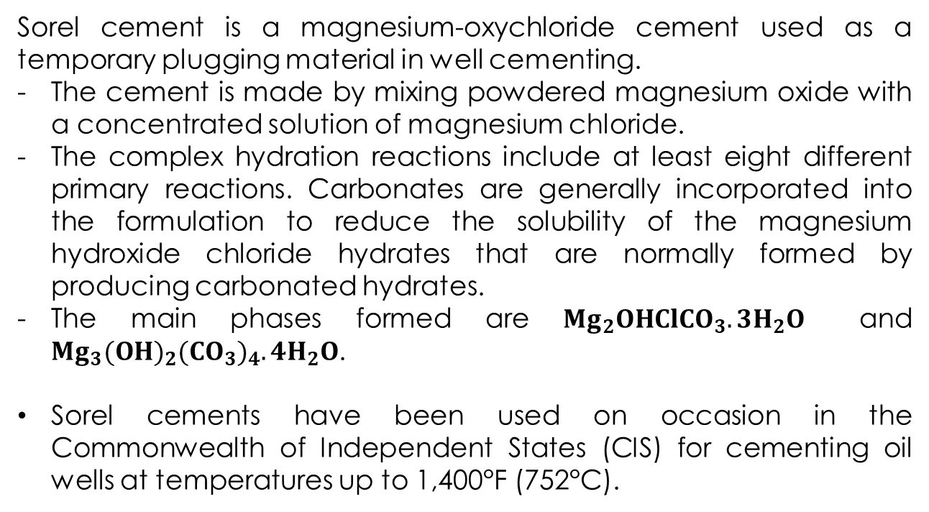
Sorel Cement
Sorel cement is a magnesium-oxychloride cement used as a temporary plugging material in well cementing.
The cement is made by mixing powdered magnesium oxide with a concentrated solution of magnesium chloride.
The complex hydration reactions include at least eight different primary reactions. Carbonates are generally incorporated into the formulation to reduce the solubility of the magnesium hydroxide chloride hydrates that are normally formed by producing carbonated hydrates.
The main phases formed are ${Mg}_{2}OHCl{CO}_{3}.3H_{2}O$ and ${Mg}_{3}{(OH)}_{2}{({CO}_{3})}_{4}.4H_{2}O$.
Sorel cements have been used on occasion in the Commonwealth of Independent States (CIS) for cementing oil wells at temperatures up to 1,400°F (752°C).

Slide 36
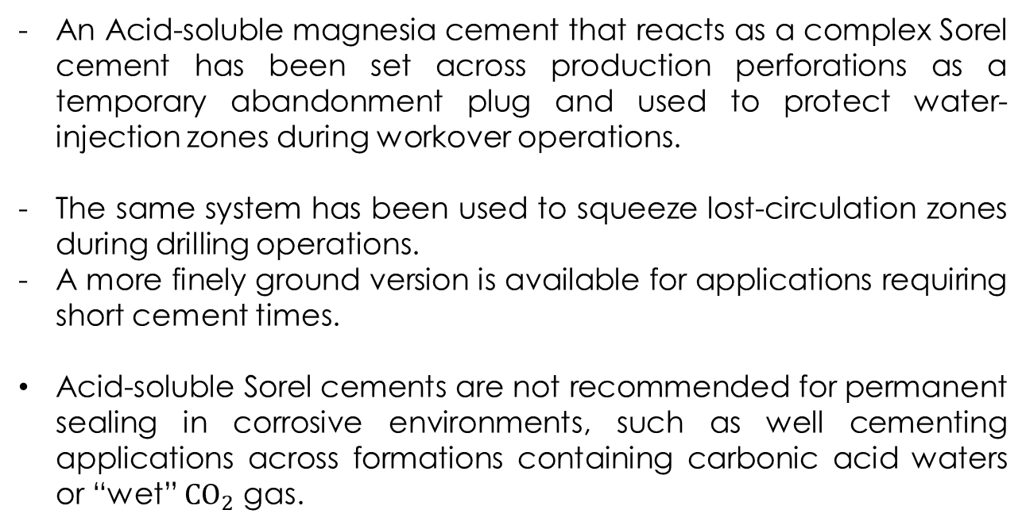
Sorel Cement
An Acid-soluble magnesia cement that reacts as a complex Sorel cement has been set across production perforations as a temporary abandonment plug and used to protect water-injection zones during workover operations.
The same system has been used to squeeze lost-circulation zones during drilling operations.
A more finely ground version is available for applications requiring short cement times.
Acid-soluble Sorel cements are not recommended for permanent sealing in corrosive environments, such as well cementing applications across formations containing carbonic acid waters or “wet” ${CO}_{2}$ gas.

Slide 37
6. Cement Specifications
6.1 Compressive Strength
6.2 Thickening Time
6.3 Cement (Solution) Weight
6.4 Filtration Amount (Water Loss)
6.5 Corrosion Resistivity
6.6 Permeability
6.7 Cement Additives

Slide 38
Compressive Strength
Compressive strength
force per unit area required to cause a set cement sample to fail under compression.
After cementing LDC should not be drilled till cement reach 500 psi of compressive strength. This compressive strength is enough to hold the casing string at place and allows to continue drilling operation.
Wait on Cement (WOC)
Is the needed time for cement after cementing to reach 500 psi compressive strength.

Slide 39
Compressive Strength
the compressive strength of used cement slurry is related to:
Pressure
Temperature
Water Content
Used Additives
Cement Class
Tim Spent After Mixing the Cement with Water

Slide 40
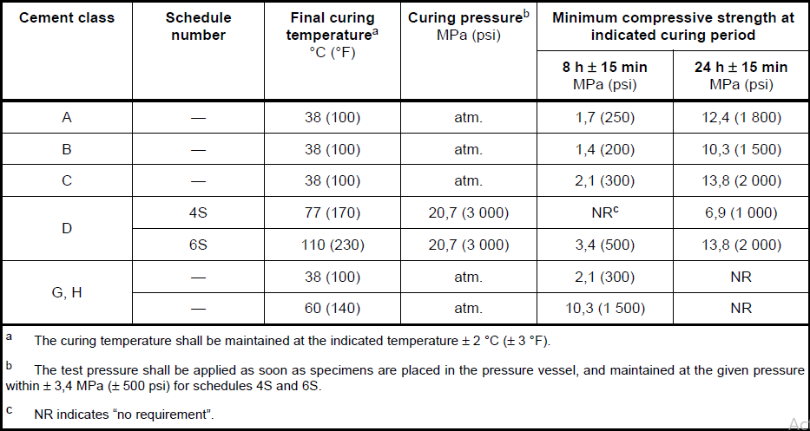
Compressive Strength Requirements

Slide 41
Thickening Time
time after which the consistency of a cement slurry has become so high that the slurry is considered unpumpable.
Cement thickening time should be enough to:
Mix cement slurry
Pump cement slurry into casing string
Displace cement slurry from inside of casing string to the desired point
Usually 2 to 3 hours thickening time is enough for this operation.
Cement slurry thickening time is chosen in order to achieve below operating issues:
Cement slurry should not be set during pumping.
Cement slurry should not remain in place for long time to avoid its mixing with formation fluids.
WOC time should not become too long.

Slide 42
Thickening Time
The results of a thickening-time test provide an indication of the length of time a cement slurry remains pumpable under the test conditions.

Slide 43
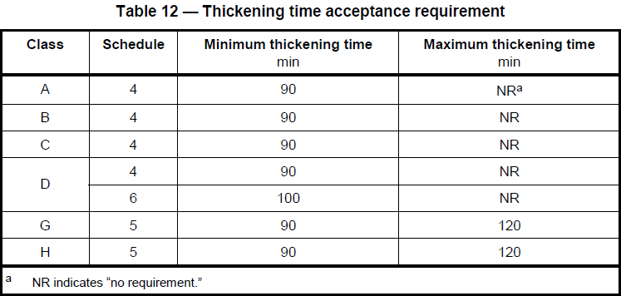
Thickening Time

Slide 44
Filtration Amount (Water Loss)
Filtrate
liquid that is forced out of a cement slurry during a fluid loss test.
An untreated slurry of Class H cement has a
30-minute API filter loss in excess of 1000 cm3. It is desirable to limit the loss of water filtrate from the slurry to
permeable formations to
Cement Setting is results of mixing water and cement powder. If this water loss before that cement arrive to the desired point, this phenomena can reduce cement slurry thickening time and motivate water-sensitive formations. Filtration amount is related to cementing operation type and cement slurry type.

Slide 45
Filtration Amount (Water Loss)
In secondary cementing (cement injection) filtration amount should be low, because cement should achieve into perforate intervals before forming “Mud Cake”, but primary cementing is less sensitive to filtration amount.
Filtration amount for any kind of cement can be measured by laboratory tests.
The cement slurry which is used for secondary cementing (cement injection) should have filtration amount about 50 to 200 cc in laboratory conditions (325 Filter Mech and 1000 psi Pressure).
The cement slurry which is used for primary cementing should have filtration amount about 250 to 400 cc in laboratory conditions (325 Filter Mech and 1000 psi Pressure).

Slide 46
6.8 Cement Additives
There are a lot of chemical materials that used to change cement slurry specifications. These chemical materials which also known as “Cement Additives” change cement slurry specifications in order to have more compatibility with surface equipment and subsurface environment.
Density-Control Additives
Setting-Time and Thickening-Time Control Additives
Lost-Circulation Additives
Filtration-Control Additives
Viscosity-Control Additives
Special Additives for Unusual Problems

Slide 47
Density-Control Additives
The density of the cement slurry must be high enough to prevent the higher-pressured formations from flowing into the well during cementing operations, yet not so high as to cause fracture of the weaker formations.
All standard (API) cements have enough weight to cause fracture to most of the formations. So, almost in all cases “Density-Control” additive should be used to decrease cement slurry weight.
In most cases, the density of the cement slurry obtained by mixing cement with the normal amount of water will be too great for the formation fracture strength, and it will be desirable to lower the slurry density.
Reducing the cement density also tends to reduce the overall cost of the cement slurry.

Slide 48
Density-Control Additives
Acts that reduce cement density:
Use nitrogen as an additive to mix foam cement
Increase water/cement ratio (WCR)
Add Low-Specific-Gravity solids
Increase water/cement ratio (WCR):
Water/Cement ratio can be changed only in the range determinated by API.

Slide 49
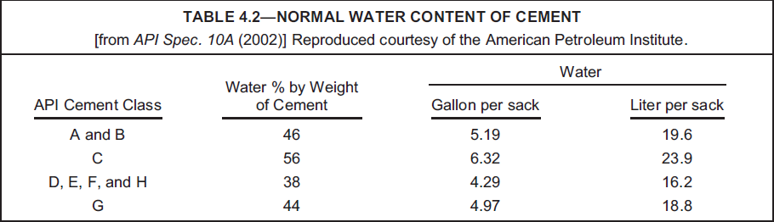
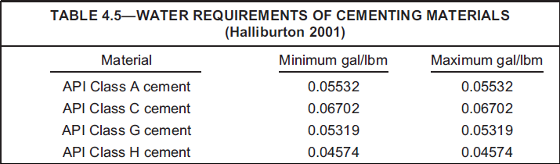

Slide 50
Density-Control Additives
The Low-Specific-Gravity solids commonly used to reduce slurry density include:
Nitrogen Plus Foaming Agents
Microspheres
Solid Hydrocarbons
Expanded Perlite
Pozzolans (Including Diatomaceous Earth)
Sodium Silicates
Bentonite (Sodium Montmorillonite)
Nitrogen and foaming agents added to cement slurries are often the best method for reducing cement density.

Slide 51
Bentonite
Addition of Bentonite to slurry will raise the WCR in addition of decreasing slurry weight and This extra water will reduce slurry weight more than usual.
Bentonite blend with dry powder cement before mixing with water.
The higher water/cement ratio approach that uses bentonite or silicate additives has been found to cause poor sealing results, leading to formation-fluid influx and migration between zones or up the annulus to the wellhead, and is not recommended for applications across potential flow zones or where unknown flow zones may exist.
Adding much amount of Bentonite decreases cement compressive strength and increases cement thickening time.

Slide 52
Bentonite
In more than 200 ºF conditions, Bentonite decreases compressive strength vs. time.
At all, Bentonite decreases cementing quality.
Specific Gravity = 2.65

Slide 53
Pozzolan
Pozzolans are siliceous and aluminous mineral substances that will react with calcium hydroxide formed in the hydration of Portland cement to form calcium silicates that possess cementitious properties.
Diatomaceous earth is an example of a pozzolan.
pozzolan usually refers to finely ground pumice or fly ash (flue dust) produced in coal-burning power plants.
The specific gravity of pozzolans is only slightly less than the specific gravity of Portland cement.
the water requirement of pozzolans is approximately the same as for Portland cements.
only slight reductions in density can be achieved with this material but because of this relatively low cost, considerable cost savings can be achieved through the use of pozzolans.
The range of slurry densities possible using various concentrations of one type of pozzolan is about 13 to 16 PPG.

Slide 54
Solid Hydrocarbons
Gilsonite and coal powder as very low gravity additives can be blend with slurry up to 40% BWOC.
Do not need much water during adding to cement.
The minimum slurry density possible using this additive is about 11 PPG.

Slide 55
Sodium Silicates
Sodium silicate liquid and metasilicate particulates are used as accelerators and for lightening the density of cement.
They are used in concentrations from 0.1% BWOC up to approximately 4% by weight.

Slide 56
Density-Control Additives
Acts that increase cement density:
decrease water/cement ratio (WCR)
Add High-Specific-Gravity solids
Decrease water/cement ratio (WCR):
Water/Cement ratio can be changed only in the range determinates by API.

Slide 57
Density-Control Additives
The High-Specific-Gravity solids commonly used to increase slurry density include:
Hematite
Ileminite
Barite

Slide 58
Hematite
Hematite is reddish iron oxide ore (Fe2O3) having a specific gravity of approximately 5.02 . Hematite can be used to increase the density of a cement slurry to as high as 19 PPG.
The water requirement for hematite is approximately 0.36 gal/100 lbm hematite.
Increases WCR while added to cement.
The effect of hematite on the thickening time and compressive strength of the cement has been found to be minimal at the concentrations of hematite generally used.
The range of slurry densities possible using various concentrations of hematite is approximately 16 to 19 PPG.

Slide 59
Ileminite
Ileminite is a combinate mineral of Iron, Titanium and Oxygen having a specific gravity of approximately 4.67 .
Ileminite don’t have much water requirement. So, even by it’s lower specific gravity in comparison with Hematite it can increase slurry density as Hematite.
The effect of Ileminite on the thickening time and compressive strength of the cement has been found to be minimal at the concentrations of Ileminite generally used, just like Hematite.
The range of slurry densities possible using various concentrations of Ileminite is approximately 16 to 19 PPG.

Slide 60
Barite
This mineral is used extensively for increasing the density of cement slurry.
The water requirements for barite are considerably higher than for hematite or ilmenite, requiring approximately 2.4 gal/100 lbm of barite.
The large amount of water required decreases the compressive strength of the cement and dilutes the other chemical additives.
The range of slurry densities possible using various concentrations of barite is about 16 to 19 PPG.

Slide 61
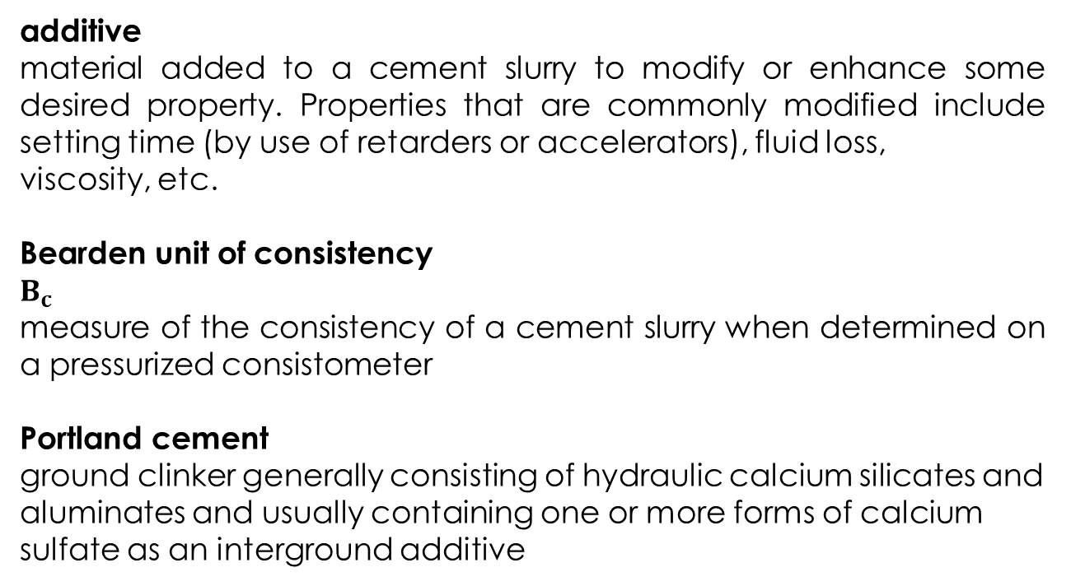
Nomenclature
additive
material added to a cement slurry to modify or enhance some desired property. Properties that are commonly modified include setting time (by use of retarders or accelerators), fluid loss,
viscosity, etc.
Bearden unit of consistency
$$B_{c}$$
measure of the consistency of a cement slurry when determined on a pressurized consistometer
Portland cement
ground clinker generally consisting of hydraulic calcium silicates and aluminates and usually containing one or more forms of calcium sulfate as an interground additive

Slide 62
Nomenclature
cement class
designation achieved under the ISO system for classification of well cement according to its intended use
cement grade
designation achieved under the ISO system for denoting the sulfate resistance of a particular cement
cement blend
mixture of dry cement and other dry materials
clinker
fused materials produced in the kiln during cement manufacturing that are interground with calcium sulfate to
make cement

Slide 63
Nomenclature
compressive strength
force per unit area required to cause a set cement sample to fail under compression
filtrate
liquid that is forced out of a cement slurry during a fluid loss test
thickening time
time after which the consistency of a cement slurry has become so high that the slurry is considered unpumpable.

