Slide 1
Final Assignment. Team 19. BUS WEB & SOC MED METR & ANALY By: Aseel, Jalal

Slide 2

Presentation Outline
Background Introduction
Data Mining Methodology.
Customer Segmentation
Predictive Model using Logistic Regression
Conclusion

Slide 3

Background
Introduction: CRISA is an Asian market research agency that specializes in tracking consumer purchase behavior in consumer goods.
Business Opportunity: A firm called IMRB requires CRISA expertise to design cost-effective promotions targeted at appropriate segments.
Business Solution : By appropriately segmenting the customers, multiple promotions could be launched, each targeted at different market segments at different times of the year.
Solution Benefit: This would result in a more cost-effective allocation of the promotion budget to different market segments.

Slide 4
Data Mining Framework
Data Cleaning – Look out for anomalies in the data and correct them.
Variable Reduction -Merge closely related categories values. -Remove variables with low variance. -Remove correlated values.
Data Exploration (Visualization – observe patterns in the data).
Customer Segmentation using clustering algorithm.
Analyse distinct persona of various segments.
Use the segmented data to train predictive classification model.

Slide 5
Data Cleaning
Look at meta-data file to understand the range of plausible values for various variables. If there is any out-of-bound or missing value, then we replace it with a valid median value.
For example the valid values for the variable CS which means Television availability are: 1 = available, and 2 = unavailable. Based on this if we encounter any value which is not 1 or 2 then it is replaced with the median value.

Slide 6
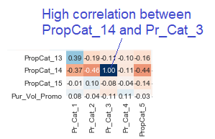
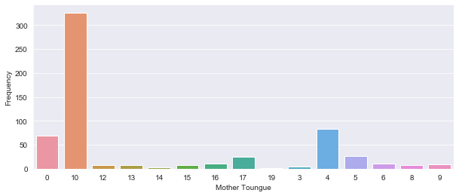
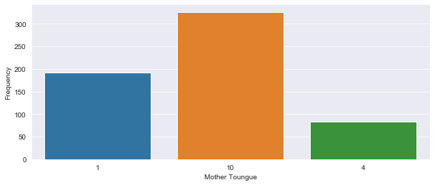
Variable Reduction
Vegetarian
merge
Vegetarian
Vegetarian,
eat eggs.

Slide 7
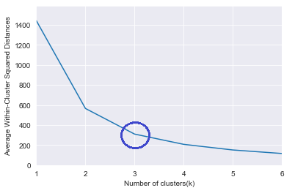
Customer Segmentation – KNN clustering
M
I
N
I
M
I
Z
E
M
I
N
I
M
I
Z
E
Maximize
To perform customer segmentation we run KNN clustering algorithm. KNN minimizes the “distances” between all records within the cluster, while maximizing the distance between various clusters.
A suitable value for the number of clusters k is obtained by plotting the elbow chart and choosing the number of clusters when the curve starts bending “near straight”. For the given data set this happens when k=3.

Slide 8


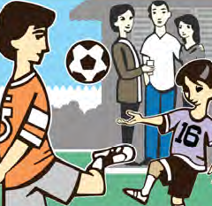
Segments Persona. Cluster 0 and 1 have lower values for Promotional Purchase – indicating lack of value consciousness
Urban Digerati (Cluster 0)
Secondary school/ college Educated.
Low affluence.
Purchases most of its item in Price Category 4, 13.
Eating Habit not well understood.
Speaks Mother Tongue 1
Emptying Nest (Cluster 1)
High Socio-economic class
Senior citizen
Highly Affluent
Loyal Customers
Purchases Brand 272, 57, 144, 352.
Product Proposition 7.
Highly Value Conscious
Mostly vegetarian
Heritage Hub (Cluster 2)
Low Socio-economic status
Senior citizen
Bigger family size
Purchase most of its items in Proposition wise 6, 11
Non Vegetarian
Mostly speak Mother Tongue 10

Slide 9

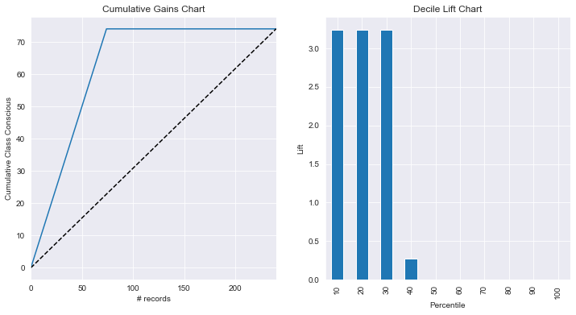
Targeted Promotion Marketing (Validation Data). There are 75 value conscious customer, and 240 total customers.
 | Random Decision | Predictive Model
Cost | 240x5= $ 1200 | 74x5= $ 370
Profit | 75x250= $ 18750 | 74x250= $ 18500
Net profit | $ 17550 | $ 18130

Slide 10

Questions

