Slide 1
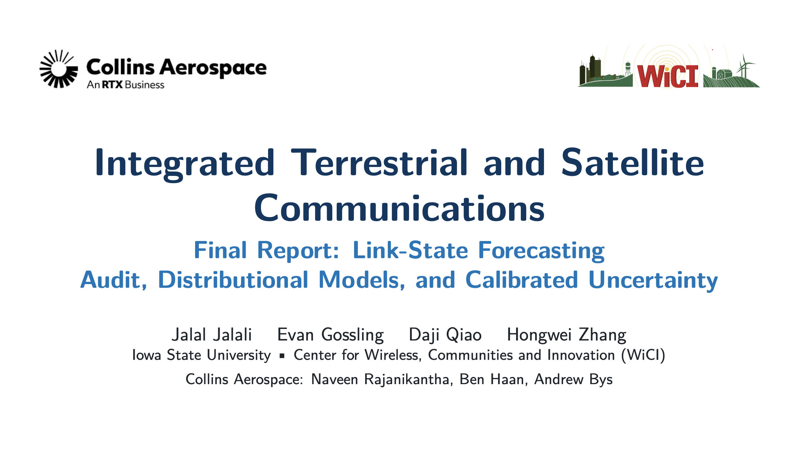
Notes:
Title (target 0:30)
SAY: Introduce the team and the Collins collaborators. Final is about making the link forecasts trustworthy enough for the multipath scheduler.

Slide 2
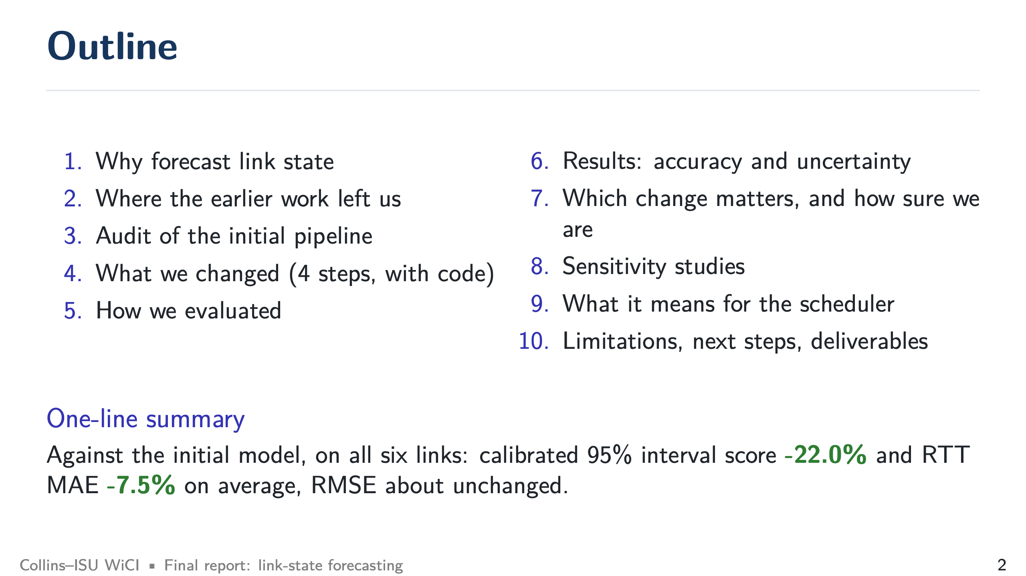
Notes:
Outline (target 0:45)
SAY: Read the one-line summary at the bottom. Tell the audience that you will show where every gain comes from and also where the model did not improve.

Slide 3
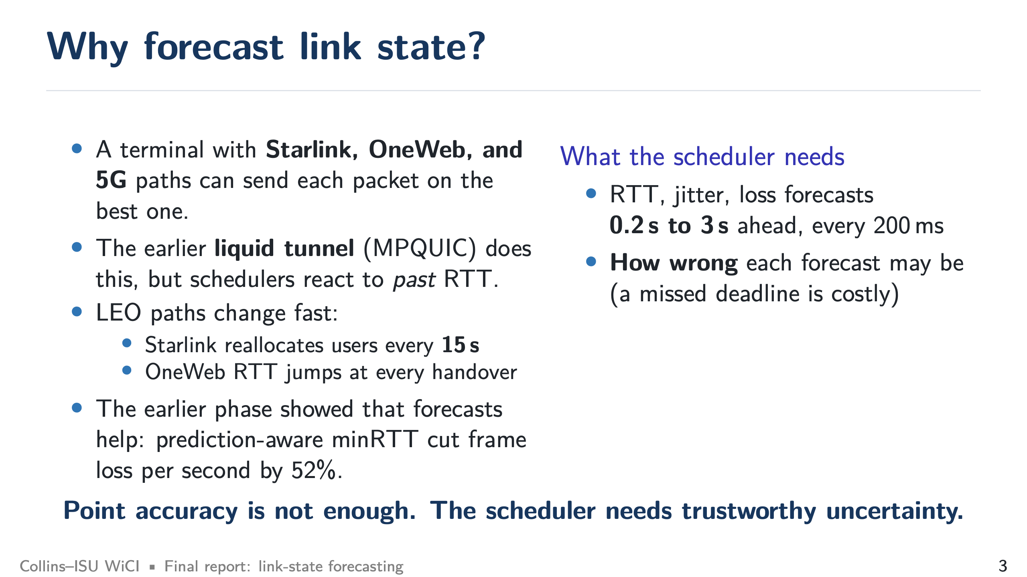
Notes:
Why forecast link state? (target 1:00)
SAY: A terminal with Starlink, OneWeb, and 5G can pick a path per packet. Schedulers today react to past RTT, which is too slow on LEO links (Starlink reallocates every 15 s, OneWeb jumps at handovers). The earlier phase already showed forecasts help (52% less frame loss per second with prediction-aware minRTT). What is missing is knowing how wrong a forecast may be.

Slide 4
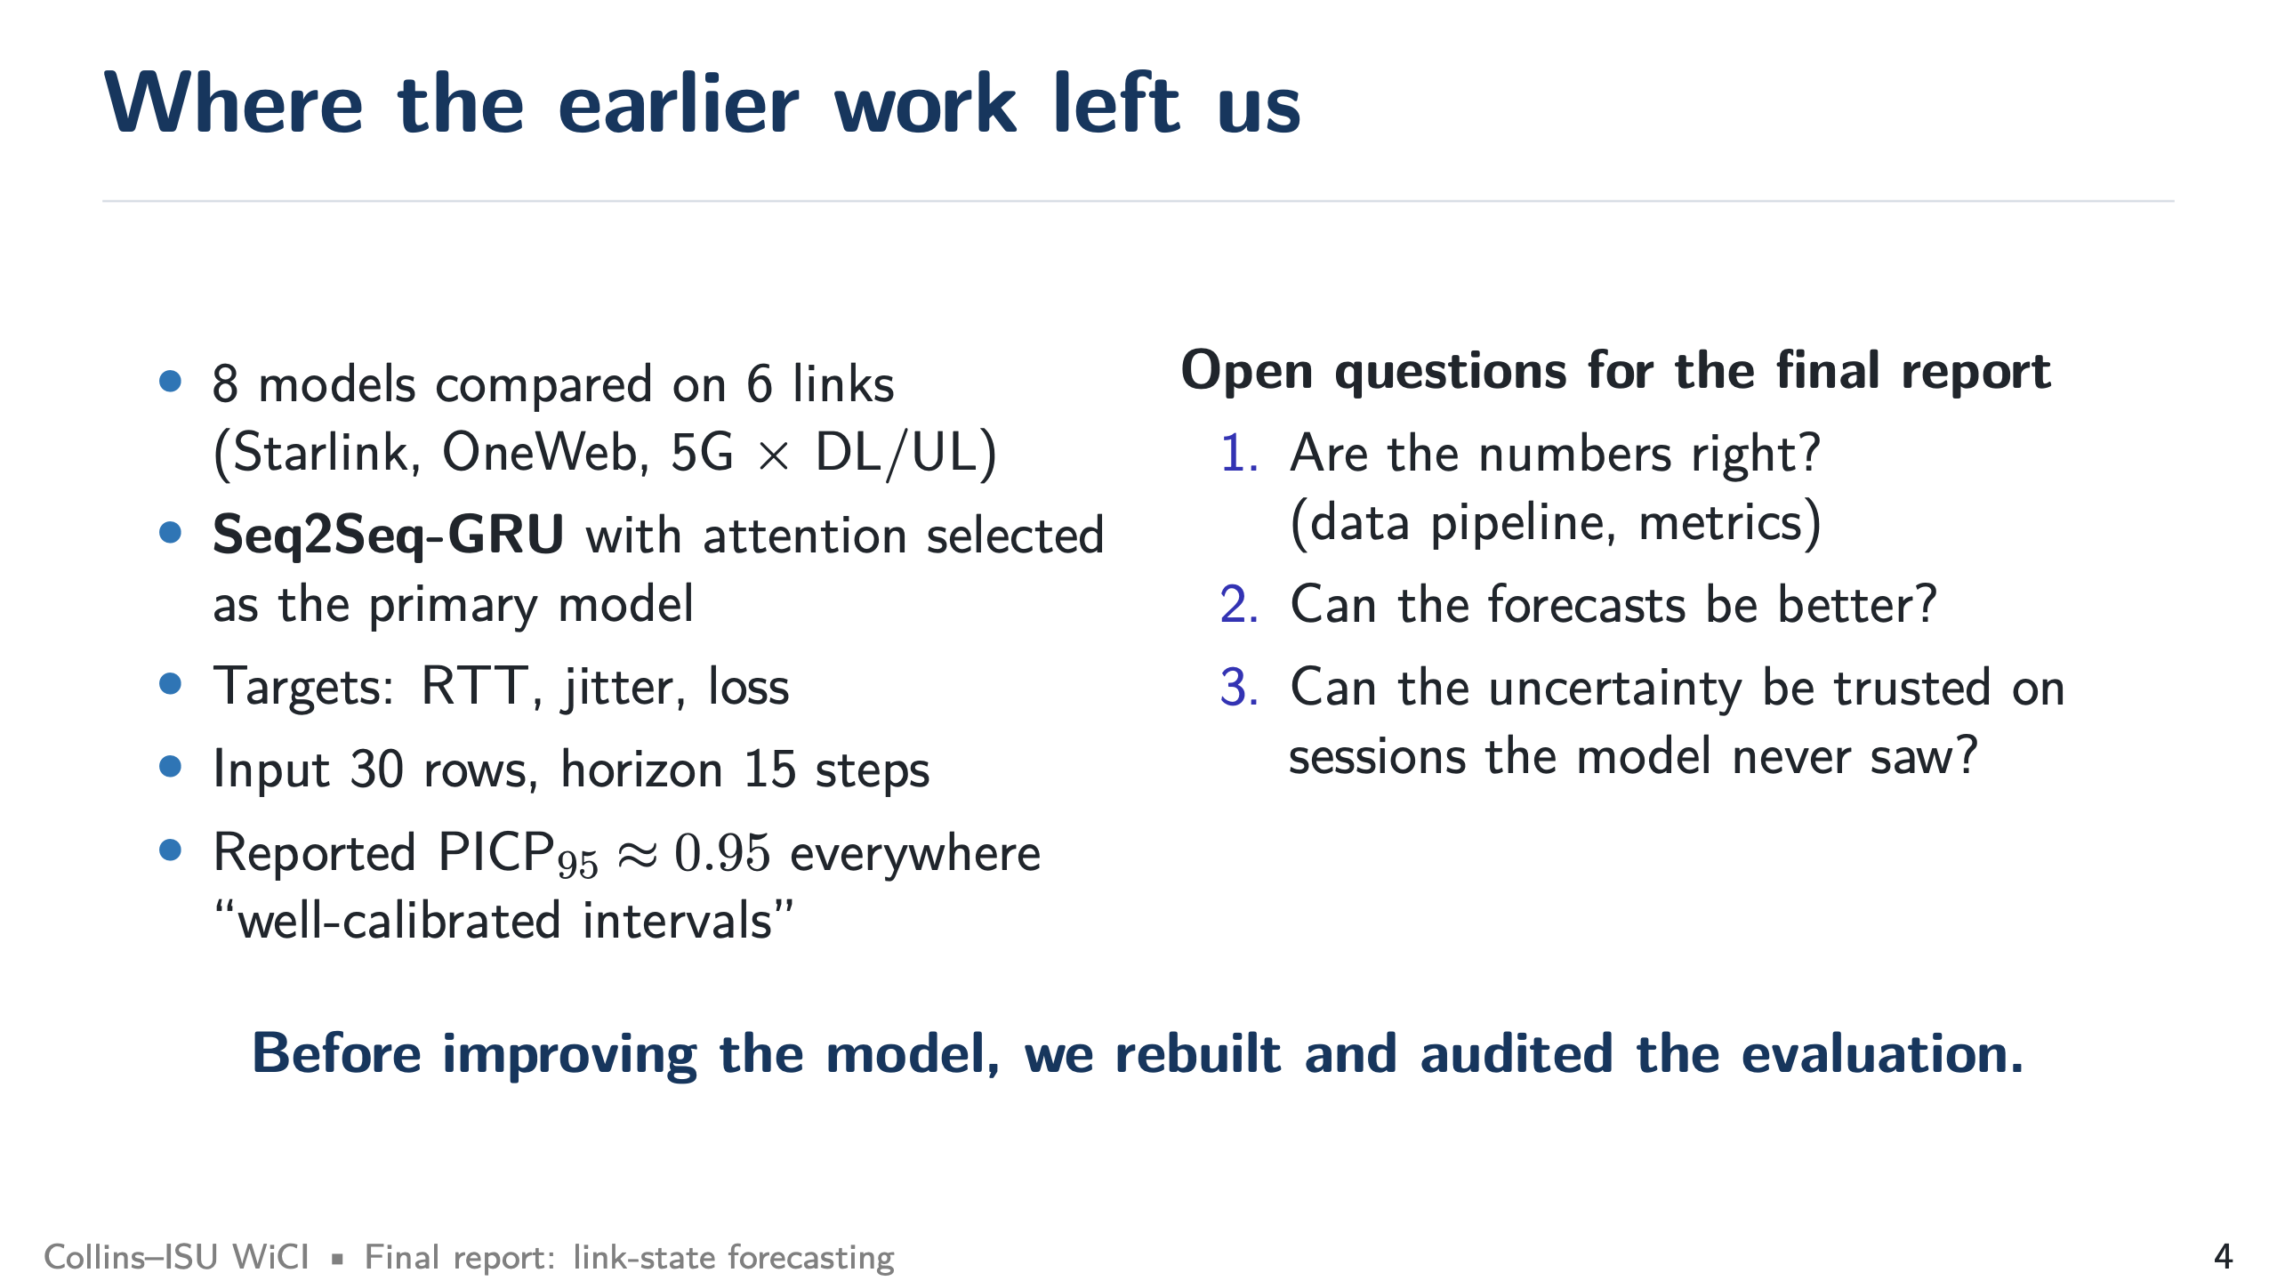
Notes:
Where the earlier work left us (target 0:45)
SAY: the initial study compared eight models and picked Seq2Seq-GRU. It reported coverage of 0.95 everywhere. Our first job was to check those numbers before improving anything.

Slide 5
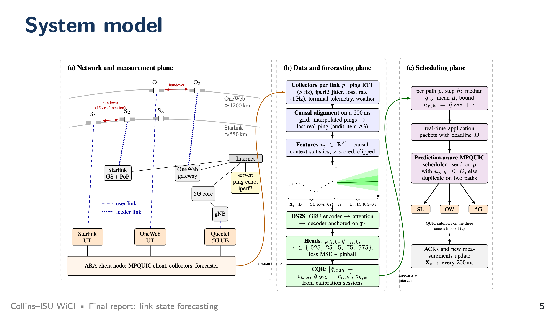
Notes:
System model (target 1:15)
SAY: Walk left to right. (a) Three access links from the ARA client to a measurement server. Point to the two satellite shells and the handovers. (b) Our pipeline: collectors, causal alignment on a 200 ms grid, a 6 s window, the forecaster, its quantiles, and calibration. (c) The scheduler uses the per-path forecasts and upper bounds, and new measurements arrive every 200 ms.
IF ASKED: Is this deployed? The forecaster runs offline on recorded data. The initial liquid tunnel has the integration hook. The end-to-end test is the next step (slide 29).

Slide 6
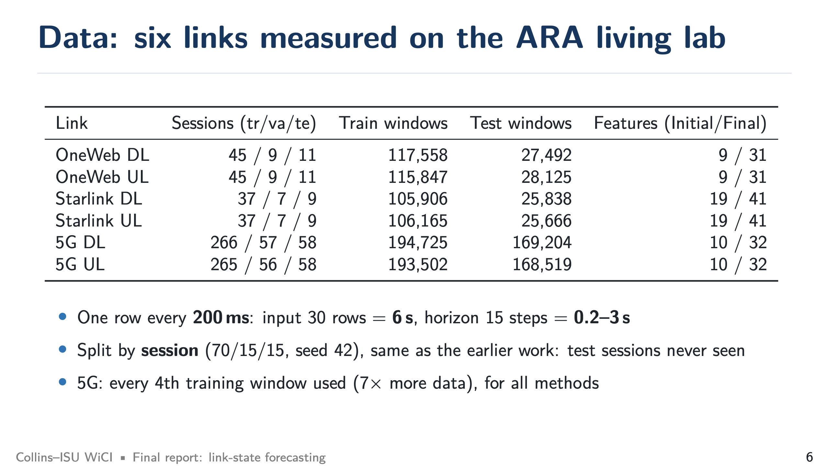
Notes:
Data (target 0:45)
SAY: Six links, sessions split by session so test sessions are never seen. Stress the time units: 30 rows is 6 s of history, 15 steps is 0.2–3 s ahead. The 5G sets are 7 times larger, so we used every fourth training window for every method.

Slide 7
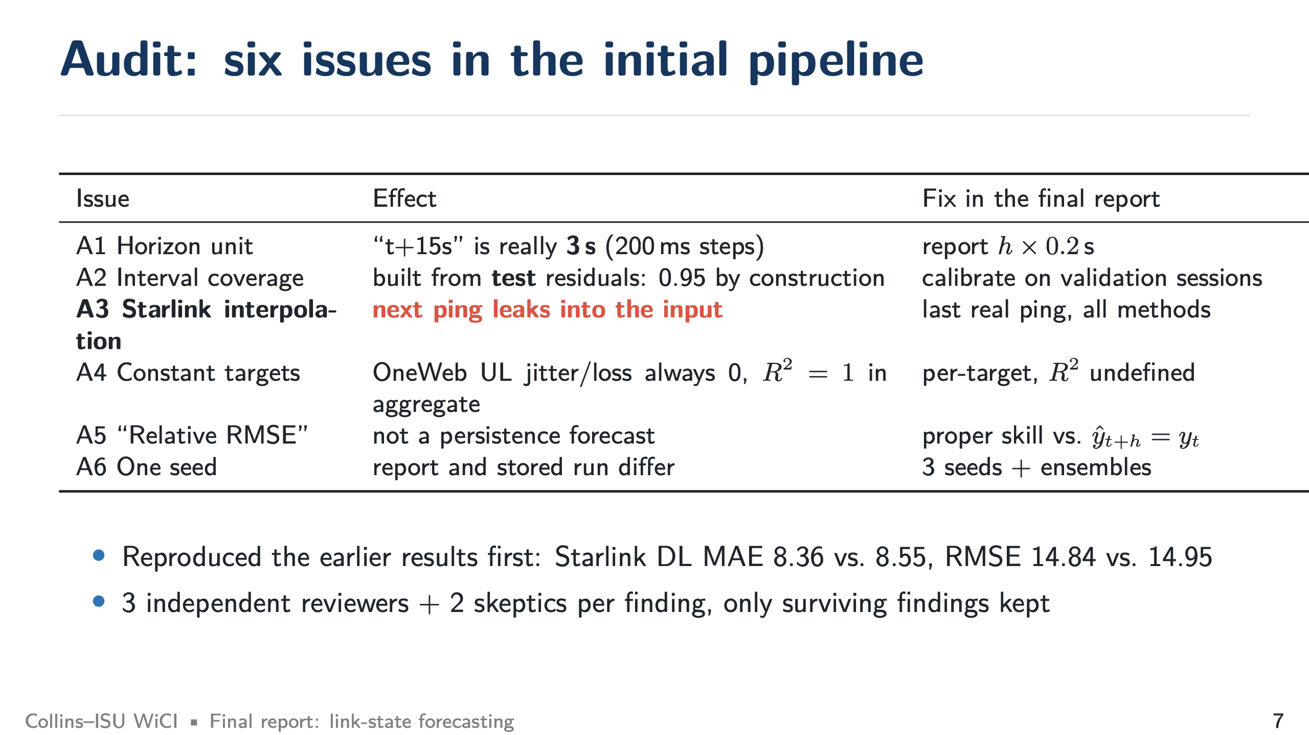
Notes:
Audit: six issues (target 1:15)
SAY: Before changing the model we reproduced initial (Starlink DL MAE 8.36 vs. 8.55 reported) and then audited it. Three reviewers checked independently and two more tried to refute each finding. The six surviving issues are on the slide. The two that change how the initial study should be read are A2 (coverage computed from test residuals) and A3 (the Starlink leak).
IF ASKED: Does this invalidate the initial study? No. The ranking of models does not change. The absolute Starlink RTT numbers were a few percent optimistic, and the 0.95 coverage was not evidence of calibration.

Slide 8
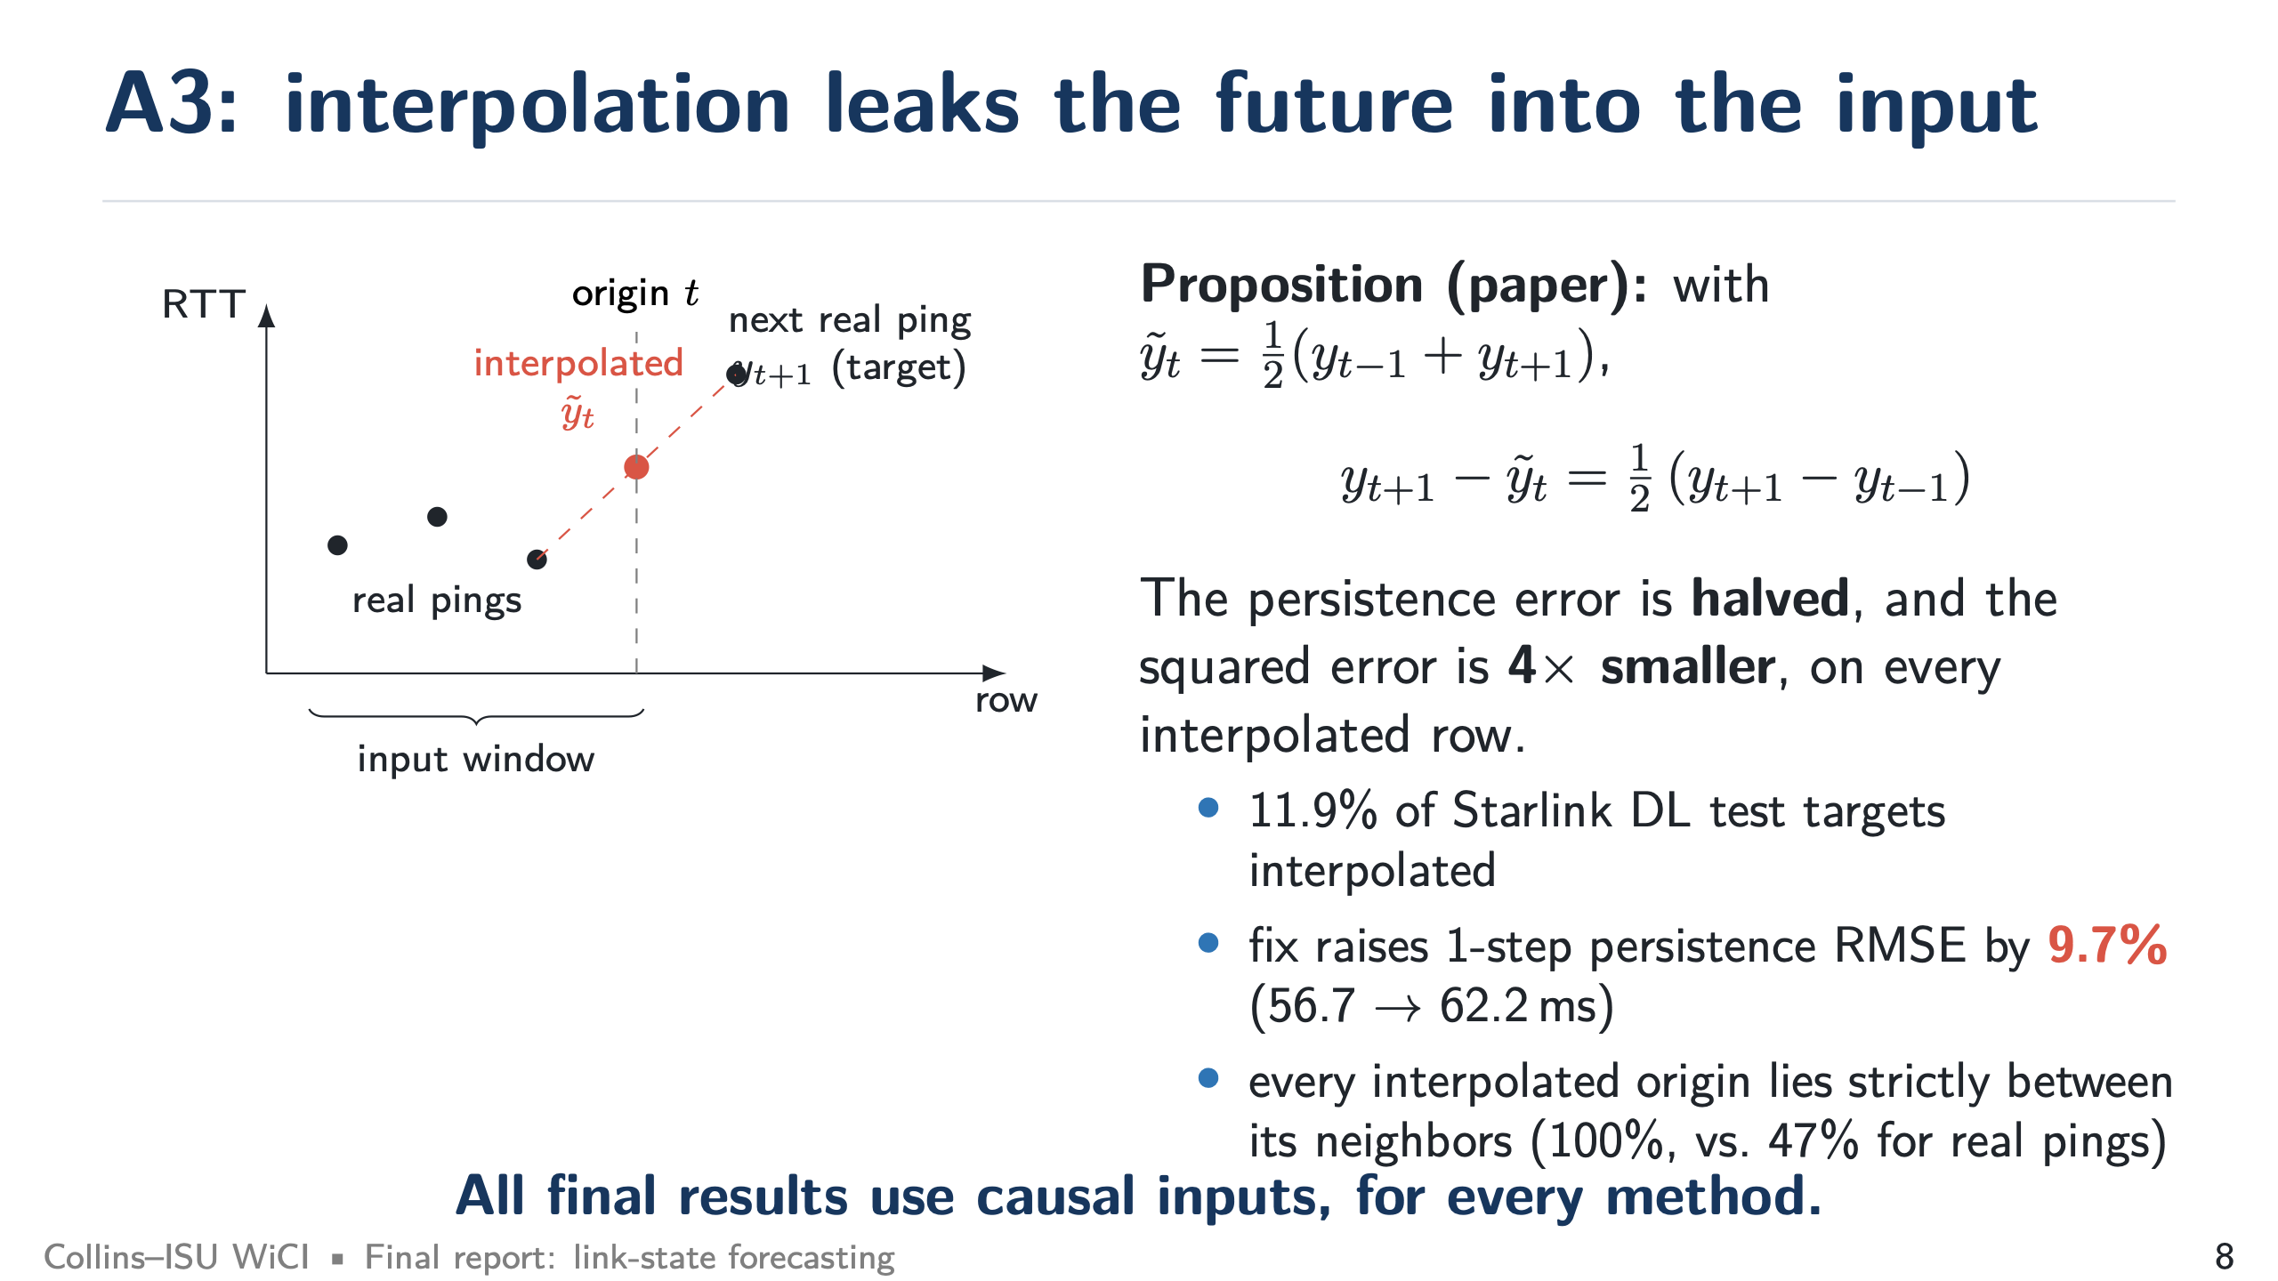
Notes:
A3: interpolation leak (target 1:30)
SAY: When a ping is missing, the parser fills it by drawing a line to the next real ping. The model's last input then already contains half of the answer. For persistence this exactly halves the error on those rows, a 4× smaller squared error. 11.9% of Starlink DL targets are interpolated, and fixing it raises the one-step persistence RMSE by 9.7%.
IF ASKED: Why did the parser do this? It is a common way to merge collectors with different clocks. It is fine for plotting, wrong for forecasting. Other links? OneWeb and 5G have no interpolated values.

Slide 9
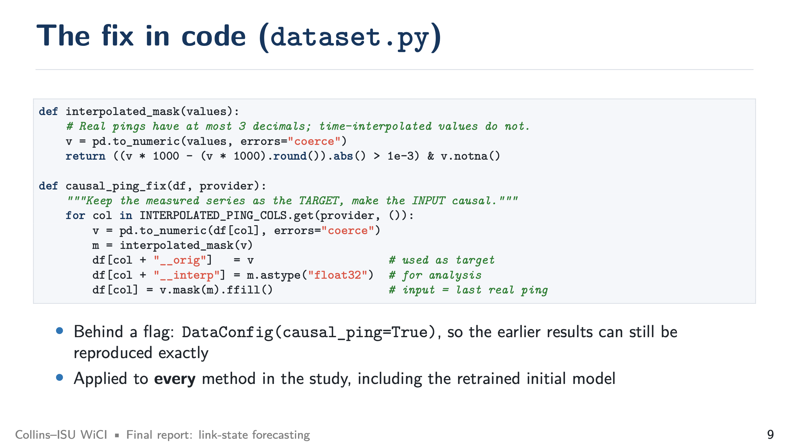
Notes:
The fix in code (target 0:45)
SAY: Real pings have at most three decimals, interpolated values do not, so they are easy to detect. The input takes the last real ping, and the target keeps the measured value. It is a flag, so the earlier results can still be reproduced exactly, and we applied it to every method.

Slide 10
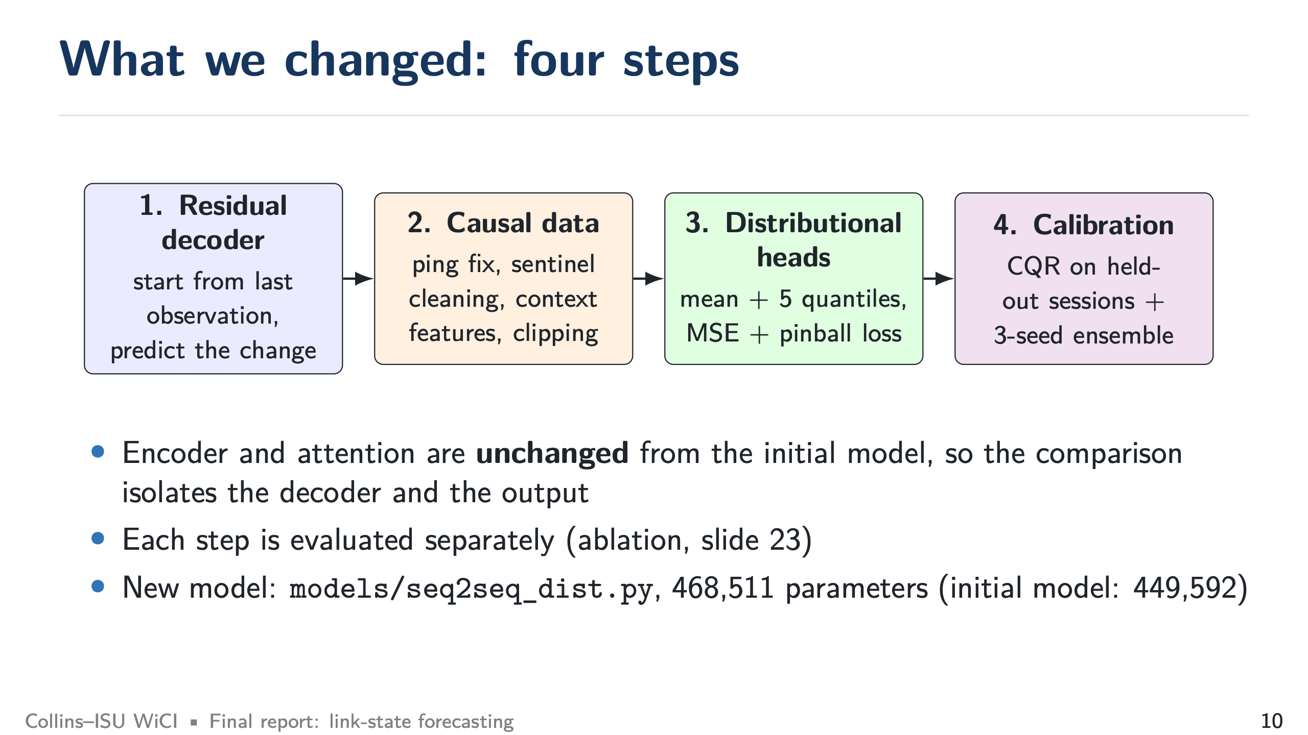
Notes:
Four steps (target 0:45)
SAY: Overview of what changed. Emphasize that the encoder and attention are identical to the initial model, so any gain comes from the decoder and the output.

Slide 11
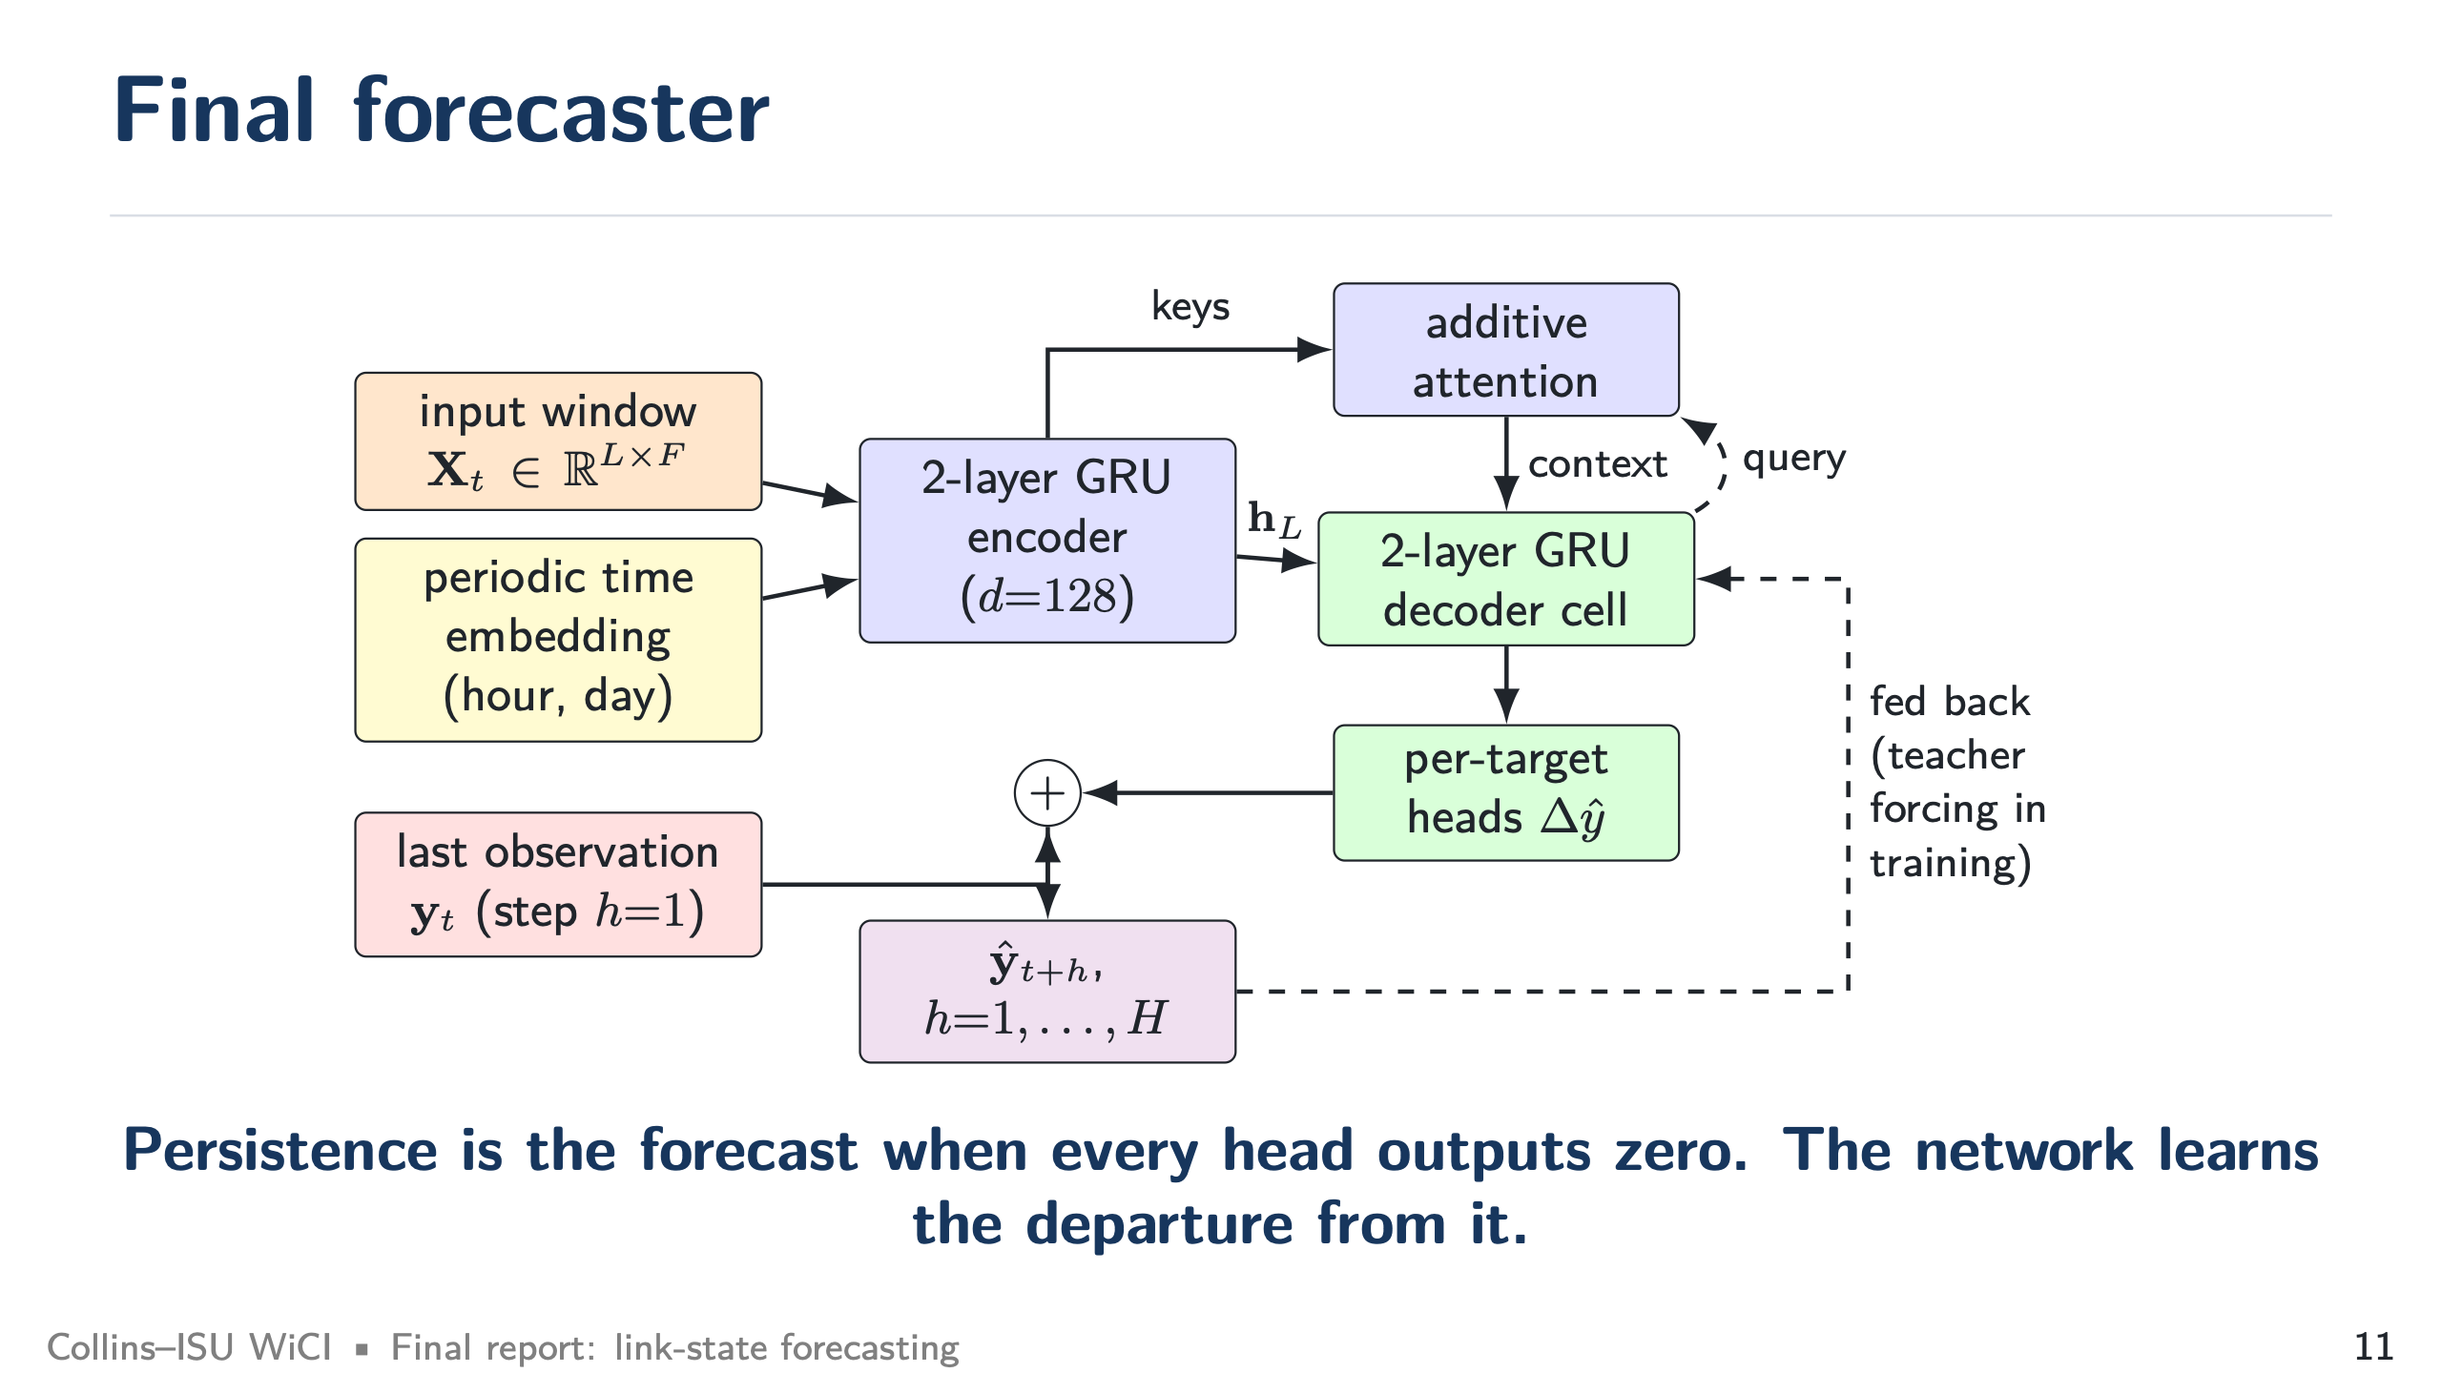
Notes:
final forecaster (target 0:45)
SAY: The decoder starts from the last observation and predicts changes. If the heads output zero, the model is just persistence. Each head now outputs a distribution.

Slide 12
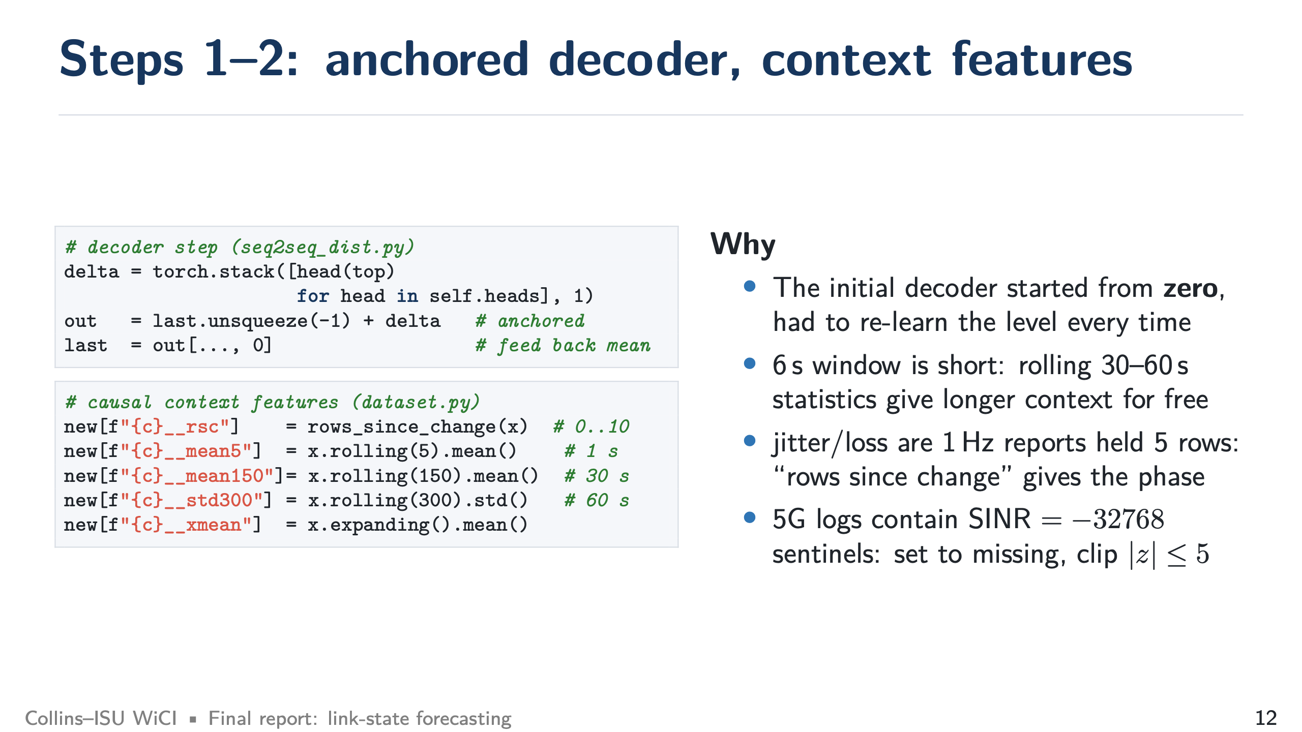
Notes:
Steps 1–2 in code (target 1:00)
SAY: Step 1: the initial decoder started from zero every time. Step 2: the window is only 6 s, so we add rolling 1 s, 30 s, and 60 s statistics, and the "rows since change" feature that tells the model where it is inside the one-second iperf report. We also removed logger sentinels like SINR =-32768.

Slide 13
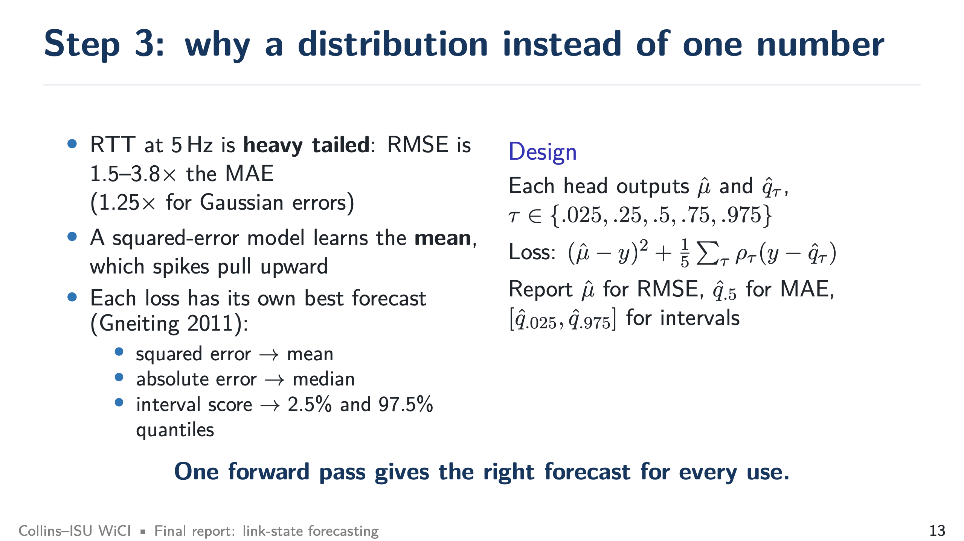
Notes:
Why a distribution (target 1:30)
SAY: This is the key idea. RTT at 5 Hz is heavy tailed: RMSE is 1.5–3.8 times the MAE (Gaussian would be 1.25). A squared-error model learns the mean, which spikes pull up. Each way of scoring has its own best forecast: the mean for squared error, the median for absolute error, quantiles for intervals. So we predict all of them in one pass.
IF ASKED: Isn't reporting the median for MAE cherry-picking? No, it is the standard result (Gneiting, 2011). We report the mean for RMSE and R^2, and both outputs come from the same model. We say which output is used for each metric.

Slide 14
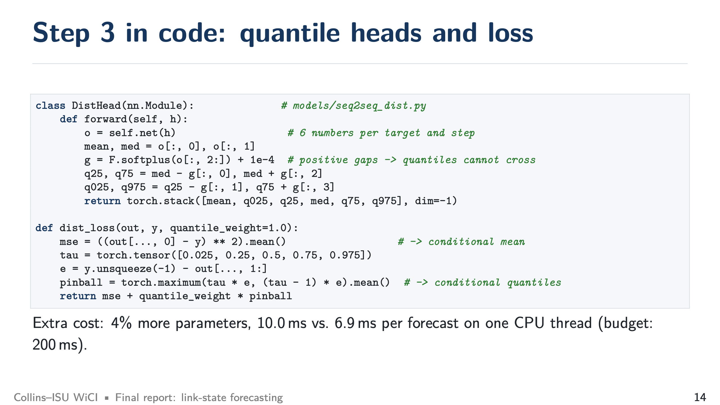
Notes:
Step 3 in code (target 1:00)
SAY: Each head outputs six numbers. The quantiles are the median plus or minus positive gaps (softplus), so they can never cross. The loss is squared error for the mean plus the pinball loss for the quantiles. The cost is 4% more parameters and 10.0 ms per forecast on one CPU thread, well within the 200 ms budget.

Slide 15
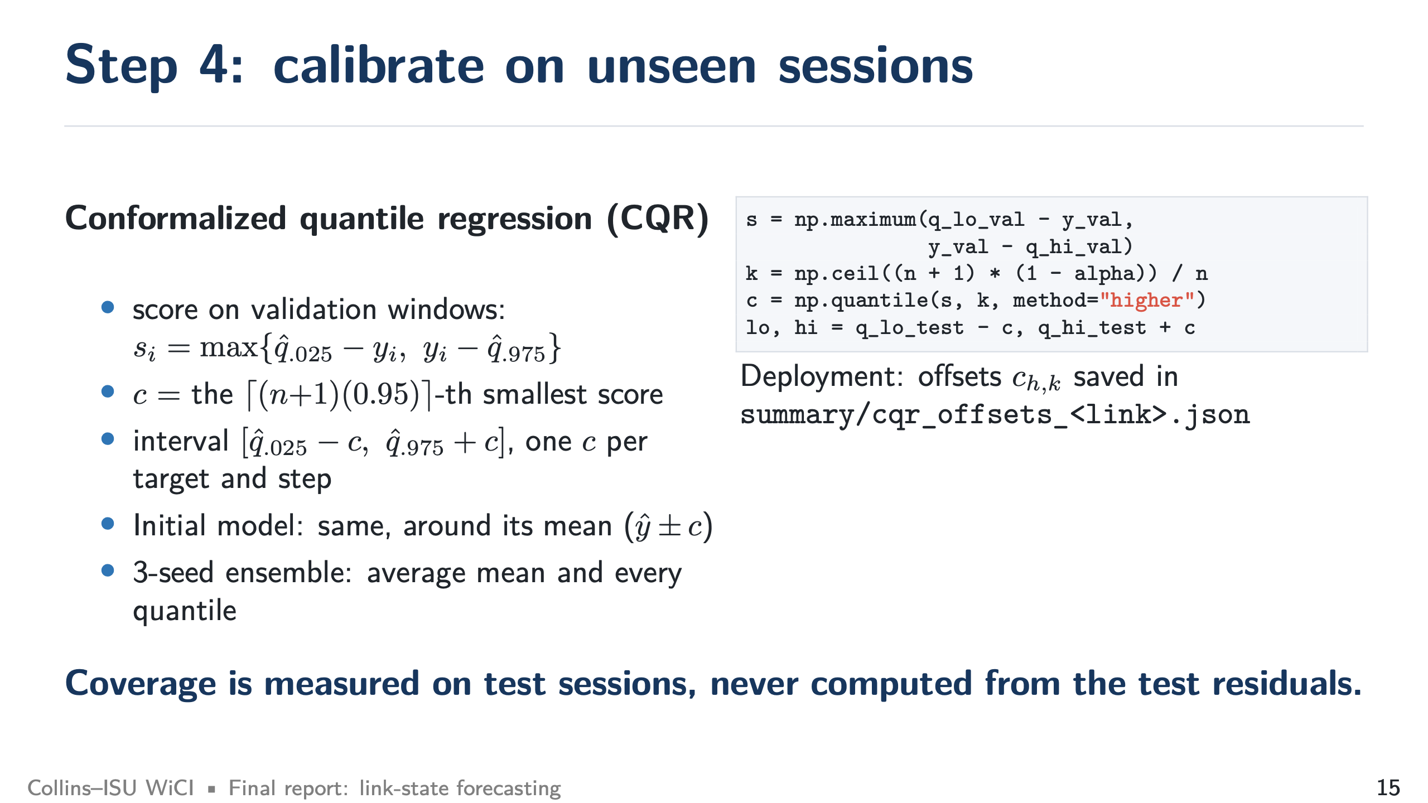
Notes:
Step 4: calibration (target 1:00)
SAY: Learned quantiles may not cover new sessions. We use conformalized quantile regression: measure how far the validation targets fall outside the quantiles, take the 95th-percentile miss as a correction c, and widen the interval by c. The initial model gets the same treatment around its mean, so both are compared fairly. The offsets are saved for deployment.
IF ASKED: Is coverage guaranteed? Only if validation and test sessions are exchangeable, which is approximately true. That is why we report the coverage we measured on test sessions (0.935–0.954).

Slide 16
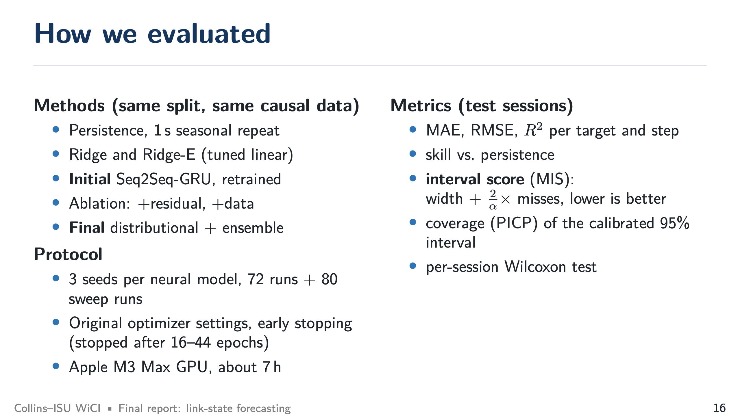
Notes:
How we evaluated (target 0:45)
SAY: Same split and same causal data for every method, four simple references, three seeds for every neural model, 72 main runs plus 80 sensitivity runs. Main metrics: MAE, RMSE, interval score, coverage, and a per-session significance test.

Slide 17
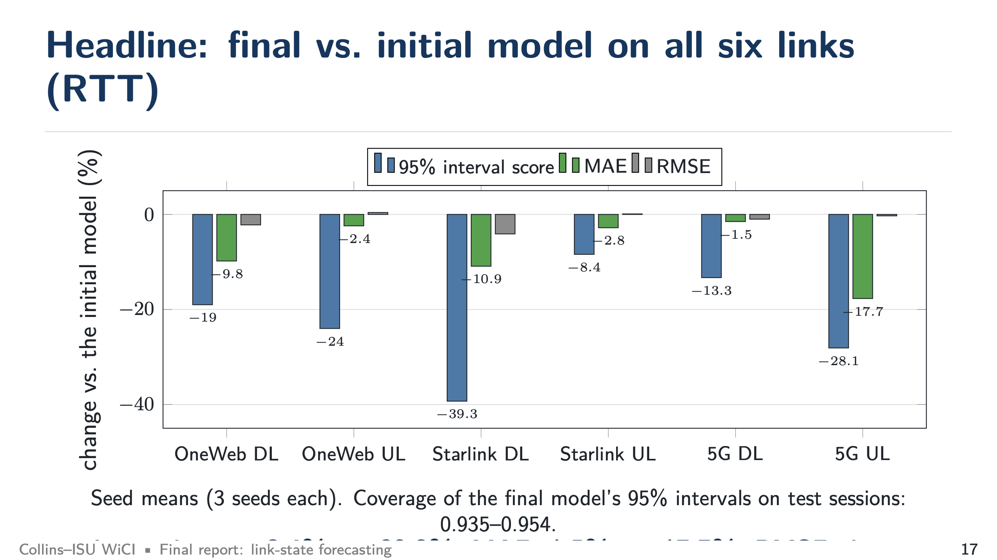
Notes:
Headline (target 1:30)
SAY: Blue bars are the interval score: -8.4% to -39.3% better on all six links. Green is MAE: -1.5% to -17.7% lower on all six. Grey is RMSE: basically unchanged. Be explicit that we did not improve squared error.
KEY NUMBERS: Largest gains: Starlink DL (MIS -39.3%, MAE -10.9%), 5G UL (MIS -28.1%, MAE -17.7%).

Slide 18
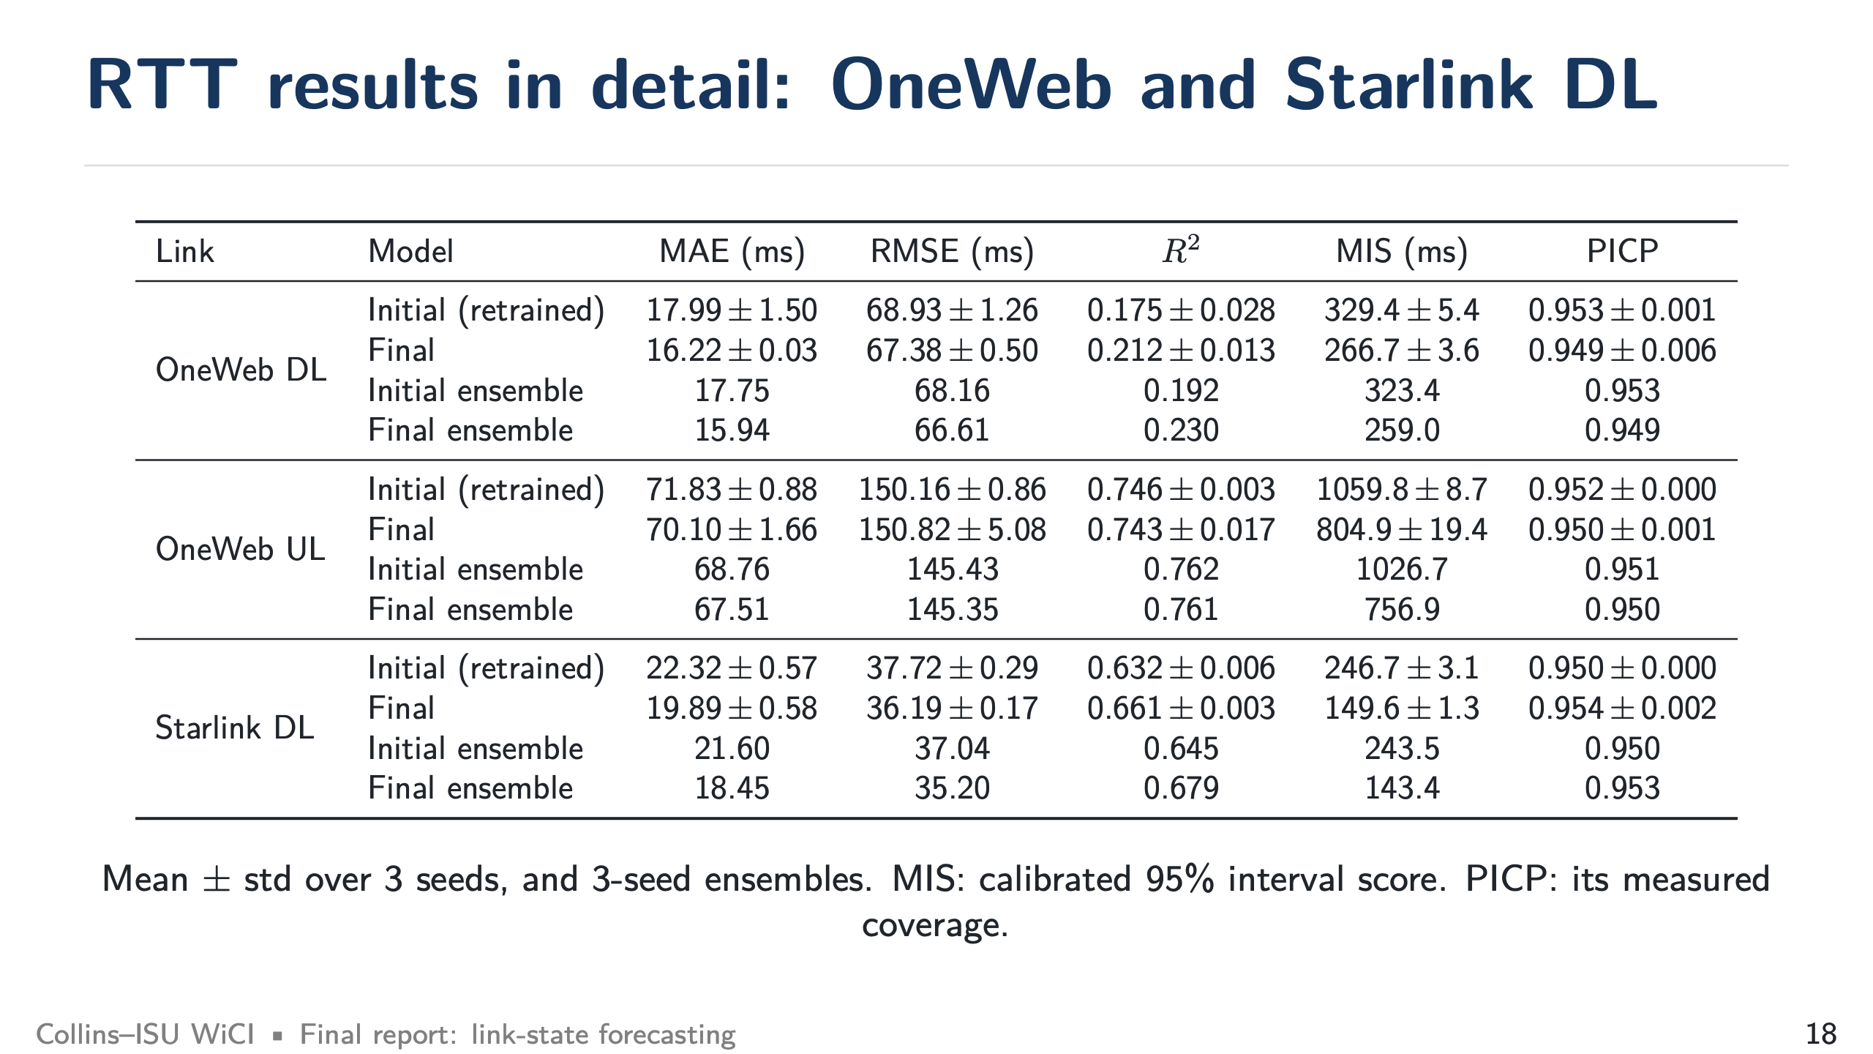
Notes:
Detail tables (target 1:00 total)
SAY: Point to one row only, for example Starlink DL: MAE 22.3 → 19.9 (single models) and 21.6 → 18.5 (ensembles), interval score 247 → 150, coverage stays at 0.95. Skip the rest unless asked.

Slide 19
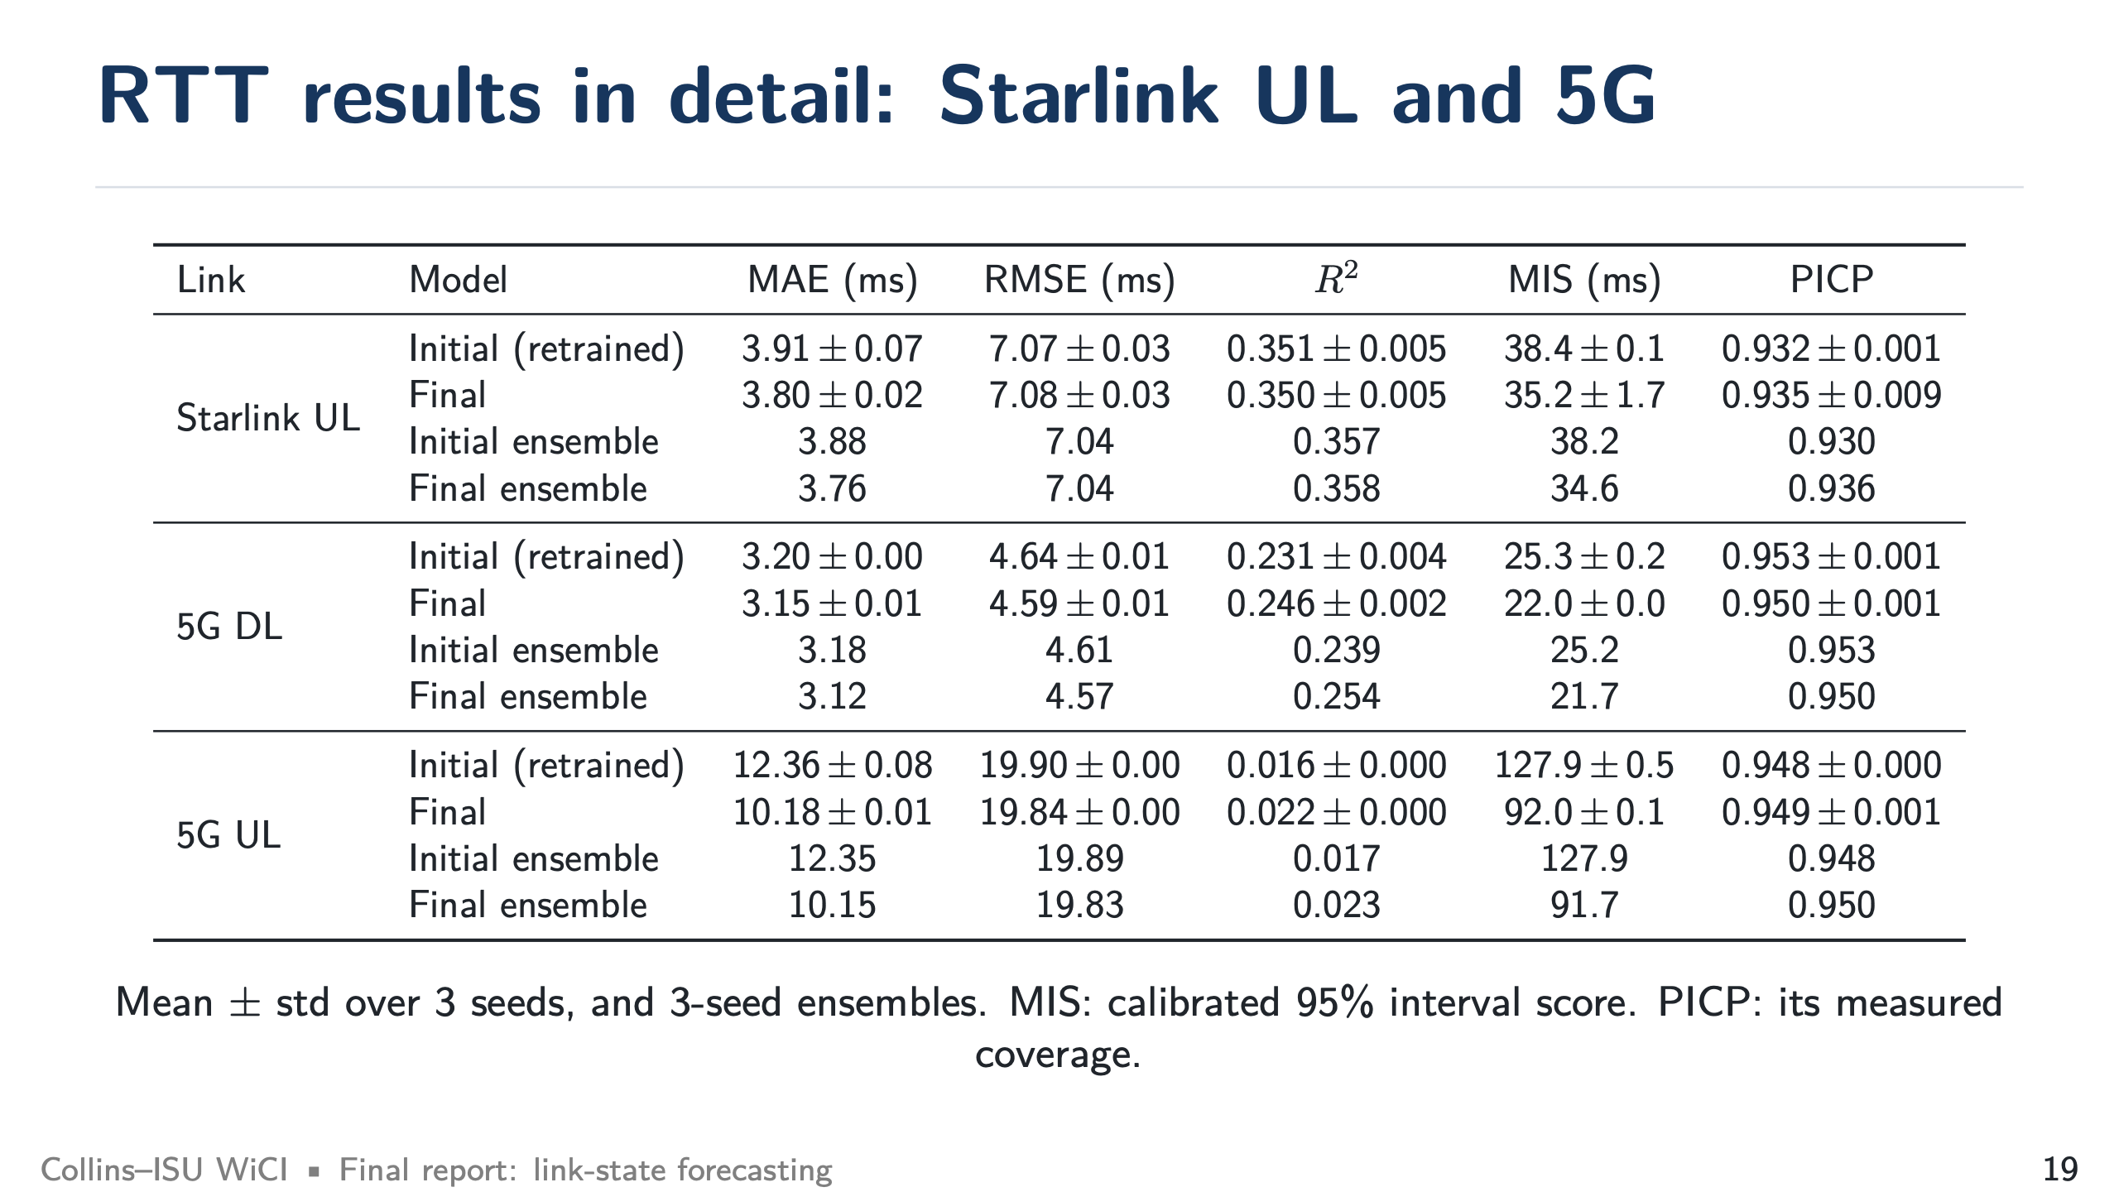
Notes:
Detail tables (target 1:00 total)
SAY: Point to one row only, for example Starlink DL: MAE 22.3 → 19.9 (single models) and 21.6 → 18.5 (ensembles), interval score 247 → 150, coverage stays at 0.95. Skip the rest unless asked.

Slide 20
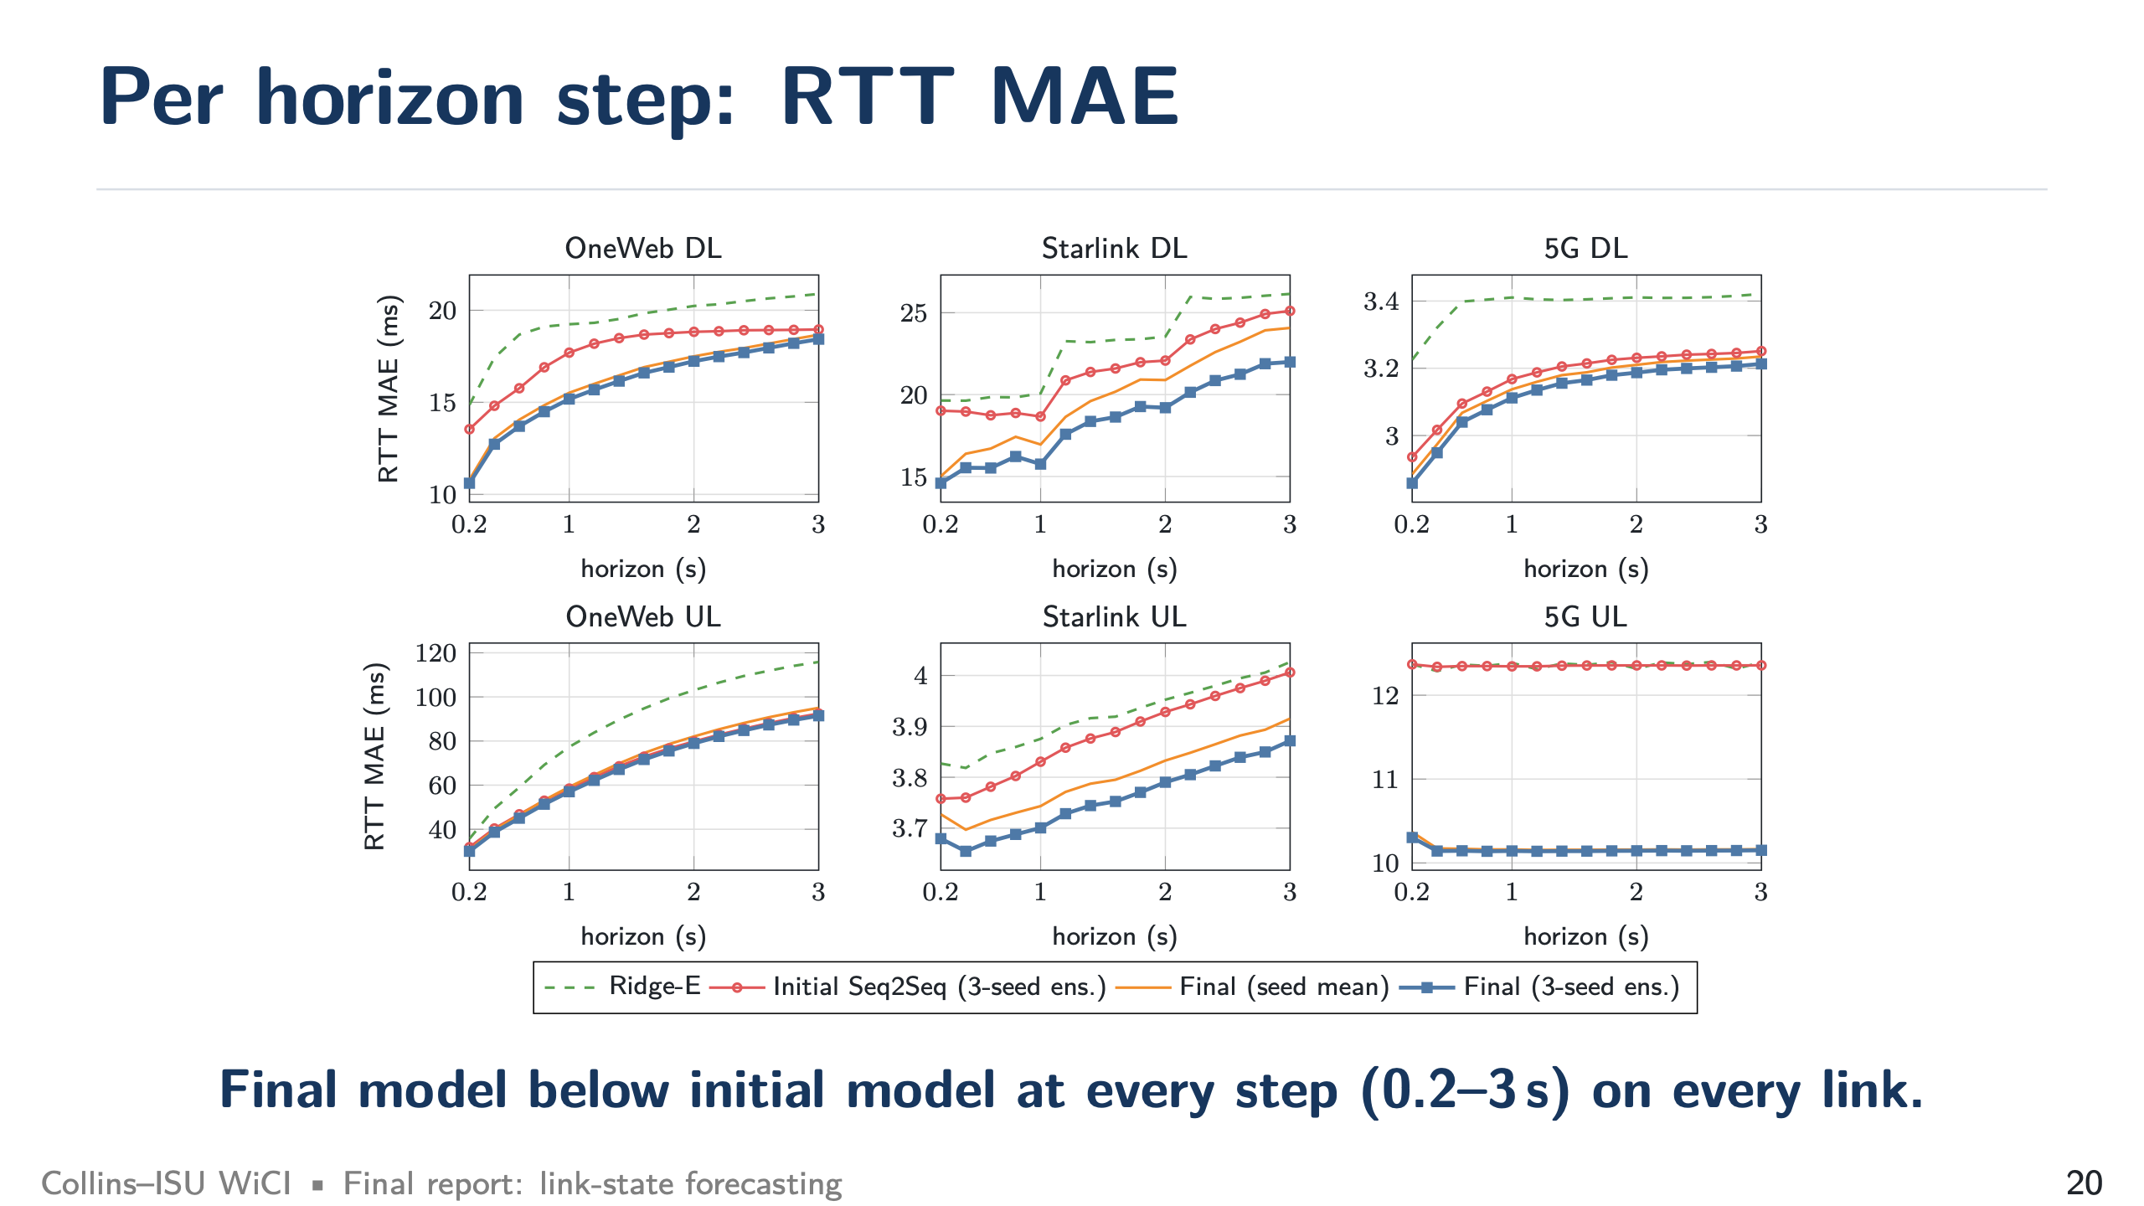
Notes:
Per horizon step (target 1:00 total)
SAY: The final curve is below initial at every step on every link, for both MAE and interval score. Errors grow with the horizon as expected.

Slide 21
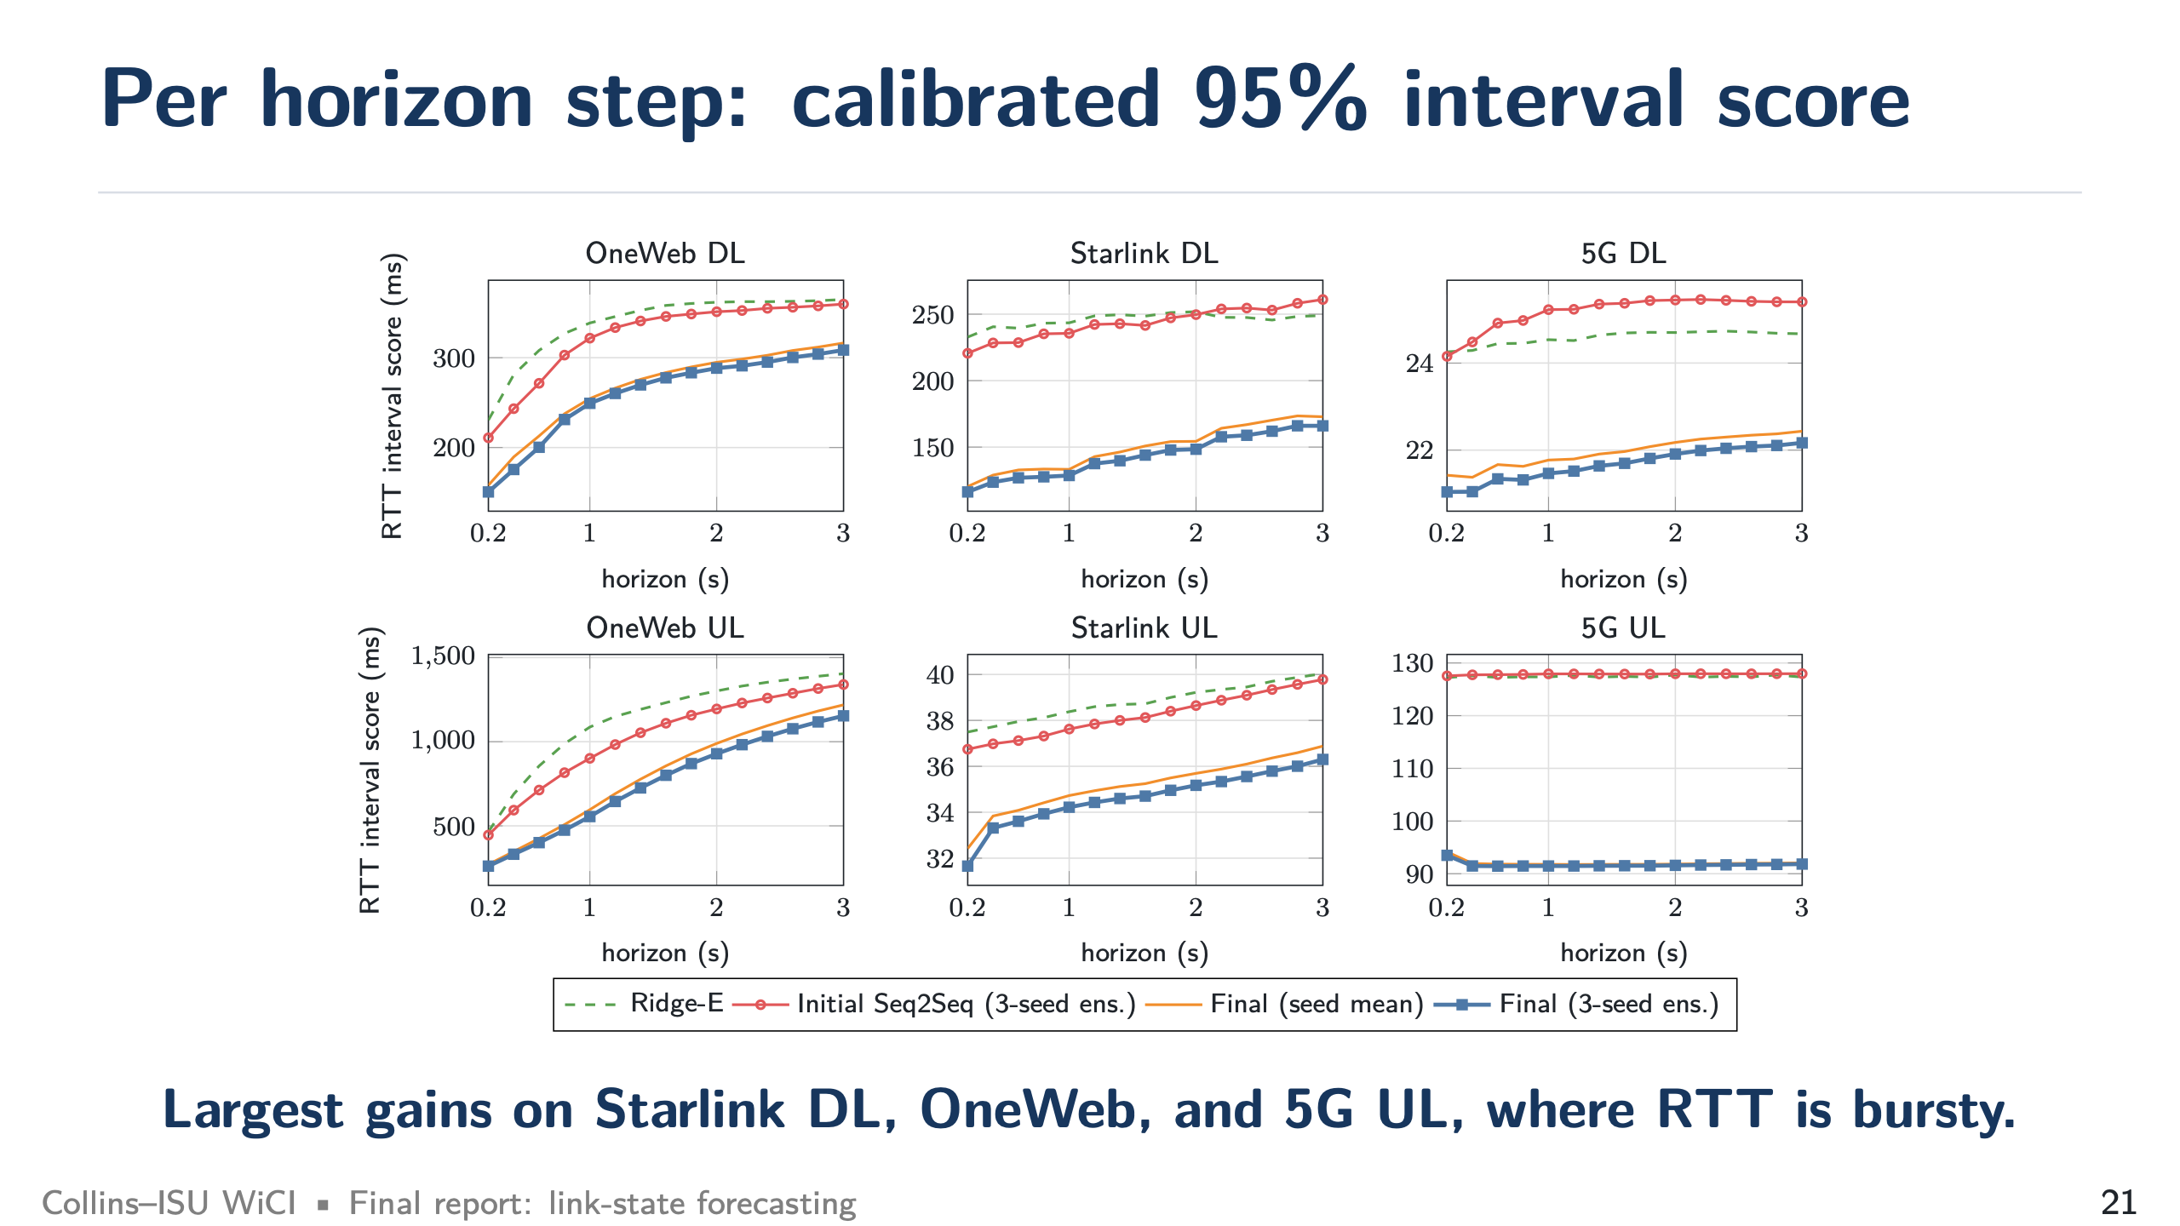
Notes:
Per horizon step (target 1:00 total)
SAY: The final curve is below initial at every step on every link, for both MAE and interval score. Errors grow with the horizon as expected.

Slide 22
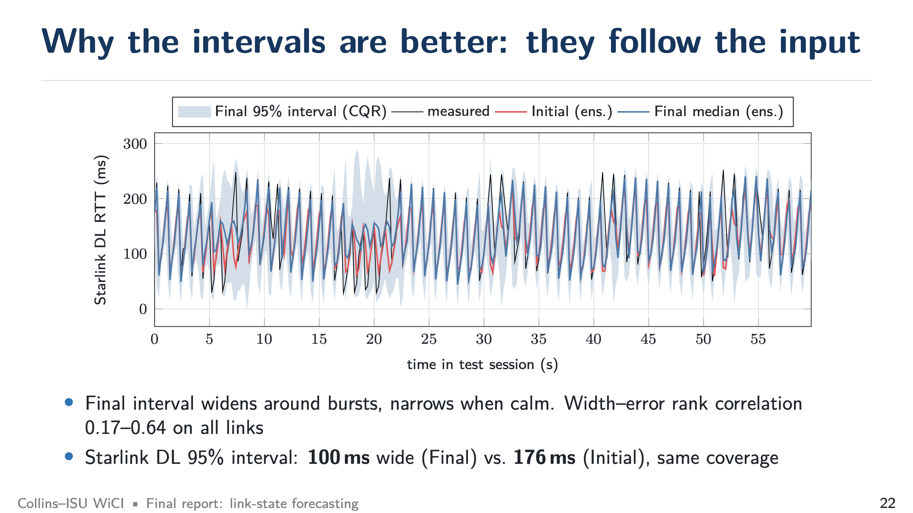
Notes:
Intervals follow the input (target 1:15)
SAY: This is the picture to remember. The blue band widens around bursts and narrows when the link is calm. A constant-width interval must be wide all the time. On Starlink DL the 95% interval is 100 ms wide instead of 176 ms at the same coverage.

Slide 23
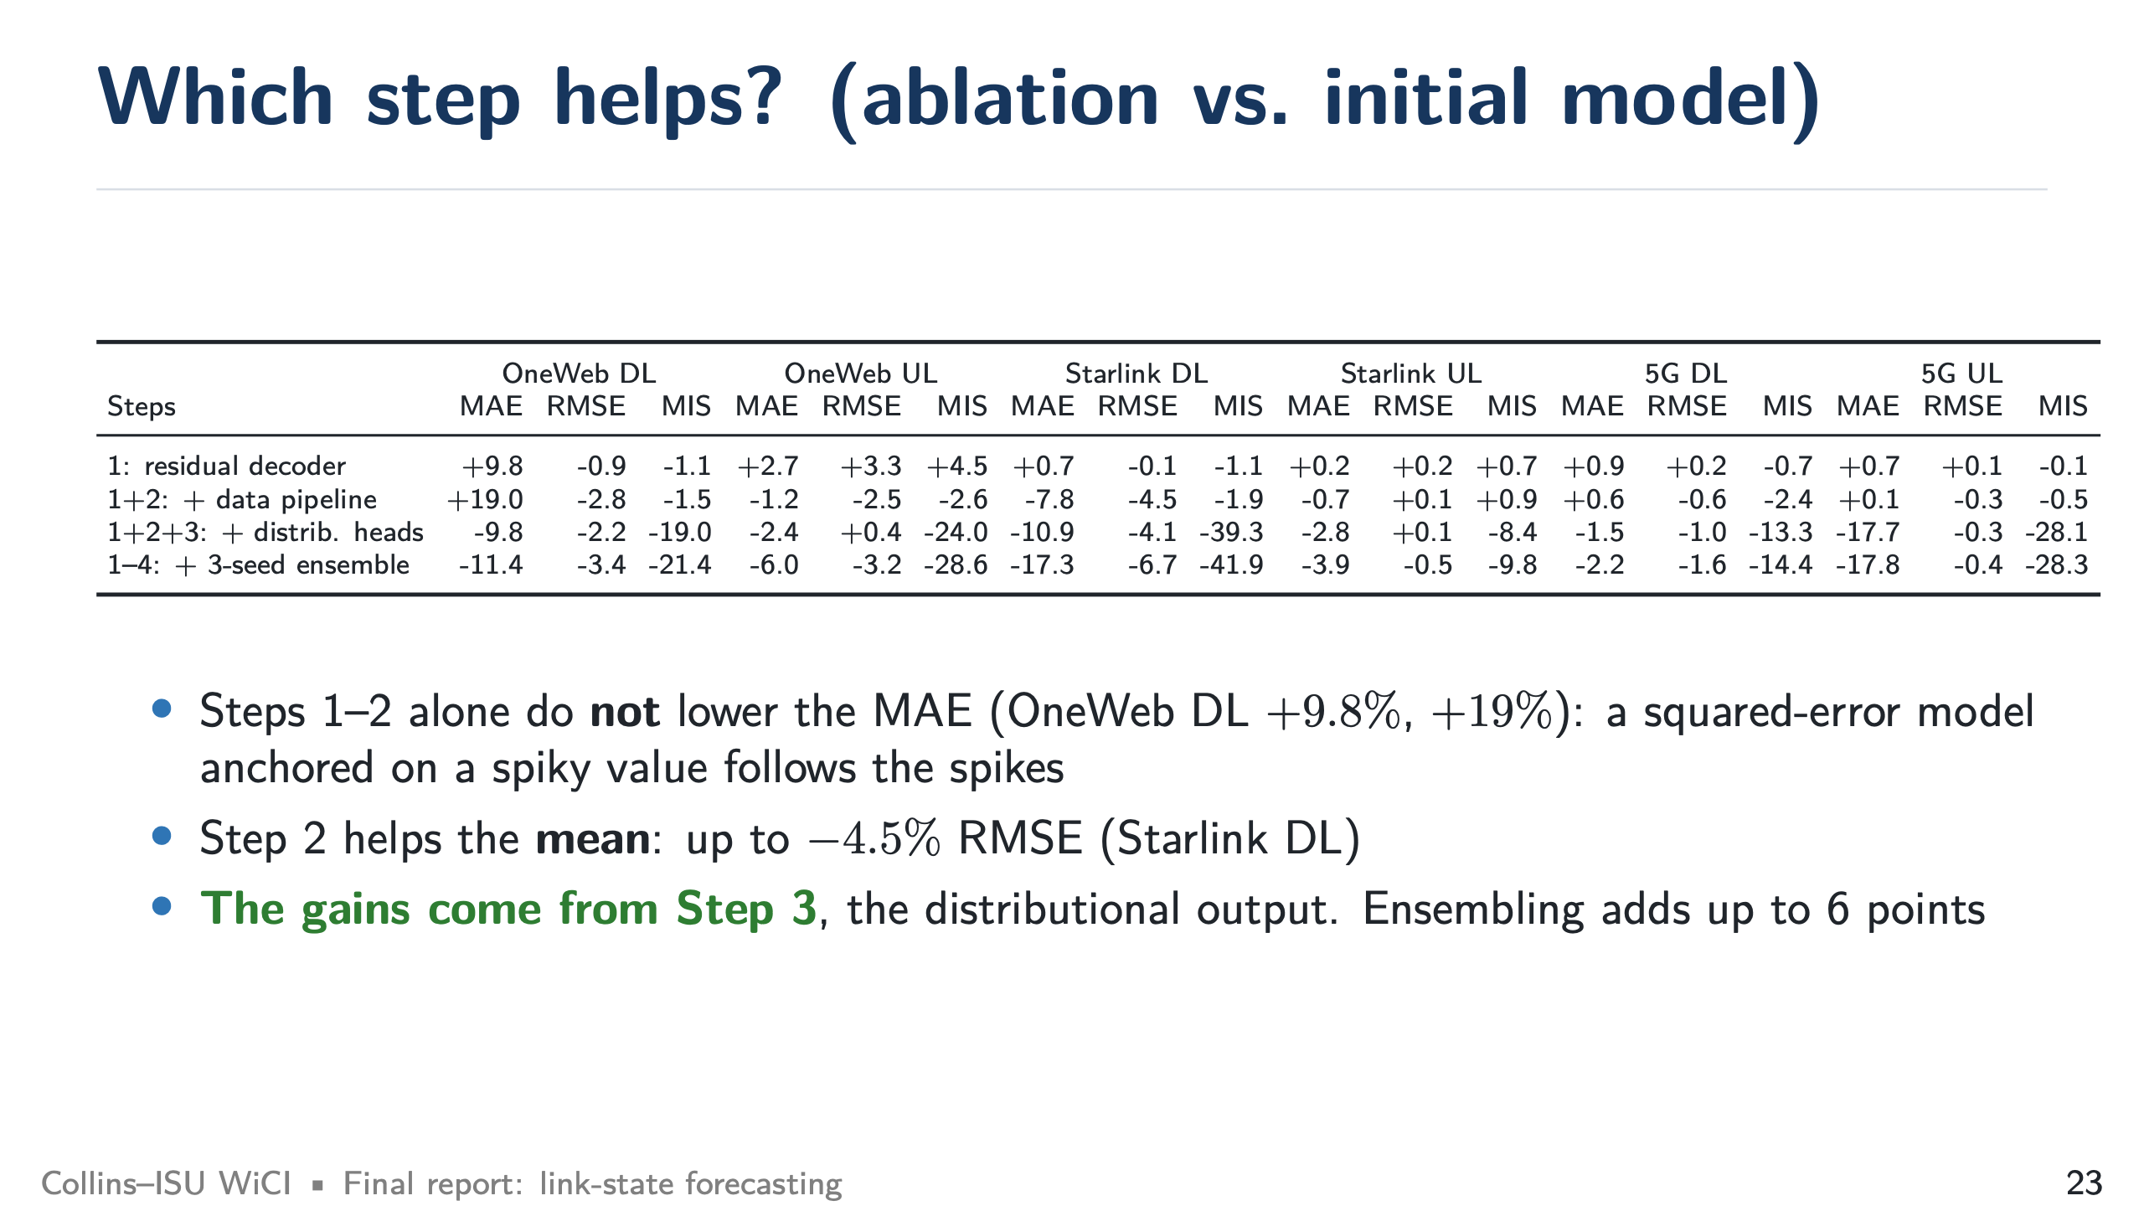
Notes:
Ablation (target 1:15)
SAY: Honest result: the residual decoder and the new features alone do not help MAE. They even make OneWeb DL worse, because a squared-error model anchored on a spiky value follows the spikes. The features help the mean a bit (up to -4.5% RMSE). The real gain comes from the distributional heads.

Slide 24
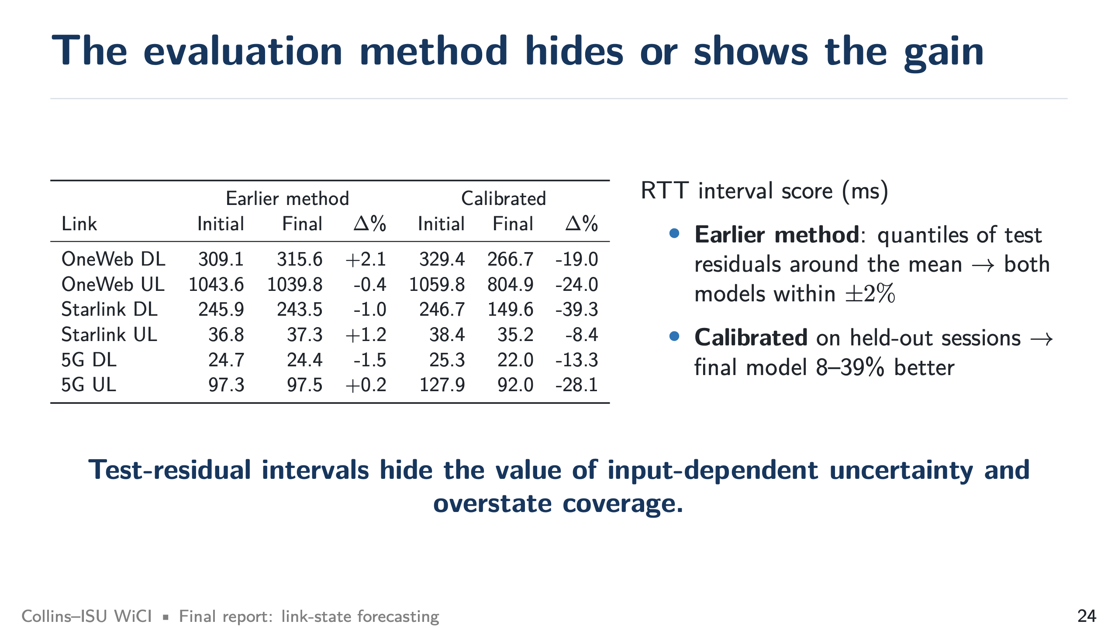
Notes:
Evaluation method matters (target 1:00)
SAY: If you compute intervals the initial way (quantiles of the test residuals), Initial and Final look the same within 2%. Only with calibration on held-out sessions does the 8–39% gain appear. The initial method also guarantees 0.95 coverage by construction, which overstates what you get in operation.

Slide 25
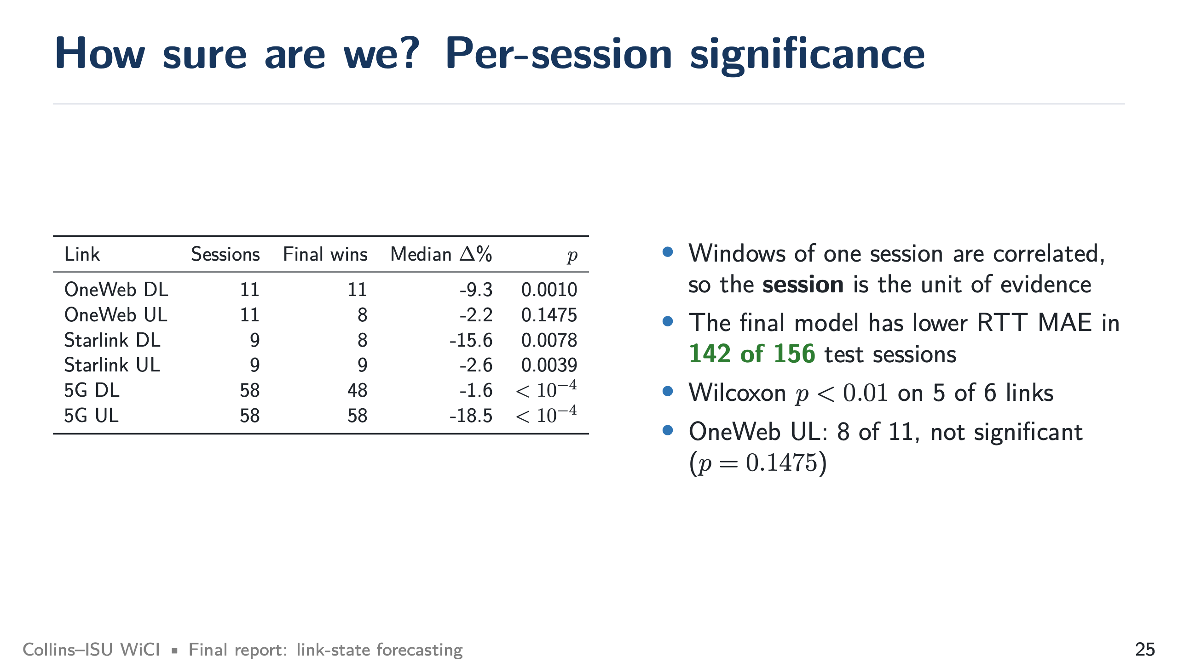
Notes:
Significance (target 1:00)
SAY: Windows from one session are correlated, so we count sessions. Final wins in 142 of 156 test sessions and is significant at 1% on five links. OneWeb UL is not significant (8 of 11 sessions).

Slide 26
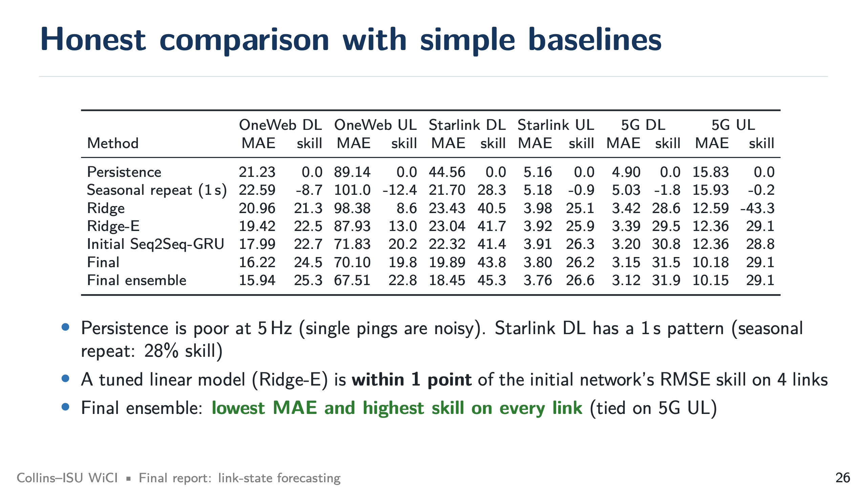
Notes:
Simple baselines (target 1:00)
SAY: Persistence is poor at 5 Hz. A simple 1 s repeat already gets 28% skill on Starlink DL. A tuned linear model is within one point of the initial network on four links, which the initial study could not show. The final model has the best MAE and skill on every link (tied on 5G UL).

Slide 27
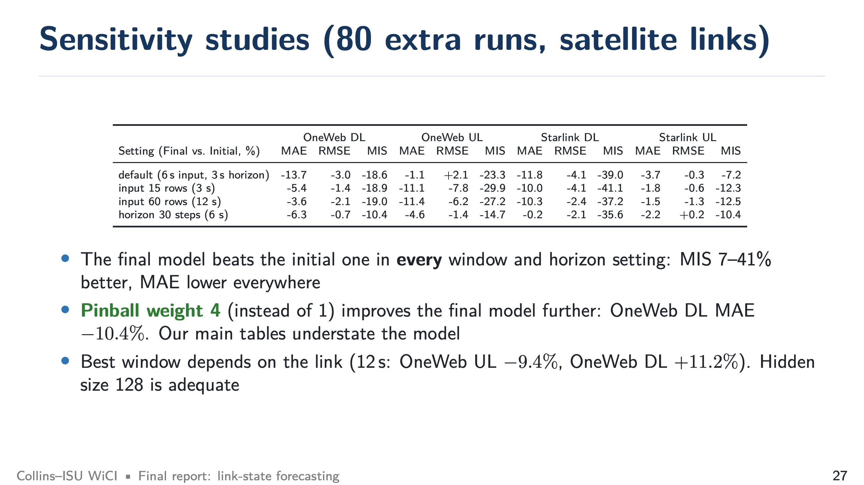
Notes:
Sensitivity (target 1:00)
SAY: The final model beats the initial one for every window and horizon we tried. The most useful finding: weighting the quantile loss 4 instead of 1 improves the final model further (OneWeb DL MAE -10.4%), so our main tables slightly understate the model. Window length is link specific.

Slide 28
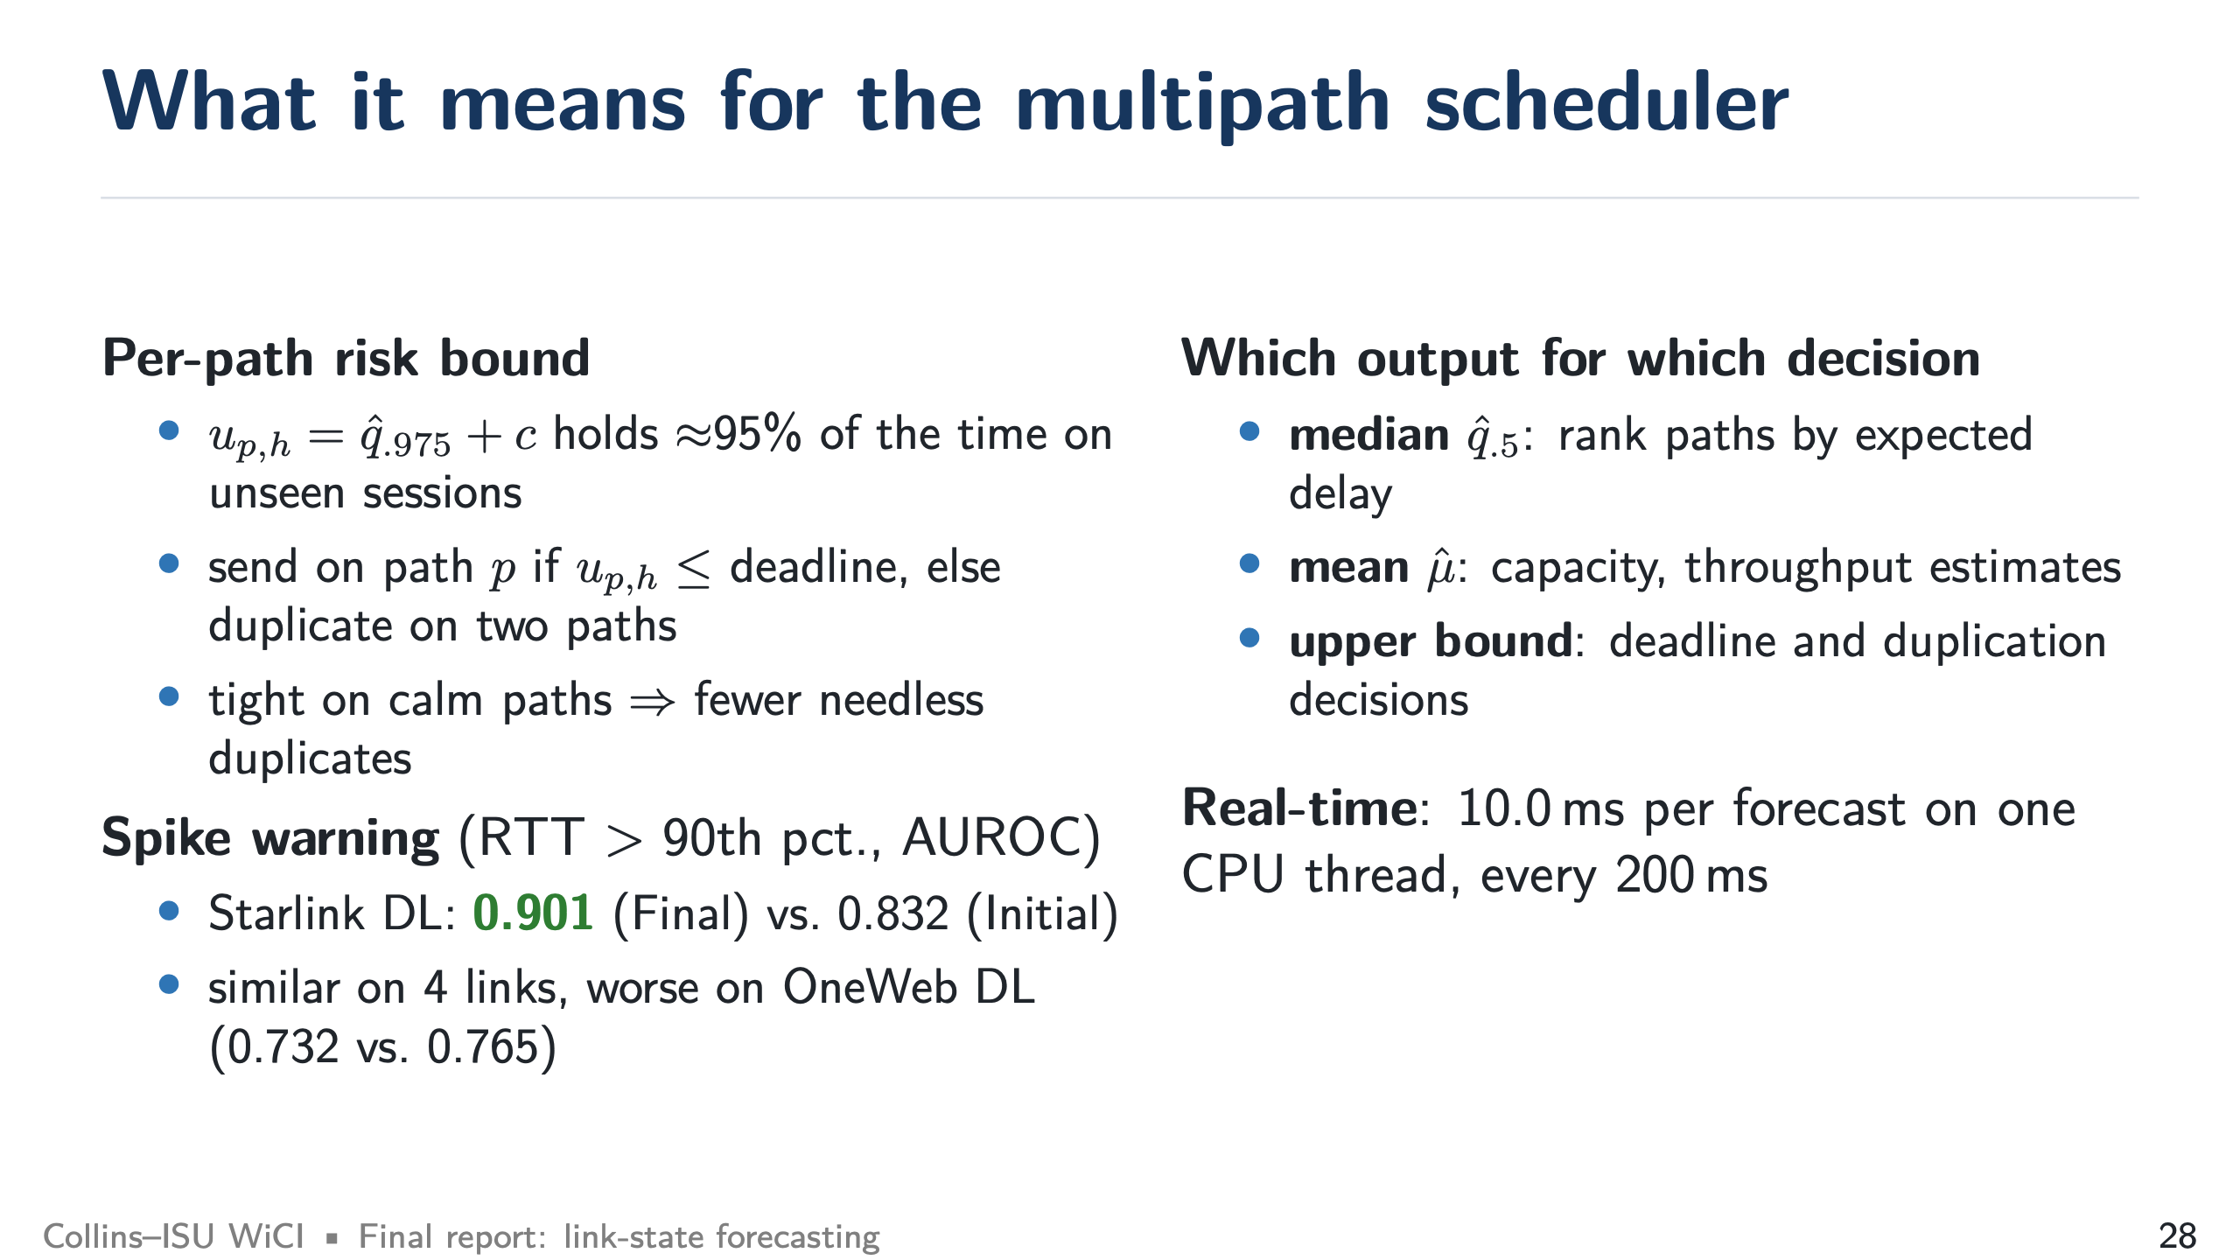
Notes:
Scheduler (target 1:00)
SAY: The upper bound is a per-path risk bound: send on a path if its bound meets the deadline, otherwise duplicate. Tight bounds on calm paths mean fewer needless duplicates. For spike warning, Final is clearly better on Starlink DL (AUROC 0.901 vs. 0.832), similar on four links, and worse on OneWeb DL (0.732 vs. 0.765).

Slide 29
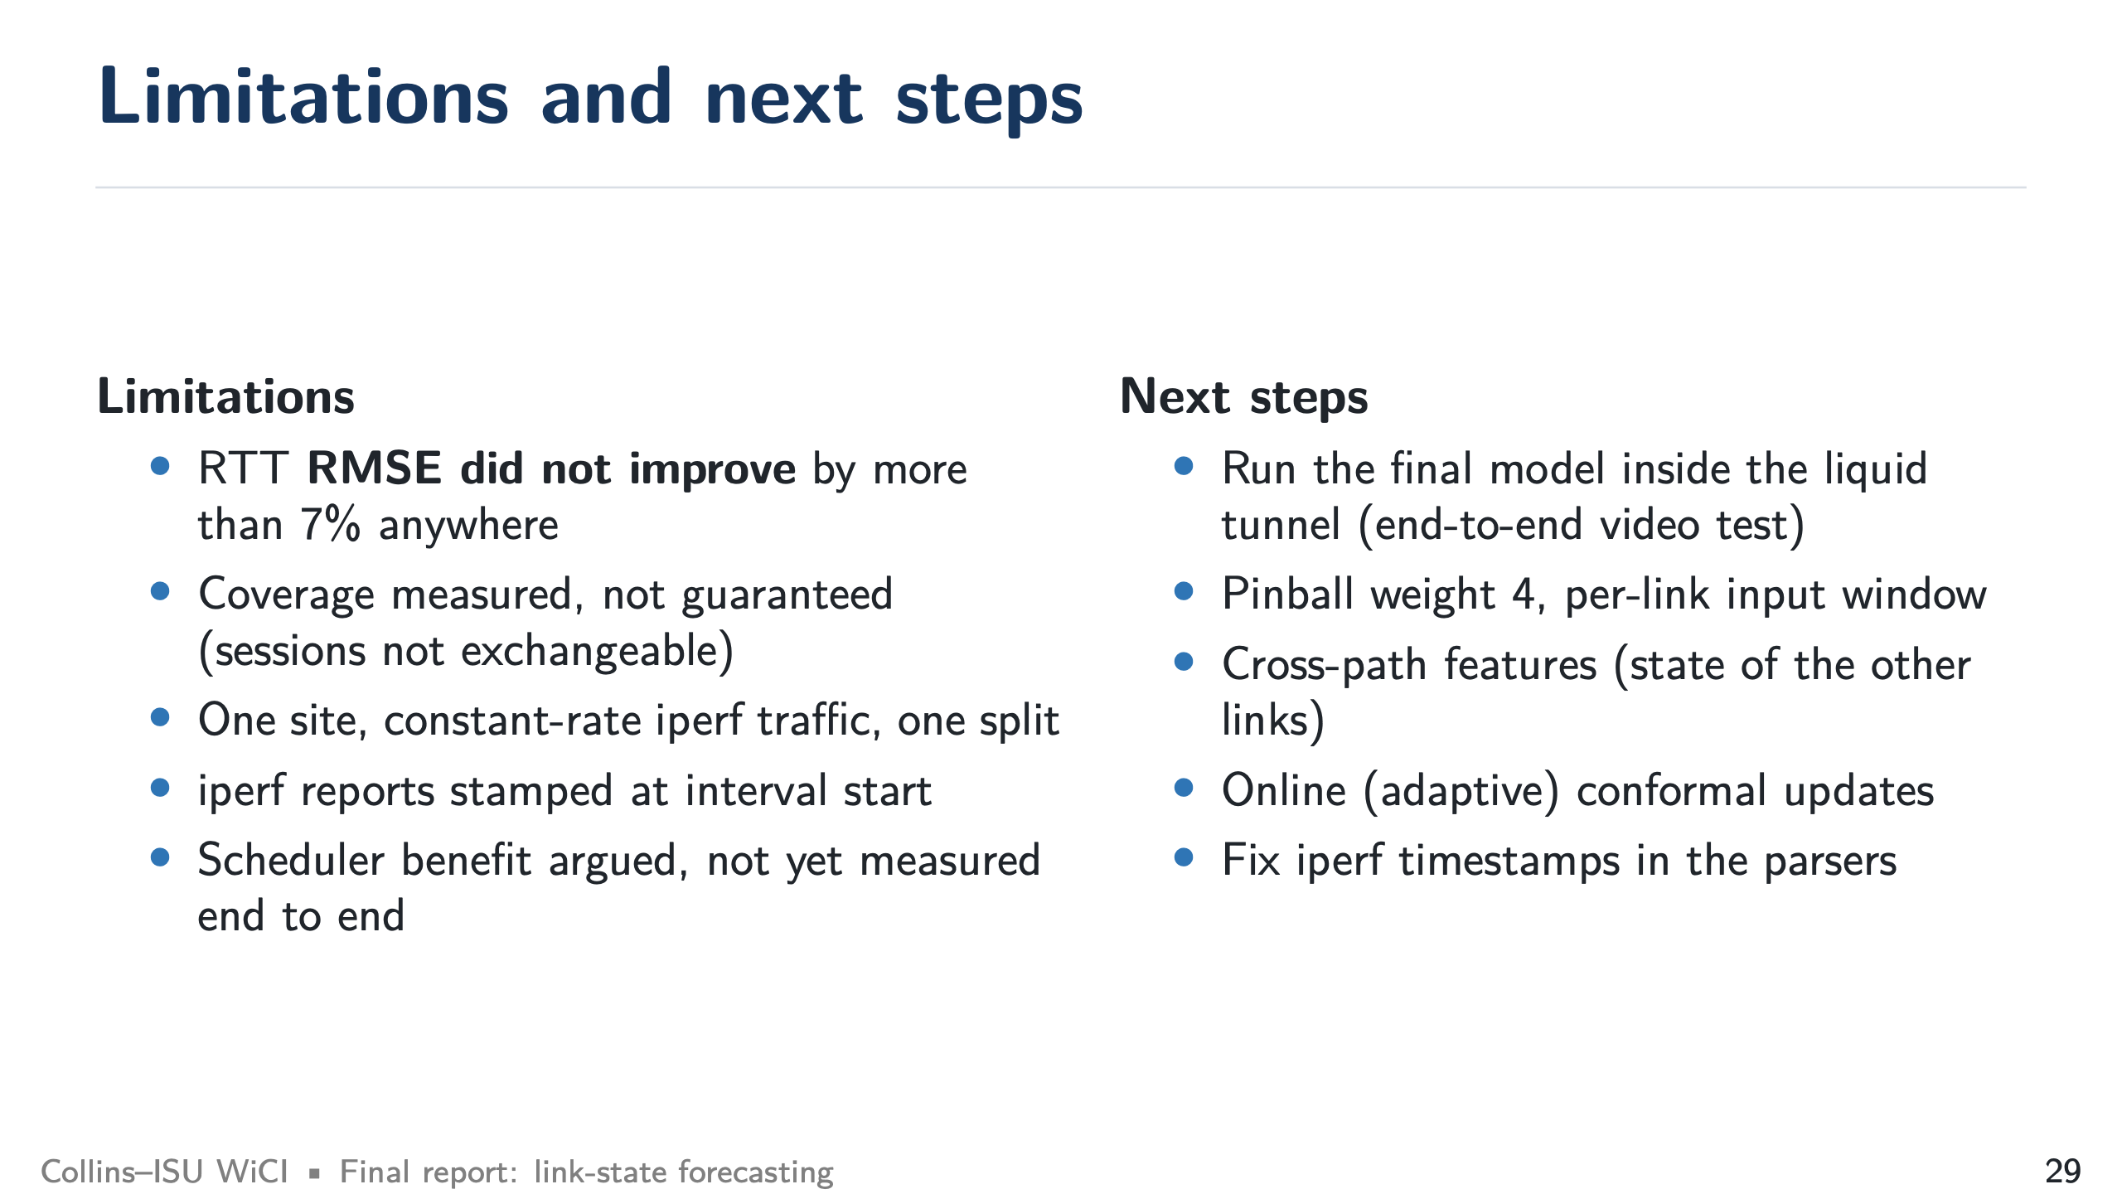
Notes:
Limitations and next steps (target 0:45)
SAY: RMSE did not improve. Coverage is measured, not guaranteed. One site and one split. The next step is the end-to-end test inside the liquid tunnel.

Slide 30
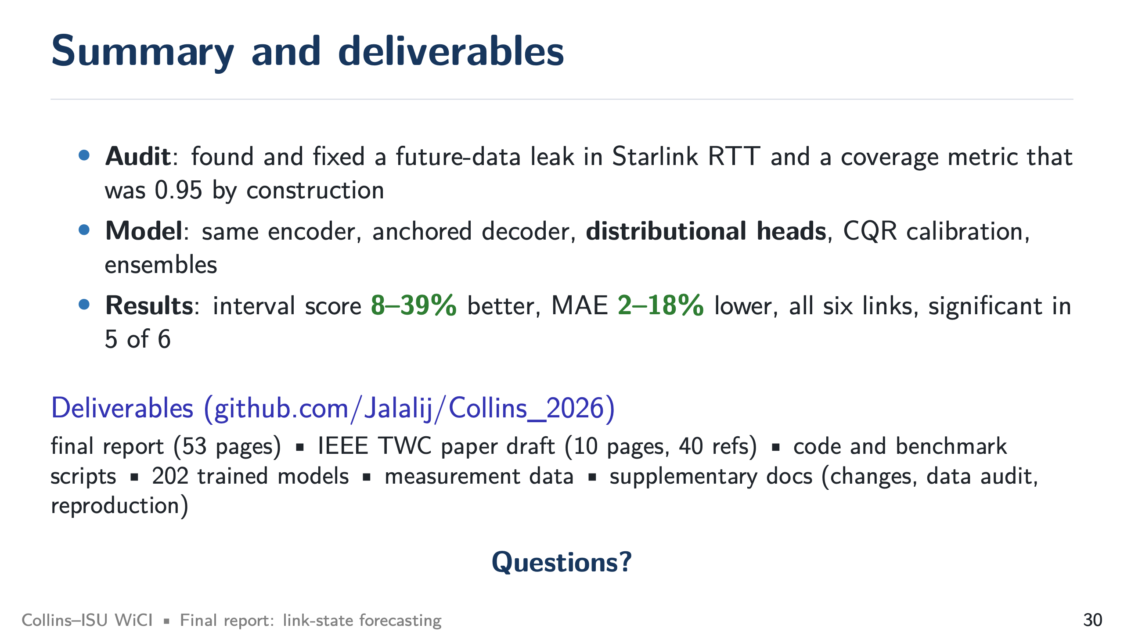
Notes:
Summary (target 0:45)
SAY: Repeat the three results. Mention that everything (report, paper, code, models, data) is on GitHub. Open for questions.

