Slide 1

SECOND HAND CARS

Slide 2
About me
I Akula Jalandhar pursuing M.Sc(Statistics) –Final year in KMICS-Hyderabad.
Iam interested in Statistics.As a better career for a statistics student, I preferred Data Science.

Slide 3
Agenda
Business Problem and Use case domain understanding(If Required)
Objective of the Project
Web Scraping – Details (Websites, Processor you followed)
Summary of the Data
Exploratory Data Analysis:
Data Cleaning Steps
Data Manipulation Steps
Univariate Analysis Steps
Bivariate Analysis Steps
Key Business Question
Conclusion (Key finding overall)
Q&A Slide
Your Experience/Challenges working on Web Scraping – Data Analysis Project.

Slide 4
Objective: The main objective of the Project is to collect, interprete , analyze the data and to know about second hand cars and find conclusions to the below Questions: What are the more selling brands in Second Hand Market? Which year cars are Selling More? Which Brands are having highest prices…etc Web Scraping – Details: For the information required for the data, I used the “cars.com” website for the data, Jupyter Notebook for Web Scrapping using Python language. In python, I have used different libraries in the process of Web Scraping.

Slide 5
Summary :
Now a days we are seeing that people are buying used cars.
The data I have collected is from a website where second hand cars are sold.
There,we see different varieties of car brands from different years and their Price Variations.
By comparing the data we can select the best car.

Slide 6
Exploratory Data Analysis:
For the Data Analysis, we may use different Libraries such as numpy, pandas, seaborn, matplot, requests,regex,time,bs4 .
After getting the data from webpage use beautiful soup and requests and store them
in a tabular form using pandas library.
Then, Save the data as csv file by using the csv command for further references & also reading the data.
If the info was as per our requirements, then we can analyze the data else we have to change the type of column by making the required changes using python commands.
Depending on data the analysis is of two types – Univariate analysis and Multivariate analysis.
Univariate analysis :It is the simplest form of analysis of each variable separately.
Multivariate analysis: It involves evaluating multiple variables to identify is there any possible association among them.

Slide 7
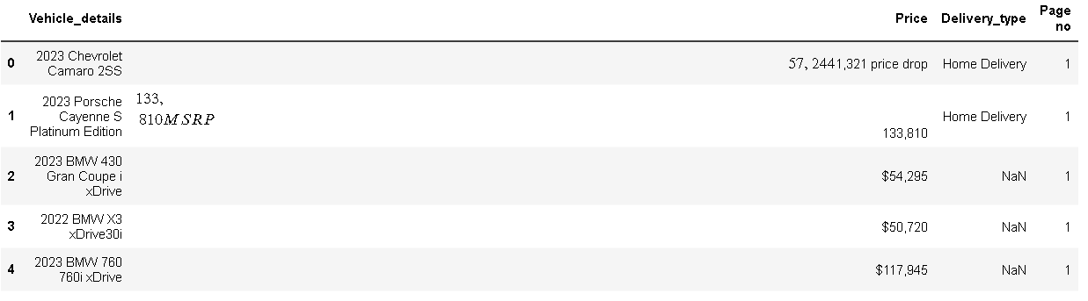
The details I collected is from “cars.com” includes CarDetails, CarPrice & whether Home Delivery available or not & page no.
The raw data is as follows:

Slide 8
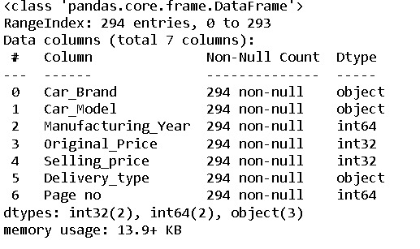
From the data collected I splitted the CarDetails column into Car Brand, Model, Year of Mfg. and CarPrice to Selling Price and Original Price.
Now by saving the table name as cardetails
check the info for getting the type of each column.
If the type of Selling Price, Original Price,
Mfg.Year, Page no is integer then we can
use the data for further analysis, else
remove duplicates and non-integer type
data and make the columns integer type.

Slide 9
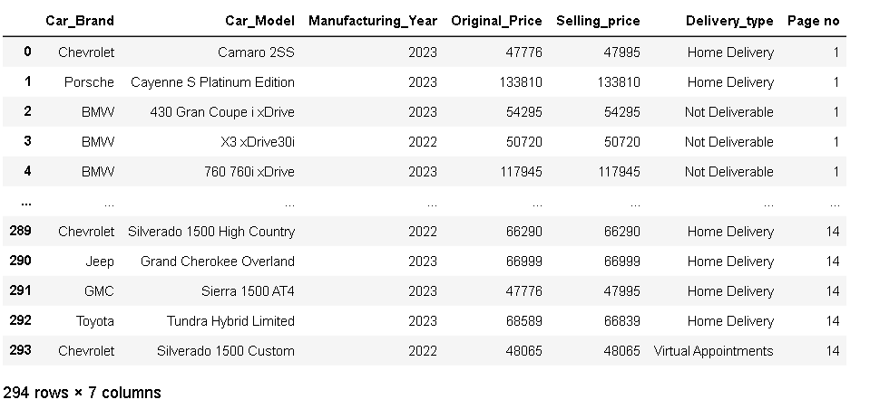
After the proper cleaning and manipulation ,we get the table as below:

Slide 10
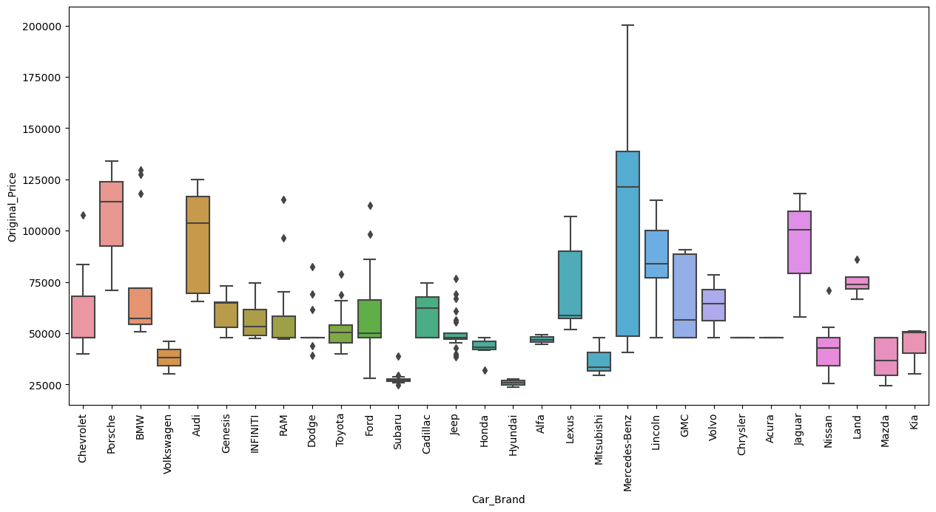
Box Plot
The BoxPlot graph shows information about diiferent" Car Brands" and their "Price" in second hand (in USD) in America.Over all,we can observe that" Mercedes-Benz" has the largest variation in between the prices of vehicles "audi" prices have large variation. The Diamond shaped points are called outliers.

Slide 11
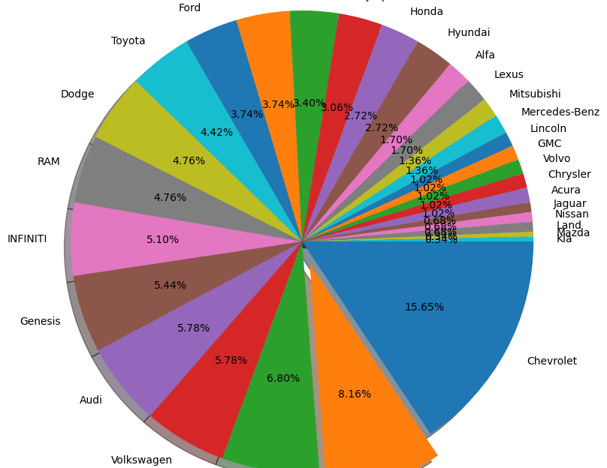
Pie-Chart
The PieChart shows information about diiferent" Car Brands" and their "Share in Second Hand Market" in America.¶
Over all,we can observe that" Chevrolet" and "Porsche" cars are holding first and second places in the market .
KIA,Mazda,LandRover,Nissan,Jaguar,Land Rover,Jaguar are holding less share in the second hand market (i.e less than 1%).May be this is because the New cars bought by the customers is less (or) The customers who bought are not interested to sell their cars.

Slide 12
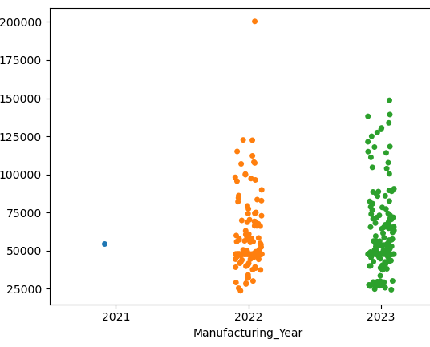
Scatter Plot :
The Scatter Plot shows the Plot of "Manufacturing Year" and" Price".Here each(.) refers to each car unit.¶
We can see that the cars that are manufactured in recent year are at High-Cost comapred to the previous.
In the data we got, the maximum data is from 2022 & 2023.Only 1 car are from 2020 & 2021

Slide 13
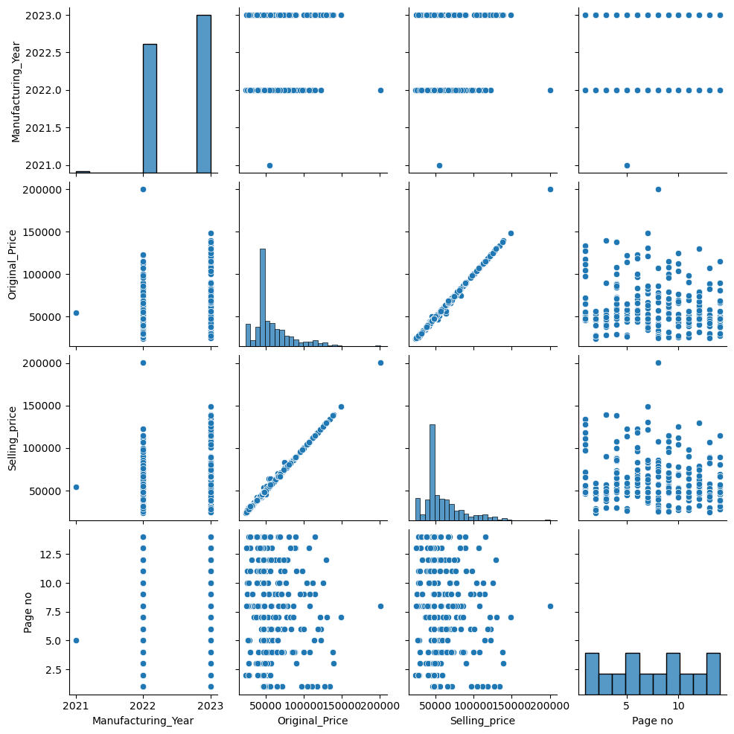
Pair Plot:
Pair plot is used to understand the best set of features to explain a relationship between two variables or to form the most separated clusters.
It allows us to plot pairwise relationships between variables within data set.

Slide 14
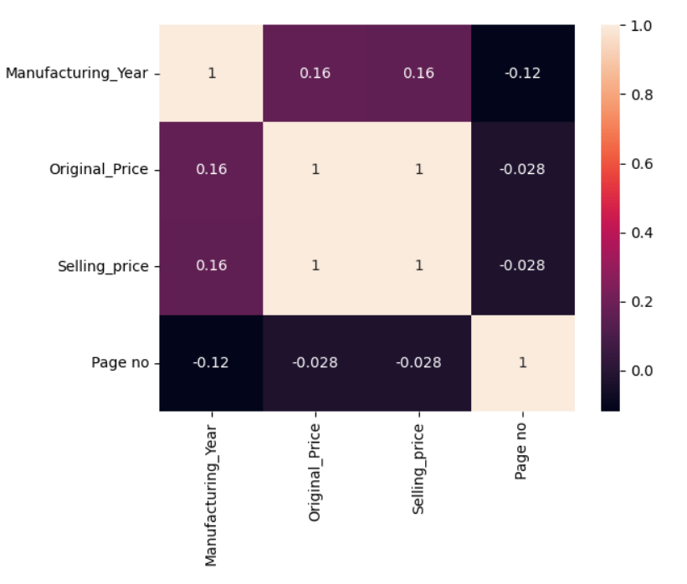
Heat map :
A heat map is a two-dimensional representation of data in which values are represented by colors.
A simple heat map provides an immediate visual summary of information.

Slide 15
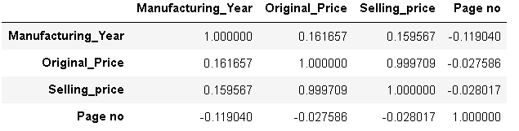
Correlation :
Here,Manufacturing year and Price are positively correlated.
Original Price and Selling Price are positively correlated.

Slide 16
Conclusions :
From the above data and graphs we conclude that recent year cars have more price than that of old year.
Only few cars are getting discount in their sale in second hand market.
Some cars which are bought at high cost are sold for low price,this may be due to rash usage.
Some cars have less difference with their because of good maintainance.
The least price of cars is 25000 and maximum price is 200000(in USD)

Slide 17
Q & A :

Slide 18
Experience/Challenges working on Web Scraping :
Every process in this project made me learn in new things.
From collection of data and writing conclusion to the graphs this is a good experience for me in Data Analysis.
This project made me to become confident in Analysis of data.

Slide 19

THANK YOU

