Slide 1
Cloud Foundry - Buildpacks
Notes:
© 2006 Capgemini - All rights reserved

Slide 2
Objectives of CF - Buildpacks
Purpose:
  To learn pivotal cloud foundry BuildPack.
Product:
  Introduction to Buildpacks
    What are Buildpacks?
    Deploying to Cloud Foundry
    Using Buildpacks
  Customizing Buildpacks
    Buildpack API
    Java Buildpack
    Configure / Extend Java Buildpack
Process:
  To learn configure buildpacks and customize buildpacks in Cloud Foundry.
© 2014 Capgemini - All rights reserved

Slide 3
Table of Contents
Introduction to Buildpacks
  What are Buildpacks?
  Deploying to Cloud Foundry
  Using Buildpacks
Customizing Buildpacks
  Buildpack API
  Java Buildpack
  Configure / Extend Java Buildpack
© 2014 Capgemini - All rights reserved

Slide 4
INTRODUCTION TO BUILDPACKS
© 2011 Capgemini - All rights reserved

Slide 5
What are Buildpacks?
Applications
  Consists of source code and application frameworks used by developers to create application
    Java/Spring
    Ruby/Rails
    Java Script for Node.js
    …
© 2007 Capgemini - All rights reserved

Slide 6
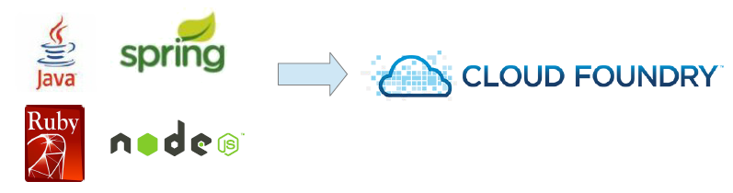
What are Buildpacks?
The Question:
  Applications can be written in many languages / frameworks:
  …and yet each type can run in Cloud Foundry
  How is this possible?
© 2007 Capgemini - All rights reserved

Slide 7
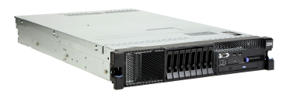
Configuring a Server from scratch
If you were configuring a new server to run an application, what would you include / install ?
  Operating system
  Runtimes for your software (Java, Ruby, Python, etc .)
  Containers as needed (e.g. Tomcat for Java, Apache HTTPD for PHP)
  Frameworks as needed (APM tools)
  Application binaries
Good idea to write a script to do this.
© 2011 Capgemini - All rights reserved

Slide 8
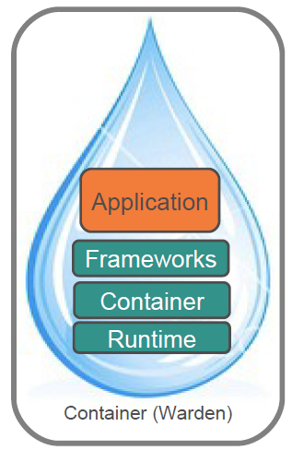
A Buildpack Does the Same Thing
Except the goal is run on Cloud Foundry
Buildpack – a combination of scripts that assembles runtimes, containers, frameworks, and your application into a droplet
Droplets run inside Warden Containers, which run inside DEAs
  Fully explained in the architecture session.
© 2011 Capgemini - All rights reserved

Slide 9
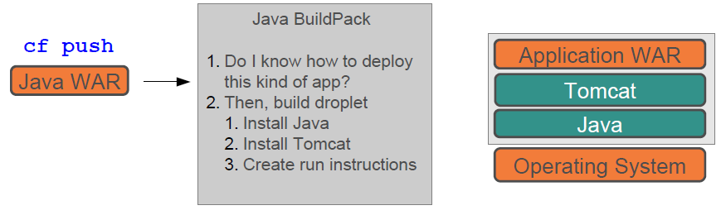
The Answer : Buildpacks
Buildpacks define how assemble a droplet to run a specific kind of application
Example:
The Buildpack “builds” the “droplet” to run an app.
  Called staging the application
© 2011 Capgemini - All rights reserved

Slide 10
Buildpacks are Not…
Buildpacks …
  Are not a special build process for our application
    Buildpacks build droplets
  Do not run on our local machine
    Buildpacks run on CF during the staging process
© 2011 Capgemini - All rights reserved

Slide 11
Buildpack Structure
Often written as Ruby script with three parts:
  Detect if the buildpack should be applied
  Compile (pack) the Droplet by combining the application code with runtimes, frameworks, plug-ins etc. necessary for the application
  Release the app to be deployed to an assigned DEA
NOTE : Assemble or pack would be a better name than Compile
No code compilation is happening
© 2011 Capgemini - All rights reserved

Slide 12
DEPLOYING TO CLOUD FOUNDRY
© 2011 Capgemini - All rights reserved

Slide 13
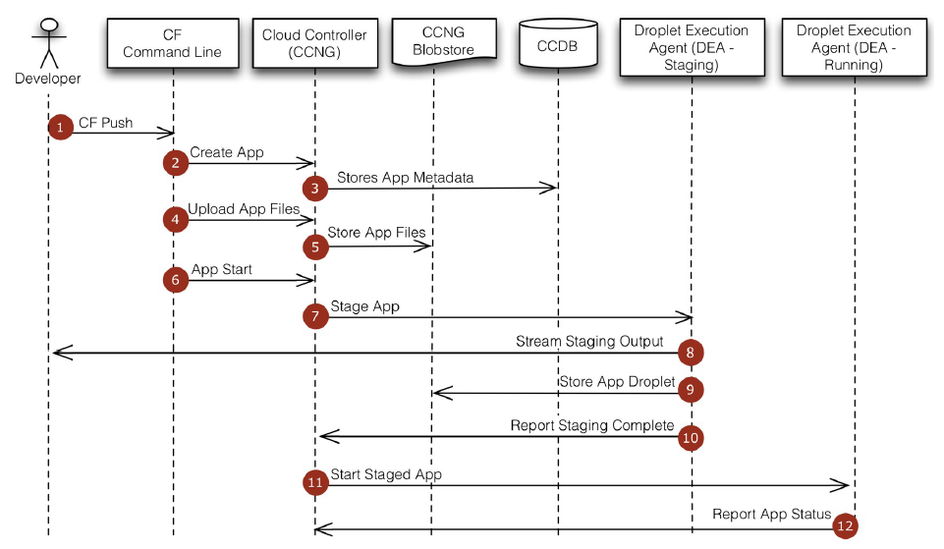
Deploying to CF
© 2011 Capgemini - All rights reserved

Slide 14
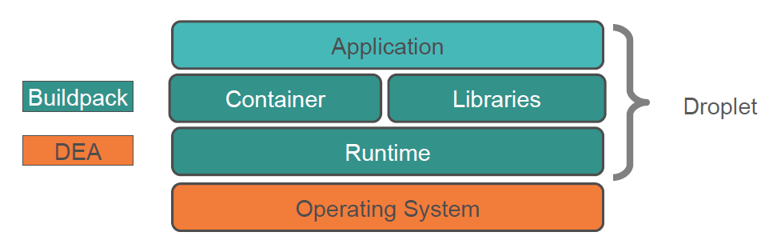
Staging and Buildpacks
Build packs are responsible for preparing the machine image for an application
© 2011 Capgemini - All rights reserved

Slide 15
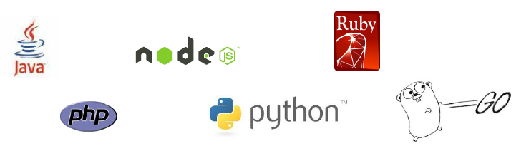
Available Buildpacks
Buildpacks are either
  Installed into a cloud foundry instance or
  Loaded from an external location at push time
Buildpacks provided by public Cloud Foundry
  Note: This list expands over time!
© 2011 Capgemini - All rights reserved

Slide 16

Custom Buildpacks
Cloud Foundry Community provides buildpacks for other languages
Or write our own
  Usually by forking /adapting an exiting buildpack
For list of CF Community Buildpacks
  https://github.com/cloudfoundry-community/cf-docs-contrib/wiki/Buildpacks
© 2011 Capgemini - All rights reserved

Slide 17

Compatibility
Buildpacks can be compatible with multiple PaaS offerings
CF buildpacks follow the Heroku buildpack design
  CF and Heroku buildpacks are compatible (if we care to make them compatible)
  Other PaaS offerings adopting the buildpack design
© 2011 Capgemini - All rights reserved

Slide 18
USING BUILDPACKS
© 2011 Capgemini - All rights reserved

Slide 19
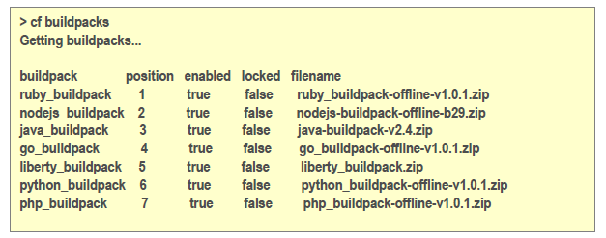
Built-In Buildpacks
Use cf buildpacks to determine installed buildpacks
© 2011 Capgemini - All rights reserved

Slide 20
Managing Built-In Buildpacks
$> cf create-buildpack <name> <path> <order>
  <path> - local directory/ zip file /URL /URL to zip file
  <order> - relative order in buildpack list
  --enable / --disable
Commands for update, delete, rename available
Administrator permissions required
© 2011 Capgemini - All rights reserved

Slide 21
Automatic Detection / Explicit Reference
$> cf push
  Application checked against pre-defined buildpacks
  Matching buildpack invoked automatically
$> cf push –b <buildpack-name>
  Desired buildpack specified (installed buildpack)
$> cf push –b <url>
  The desired buildpack is referenced by a Git URL
    Note: “disable custom buildpacks” disables this option
© 2011 Capgemini - All rights reserved

Slide 22
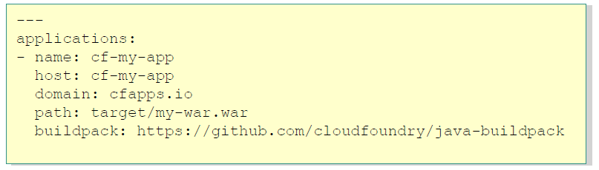
Specify within manifest
Use buildpack element
  Specify name or URL
Remember precedence
  Options specified in push command override manifest
© 2011 Capgemini - All rights reserved

Slide 23
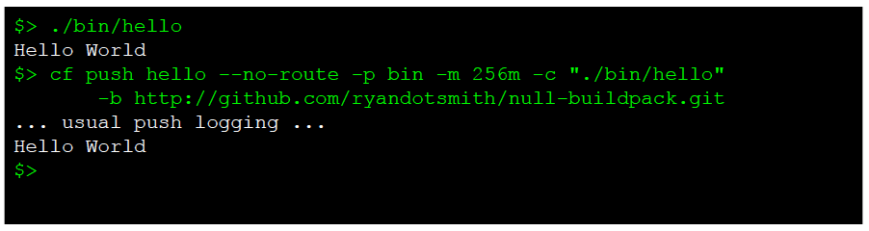
Pushing an Executable
Suppose I have a binary executable?
  Such as a script or statically compiled C,C++ application
  Must be compiled for x86 Linux
Then I can push and run it using the “null” buildpack
© 2011 Capgemini - All rights reserved

Slide 24
CUSTOMIZING BUILDPACKS
© 2011 Capgemini - All rights reserved

Slide 25
Buildpack API
© 2011 Capgemini - All rights reserved

Slide 26
Buildpack API
/bin/detect app_directory
  Inspect application bits to determine builbpack applicability
/bin/compile app_directory cache_directory
  Download and install runtime, container, packages, libraries; install application bits as necessary
/bin/release app_directory
  Build application start command
© 2011 Capgemini - All rights reserved

Slide 27



/bin/detect
 | Gemfile exists?
 | package.json exists?
 | setup.py exists?
© 2011 Capgemini - All rights reserved

Slide 28
/bin/compile
‘Builds’ the Droplet
Downloads and installs any necessary runtime
  Java VM, Ruby interpreter, JavaScript interpreter …
  Container or web server
  Support libraries, packages, modules
    Java jars, Ruby gems, NPM packages
Then install the app bits into the runtime or container
© 2011 Capgemini - All rights reserved

Slide 29
/bin/compile caching
Runtime, container, and support packages are often downloaded from sources external to Cloud Foundry
  Depending on the buildpack
DEA provides a location for storing downloaded artifacts to speed subsequent staging operations
© 2011 Capgemini - All rights reserved

Slide 30
/bin/release
Builds a YAML-formatted hash with three possible keys
On Cloud Foundry (currently) only the web: value is used to get the start command for the app
addons: [ ]
config_vars: { }
Default_process_types :
web: <start command>
© 2011 Capgemini - All rights reserved

Slide 31
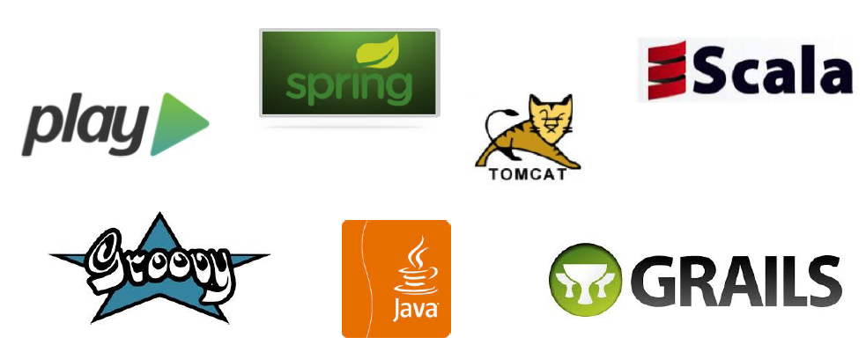
Java Buildpack
Supports variety of JVM languages, containers, and frameworks with a modular, configurable, and extensible design
© 2011 Capgemini - All rights reserved

Slide 32
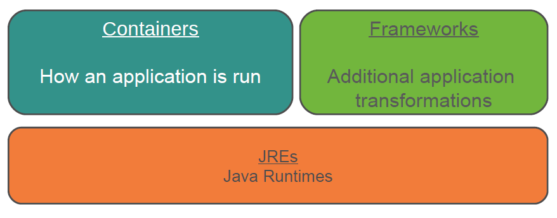
Java Buildpack Concepts
© 2011 Capgemini - All rights reserved

Slide 33
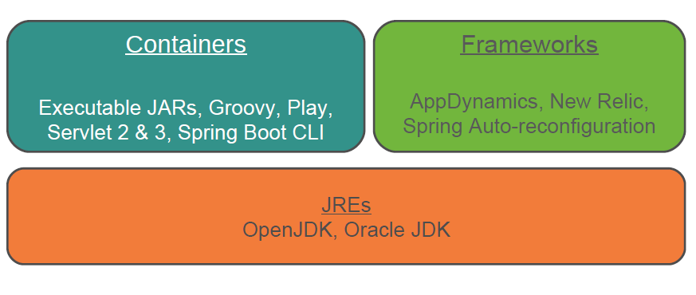
Java Buildpack Concepts
© 2011 Capgemini - All rights reserved

Slide 34
Container Detection Criteria
Java main() | META-INF/MANIFEST.MF exists with Main-Class attribute set
Tomcat | WEB-INF directory exists
Groovy | .groovy file with a main() method, or .groovy file with no classes, or .groovy file with a shebang (#!) declaration
Spring Boot CLI | One or more POGO .groovy files with no main() method, and no WEB-INF directory
Play | start and lib/play.play_*.jar exist
© 2011 Capgemini - All rights reserved

Slide 35
Framework detection criteria
App Dynamics App Dynamics service bound to app
New Relic New Relic service bound to app
Spring spring-core*.jar in the application
AutoConfiguration directory
© 2011 Capgemini - All rights reserved

Slide 36
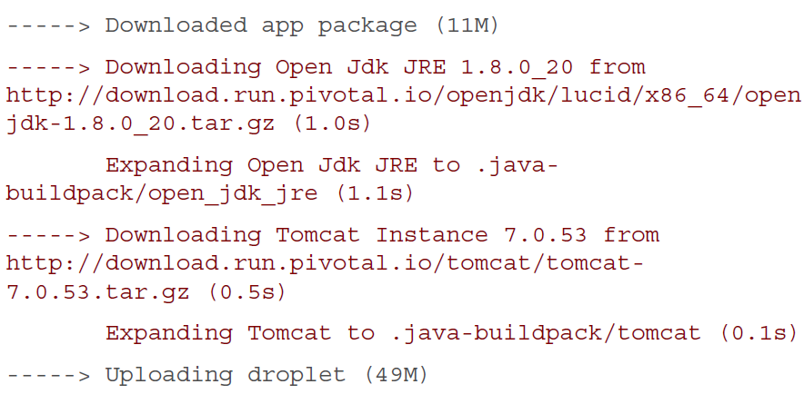
/bin/compile Output Example
Output example:
© 2011 Capgemini - All rights reserved

Slide 37
See what’s Going On
$> cf files <app-name> app
  java-buildpack.log
  java-buildpack
    open_jdk_jre
    spring_auto_reconfiguration
    tomcat
    …
  META-INF/
  WEB-INF/
Log output from buildpack
Sandboxes for each component
used during staging
© 2011 Capgemini - All rights reserved

Slide 38
Configure / Extend Java Buildpack
© 2011 Capgemini - All rights reserved

Slide 39

Customization
You may alter Java buildpack
  Configure artifacts used by standard JREs, Containers, and Frameworks
  Extend the buildpack with your own JREs, Containers, and Frameworks
Customization is done by forking the buildpack
… or Simply downloading, modifying and zipping.
© 2011 Capgemini - All rights reserved

Slide 40
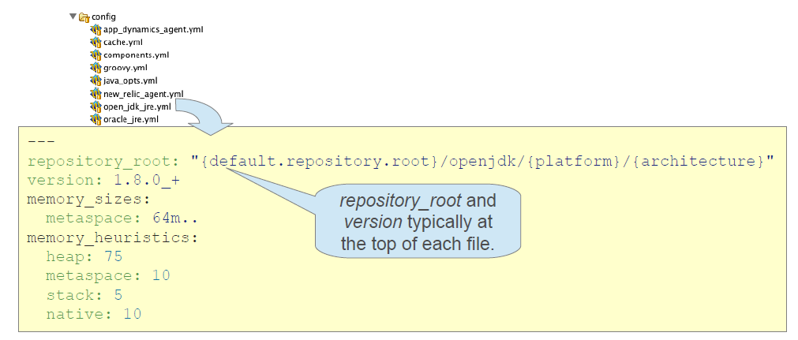
Customizing Configuration
Most configuration options found in / config
  determine behavior of a JRE, Container or Framework
© 2011 Capgemini - All rights reserved

Slide 41
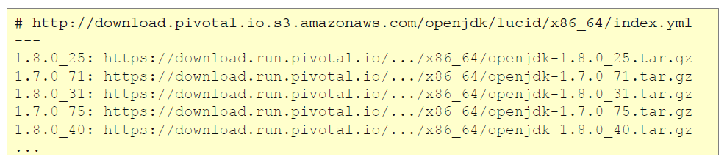
Locating Downloads
URLs derived from repository root
  { default.repository.root } /openjdk/ { platform} / { architecture}
  download.pivotal.io.s3.amazonaws.com / openjdk / lucid /x86_64
  index.yml holds location of each version
© 2011 Capgemini - All rights reserved

Slide 42
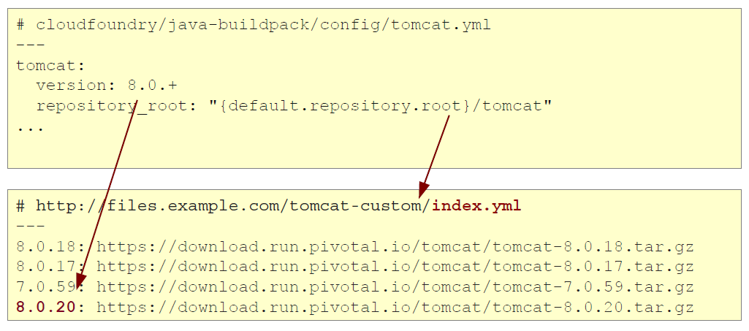
Customization by Configuration : Tomcat
Example: customizing the Tomcat artifact for download
© 2011 Capgemini - All rights reserved

Slide 43
Resource Configuration
Tomcat container supports simple customization of context.xml and server.xml
  Files will overlay sandbox provided values.
Not just for Tomcat
  JDK, New Relic, etc.
resource/tomcat/conf
context.xml
server.xml
© 2011 Capgemini - All rights reserved

Slide 44
Extending the Buildpack - 1
You can extend the Java Buildpack
  To add different JRE, Container or Framework
Implement support class (Ruby) in the appropriate directory
  With additional support classes as necessary
  lib / java_buildpack
  jre
  container
  framework
© 2011 Capgemini - All rights reserved

Slide 45
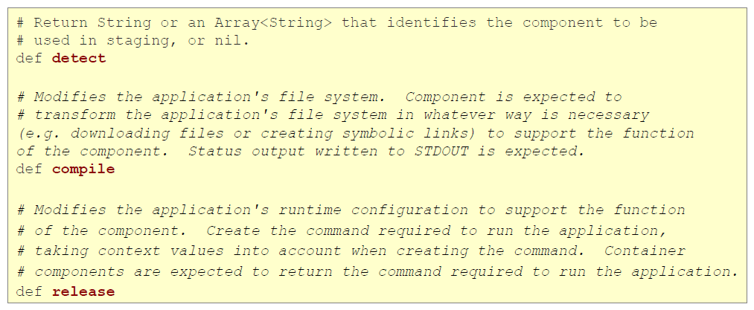
Extending the Buildpack - 2
Support class types have similar interfaces, following the buildpack scripts naming conventions
© 2011 Capgemini - All rights reserved

Slide 46
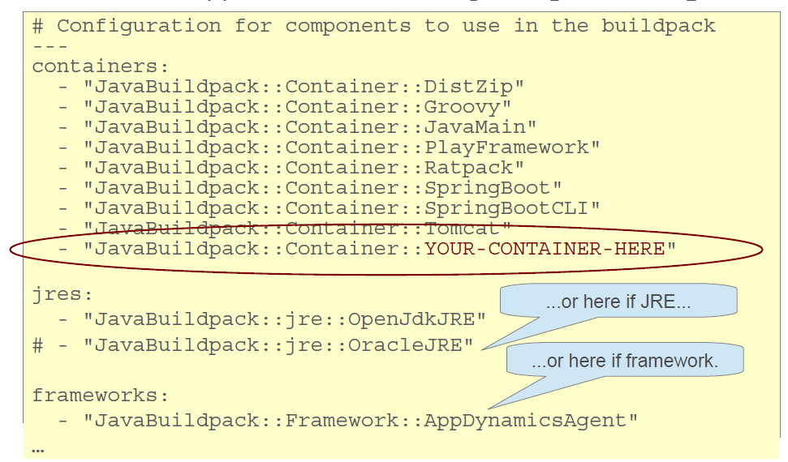
Extending the Buildpack - 3
Add new support class to config/components.yml
© 2011 Capgemini - All rights reserved

Slide 47
More on Customization
Much more information and documentation included in the GitHub repository
https://github.com/cloudfoundry/java-buildpack
© 2011 Capgemini - All rights reserved

Slide 48
Customization without Forking
Simple customization of properties can be done without forking the buildpack
  Set environment variables instead
    Either using cf set-env or in the env: section of manifest
Three options:
  JAVA_OPTS variable
  JBP_CONFIG variable
© 2011 Capgemini - All rights reserved

Slide 49
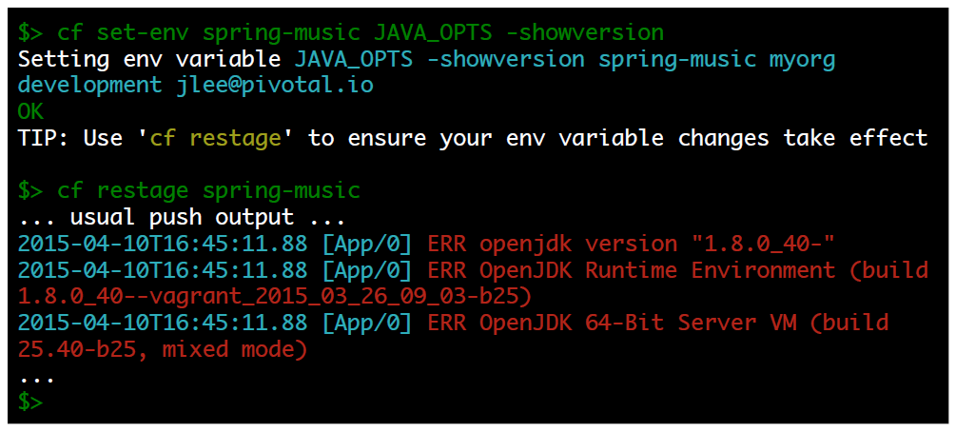
Change JVM Runtime Options - I
The JAVA_OPTS variable is recognized when app runs:
© 2011 Capgemini - All rights reserved

Slide 50
Change JVM Runtime Options - II
Most JVM options can be specified this way
  Except some that govern memory sizing
    Such as –Xms, -Xmx, - Xss, -XX:maxPermSize,
      XX: MarketaspaceSize, -XX:MetaspaceSize,
      -XX:PermSize
  Most other –XX options can be used
  For full details see:
  https://github.com/cloudfoundry/java-buildpack/blob/master/docs/framework-java_opts.md
© 2011 Capgemini - All rights reserved

Slide 51
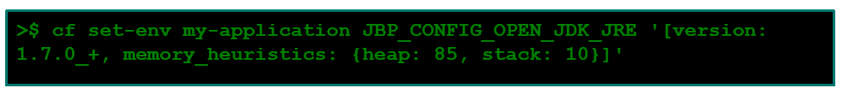
JBP_CONFIG variables
Use environment variable to override a buildpack configuration file
  Naming convention used:
    my_file.yml→JBP_CONFIG_MY_FILE
  Variable must be set to valid inline YAML syntax
To change default version of Java to 7
  Override open_jdk_jre.yml
© 2011 Capgemini - All rights reserved

Slide 52
Offline Buildpacks
Wish to avoid download buildpacks from Internet
Java buildpack can be packages as offline Buildpack
  Builds droplets without internet connection
One – time build process
  Internally packages latest version of each dependency within the buildpack
  Disables remote downloads
  About 180M in size
  Install using cf create-buildpack/update-buildpack
  https://github/cloudfoundry/java-buildpack/blob/master/docs/buildpack-modes.md
Note: Pivotal CF ships with offline buildpacks!
© 2011 Capgemini - All rights reserved

Slide 53
Recap
detect
/bin/compile
java buildpacks
cf set-env
forking
offline
© 2014 Capgemini - All rights reserved
Notes:
Recap – tips : To make it further lighter, many facilitator ask participant that they were allow to leave only if they will answer say 12 correct answers out of 15 questions. And then produce all recaps as questions.
© 2006 Capgemini - All rights reserved

Slide 54
Notes:
© 2006 Capgemini - All rights reserved

