Slide 1
Cloud Foundry – Logging And Trouble Shooting
Notes:
© 2006 Capgemini - All rights reserved

Slide 2
Objectives of CF – Logging And Trouble Shooting
Purpose:
  To learn pivotal cloud foundry Logging and Trouble Shooting
Product:
  Logging
  Trouble Shooting
  Understanding Application Deloyment
Process:
  To learn and deploy a service.
© 2014 Capgemini - All rights reserved

Slide 3
Table of Contents
Logging
Trouble Shooting
How Deployment Happens
© 2014 Capgemini - All rights reserved

Slide 4
LOGGING
© 2011 Capgemini - All rights reserved

Slide 5
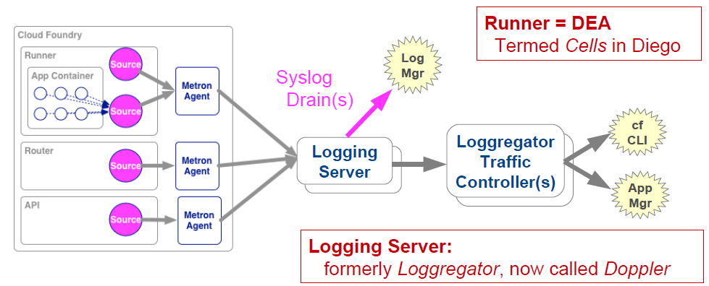
Log Aggregation Architecture
Collects logging output from:
  Application Instances, CF Components
Aggregates into a consolidated log
© 2011 Capgemini - All rights reserved

Slide 6
Logging Terminology
CF 1.3 or earlier
  Apps & CF Components logged to a Loggregator process
  It both accumulated and supplied logging information
  Loggregator referred to this process
CF 1.4 or later
  Loggregator : entire Log Aggregation Architecture
    Metric agents + logging servers + traffic controllers
  Multiple components
    Metron Agents : receive both log and mertics
    Doppler Server(s) : accumulates data from agents
    Traffic Controller(s) : allow access to metrics and logs
© 2011 Capgemini - All rights reserved
Notes:
© 2006 Capgemini - All rights reserved

Slide 7
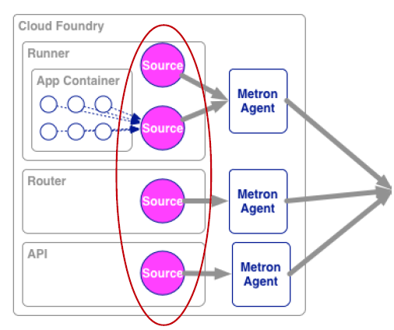
Logging - Sources
Application Instances
  Logs collected from all application instances
    From sysout or syserr
Cloud Foundry Components
  Router, Cloud Controller, DEA's ect
  Useful to understand update/deployment issues
© 2011 Capgemini - All rights reserved

Slide 8
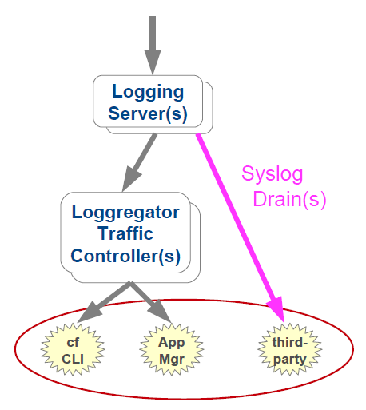
Logging - Sinks
CLI - Tail
  Quick, direct way to obtain output
  cf logs <appname>
Third-party log managers
  Splunk, Logentries, logstash, Papertrail, ect
© 2011 Capgemini - All rights reserved

Slide 9
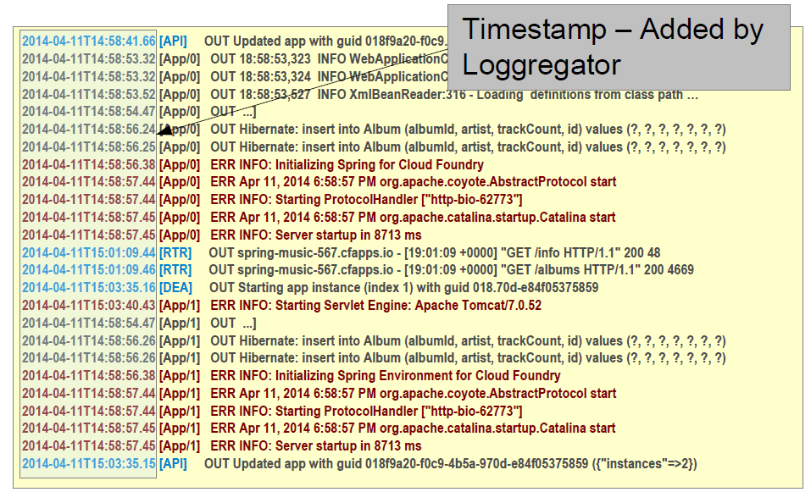
A Tour of Log Output
© 2011 Capgemini - All rights reserved

Slide 10
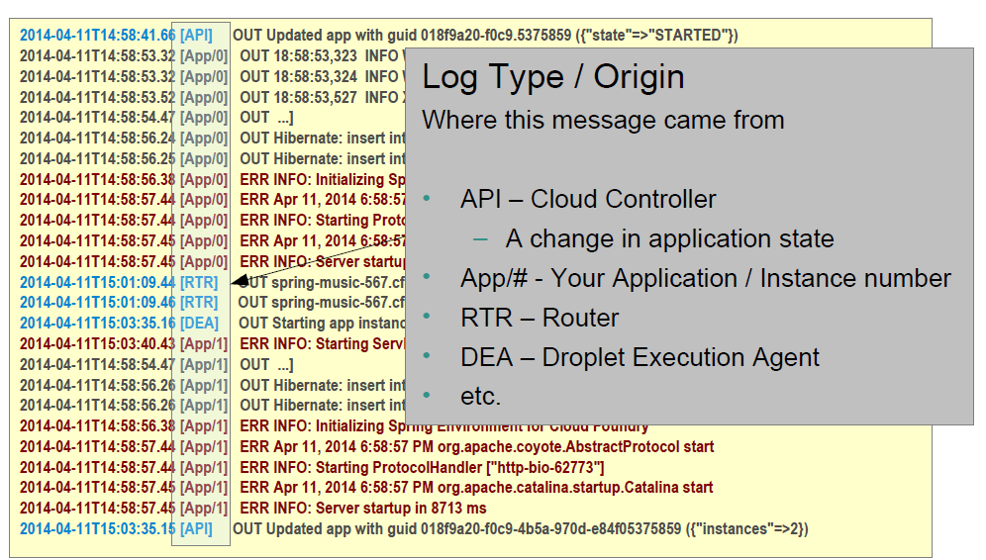
A Tour of Log Output
© 2011 Capgemini - All rights reserved

Slide 11
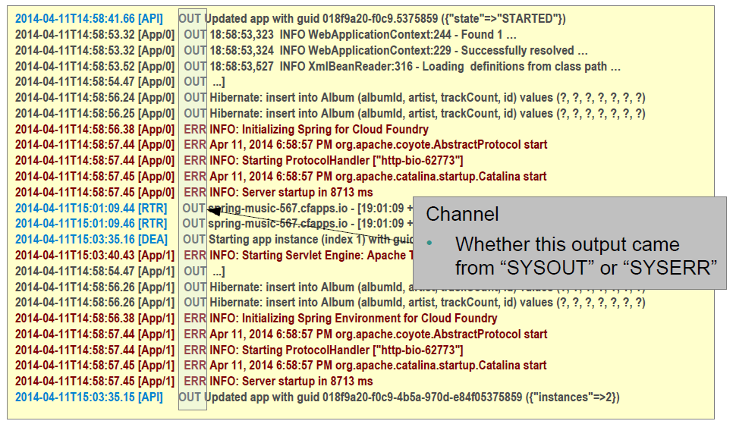
A Tour of Log Output
© 2011 Capgemini - All rights reserved

Slide 12
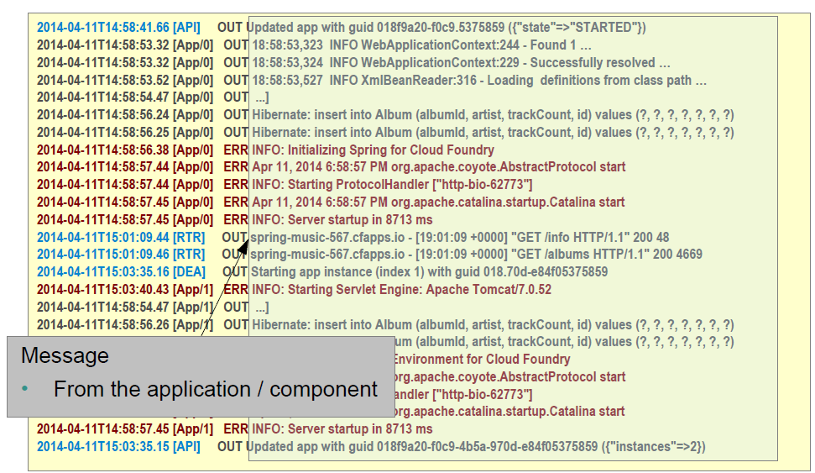
A Tour of Log Output
© 2011 Capgemini - All rights reserved

Slide 13
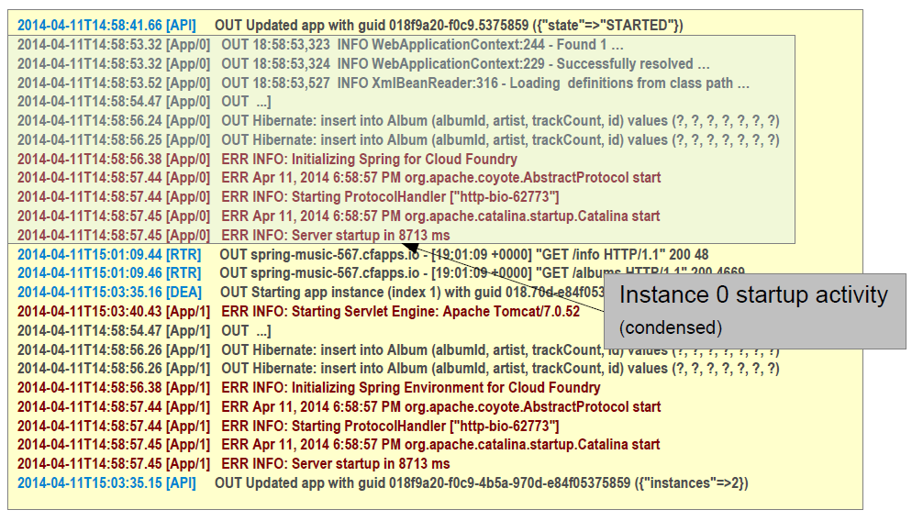
A Tour of Log Output
© 2011 Capgemini - All rights reserved

Slide 14
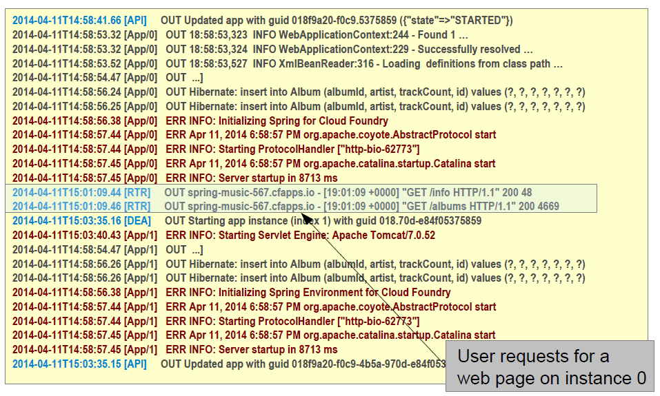
A Tour of Log Output
© 2011 Capgemini - All rights reserved

Slide 15
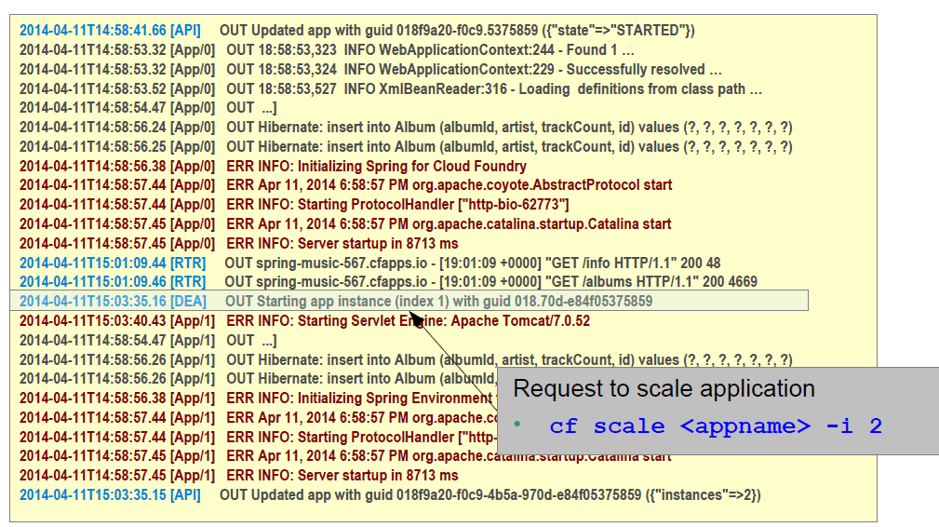
A Tour of Log Output
© 2011 Capgemini - All rights reserved

Slide 16
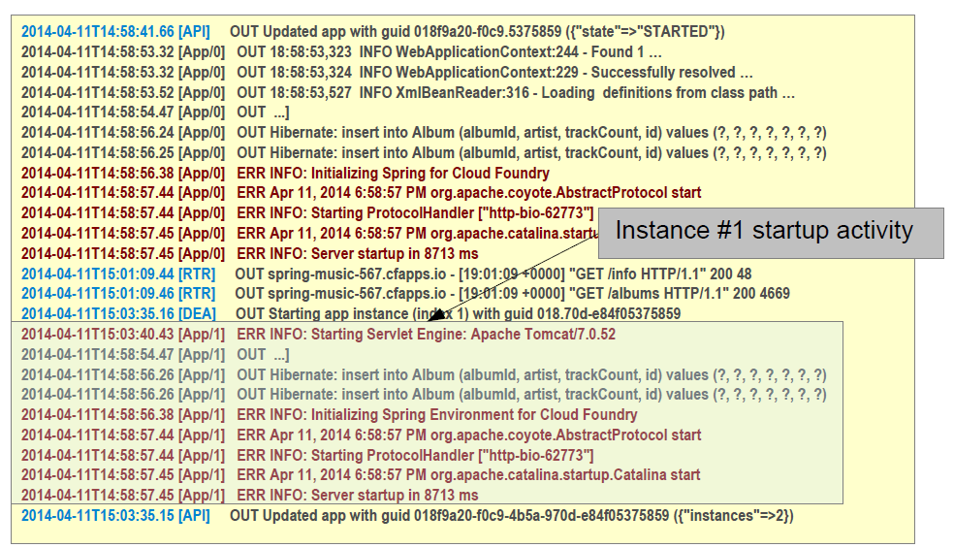
A Tour of Log Output
© 2011 Capgemini - All rights reserved

Slide 17
Accessing Logs
Tailing - provides real time tail of output from loggregator
  cf logs <<app_name>>
  Live feed
  Use <ctrl> c to exit
Recent activity
  cf logs <<app_name>> --recent
© 2011 Capgemini - All rights reserved

Slide 18
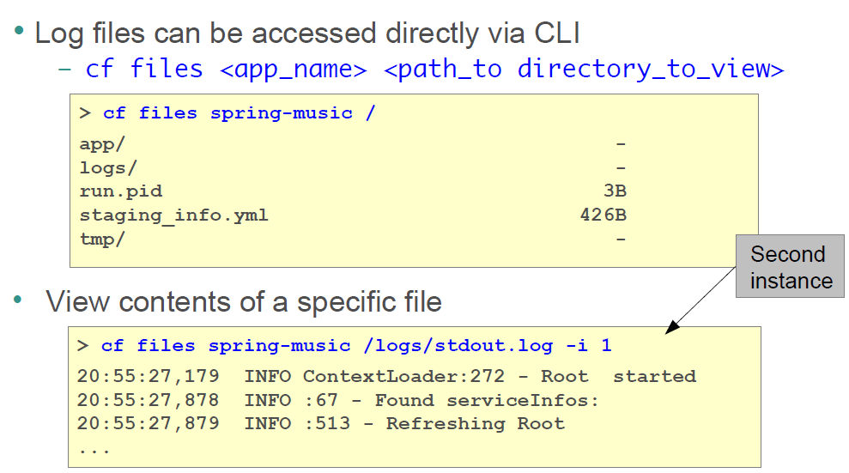
Direct Access to Files/Logs
© 2011 Capgemini - All rights reserved

Slide 19
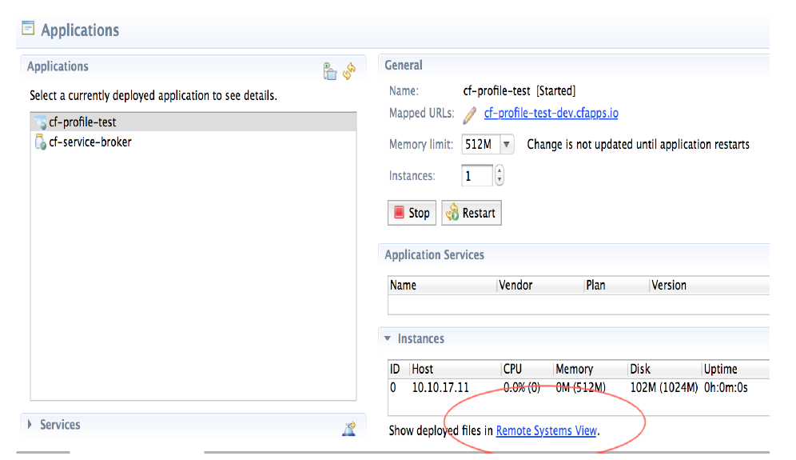
Eclipse Remote System View
© 2011 Capgemini - All rights reserved

Slide 20
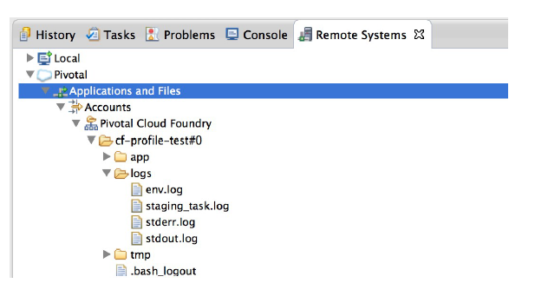
Eclipse Remote Systems View - cont
Eclipse plug-in for Cloud Foundry
  Remote Systems View
  Access logs
© 2011 Capgemini - All rights reserved

Slide 21
TROUBLESHOOTING
© 2011 Capgemini - All rights reserved

Slide 22
Troubleshooting applications in Cloud Foundry
Troubleshooting Applications in Cloud Foundry can be hard
  Deployment / push issues
  Runtime issues
Important to be familiar with the tools at your disposal
© 2007 Capgemini - All rights reserved

Slide 23
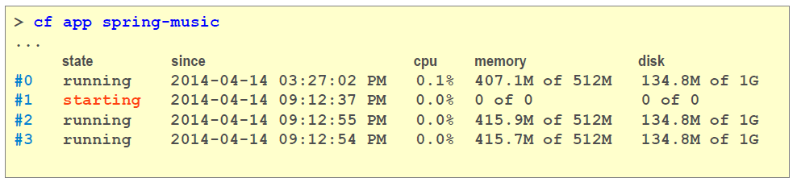
cf apps command
cf apps - Lists all applications within a space
  ... and their status
cf apps <app-name> - Lists all instances of an application within a space
  ... and their status
© 2011 Capgemini - All rights reserved

Slide 24
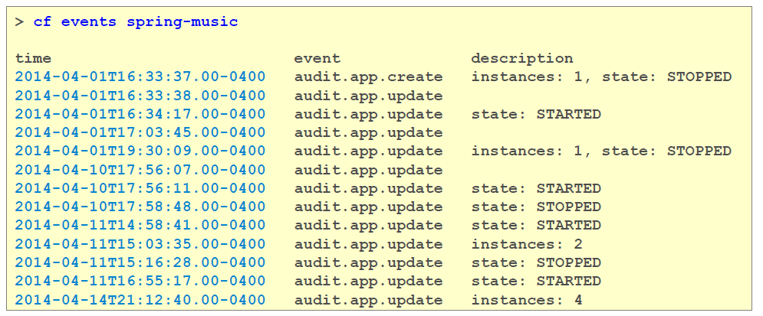
Events
cf events <app-name>
  Event log related to your application
© 2011 Capgemini - All rights reserved

Slide 25
Recent Logs
Obtain most recent subset of logs
  very useful when diagnosing a crash
  cf logs <app-name> --recent
© 2011 Capgemini - All rights reserved

Slide 26
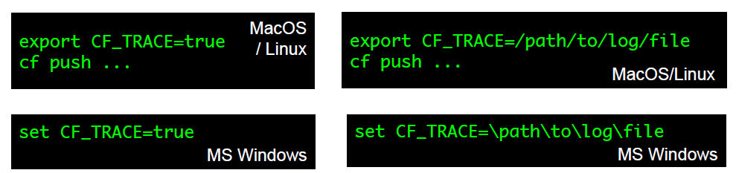
CF_TRACE
Set this environment variable
  On our own machine (not a Cloud Foundry variable)
  Detected by the cf utility causing it to generate extra debugging output
  Displays REST messages between cf and Cloud Foundry
Usage
© 2011 Capgemini - All rights reserved

Slide 27
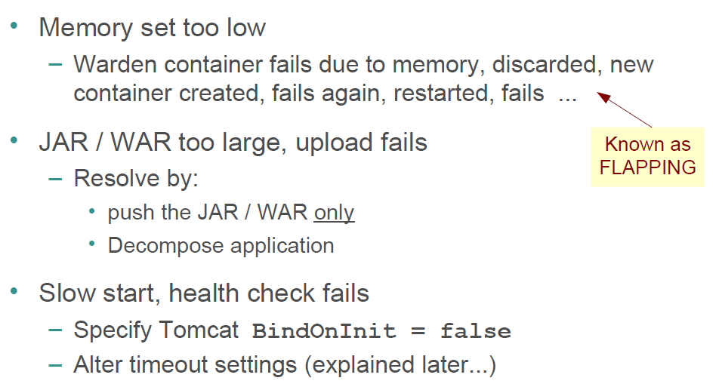
Common CF Deployment Issue - Java
© 2011 Capgemini - All rights reserved

Slide 28
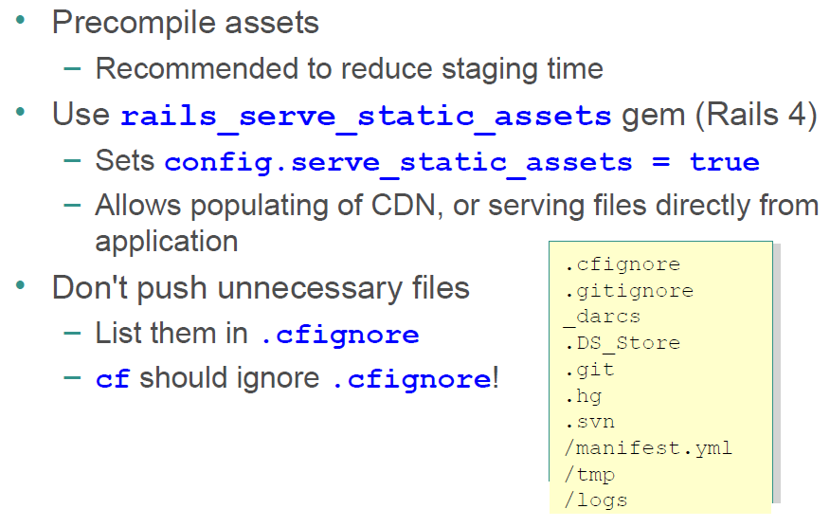
Best Practices - Ruby
© 2011 Capgemini - All rights reserved

Slide 29
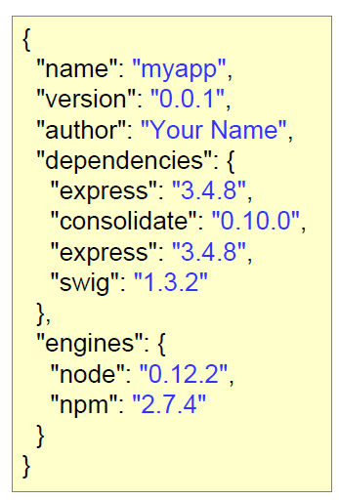
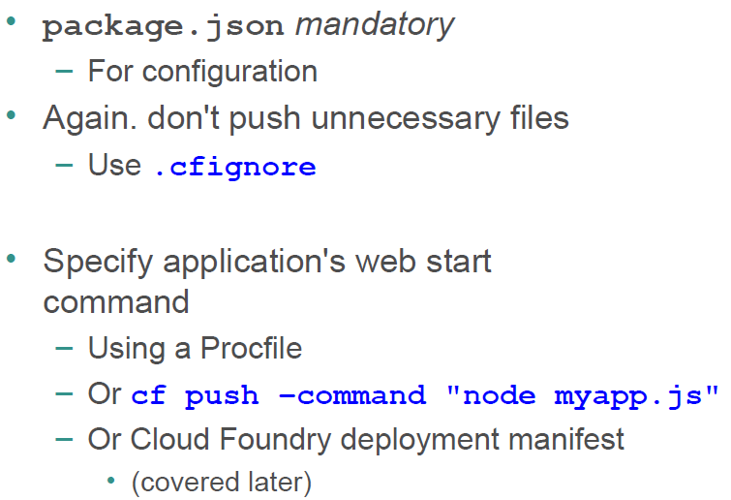
Best Practices – Node.js
© 2011 Capgemini - All rights reserved

Slide 30

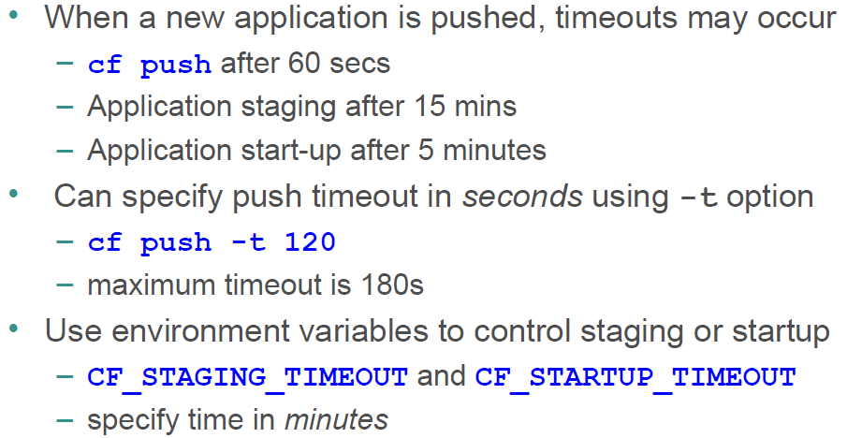
Controlling Timeouts
© 2011 Capgemini - All rights reserved

Slide 31
What about IDE Debugging?
Connecting an IDE to an application running on Cloud Foundry is basically not possible
Cloud Foundry restricts incoming traffic
  Only HTTP on port 80 & 443
Work-arounds are possible
  Described in later module
Recommendations: debug applications locally, rely on techniques just described for troubleshooting.
© 2011 Capgemini - All rights reserved

Slide 32
HOW DEPLOYMENT HAPPENS
© 2011 Capgemini - All rights reserved

Slide 33
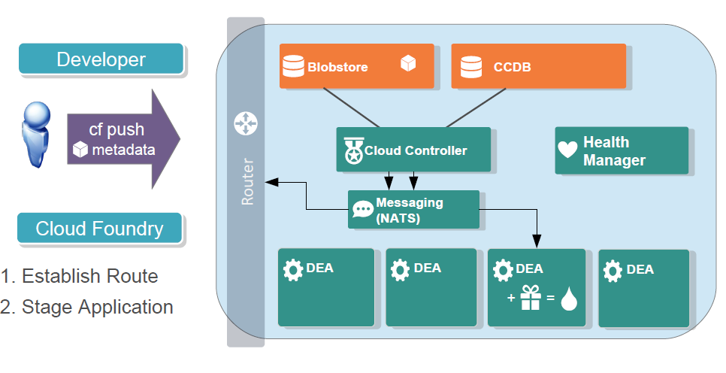
Deploying App to Cloud Foundry
Push & Staging
© 2011 Capgemini - All rights reserved

Slide 34
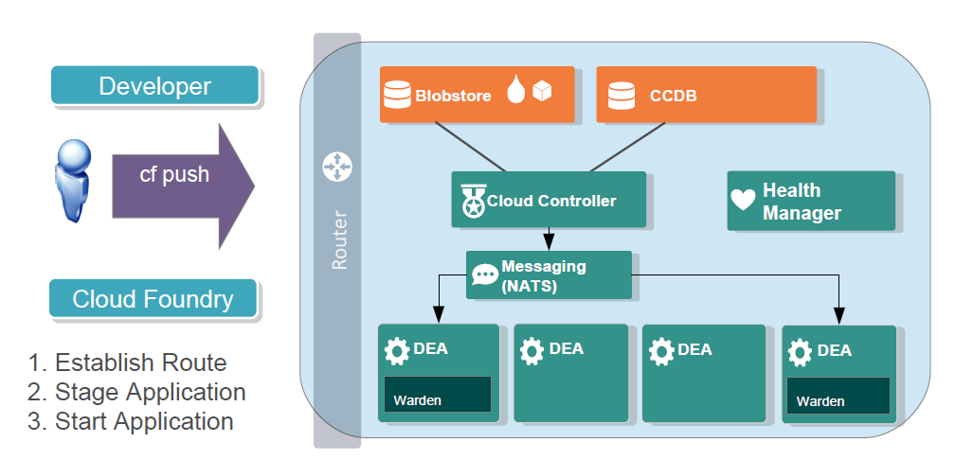
Deploying App to Cloud Foundry
Starting
© 2011 Capgemini - All rights reserved

Slide 35
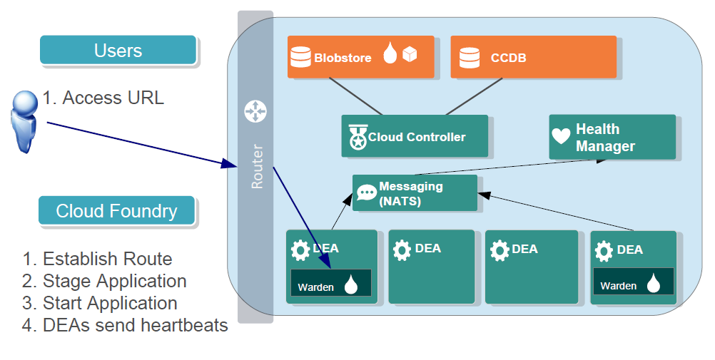
Deploying App to Cloud Foundry
Health Management & Running
© 2011 Capgemini - All rights reserved

Slide 36
Summary
How to log and troubleshooting application
How deployment Happens
© 2011 Capgemini - All rights reserved

Slide 37
Recap
Log
CF_TRACE
troubleshooting
deployment
cf logs
cf events
© 2014 Capgemini - All rights reserved
Notes:
Recap – tips : To make it further lighter, many facilitator ask participant that they were allow to leave only if they will answer say 12 correct answers out of 15 questions. And then produce all recaps as questions.
© 2006 Capgemini - All rights reserved

Slide 38
Notes:
© 2006 Capgemini - All rights reserved

