Slide 1
Pivotal Cloud Foundry – Managing Applications
Notes:
© 2006 Capgemini - All rights reserved

Slide 2
Objectives of PCF
Purpose:
  To learn how to manage applications in cloud founry.
Product:
  Log Management
  Application Performance management
  Autoscaling
  Zero-Downtime Deployments
Process:
  Understand 3rd party log, auto scaling, APM and zero-downtime deployments.
© 2014 Capgemini - All rights reserved

Slide 3
Table of Contents
Log Management
Application Performance management
Autoscaling
Zero-Downtime Deployments
© 2014 Capgemini - All rights reserved

Slide 4
LOG MANAGEMENT
© 2011 Capgemini - All rights reserved

Slide 5
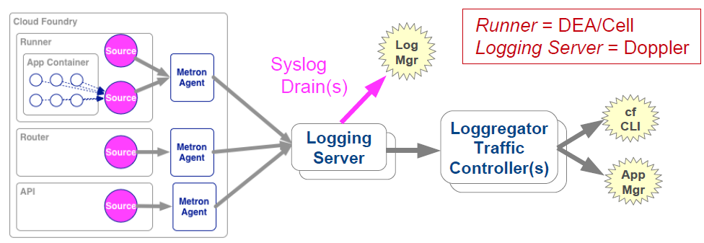
Recall: Log Aggrgation Architecture
Collects log output from app instance, CF components
Aggregates into a consolidated log
Sinks to cf logs, App Mgr, third-party log managers
© 2011 Capgemini - All rights reserved

Slide 6
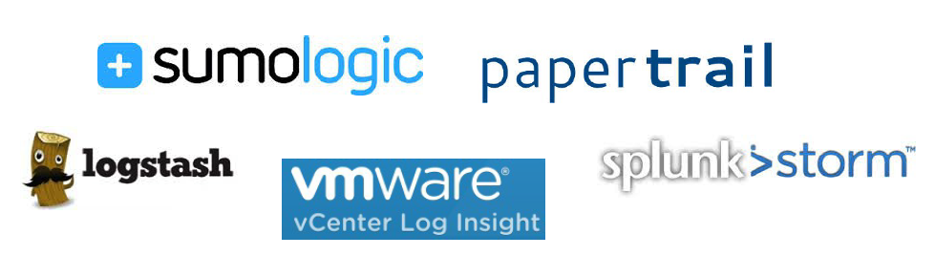
Why Third-Party Log Managers?
Recommended approach
  Can store far more logging information than CF
  Allow for persistence, storage, searching, analyzing, metrics
Variety of third-party log managers supported:
© 2011 Capgemini - All rights reserved

Slide 7
Connecting to Third-Party Log Managers
Setup Log Managers, determine HOST and PORT.
  Process varies according to vendor
Create User ProvidedService with a Syslog drain:
  cf cups <SERVICE> -l syslog://<HOST>:<PORT>
Bind to application, restage
  Cloud Foundry sinks loggregator output to this drain for this application
© 2011 Capgemini - All rights reserved

Slide 8
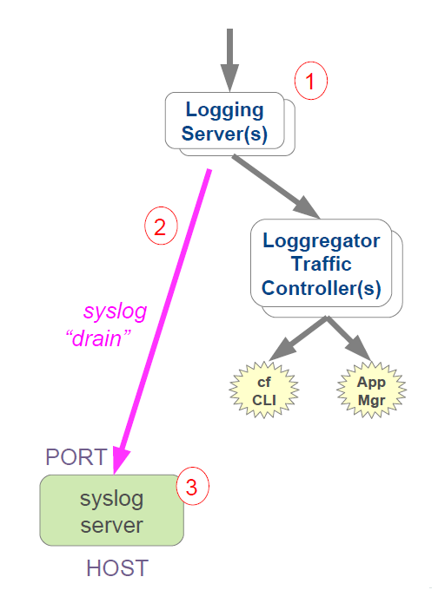



How It Works
All output for app collected by Logging(Doppler) server
Loggregator opens socket to HOST:PORT
  sends all log info for app to socket in syslog format
Received by third-party syslog server
© 2011 Capgemini - All rights reserved

Slide 9
Example: PWS and PaperTrail
PaperTrail: Cloud-based Log Manager
  Create account at https://papertrailapp.com
  Use the "Add System" button
    Papertrail will provide you the URL to use for your syslog drain
    Example: logs2.papertrailapp.com:41845
© 2011 Capgemini - All rights reserved

Slide 10
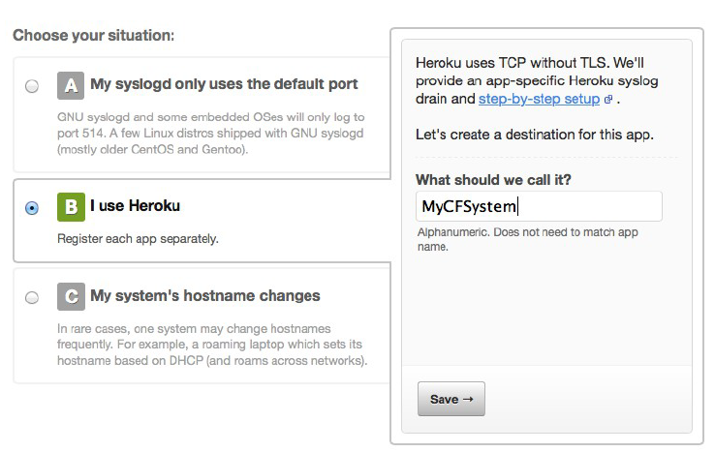
Example: PWS and PaperTrail
Click the "Alternatives" link
Select the "Heroku" option
Name your system
© 2011 Capgemini - All rights reserved

Slide 11
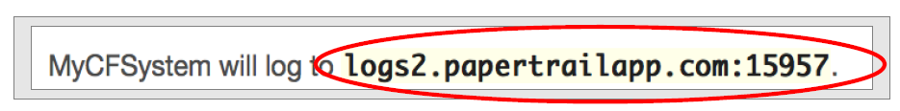
Example: PWS and PaperTrail
Setup user defined service using Papertrail's URL
Create User Provided Service with a Syslog drain:
    cf cups the-drain -l
    syslog://logs2.papertrailapp.com:15957
Bind to application, restart:
    cf bind-service the-app the-drain
    cf restart the-app
© 2011 Capgemini - All rights reserved

Slide 12
About Syslog
De facto standard for logging on Unix/Linux
  Can log to a file or a server syslogd (via a protocol)
  Splunk, Papertrail and others provide syslog servers
To log to syslog
  Generate a TCP and UDP message in the right format
  Open a socket to your syslog server and send
Higher level logging options exists
  https://github.com/cloudfoundry-community/java-loggregator
  Output handlers for Java logging or log4j/ logback
© 2011 Capgemini - All rights reserved

Slide 13
APPLICATION PERFORMANCE MANAGEMENT
© 2011 Capgemini - All rights reserved

Slide 14

Application Performance Management
Logs and analysis only takes you so far
Important to have real-time monitoring of applications
  Uptime, performance, etc.
Application Performance Monitoring (APM) Tools
  Monitor your application while running
  Several choices available in Cloud Foundry
    PWS - New Relic and AppDynamics
    Pivotal Spring Insight
© 2011 Capgemini - All rights reserved

Slide 15

Pivotal Web Services and New Relic
PWS offers simple interface to New Relic
  Available as Marketplace Service
  Tracks different instances of application
  Monitors down to the line of code
How to Use:
  Create New Relic service in desired space
  Bind to desired Application(s)
  Re-stage application
    Java Buildpack includes New Relic Agent, others may not
  APM available as a link from within PWS
© 2011 Capgemini - All rights reserved

Slide 16
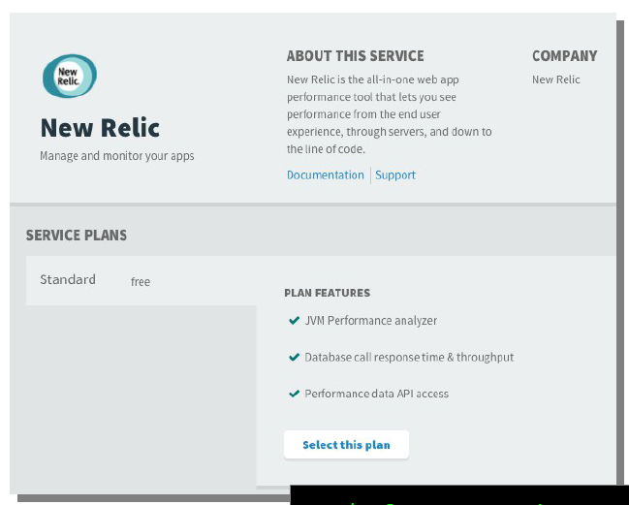

Creating the New Relic Service
Use App Manager Console
Use CF CLI
© 2011 Capgemini - All rights reserved

Slide 17
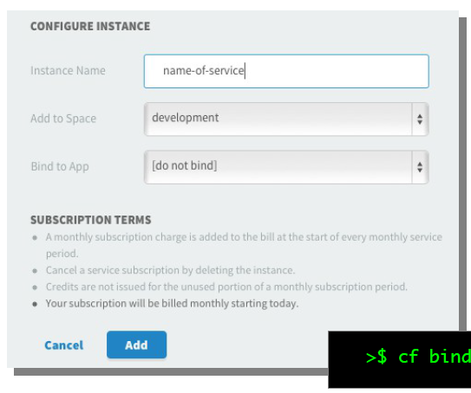

Create Service / Bind Application
Use CF CLI or App Manager Console:
© 2011 Capgemini - All rights reserved

Slide 18
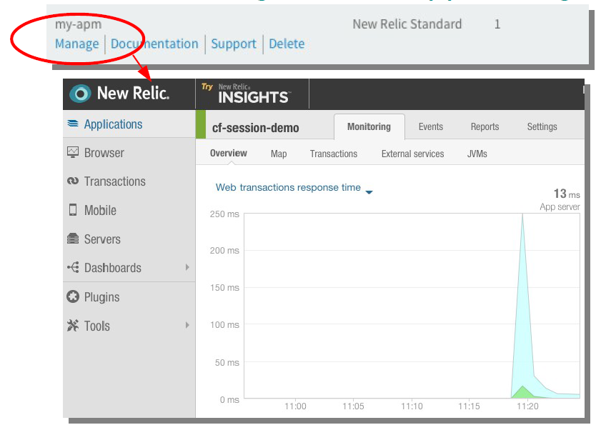
Access via Manage Link in App Manger
© 2011 Capgemini - All rights reserved

Slide 19
AUTOSCALING
© 2011 Capgemini - All rights reserved

Slide 20
Scaling Options
CF allows horizontal scaling
  Controlling the # of instances of an application running
  All behind a common router (load balancer)
  Controllable via the manifest, cf command line, or App Manager console
All options require manaual intervention
© 2011 Capgemini - All rights reserved

Slide 21
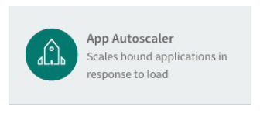
AutoScaling
CF can allow applications to be automatically scaled
  "AutoScaling"
System load can be used as a trigger in place of manual interaction.
Autoscaling Service
  Must be installed by administrator
  Not available in PWS
© 2011 Capgemini - All rights reserved

Slide 22
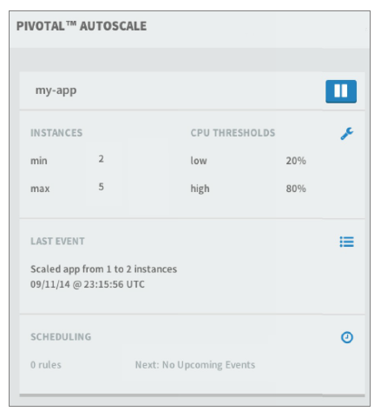
AutoScaling Service - Steps
Create the service
  Select the desired plan
Bind to Application
Set desired scaling parameters
  Add instance whenever high threshold is reached
  Subtract instance whenever low threshold is reached
© 2011 Capgemini - All rights reserved

Slide 23
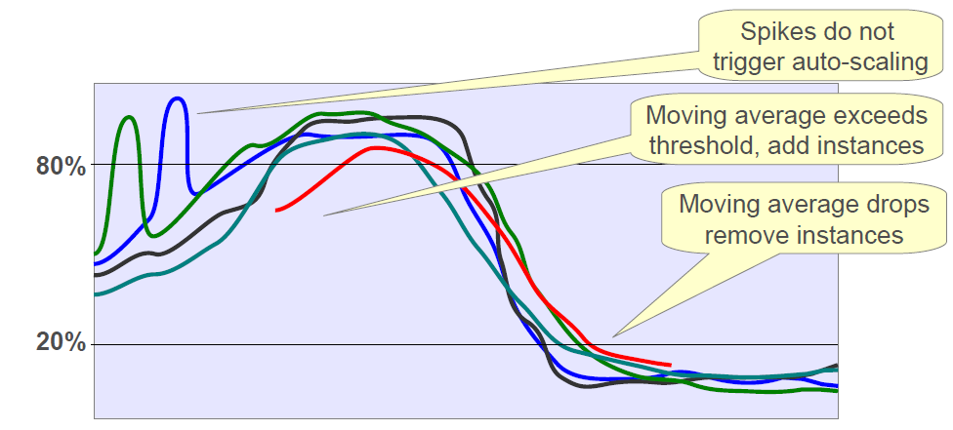

AutoScaling - Moving Average
Scaling activity based on moving averages
  Softens effect of temporary spikes
Manual scaling disables AutoScaling
  Re-enable:
© 2011 Capgemini - All rights reserved

Slide 24
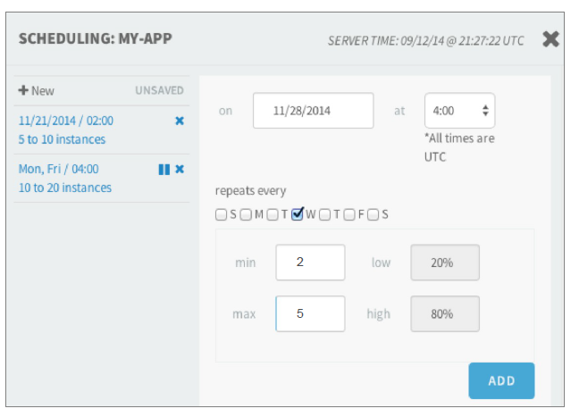
AutoScaling - Scheduling
Autoscaling events can be scheduled
Changes auto scaling behaviour on the given date / time.
May be single event or recurring
© 2011 Capgemini - All rights reserved

Slide 25
ZERO-DOWN TIME DEPLOYMENT
© 2011 Capgemini - All rights reserved

Slide 26
Blue Green Deployments
cf push causes CF to stop old instances, then start new
  Bad news if you are a user
Blue/Green Deployment eliminates user downtime
  Also known as "zero-downtime" or "A/B" Deployment
  Avoids "Site Temporarily Down for Maintenance"
How it works:
  Run 2 versions of an application (new /old)
  Not merely multiple instances
  Alter routes for applications to transfer traffic
  Note: Users can still experience session loss.
© 2011 Capgemini - All rights reserved

Slide 27
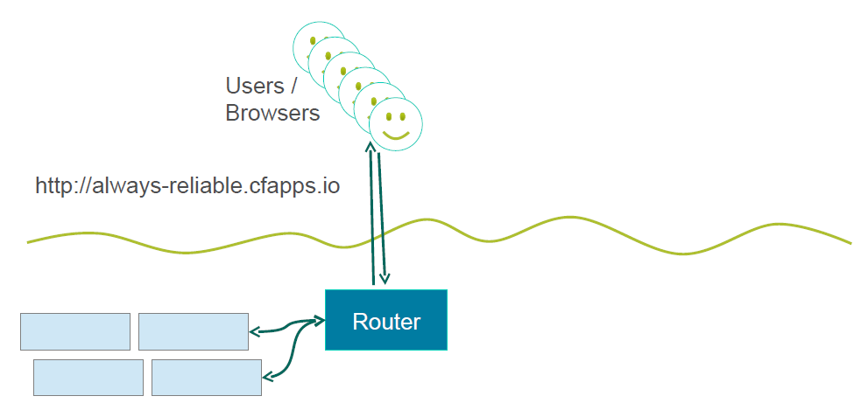
Blue Green Deployment – Existing App
  cf push blue -p app.war -n always-reliable -i 4
© 2011 Capgemini - All rights reserved

Slide 28
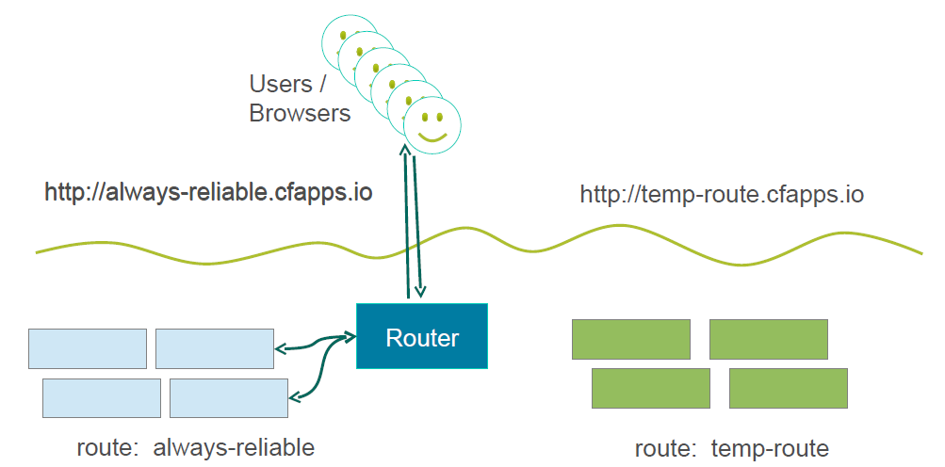
Blue Green Deployment – New App
cf push green -p app.war -n temp-route -i 4
© 2011 Capgemini - All rights reserved

Slide 29
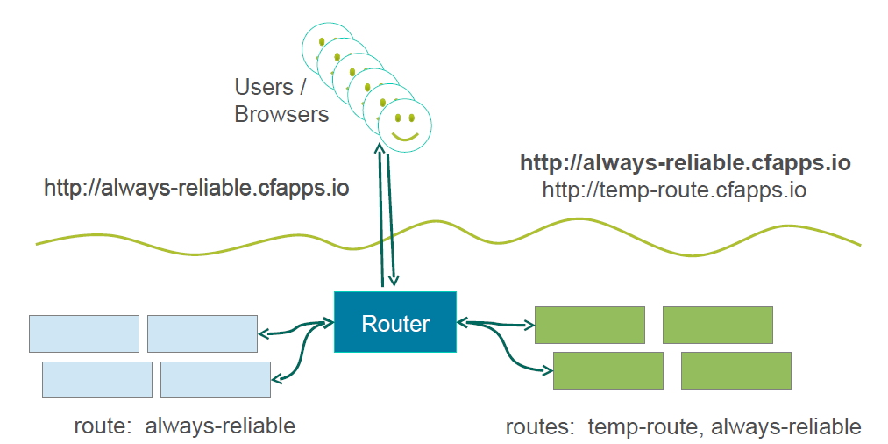
Blue Green Deployment – Duplicate Route
  cf map-route green cfapps.io -n always-reliable
© 2011 Capgemini - All rights reserved

Slide 30
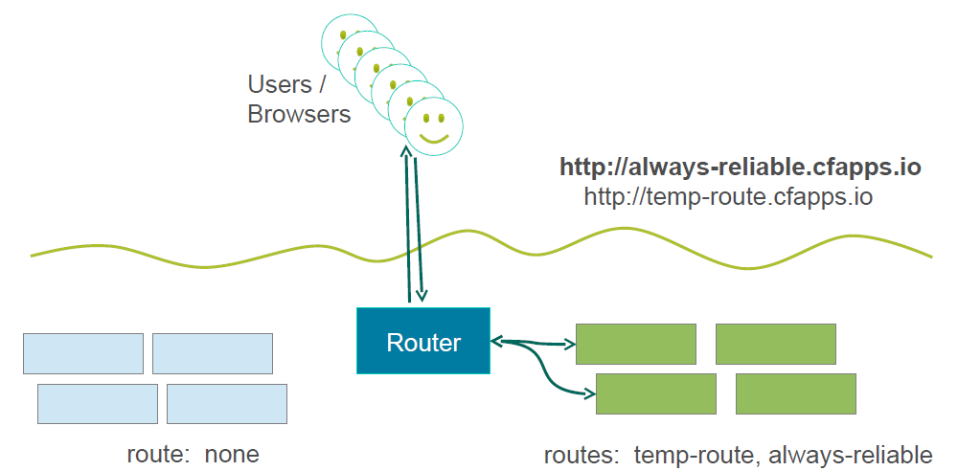
Blue Green Deployment – Disconnect Blue
  cf unmap-route blue cfapps.io -n always-reliable
© 2011 Capgemini - All rights reserved

Slide 31
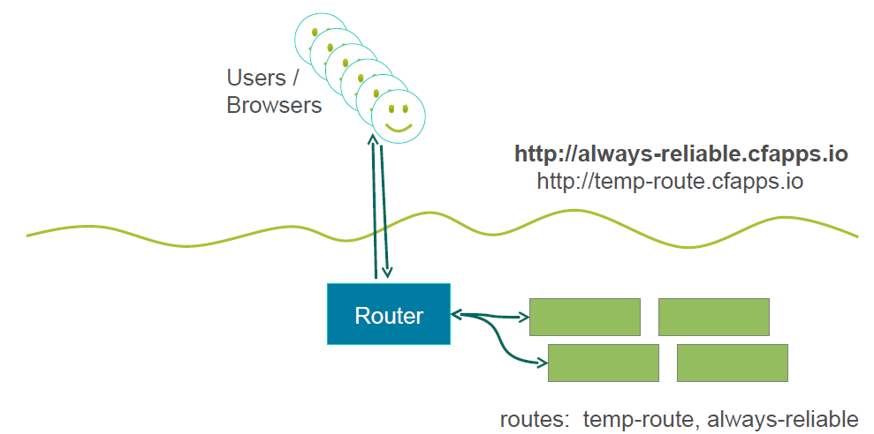
Blue Green Deployment – Remove Blue
  cf delete blue
© 2011 Capgemini - All rights reserved

Slide 32
Canary Deployments
variation on the Blue/Green deployment
  "Canary in a coal mine"
Start with many 'blue' instances
Start a single 'green' instance, route traffic to both
  Green instance is the 'Canary'
Watch the Canary
  If it behaves, scale 'green' up /scale 'blue' down.
Continue monitoring and scaling until zero blue instances.
© 2011 Capgemini - All rights reserved

Slide 33
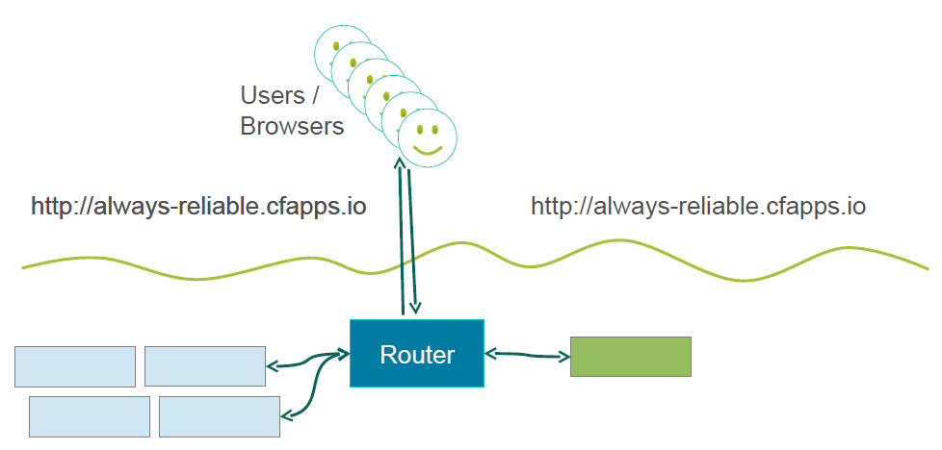
Canary Deployment – Push The Canary
cf push green -p app.war -n always-reliable -i 1
© 2011 Capgemini - All rights reserved

Slide 34
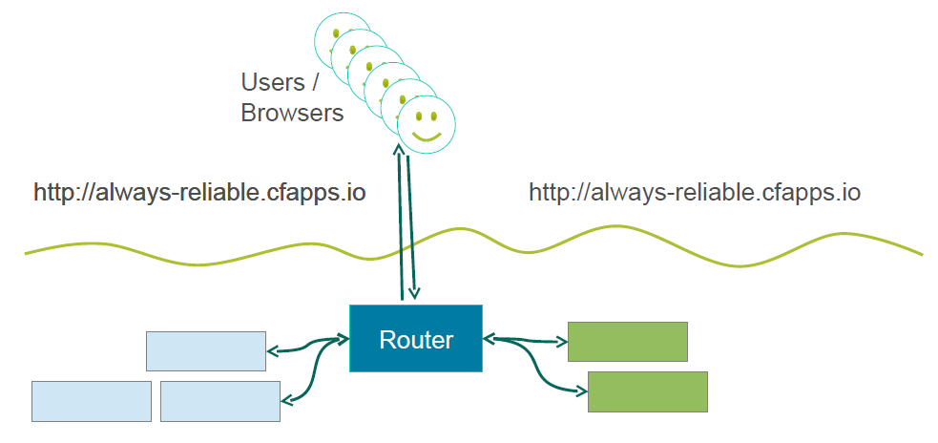
Canary Deployment – Scale Traffic
cf scale green –i 2
cf scale blue –i 3
© 2011 Capgemini - All rights reserved

Slide 35
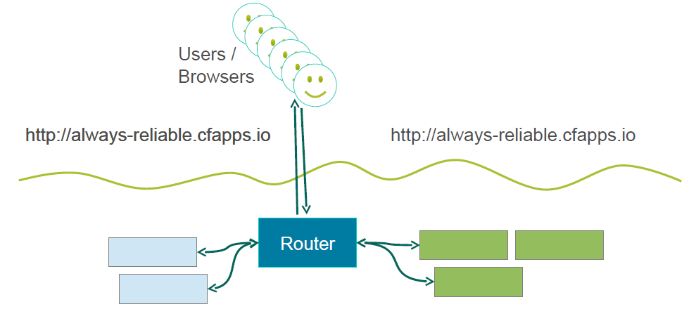
Canary Deployment – Scale Traffic
cf scale green –i 3
cf scale blue –i 2
© 2011 Capgemini - All rights reserved

Slide 36
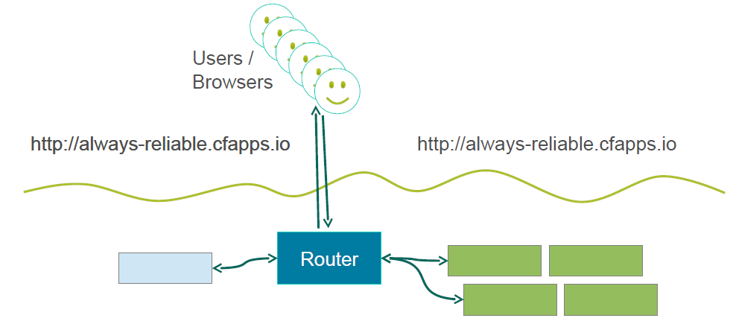
Canary Deployment – Scale Traffic
cf scale green –i 4
cf scale blue –i 1
© 2011 Capgemini - All rights reserved

Slide 37
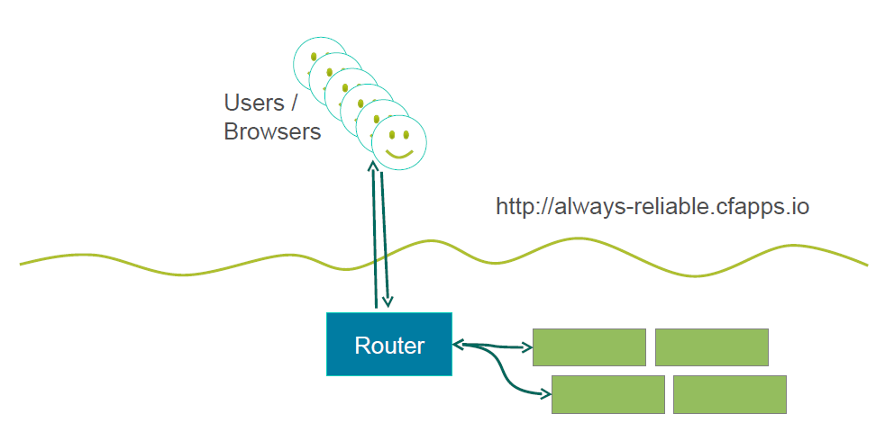
Canary Deployment – Scale Traffic
cf delete blue
© 2011 Capgemini - All rights reserved

Slide 38
Summary
How to integrate with third-party log manager
How to integrate with APM services
How to employ App Autoscaling
How to deploy with zerotime
© 2011 Capgemini - All rights reserved

Slide 39
Recap
3rd party log
autoscale
ops manager
blue
green
zerodown-time
canary
© 2014 Capgemini - All rights reserved
Notes:
Recap – tips : To make it further lighter, many facilitator ask participant that they were allow to leave only if they will answer say 12 correct answers out of 15 questions. And then produce all recaps as questions.
© 2006 Capgemini - All rights reserved

Slide 40
Notes:
© 2006 Capgemini - All rights reserved

