Slide 1
Managing Your Project
SOC10101 (40 Credit)

Slide 2
Induction Week
SOC10101
Turning your ‘Topic’ into a ‘Project’ – Xiaodong and Andrew Tuesday 3pm -5pm F11
Information Searching, by Jane Haigh Wednesday 12pm -1pm F10
Managing your Project – by Xiaodong on how to manage Honours Projects to success Wednesday 11am-12pm F10

Slide 3
Lecture Series
Week | Title
2 | The Format of the Report
3 | Critical Literature Reviewing (a guest lecture by Kendall Richards)
4 | Maintaining Good Academic Practice in your Project (including guest lecture by Dr Phil Turner)
Lectures for the Honours Project are held in weeks 2-4 ONLY
Wednesday 11am-12pm F10

Slide 4
Honours Project Moodle Site
Everything on this website should be read by you – avidly
  LS000890 - Honours Project (SOC10101 Jan 2017)
All the information you require to help you start, manage and submit a successful project is contained here
If you’ve not read the project handbook – do it today!

Slide 5
What We’ll Cover
The learning outcomes:
  Briefly; we’ll look at these in more detail in the lecture in week 2
The process:
  Exhaustively; today we’ll go over all the main forms, meetings and events

Slide 6
The learning outcomes
Manage a substantial individual project, including planning, documentation and control.
Construct a focussed problem statement and conduct a suitable investigation, including literature or technology review, into the context of that problem.
Demonstrate professional competence by applying appropriate theory and practice to the analysis, design, implementation and evaluation of a non-trivial set of deliverables.

Slide 7
The learning outcomes
4. Show a capacity for self-appraisal by analysing the strengths and weaknesses of the project process and outcomes with reference to the initial objectives and to the work of others.
5. Provide evidence of the foregoing in the form of a report.
6. Defend the work orally at a Viva Voce examination and by means of a poster presentation.

Slide 8
Who’s Involved?
Module leader: Xiaodong Liu, C55, x.liu@napier.ac.uk
  Maintains the running of the module, makes sure students, supervisors and second markers know their responsibilities
You, the student
  Takes responsibility for the project, manages the work, submits paperwork to the School Office (C34) and maintains communications with supervisor
Supervisor
  Works with the student throughout the project, via regular meetings
Second Marker
  Completes a report on the IPO, attends Interim Review meeting and the poster session, and conducts the Viva Voce

Slide 9
Main Events/Activities: T1
What | When | Who’s Responsible?
Submission of Project Registration form | Last semester, Friday of Week 15 | Student, with input from the supervisor
Requirements:
The name of a supervisor A project title Awareness of whether project requires ethical clearance Suggestions for second marker (supervisor normally completes that part) Signatures of you & supervisor

Slide 10
Main Events/Activities: T1
What | When | Who’s Responsible?
Submission of Initial Project Overview form | End of week 3 (Friday), to the Moodle IPO Submissions and Feedbacks page | Student, with input from the supervisor
Requirements:
You must provide an overview of the project content & milestones, main deliverables, target audience, work to be done, the knowledge/info required, information sources that provide a context (work already done, state-of-the-art), importance of the project & key challenges IS students must use the special IPO template & guide designed for the IS group (IS-IPO and IS-IPO Guide) You must keep a copy of this for your Report (Appendix 1)

Slide 11
Main Events/Activities: T1
What | When | Who’s Responsible?
Report on the IPO | Week 4 | 2nd marker completes and upload to Moodle IPO Submissions and Feedbacks page
Requirements:
This form is to be completed by the second marker – you’ll get a copy straight afterwards The form will identify whether the project is of the required standard, is viable, is a realistic challenge, is appropriate for your programme/specialisation, and if you are adequately supported The 2nd marker can request that you make changes to the project at this stage

Slide 12
Main Events/Activities: T1
What | When | Who’s Responsible?
Preparation for the Interim Review Meeting | In the run-up to Week 9 | Student
Requirements:
You have to prepare and submit evidence that you have made significant progress with the project It is usual to submit good drafts of chapters of work completed at this point, e.g. literature or technology review. Material should be emailed to Supervisor and 2nd marker well in advance of the meeting

Slide 13
Main Events/Activities: T1
What | When | Who’s Responsible?
Interim Review Meeting | Week 9 earliest, and no later than week 12 | Supervisor arranges, 2nd marker takes the lead
Requirements:
Again, you need to be able to answer questions about the work you’ve done so far You should be able to demonstrate that you’ve attended meetings, have a plan of work, and know how to evaluate your work

Slide 14
Main Events/Activities: T1
What | When | Who’s Responsible?
Report on the Interim Review Meeting | Week 9 earliest, and no later than week 12 | 2nd marker
Requirements:
This form is to be completed by the second marker – you’ll get a copy straight afterwards 2nd marker will comment on your attendance, progress, plan of work, evaluation approach, and make some recommendations You must keep a copy of this for your Report (Appendix 2)

Slide 15
Main Events/Activities: T2
What | When | Who’s Responsible?
Report Submission | Week 12 | Student
Requirements:
Project Report, with accompanying CD (containing the text of your work and any code or other work generated), submitted to the School Office (C34)

Slide 16
Main Events/Activities: T2
What | When | Who’s Responsible?
Poster Session | Week 12 | Student
Requirements:
You must design and produce a poster illustrating the background, the process and the results of your work, and attend the poster session in the JKCC The Poster is assessed as part of LO6

Slide 17
Main Events/Activities: T2
What | When | Who’s Responsible?
Viva Voce | Week13-15 | Supervisor arranges, 2nd marker takes the lead
Requirements:
Prepare! Its not a memory test, but a chance to provide more information about your work. A viva voce is ALWAYS held, and is assessed as part of LO6 Supervisor and 2nd marker complete their marking forms independently BEFORE this meeting, and then complete a joint marking form afterwards

Slide 18
Main Events/Activities: T1 & T2
What | When | Who’s Responsible?
Diary Sheets or equivalent | Weekly | Supervisor & Student
Requirements:
Supervisor should set objectives on a diary sheet during each meeting, to guide the work for the coming week Student should complete the ‘progress’ section before the subsequent meeting Supervisor then provides comments on work done Supervisor then uses a new sheet to set fresh objectives

Slide 19
Today’s Activity
Is designed to help prepare you to meet LO1: Manage a substantial individual project, including planning, documentation and control.
General advice for LO1 includes:
Get a folder for your diary sheets and maintain this: keep all copies
Prepare for project meetings: take the lead in these meetings, and identify areas of difficulty (and possible solutions) early on
Generate a Project Plan as early as possible – and revise it regularly
Be aware of the need to multitask – project work is rarely completely sequential. Activities will overlap, iterations may be necessary.

Slide 20
Today’s Activity
A project plan should:
Identify key dates
Establish the amount of time required for each activity
Distinguish between activities and outputs
Identify critical points for the project
Always be current – regular revisions are necessary

Slide 21
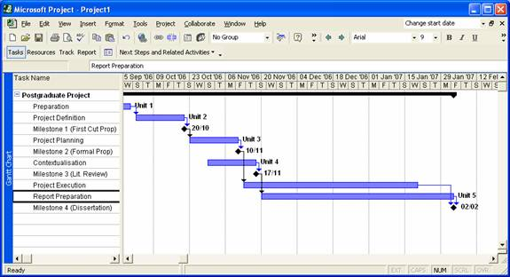
Example 1

Slide 22
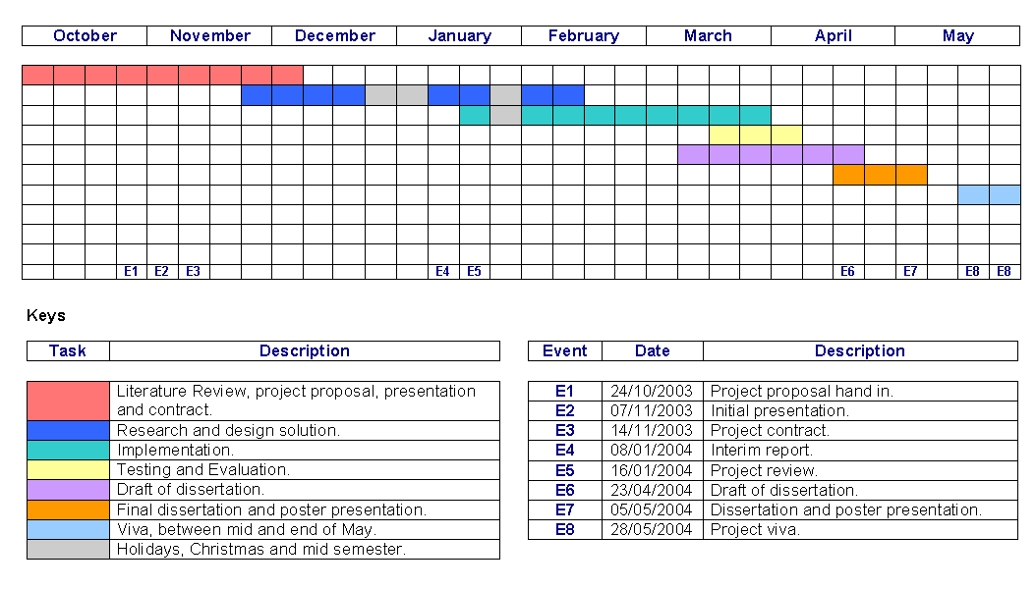
Example 2

Slide 23
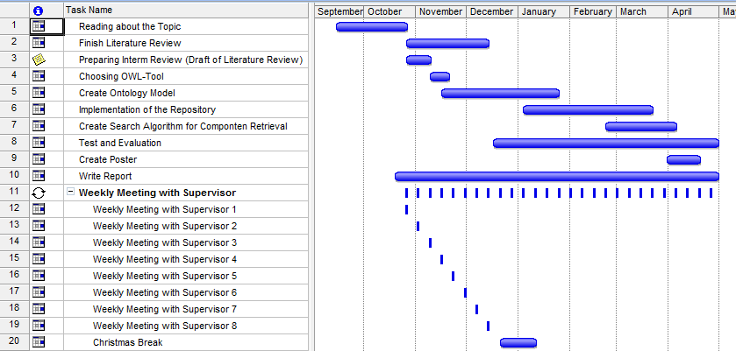
Example 3

Slide 24
Tasks
**Re-form the groups that you were placed in on Tuesday
**Remind yourself of the project idea you generated
**The task of the group is the following:
Produce a project plan for this project
The plan should show the main activities of the project, and how much time is to spent on them (you will need to brainstorm to decide what activities to include)
The plan should also show when outputs (e.g. chapters) are to be produced, and when main activities (e.g. interim review) are to take place.
Use the flipchart paper and pens supplied to record your work

