Slide 1
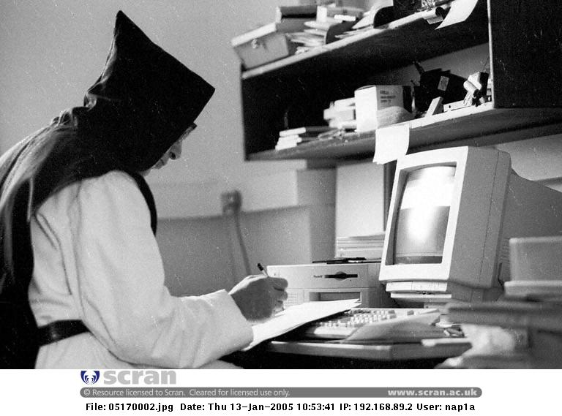
Kendall Richards
Academic Support Adviser Engineering, Computing & Creative Industries
k.richards@napier.ac.uk
X2659

Slide 2







Project Management: general issues
Complacency & procrastination
Supervisor ‘issues’
Lack of searching skills
Over the top searching skills
Fear factor post interim presentation
Getting time to see me or supervisor
Colin Smith

Slide 3
Main problems? You tell me:
Searching
Sources
Note-taking
Writing up
Referencing

Slide 4
Key Skills?
Searching
Reading extensively
Taking notes
Writing up
Analysis
Referencing
Multitasking
Time management

Slide 5
Why are we asking you to do a project?

Slide 6



Purpose of a Dissertation?
Time management and planning
Independent study and self motivation
Decision making and self-confidence
Communication
Creativity and imagination
Analytical and critical ability
Logical reasoning
Creation of something

Slide 7
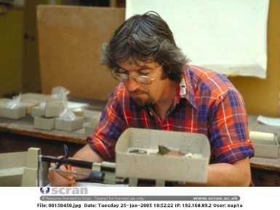
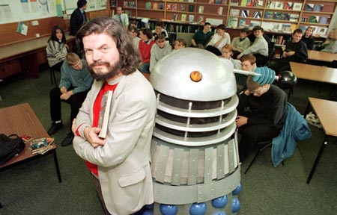
Undergraduates Undertake a Project To:
Develop techniques required to tackle computing problems rigorously
Investigate, design and evaluate a problem
Demonstrate ability to tackle computing problems

Slide 8
What do your lecturers have to say?
Hons Year – main issue is the fact that they own and manage their own time to a greater extent and must plan accordingly. Many also realise too late that Hons year is a competitive year against the classification and against each other.
Getting students with problems to approach Staff, all a bit shy and reluctant, yet this is when they may need the greatest support.

Slide 9
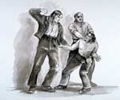

Current Broad View
What are you investigating?
Why are you investigating this?
How do you intend investigating this?

Slide 10
Why were you asked?: Because the following have to be answered in the final paper:
What did you do?
Why did you do it?
How did you do it?
What did you find?
What can you conclude? (So what?)

Slide 11
Deliverables: Objectives and summary
Main aims?
The idea behind this project is….
Main area of interest….
Research question……
My thesis is that….
Make it interesting!

Slide 12
Take some time to do a mind map of ideas for your project:
Discuss it with someone next to you
sources
Themes?
topic
ideas

Slide 13
Identifying a Topic
Developing a
Theoretical position
Extend literature
search
Reading critically
&
note taking
Re-evaluating
Initial position

Slide 14
What are you looking at?
What sources are you/will you be using?
Books
Trade journals
Research journals
E-journals
Data bases

Slide 15
Getting Started: Search
Brainstorm key search terms

Slide 16
Databases? Which ones?
Library
Ieeexplore
Google?
Volunteer please

Slide 17
Found some sources?
Reliability?
Authority?
Objectivity?
Relevance?

Slide 18
How about these that you were asked to look at?
Source 1
Source 2
Source 3
Source 4

Slide 19

Reliability
What is the source: did it come from an academic, government or commercial site or a Usenet newsgroup?
If it is from a commercial site, what is the site designed to sell?
Does the goal affect the quality or objectivity of the information provided?
Accuracy, honesty, stability, support and logistics

Slide 20

Authority
Postings to Usenet groups frequently reflect individual opinion. What do you know about the author?
Source, qualifications, credentials, experience
and level of articulation

Slide 21

Objectivity
Is the information presented objectively, or does it reflect the biases of the author or web site?
How thorough is the coverage compared to other sources?
Motive, neutrality, detachment and
non-opionatedness

Slide 22

Relevance
If your speciality is changing rapidly, how current is the information?
How recently was the site updated?
Does the information retrieved add a significant perspective to your research?
Recency, pertinence and sustainability, maturity

Slide 23

Brainstorm time.
What are the main principles/elements of academic writing?
What do we look for?

Slide 24
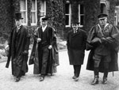


Principles of Academic Communication
Honesty-state only that which can be supported
Reality-be clear and direct in style and aims and objectives
Relevance

Slide 25
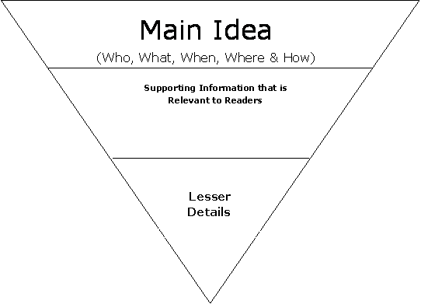
Academic writing: Structure?
Contextualise
Outline
Overview
Thesis
Introduction
Body
Conclusion
Thematic?
Headings?
Broad to specific
Support
Sum up
Support
Thesis?
Conclude

Slide 26
Style?
Formal
Objective
Structured
Example?

Slide 27
Style questions?
Can I use “I”?
Can I give my opinion?
How can I give my opinion?
How can I be precise?

Slide 28
Academic phrasebank

Slide 29
Contents
Abstract
List of tables
List of figures
Acknowledgements
Introduction and aims including: motivation, scope and content
Investigation (lit rev)
Project planning
Analysis
Design
Implementation
Testing
Evaluation
Conclusions
Appendices and references

Slide 30
Abstract
Short (200-300wds)
Statement of objectives, main findings and conclusions
Arouse interest
Use the third person
Write this last

Slide 31
Introduction
State aims
Explain why work was done
Who else has done this? (some references)
Your approach
Should be clear and concise

Slide 32

Literature review
theories
Essential- everything comes out of the literature review
authors
context
gaps
method
scope

Slide 33
Main body
Theory
Materials
Techniques
Results
Discussion/Analysis
Divided into chapters

Slide 34
Conclusion
Discussion of results
Compare results to objectives stated in introduction
How do these compare to other investigators?
Merits of methods used?
Suggestions/improvements/further work?

Slide 35
Define plagiarism.

Slide 36
What Is Plagiarism?
Plagiarism is to take someone else’s words or ideas and present them as your own without proper acknowledgement (Marshall and Rowland, 1998)
Notes:
This could be used as an example to show how an idea has been paraphrased and acknowledged appropriately

Slide 37
Is this plagiarism?
Copying word for word sentences or whole paragraphs
Summarising or changing some of the text
Using your own words to describe what someone else has written

Slide 38
Is this plagiarism?
Repeating a commonly known fact or quote
Working with another student on the same essay and submitting work that is similar
Working in a group and submitting similar work
Copying files, pictures, data, graphs, algorithms or computer code
Repeating something you heard on a news bulletin

Slide 39
Forms of Plagiarism
Quoting directly, paraphrasing or writing about someone’s ideas without giving a reference
Using an author’s exact words without indicating they are quoted and referenced
Presenting your own version of other people’s ideas without acknowledgement
Putting ideas into your own words but only changing a few words

Slide 40
Forms of Plagiarism (Continued)
Taking an image, diagram or artwork from another source without acknowledgement
Collaborating inappropriately with other students when individual work is required
Copying another student’s work or someone else’s work and submitting it as your own

Slide 41
Three Main Rules
Reference included every time someone else’s ideas or information is used
Must be used when you quote, paraphrase, summarise and copy (reproduce figures/diagrams/tables)
References appear in the text of your document and in the reference list and/or bibliography

Slide 42
Benefits of good referencing
You demonstrate accountability
Your work is comprehensible to readers
they can be confident that you have skills in literature searching and have researched the topic thoroughly to find and use material at the appropriate level
they can see how your ideas can be supported by earlier research
The readers have good signposts to original sources should they wish to follow them up

Slide 43
Referencing
Provision of in-text citations
(in the body of the work)
Author-date (Harvard)
2 key activities
Number (Vancouver)
Provision of full citations (usually at the end of the work)
Reference lists
Bibliographies

Slide 44
Referencing
Provision of in-text citations
(in the body of the work)
Author-date (Harvard)
Either/or
Number (Vancouver)

Slide 45
Referencing
Sometimes you are required to provide
- a reference list
- a bibliography
- both a reference list and a bibliography
Many standards exist, e.g. APA, British Standard, journal specific formats
Provision of full citations (usually at the end of the work)
Reference lists
Bibliographies

Slide 46
In-text citations – author-date (Harvard) system
You should provide a reference in the text of your work whenever you use the work of someone else.
At a minimum you give the author name and the date of the publication.
If you paraphrase or quote that person’s work you also need to give the page number of the work (or paragraph number for material from a web page).
The citation in the text is a pointer to the list(s) at the end of your work.

Slide 47
Examples of in-text references
Huberman and Hogg (1994, pp. 2-3) present a "detailed model of collaborative performance enhancement and examine its dynamical consequences for the community as a whole" with direct reference to informal networks supported by incentive schemes as facilitators of learning and problem solving "enhanced by exchanging information". This approach is also illustrated in several papers presented at a recent conference (Proceedings of the Third European Conference on Organizational Knowledge, Learning and Capabilities, 2002), for example work presented on inter-organizational communities of practice (Huang, Newell, & Galliers, 2002). Similarly knowledge sharing as "exchange" is described in the context of studies of collaborative software development (e.g., Lerner, 2001; Scott & Kaindl, 2000, p. 119); economic self-interest in electronic discussion groups (Gray & Meister, 2001); intranets as tools for knowledge transfer (e.g., Hendriks, 1999; Newell, Scarbrough, & Swan 2001); the creation of models of knowledge transactions in computer-mediated networks of practice from a social capital perspective (Faraj & Wasko, 2001); and the development of a knowledge sharing typology based on empirical research with management consultancy firms in Denmark (Jacoby Petersen & Poulfelt, 2002).

Slide 48
In-text references are citation pointers
Examples of in-text references
Huberman and Hogg (1994, pp. 2-3) present a "detailed model of collaborative performance enhancement and examine its dynamical consequences for the community as a whole" with direct reference to informal networks supported by incentive schemes as facilitators of learning and problem solving "enhanced by exchanging information". This approach is also illustrated in several papers presented at a recent conference (Proceedings of the Third European Conference on Organizational Knowledge, Learning and Capabilities, 2002), for example work presented on inter-organizational communities of practice (Huang, Newell, & Galliers, 2002). Similarly knowledge sharing as "exchange" is described in the context of studies of collaborative software development (e.g., Lerner, 2001; Scott & Kaindl, 2000, p. 119); economic self-interest in electronic discussion groups (Gray & Meister, 2001); intranets as tools for knowledge transfer (e.g., Hendriks, 1999; Newell, Scarbrough, & Swan 2001); the creation of models of knowledge transactions in computer-mediated networks of practice from a social capital perspective (Faraj & Wasko, 2001); and the development of a knowledge sharing typology based on empirical research with management consultancy firms in Denmark (Jacoby Petersen & Poulfelt, 2002).

Slide 49
Take care with positioning of citation pointer
Examples of in-text references
Huberman and Hogg (1994, pp. 2-3) present a "detailed model of collaborative performance enhancement and examine its dynamical consequences for the community as a whole" with direct reference to informal networks supported by incentive schemes as facilitators of learning and problem solving "enhanced by exchanging information". This approach is also illustrated in several papers presented at a recent conference (Proceedings of the Third European Conference on Organizational Knowledge, Learning and Capabilities, 2002), for example work presented on inter-organizational communities of practice (Huang, Newell, & Galliers, 2002). Similarly knowledge sharing as "exchange" is described in the context of studies of collaborative software development (e.g., Lerner, 2001; Scott & Kaindl, 2000, p. 119); economic self-interest in electronic discussion groups (Gray & Meister, 2001); intranets as tools for knowledge transfer (e.g., Hendriks, 1999; Newell, Scarbrough, & Swan 2001); the creation of models of knowledge transactions in computer-mediated networks of practice from a social capital perspective (Faraj & Wasko, 2001); and the development of a knowledge sharing typology based on empirical research with management consultancy firms in Denmark (Jacoby Petersen & Poulfelt, 2002).

Slide 50
Take care with positioning of citation pointer
Examples of in-text references
Huberman and Hogg (1994, pp. 2-3) present a "detailed model of collaborative performance enhancement and examine its dynamical consequences for the community as a whole" with direct reference to informal networks supported by incentive schemes as facilitators of learning and problem solving "enhanced by exchanging information". This approach is also illustrated in several papers presented at a recent conference (Proceedings of the Third European Conference on Organizational Knowledge, Learning and Capabilities, 2002), for example work presented on inter-organizational communities of practice (Huang, Newell, & Galliers, 2002). Similarly knowledge sharing as "exchange" is described in the context of studies of collaborative software development (e.g., Lerner, 2001; Scott & Kaindl, 2000, p. 119); economic self-interest in electronic discussion groups (Gray & Meister, 2001); intranets as tools for knowledge transfer (e.g., Hendriks, 1999; Newell, Scarbrough, & Swan 2001); the creation of models of knowledge transactions in computer-mediated networks of practice from a social capital perspective (Faraj & Wasko, 2001); and the development of a knowledge sharing typology based on empirical research with management consultancy firms in Denmark (Jacoby Petersen & Poulfelt, 2002).

Slide 51
Consider the value of quoting over paraphrasing
Examples of in-text references
Huberman and Hogg (1994, pp. 2-3) present a "detailed model of collaborative performance enhancement and examine its dynamical consequences for the community as a whole" with direct reference to informal networks supported by incentive schemes as facilitators of learning and problem solving "enhanced by exchanging information". This approach is also illustrated in several papers presented at a recent conference (Proceedings of the Third European Conference on Organizational Knowledge, Learning and Capabilities, 2002), for example work presented on inter-organizational communities of practice (Huang, Newell, & Galliers, 2002). Similarly knowledge sharing as "exchange" is described in the context of studies of collaborative software development (e.g., Lerner, 2001; Scott & Kaindl, 2000, p. 119); economic self-interest in electronic discussion groups (Gray & Meister, 2001); intranets as tools for knowledge transfer (e.g., Hendriks, 1999; Newell, Scarbrough, & Swan 2001); the creation of models of knowledge transactions in computer-mediated networks of practice from a social capital perspective (Faraj & Wasko, 2001); and the development of a knowledge sharing typology based on empirical research with management consultancy firms in Denmark (Jacoby Petersen & Poulfelt, 2002).

Slide 52
Provision of page numbers (or non-provision) is meaningful
Examples of in-text references
Huberman and Hogg (1994, pp. 2-3) present a "detailed model of collaborative performance enhancement and examine its dynamical consequences for the community as a whole" with direct reference to informal networks supported by incentive schemes as facilitators of learning and problem solving "enhanced by exchanging information". This approach is also illustrated in several papers presented at a recent conference (Proceedings of the Third European Conference on Organizational Knowledge, Learning and Capabilities, 2002), for example work presented on inter-organizational communities of practice (Huang, Newell, & Galliers, 2002). Similarly knowledge sharing as "exchange" is described in the context of studies of collaborative software development (e.g., Lerner, 2001; Scott & Kaindl, 2000, p. 119); economic self-interest in electronic discussion groups (Gray & Meister, 2001); intranets as tools for knowledge transfer (e.g., Hendriks, 1999; Newell, Scarbrough, & Swan 2001); the creation of models of knowledge transactions in computer-mediated networks of practice from a social capital perspective (Faraj & Wasko, 2001); and the development of a knowledge sharing typology based on empirical research with management consultancy firms in Denmark (Jacoby Petersen & Poulfelt, 2002).

Slide 53
Use appropriate abbreviations
Examples of in-text references
Huberman and Hogg (1994, pp. 2-3) present a "detailed model of collaborative performance enhancement and examine its dynamical consequences for the community as a whole" with direct reference to informal networks supported by incentive schemes as facilitators of learning and problem solving "enhanced by exchanging information". This approach is also illustrated in several papers presented at a recent conference (Proceedings of the Third European Conference on Organizational Knowledge, Learning and Capabilities, 2002), for example work presented on inter-organizational communities of practice (Huang, Newell, & Galliers, 2002). Similarly knowledge sharing as "exchange" is described in the context of studies of collaborative software development (e.g., Lerner, 2001; Scott & Kaindl, 2000, p. 119); economic self-interest in electronic discussion groups (Gray & Meister, 2001); intranets as tools for knowledge transfer (e.g., Hendriks, 1999; Newell, Scarbrough, & Swan 2001); the creation of models of knowledge transactions in computer-mediated networks of practice from a social capital perspective (Faraj & Wasko, 2001); and the development of a knowledge sharing typology based on empirical research with management consultancy firms in Denmark (Jacoby Petersen & Poulfelt, 2002).

Slide 54
worldcat

Slide 55
Time Management: Control of your Environment
Set aside a place for study and only study
Before you begin a piece of work, write down the time you expect to finish and what you expect to have done
Strengthen your ability to study by using a social symbol
If your mind wanders, stop and remove yourself
Set aside certain times for study. Certain behaviour can become habitual.
Don’t start unfinished business just before the time to start studying
Set small, short-range sub goals
Keep a reminder pad
Relax before you study and schedule breaks.

Slide 56
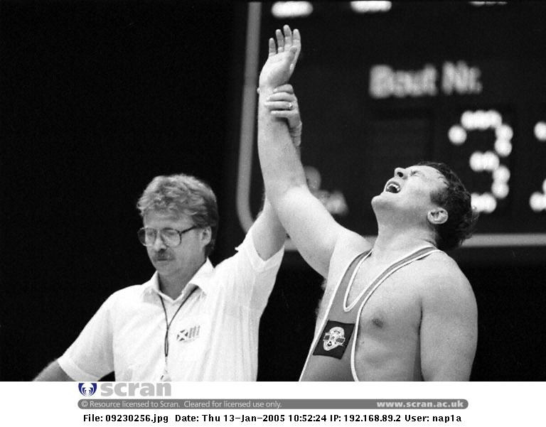

Points to Ponder
The only person who likes change is a wet baby.

Slide 57
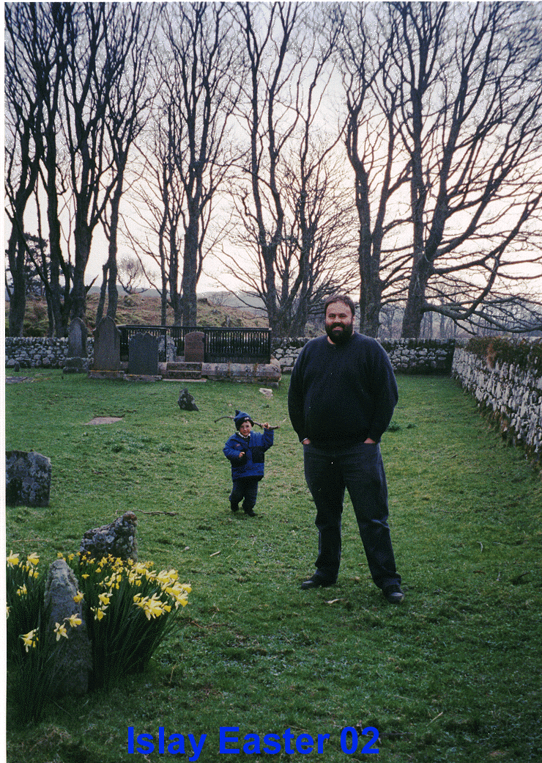
Little Things Can Sneak up on You!

Slide 58
What is critical thinking and analysis?

Slide 59
How might Critical Thinking be applied to other disciplines?
Computing project?
Work with a partner (or more) in the same discipline
Break down your discipline. What is it exactly that you do?
Where else can critical thinking be applied?

Slide 60
How do I do this?
Note making not note taking
Wide and varied reading
Synthesis
Analysis interpretation

Slide 61
Critical Thinking reduced to three components
Clarity
Accuracy
Relevance
Critical thinkers are sceptical.

Slide 62

It is not:
Description
Narrative
Repetition
Blah blah blah

Slide 63
It is
Evaluation, discussion, comparison and contrast, analysis
Look for:
Similarities
Common issues raised
Contradictions (why?)
Criticisms
On balance, what is your academic opinion?

Slide 64
Scholarship
Significance:
 | Criticality - Criticality / Scholarship / Analysis | Sources – How these are used in the assignment | Focus – How much the writing focuses on the task | Structure - of text and paragraphs | Language – Whether it is academic and appropriate
1 | Critical, Justified, Analytical, Original | Excellent range of sources; balanced, contextualised, and critiqued | Totally focused on the task, nothing irrelevant | No changes – nothing to remove, nothing to add | Totally appropriate, nothing redundant
2 | Critical, Justified, Analytical | Excellent range of sources; balanced and contextualised | Almost totally focused on the task and very little irrelevant. | All parts exist – some parts could be fuller / some could be removed | Almost totally appropriate / very little redundant
3 | Critical, not always justified, not enough analysis | Very good range of sources | Mostly relevant | All parts exist, some should be fuller / some should be removed | Mostly appropriate
4 | Sometimes critical, not always justified, not always analytical | Good range of sources | Much relevance, much irrelevance, much absence | All parts exist, some very incomplete, some redundant | Generally appropriate
5 | Very little criticality – mostly narrative | Some sources used | Often irrelevant | Some parts missing | Often inappropriate
6 | No criticality – all narrative | Very few sources | Highly irrelevant | Many parts missing | Highly inappropriate
7 | No criticality – all narrative | None used / danger of plagiarism | Totally irrelevant | Non-existent | Totally inappropriate

Slide 65
Model paper:
Document

Slide 66
Look at any article:
Skim the article
Anything stand out?
Think of any lectures you might have had that relate
Use the grid system to identify key concepts/themes/arguments
Make some bullet points
Write an analytical summary of the article with references

Slide 67
Computing?
Different Programming languages, analysis of strategies, software etc
Object Oriented Language and toolkits: similarities and differences
Operating systems: subtleties of how processes are handled
Artificial Intelligence: assumptions
Programming: what is to be accomplished? How are the objectives determined? What steps are to be taken?

Slide 68
Reduced to three components
Clarity
Accuracy
Relevance
And perhaps ethics.
Critical thinkers are sceptical.

Slide 69
How do I do this?
Note making not note taking
Synthesis
Analysis interpretation

Slide 70
The five ‘R’ s in note taking/making
Record- during lecture, reading
Reduce- as soon after as possible, summarise ideas/concepts. Summarising clarifies meanings and relationships and strengthens memory
Recite- cover notes and use only cues and maps to help recall content in your own words
Reflect- reflective students question/compare/contrast/evaluate. Unless ideas are reflected on and used they become stale and inert.
Review- 10 minutes each week for a quick review will help retain knowledge

Slide 71
Use Grids to plan writing.
Planning, activity, results, discussion
Report sections

Slide 74
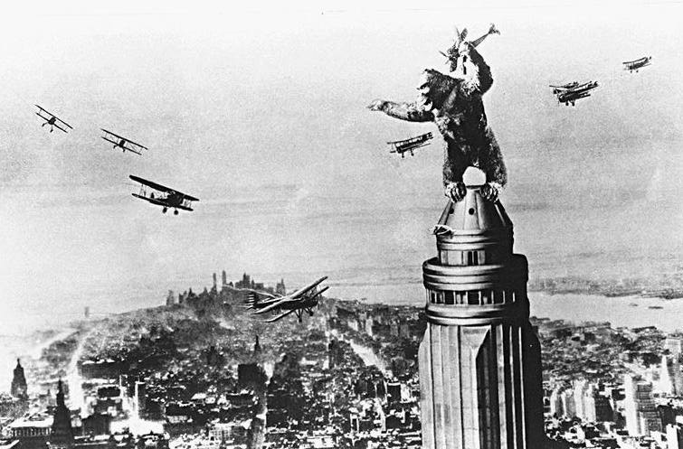

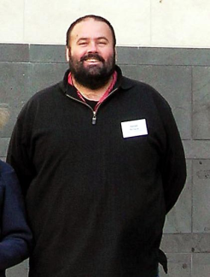
The attack of Koursework Kong
Advisory sessions
One to one
Seminars and lectures
Group projects
Lectures/notetaking
Exams
Essays
Coping!
Time management
presentations
Your Academic Support Adviser can save you yet…..
Kendall Richards: Engineering, Computing & Creative Industries
Merchiston C77 x2659 k.richards@napier.ac.uk

