Slide 1
Jalen Broxie final
File created on: 4/23/25 8:52:47 AM EDT

Slide 2
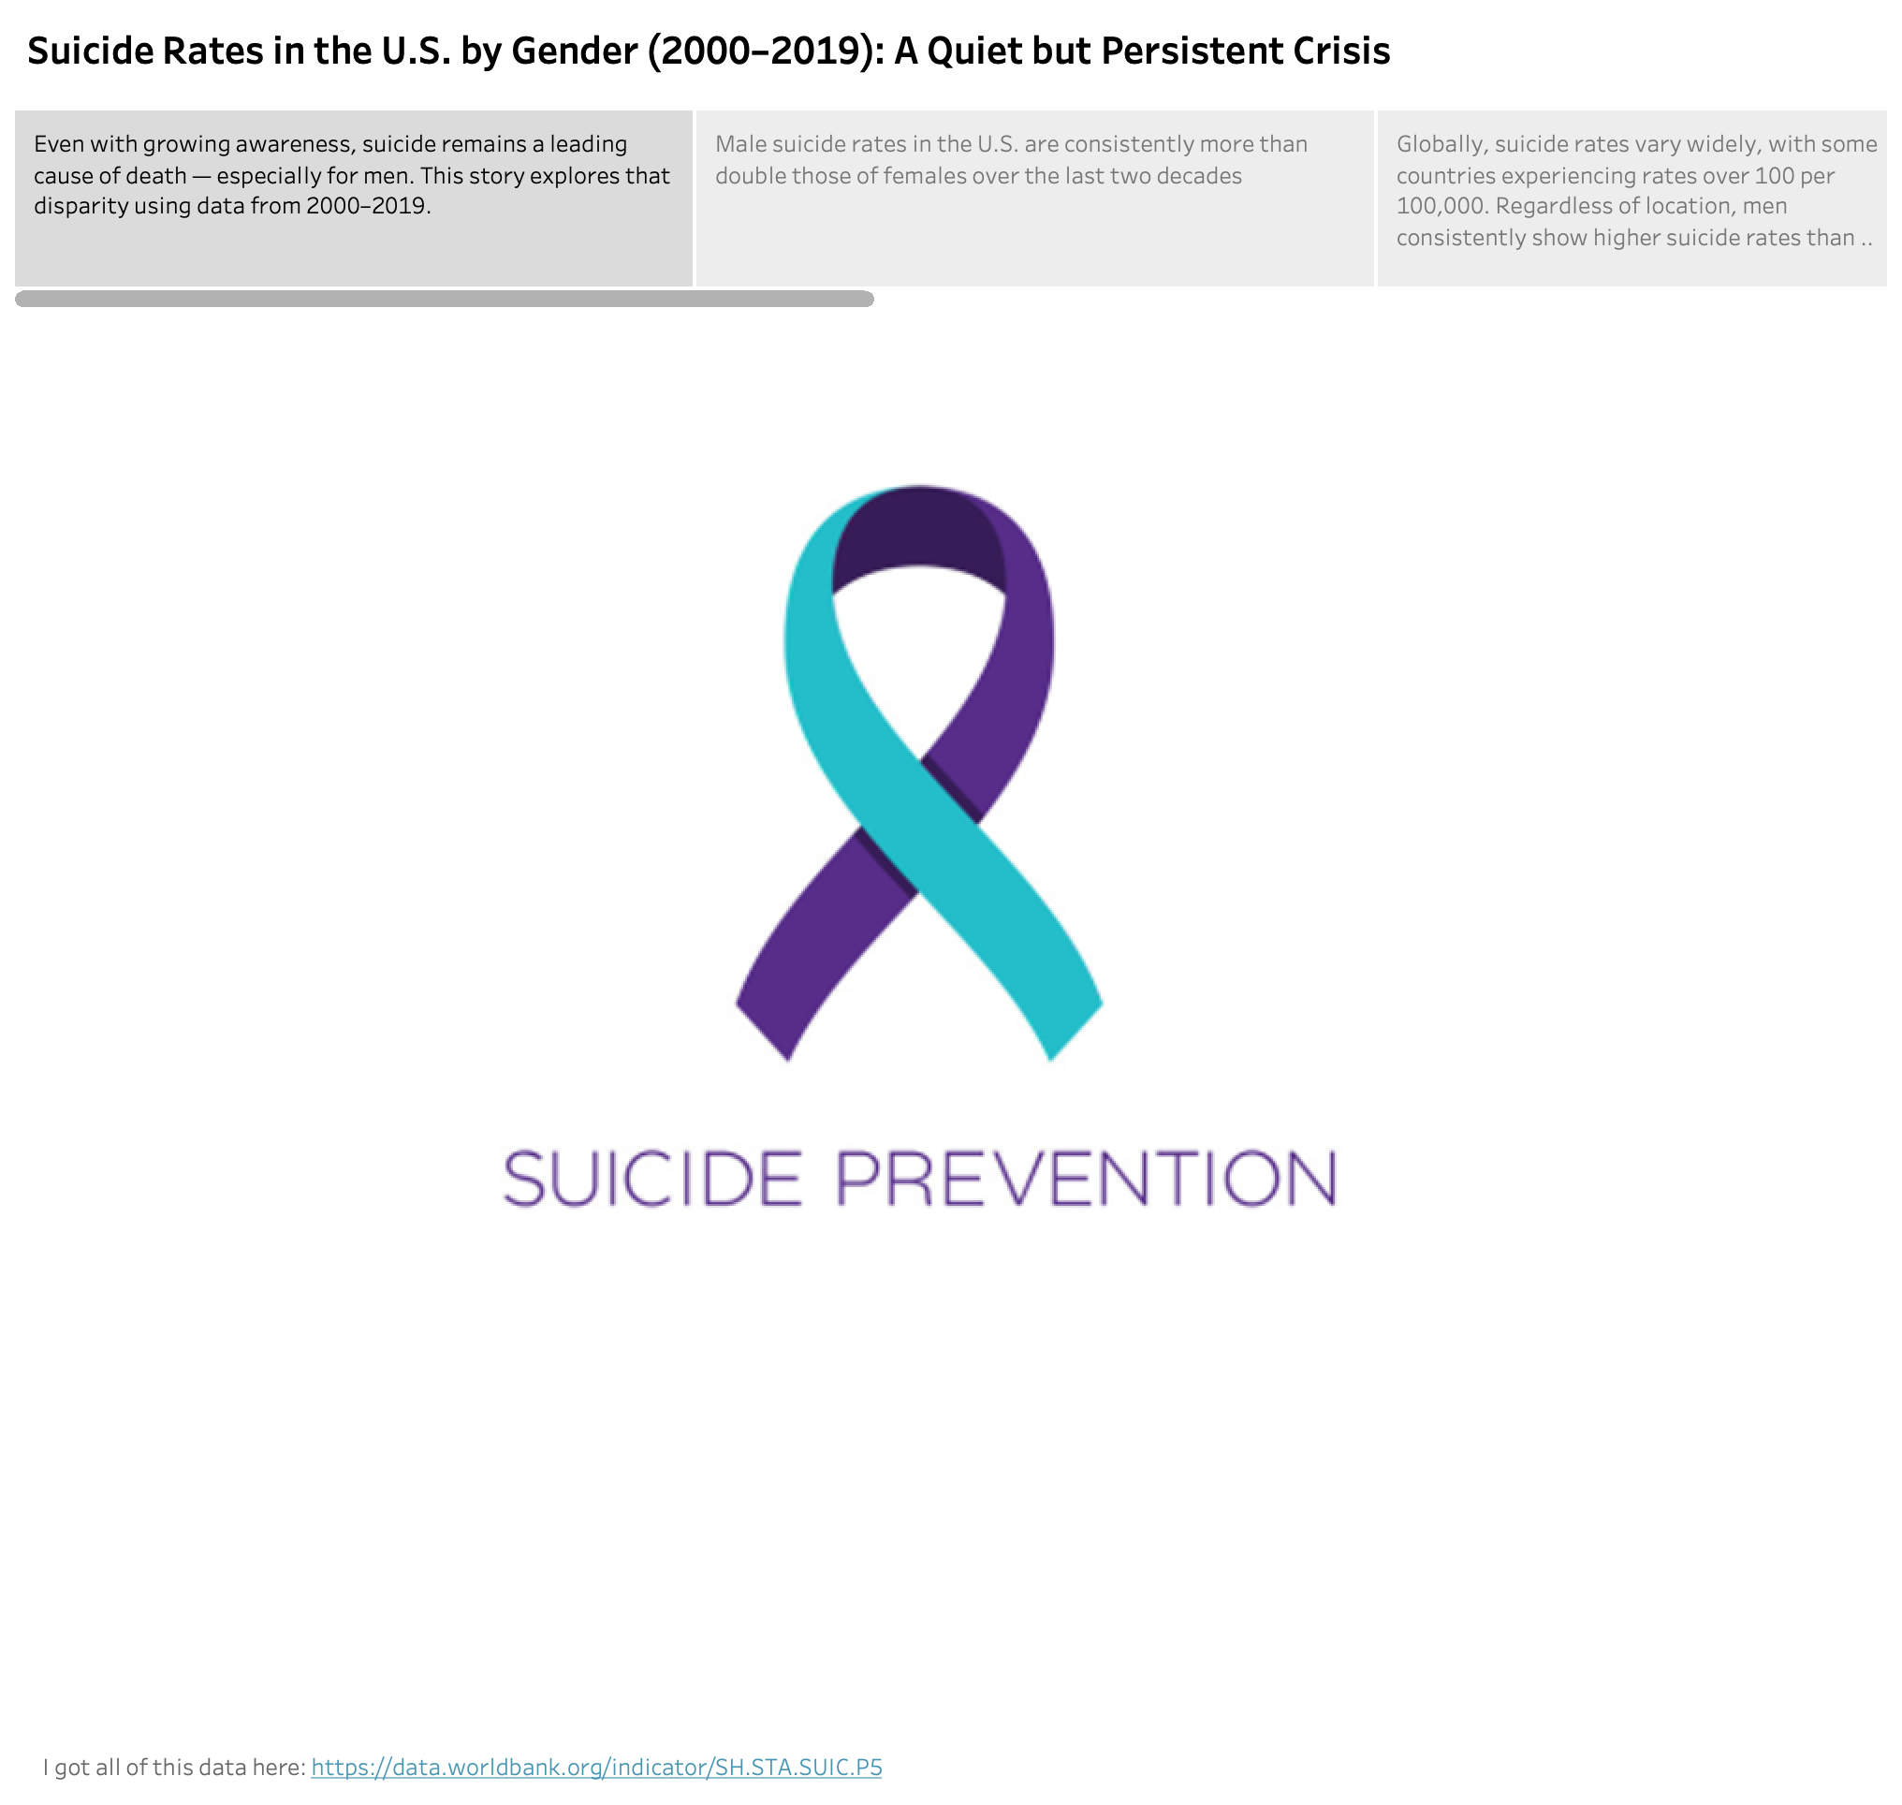

Slide 3
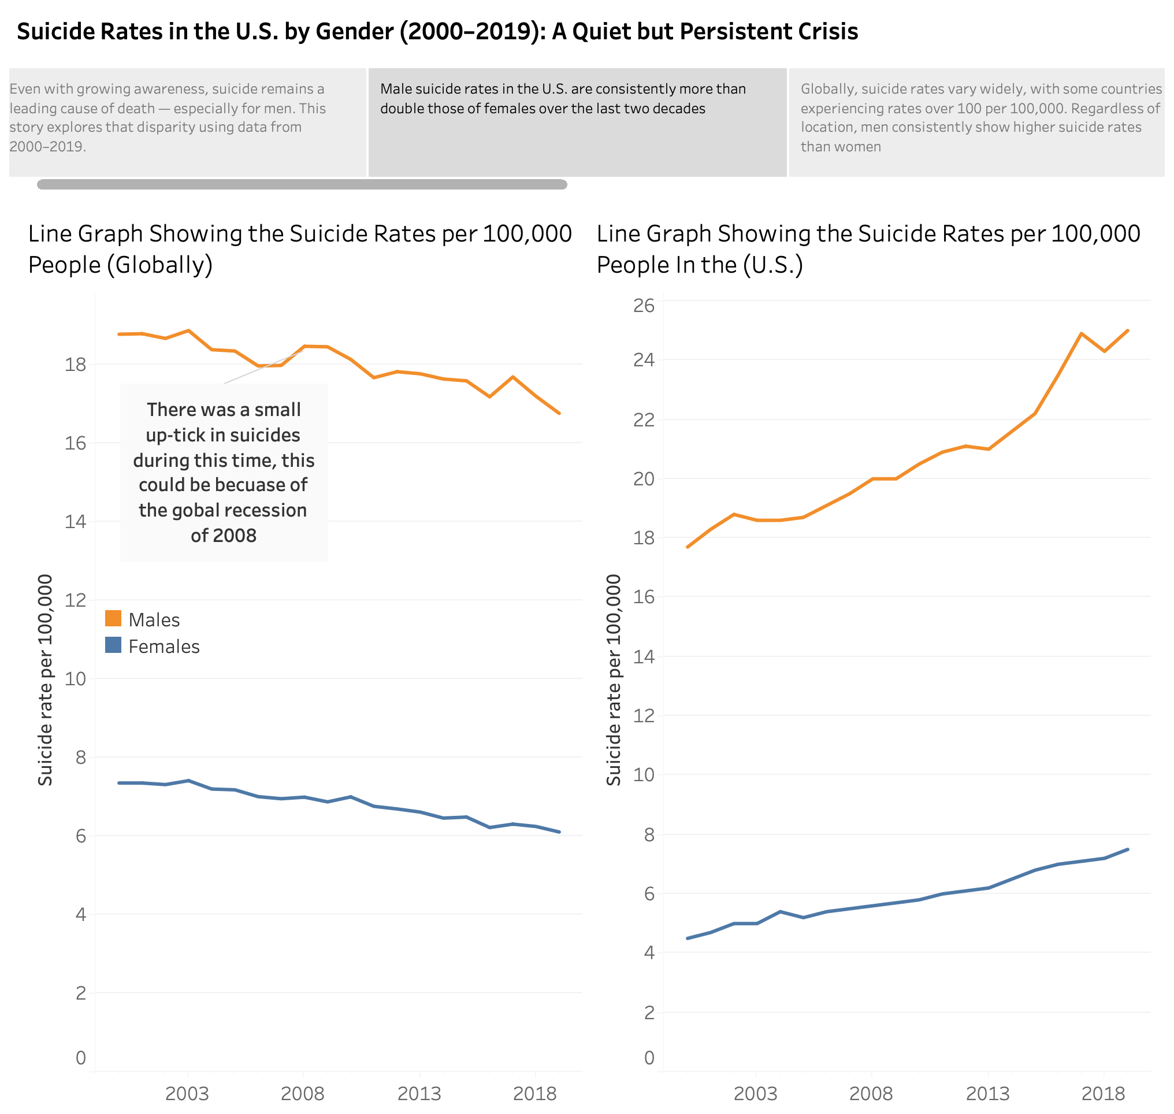

Slide 4
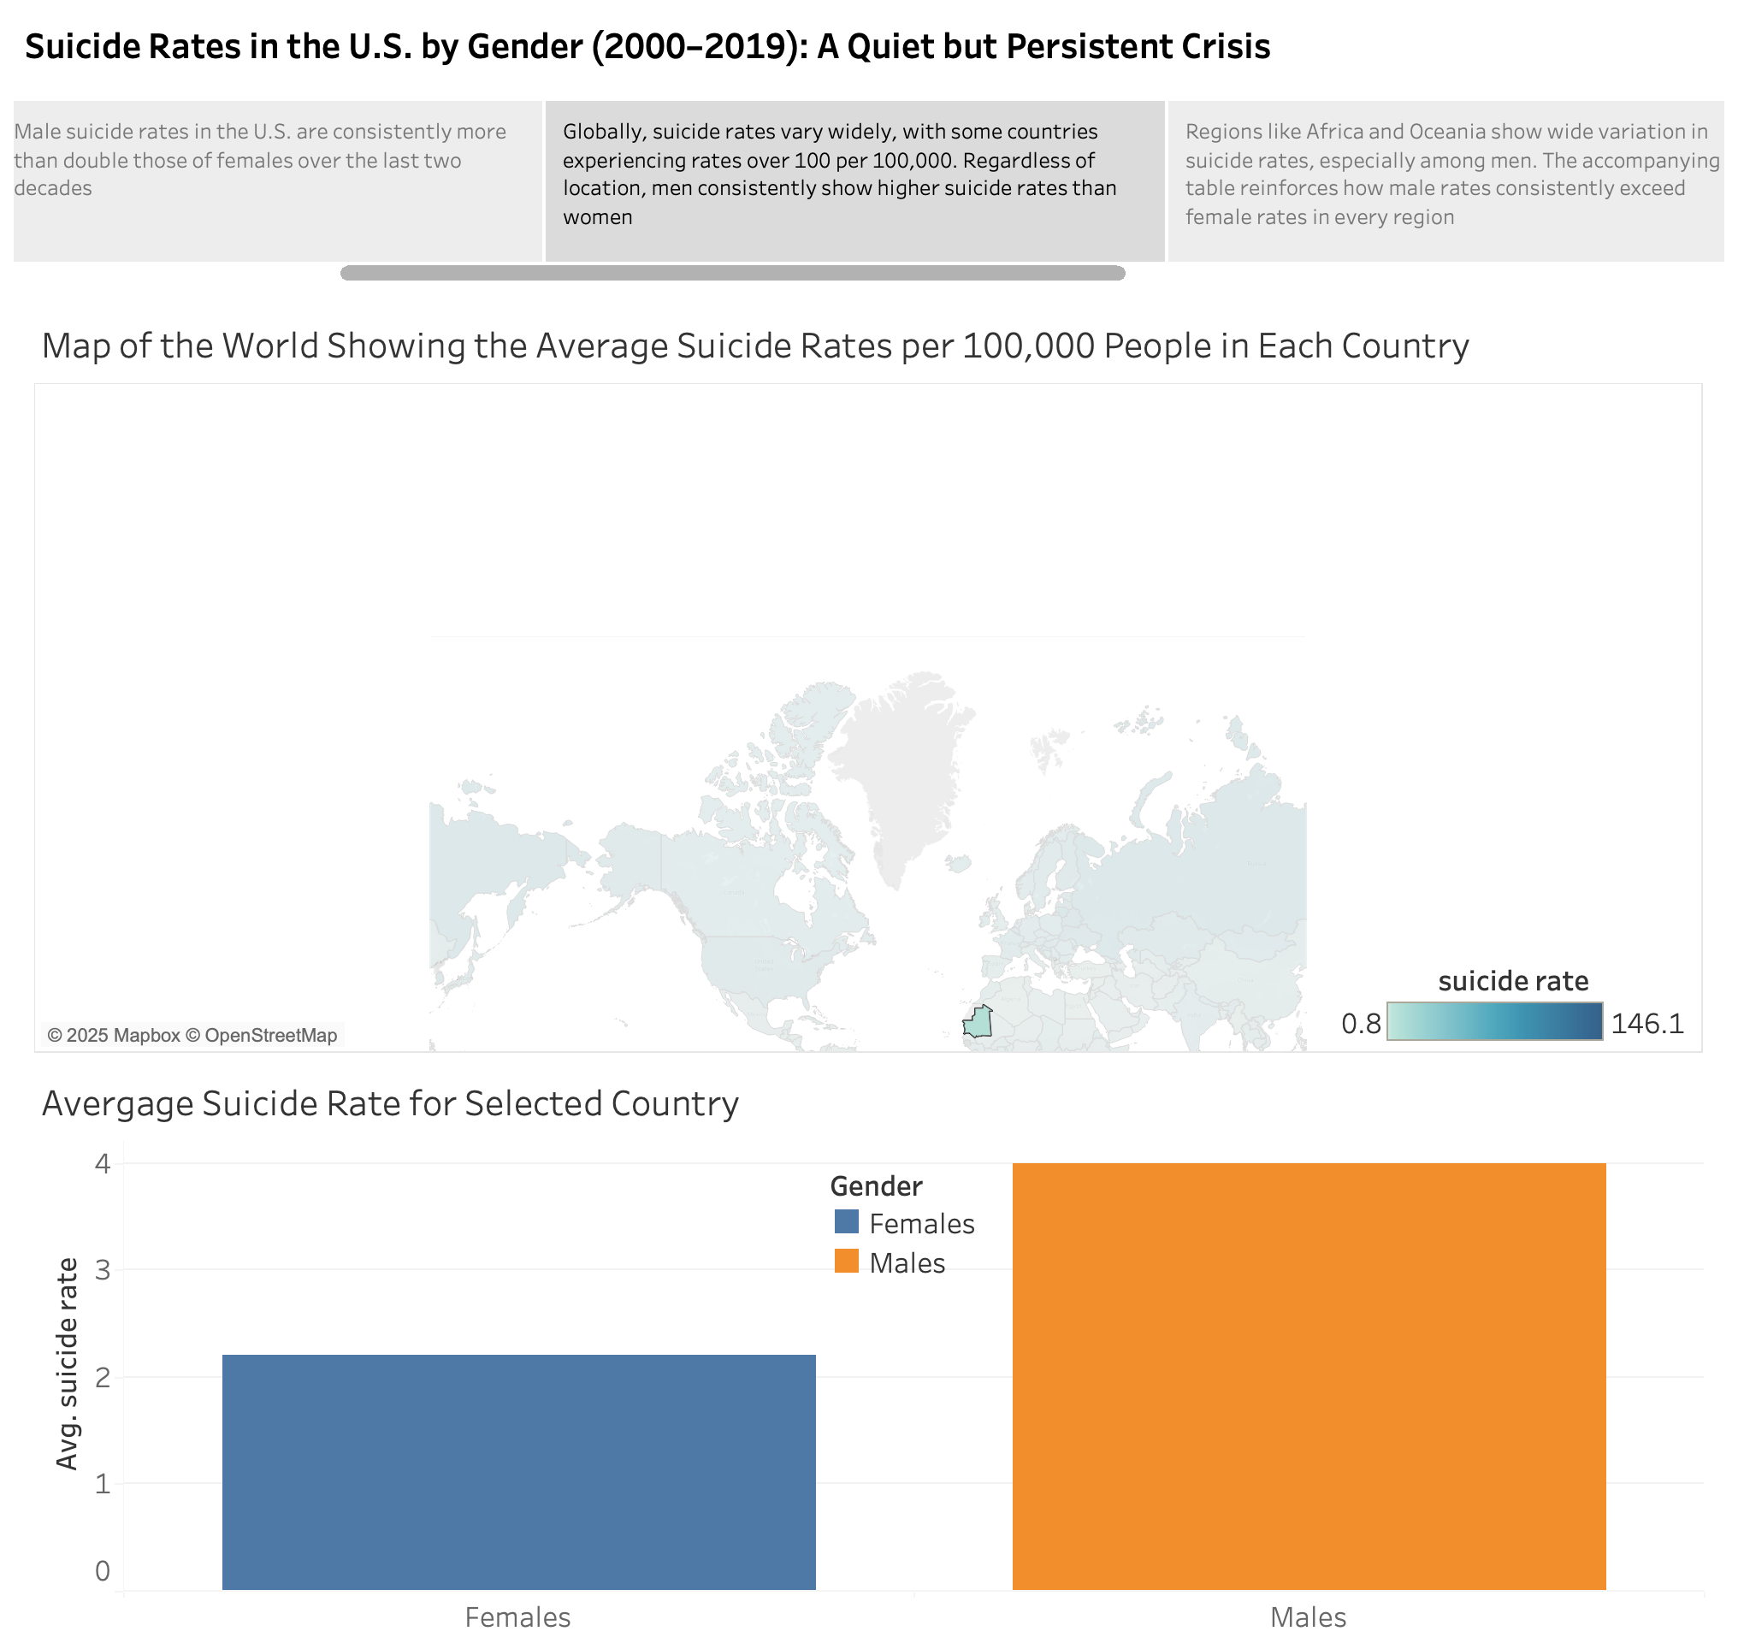

Slide 5
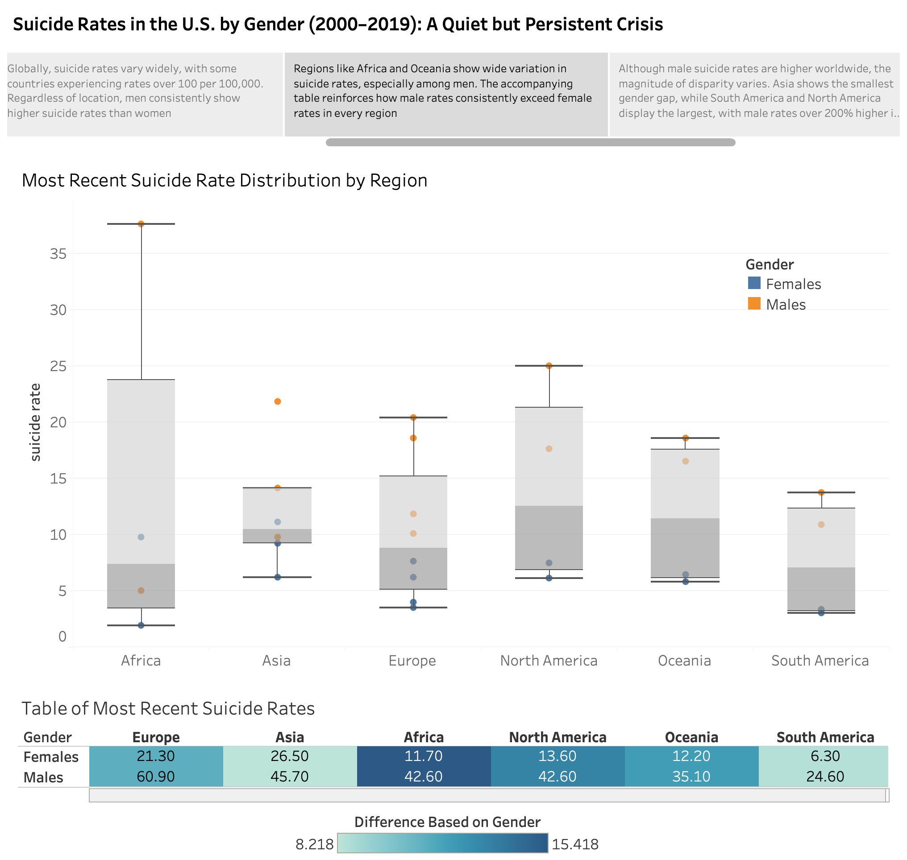

Slide 6
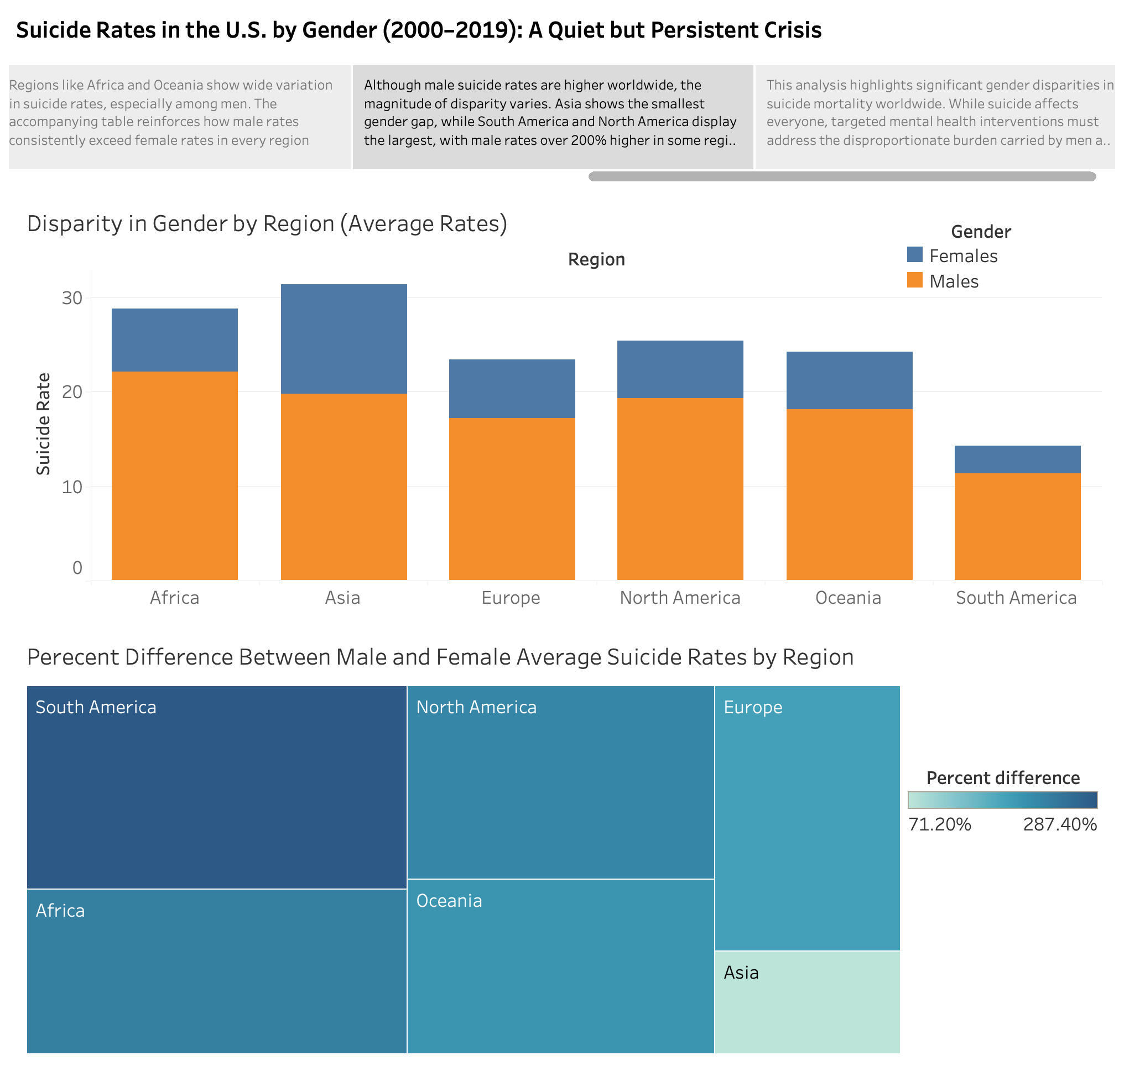

Slide 7
