Slide 1
Drawproof
AI & Fintech XRPL Hackathon · Lending Track · NYC 2026
Construction money should move
only when the building does.
Investors fund a project. Each milestone's money waits in an XRP Ledger escrow until a licensed inspector's signed audit and an AI evidence review both pass.
Maple St duplex $400K construction loan · 5 milestones
$160K released $80K in review $160K locked
Foundation
Framing
Roofing
Interiors
Handover
$60K
$100K
$80K
$100K
$60K
Released
Released
In review
Locked
Locked
Notes:
0:00–0:08. "We're Drawproof. Construction money should move only when the building does." Do not walk the timeline; it previews the product. Example project figures are illustrative and match the $400K duplex example in docs/07-pitch.md.

Slide 2
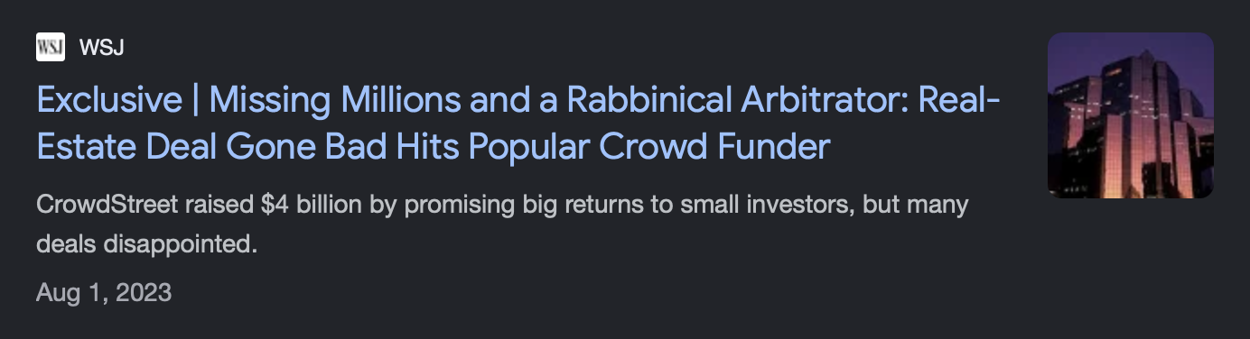
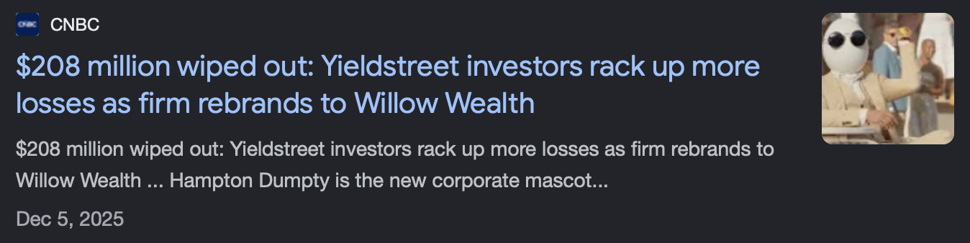
Construction money moves on trust, not evidence
Investors release funds on a sponsor's word, and find out what happened after the money is gone.
$62.8M
raised from more than 800 investors through CrowdStreet. The sponsor diverted it, and its CEO was sentenced to 87 months in federal prison.
Source: U.S. Department of Justice, May 20, 2025
$453.5B
5–14 days
~30%
in U.S. construction and development loans on bank balance sheets (FDIC via NAHB, Q2 2026)
from a builder's draw request to funding at today's lenders (Built Technologies)
of CRE-fraud reports to FinCEN involved misappropriated funds (FinCEN, 2011)
Notes:
0:08–0:30. "More than 800 investors put approximately $62.8 million into the Nightingale deals on CrowdStreet. The sponsor diverted the funds. It keeps happening: Yieldstreet investors have lost hundreds of millions. Construction lenders face the same gap every draw: money goes out on a sponsor's word, not on evidence the work happened." Use the case as motivation for accountability; do not claim Drawproof would have prevented the entire fraud. Sources: https://www.justice.gov/usao-ndga/pr/head-commercial-real-estate-investment-firm-sentenced-federal-prison-628-million-fraud ; NAHB/FDIC https://eyeonhousing.org/2026/08/single-family-adc-lending-falls-back-in-q2/ ; Built (vendor) via Bisnow; FinCEN CRE Financing Fraud report (2011).

Slide 3




Every draw must pass its test suite
Like a software release: every check passes, the draw is paid. One fails, the money stays locked.
Automated review
Licensed inspector
XRP Ledger
AI and rule checks across every photo, invoice and audit
Visits the site and signs the audit
Holds the money and keeps the record
Photo location matches the site
Assigned by Drawproof
Vault pools investor RLUSD
Reused photos detected
Signs with their own key
Escrow fixes the payee
Invoices match the budget
Required for every release
Results recorded on-chain
Drawproof's release service finishes an escrow only after every required check passes. The ledger fixes where the money can go and when it expires.
Notes:
0:30–0:45. "Every draw has a test suite. Our automated review checks the builder's evidence for consistency: location, reused photos, invoices against the budget. A licensed inspector, assigned by us and not the builder, visits the site and signs the audit. The XRP Ledger holds the money in escrow and records every result." Duplicate-photo matching is deterministic, not model reasoning. The platform's release service controls timing; the ledger does not evaluate the AI verdict.

Slide 4
From investor deposit to verified draw
Native XRP Ledger features carry the money. No custom smart contract holds the funds.
1
2
3
4
Fund
Lock
Review
Release or hold
Verified investors deposit RLUSD into the project's vault and receive shares.
The vault lends to a multisig project account, with one escrow per milestone.
The builder uploads evidence, the inspector signs the audit, and each result is recorded.
Pass paid to the builder
Fail stays locked in escrow
Single Asset Vault
Credentials
Lending Protocol
Token Escrow
Signed attestations
EscrowFinish
CancelAfter
28
XRPL Devnet transactions run one project's full money path
Credentials, vault deposits, loan to a multisig project account, milestone escrows, signed audit record and release. Every transaction links to the public explorer.
Notes:
0:45–1:00. "Investors fund the project's vault. The vault lends to a multisig project account, and each milestone is locked in its own escrow. Evidence is reviewed. Pass, and the builder is paid. Fail, and the money stays locked." Proof: docs/proof-devnet-2026-10-25-v2.md, demo run: 28 transactions plus one expected tec. Devnet only; Vault and Lending Protocol are not on mainnet yet.

Slide 5

Demo: one draw released, one held
Recorded · 1:40 · XRPL Devnet · Edited for time
What to watch
0:00
Maple St funded, draws locked
0:10
Inspector signs the site audit
0:30
Checks run with readable reasons
Replace with the demo video: Insert › Video › This Device, sized to this frame
0:50
Milestone 1 passes and is paid
1:10
Milestone 2 reuses a photo and stays locked
Devnet prototype with a mock RLUSD token. The AI mode is labeled on screen. Not an offer to invest.
Notes:
1:00–2:40. Play the local MP4 (silent, live narration) per docs/04-demo-script.md. Keep the project and milestone visible; show review before signing or paying; end on the failed milestone still locked. Label the actual verifier mode (mock judgments unless a live run is validated in the recording). Do not narrate the old 'Ledger says no' beat.

Slide 6



Drawproof
AI & Fintech XRPL Hackathon · Lending Track · NYC 2026
Thank you.
Questions?
How Drawproof earns
Verification fee
per project, builder pays
Origination fee
1.5–2% at loan close
What we built this weekend
Management fee
~10% of loan interest
Milestone escrows on the XRP Ledger
Each draw can only go to the builder or back to the project.
First-loss cover
we post 10%, lose first
A test suite for every draw
$400K duplex, 9 months, 5 draws ≈ $12.5K platform revenue (~3%). Illustrative, not a forecast.
Signed inspector audit plus AI evidence review gate each release.
Full money path on XRPL Devnet
Next: one construction-lending pilot
28 transactions: vault, loan, escrows, audit record, release.
Notes:
2:40–2:50. "We earn verification, origination, and management fees, and we post first-loss cover, so we lose first if we verify a bad project. Next, we're looking for one construction-lending pilot. Thank you. Happy to take questions." Leave this slide up for Q&A. Unit economics from docs/07-pitch.md: fee $500 + origination $8,000 + inspections $1,250 + management ≈ $2,700 ≈ $12.5K; not a forecast. Regulatory framing and Smart Escrows roadmap are Q&A only (docs/judge-faq.md).

