Slide 1

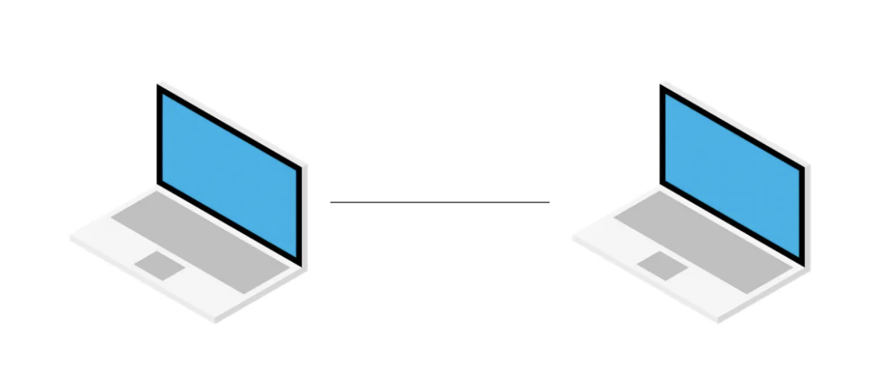

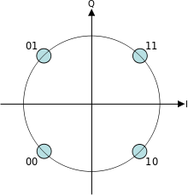
QPSK transmission from PC to PC using GNU Radio
By Abdeljalil Biad & Mohamed Aziz Gam

Slide 2
Overview
Project Description and Objectives
What is QPSK and why it is used for
Procedure
Results
Conclusion

Slide 3
Project Description and Objectives
Communication System Model from the source to a sink
Source
Modulation
D/A Converter
Communication Channel
Destination
Demodulation
A/D Converter

Slide 4
Project Description and Objectives
Using GNU-Radio to establish a QPSK based Communication System Between 2 Pc‘s
Understand issues of signal distortion and channel effects
Recognize the stages required to transmit and receive QPSK signals

Slide 5
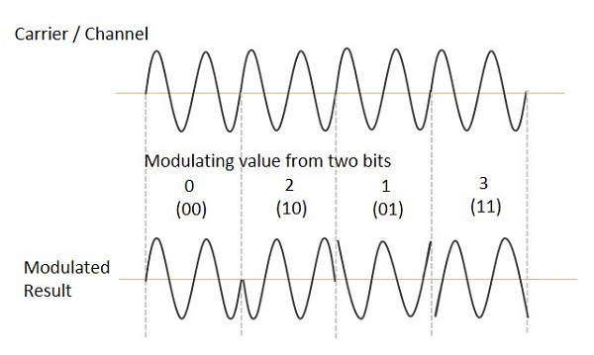
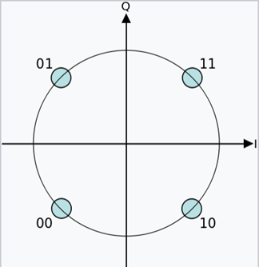
Quadrature Phase Shift Keying (QPSK)
Figure 2 : The QPSK waveform for two-bits [2]
Figure 3: QPSK Constellation [3]

Slide 6
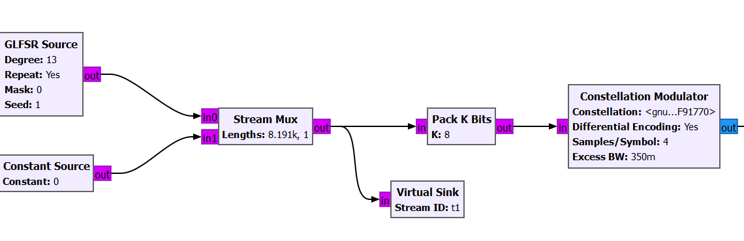
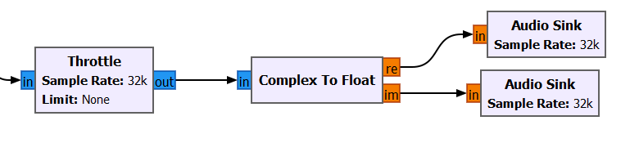
Transmitter – GNU Radio
Pseudo-Random Source generating Float Outputs
Implements QPSK Scheme with Differential Encoding.
Variable Samples per Symbol for flexible Symbol Rates.
Excess Bandwidth Factor set variably for Pulse Shaping.

Slide 7
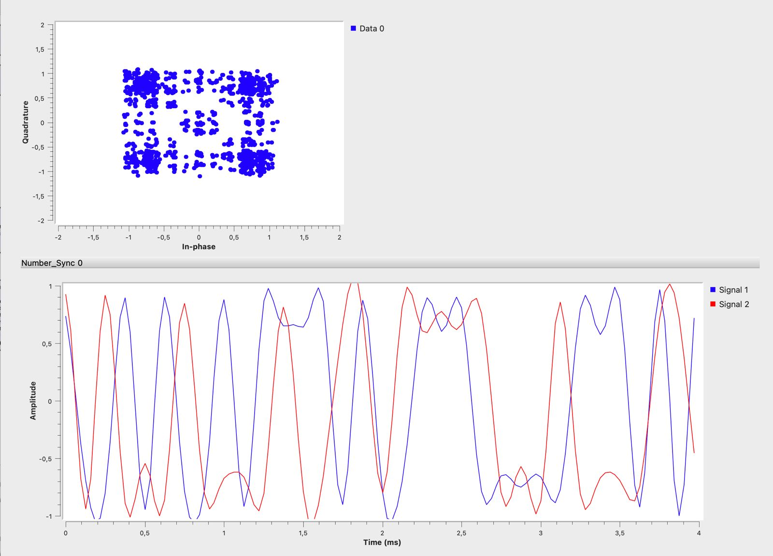
Transmitter Signal

Slide 8
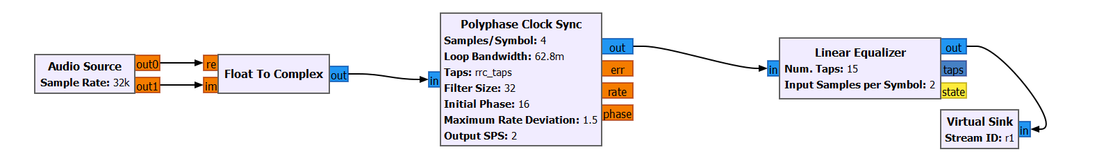
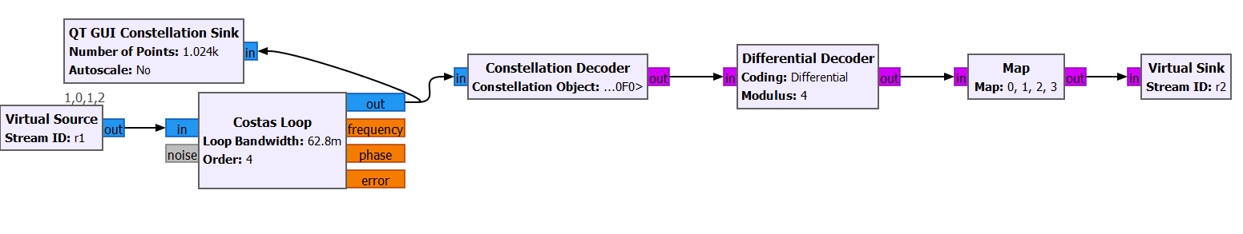
Receiver – Level (1)
clock recovery
matched filter to remove ISI
down-samples the signal
equalizes the incoming signal using an FIR filter.
Decode a constellation's points current and previous
symbols and the alphabet modulus to perform differential decoding
carrier recovery module
locks to the center frequency of a signal
downconverts it to baseband

Slide 9
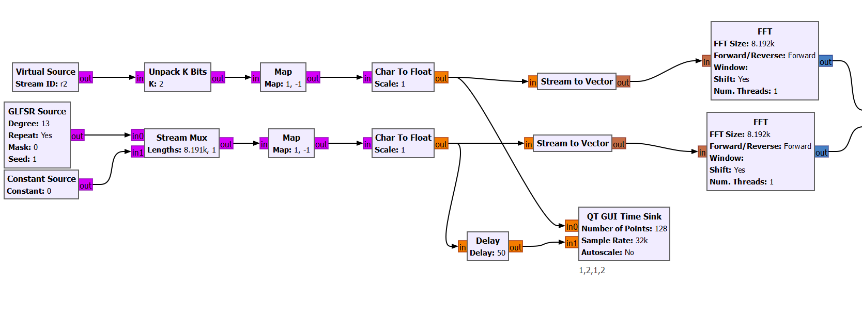
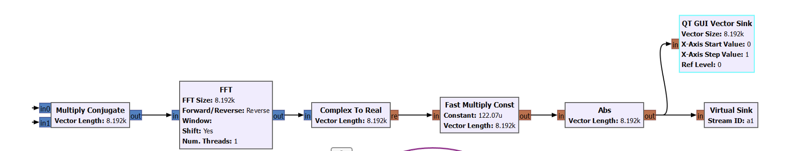
Receiver – Level (2)
Signal Clock Synchronisation & Peak Detection
Reproducing the Same Sequence as The Transmit Signal
Forward Fourier Transform in Order to turn the Convolution into a Multiplication

Slide 10
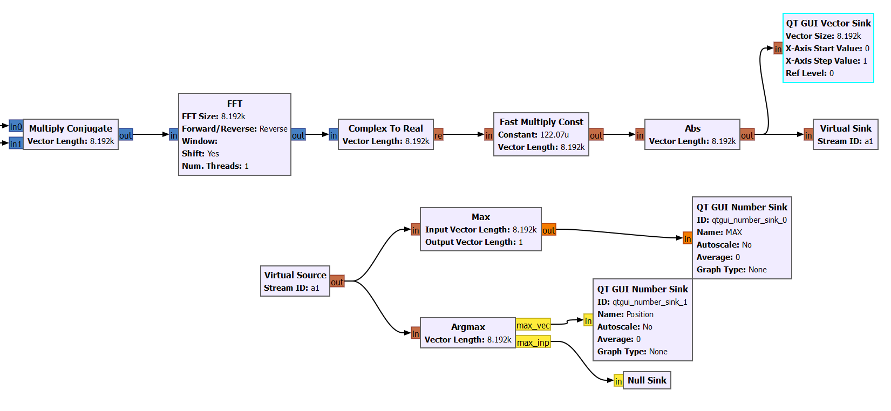

Receiver – Level (3)
Size $2^{d}$ Inverse Fourier Transform
Compares Vectors from multiple Streams and Determines
the maximum value from each Vector over all Streams
Compares Vectors from multiple Streams and Determines the index
in the Vector and Stream Number where the maximum value Occurred.

Slide 11
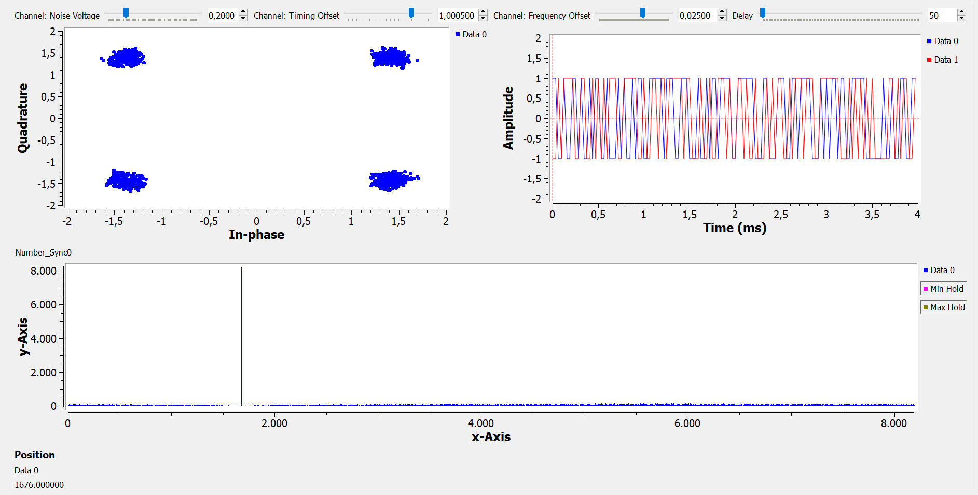
Results- Before Correlation

Slide 12
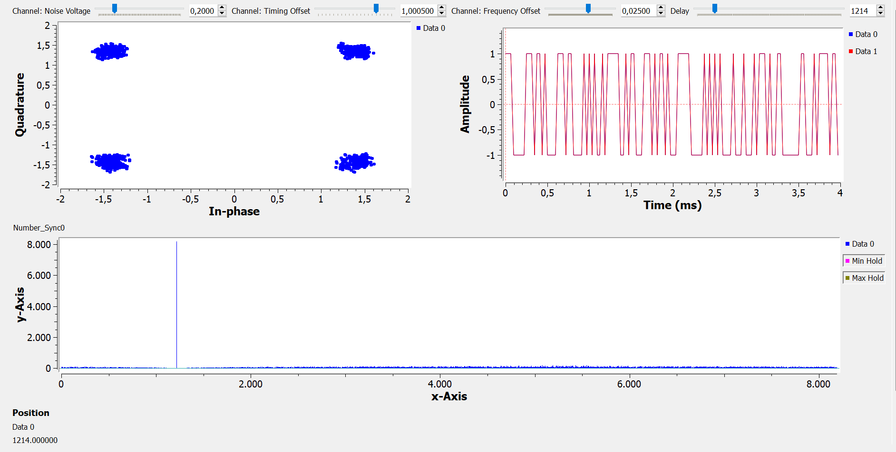
Results- After Correlation
Peak Position of the Convolution
The Amplitude of the Peak

Slide 13
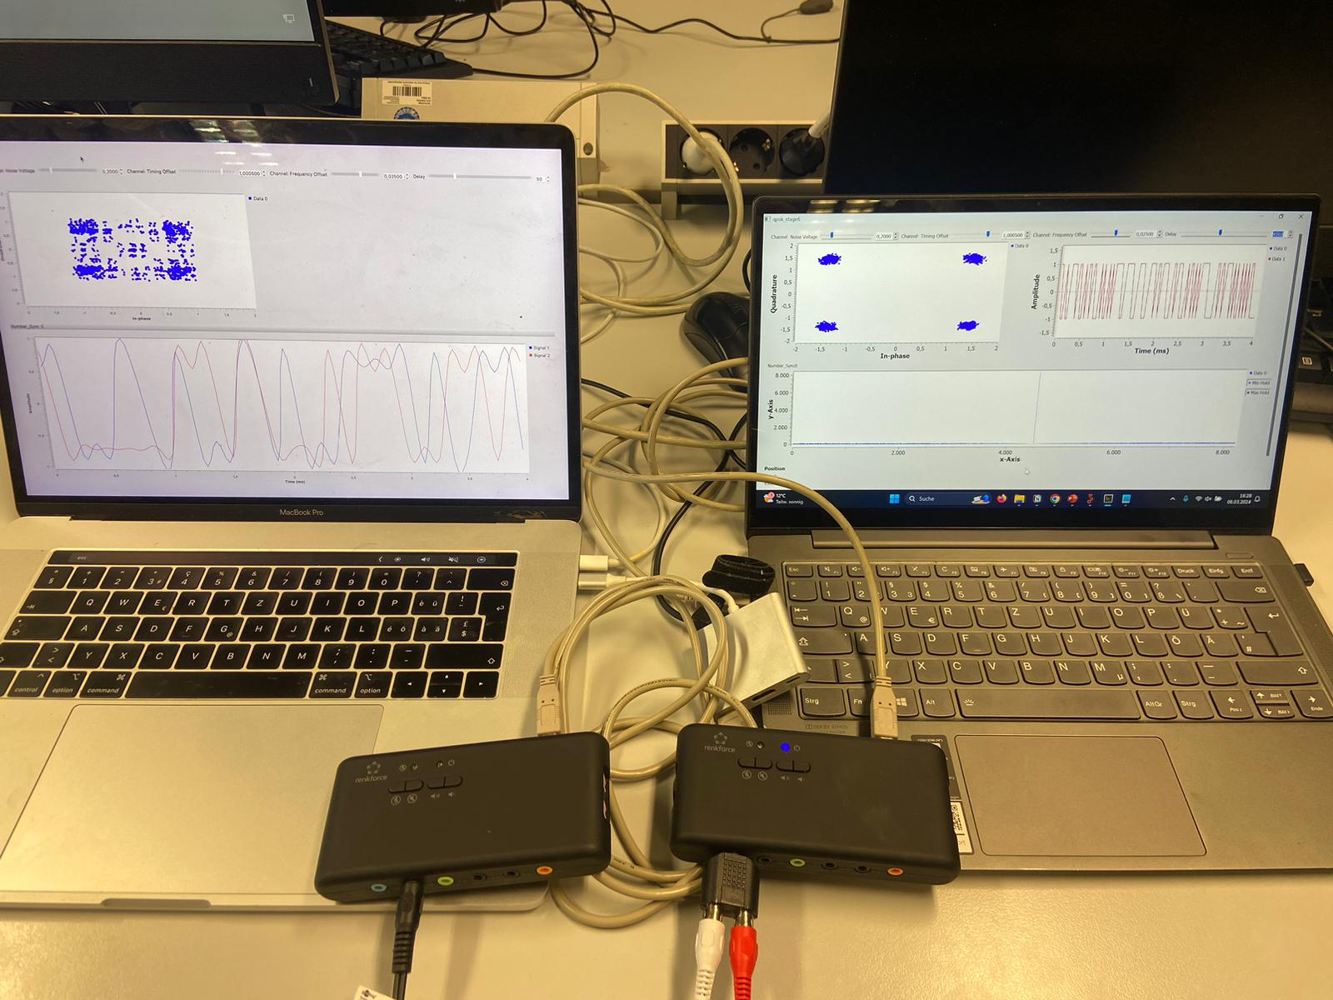
Implementation

Slide 14
Conclusion
GNU-Radio as an open-source software development toolkit that provides signal processing blocks to implement software radios and signal processing systems
QPSK as a modulation methode

Slide 15
Quellen
[1] Quadrature Phase Shift Keying. Available at: https://www.tutorialspoint.com/digital_communication/digital_communication_quadrature_phase_shift_keying.htm (Accessed: 05 March 2024).
[2] QPSK Constellation Diagramm Available at : https://fr.wikipedia.org/wiki/Phase-shift_keying

Slide 16
Thank you for your Attention

