Slide 1
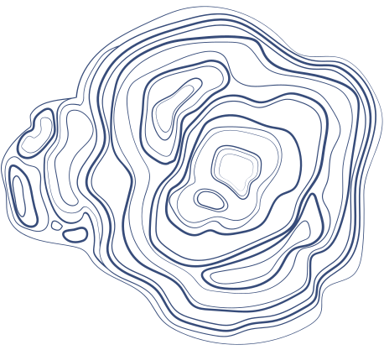

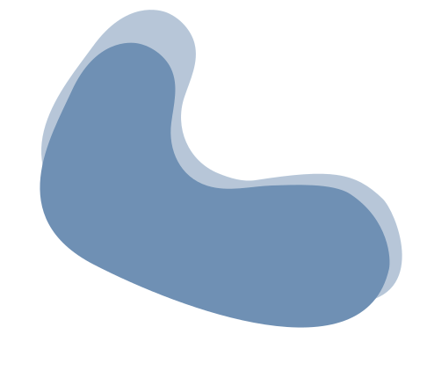

ARABIC SPELL CHECKER WITH NLP INTEGRATION
Birzeit
June 2024

Slide 2



OUR TEAM
1. Obada Hattab 1171616
2. Maryan Kassis 1200861
3. Ja﻿lila Mouadi 1201611

Slide 3



INTRODUCTION
In this project, we aim to develop an Arabic spell checker that leverages natural language processing (NLP) techniques to improve accuracy and efficiency. Our spell checker is designed to identify misspelled words and provide contextually appropriate correction suggestions. By incorporating methods such as tokenization, stemming, and part-of-speech tagging, we ensure that the recommendations are precise and sensitive to linguistic patterns.

Slide 4


DATASET AND TECHNIQUES
Data Set
We get a comprehensive dataset, including a dictionary with over 890,000 words for the Levenshtein algorithm and 8,660 lines of corpora for the n-gram model.
Algorithms used
The n-gram model, a probabilistic model, estimates the likelihood of a word given its preceding words, enhancing the contextual accuracy of corrections.
The Levenshtein distance is employed to calculate the minimal number of single-character edits required to transform one word into another, helping to detect and correct misspellings.
NLP Techniques
Additionally, we utilize NLP techniques such as tokenization to break down text into individual tokens, part-of-speech tagging to label words by their grammatical roles, and stemming to reduce words to their root forms.

Slide 5
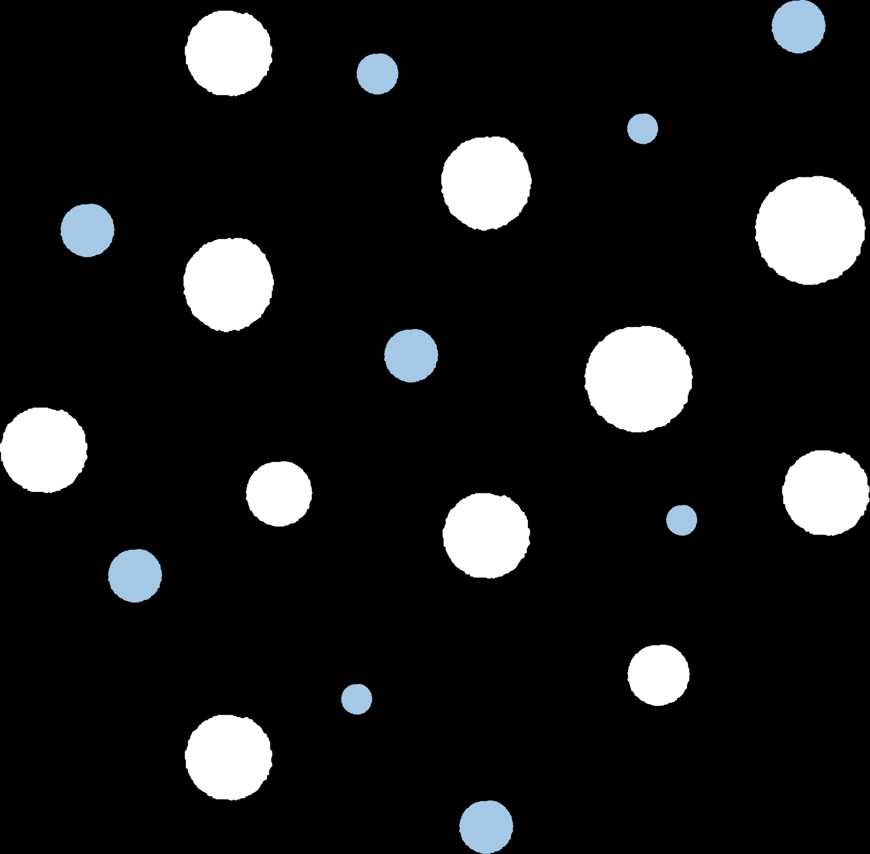
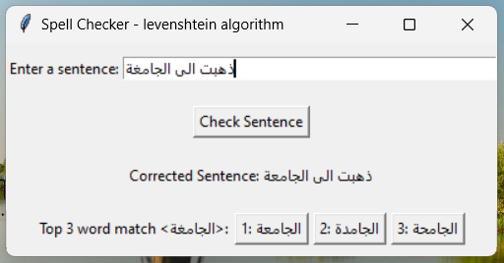
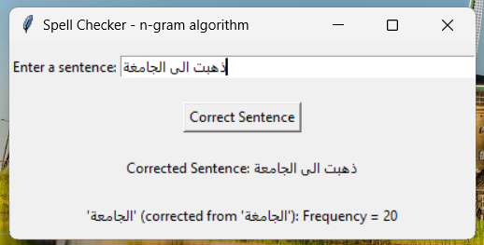
RESULT - INTERACTIVE GUI

Slide 6
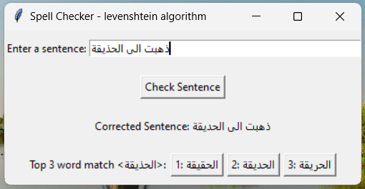
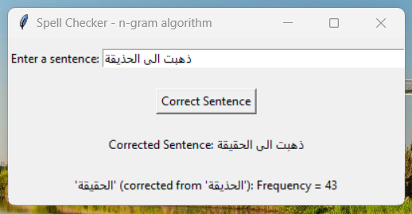
RESULT - INTERACTIVE GUI

Slide 7
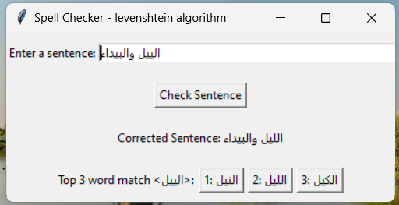
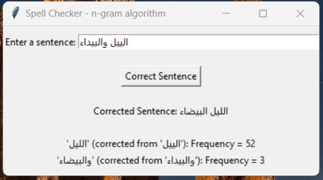
RESULT - INTERACTIVE GUI

Slide 8



CONCLUSION
This study presents an Arabic spell checker that integrates modern NLP models with traditional spell-checking methods. While the Levenshtein distance method effectively corrects basic typos, it lacks contextual awareness. The n-gram model improves accuracy by considering word sequence frequencies, offering contextually relevant corrections. Combining these approaches with advanced NLP strategies like BERT ensures that corrections are both contextually and phonetically accurate. Experimental results indicate that this hybrid approach creates a reliable and robust Arabic spell checker.

Slide 9

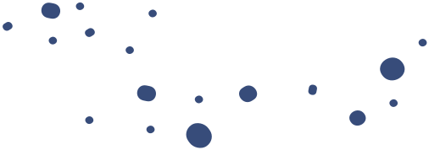
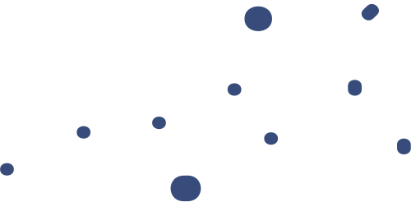


Question &
Answer

Slide 10
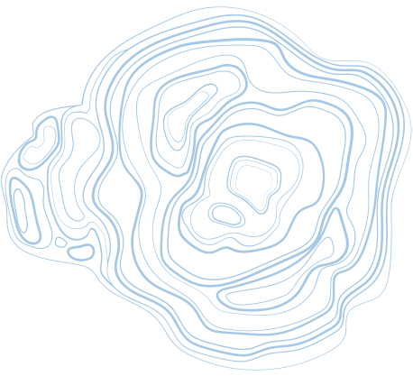



Thank You

