Slide 1
MageCart
How Magecart can ruin
our e-commerce business

Slide 2
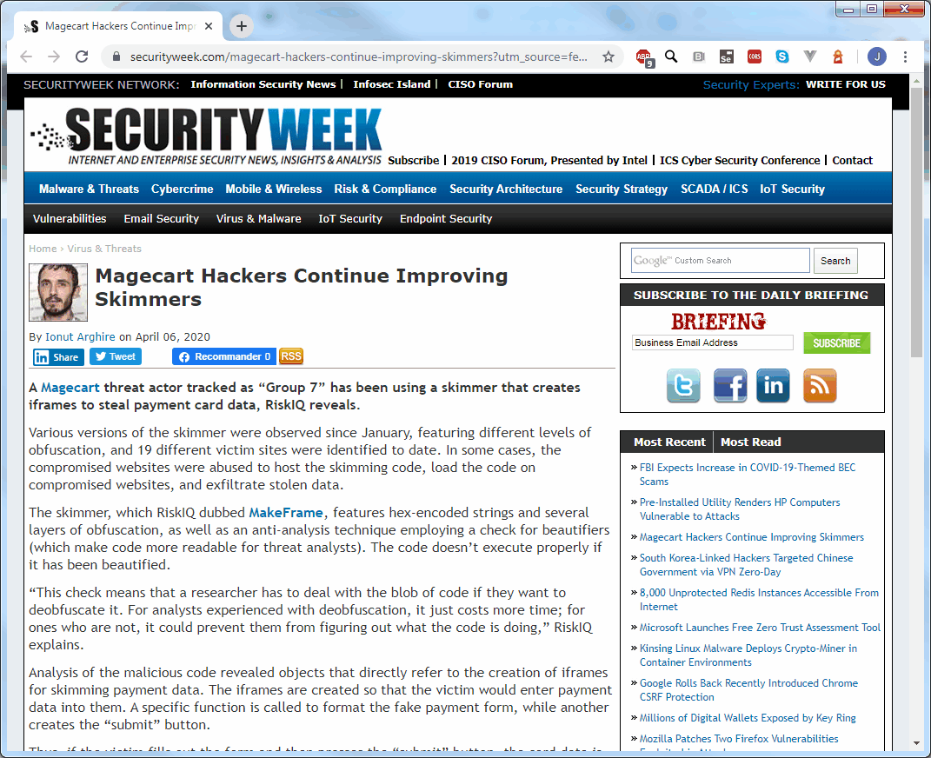
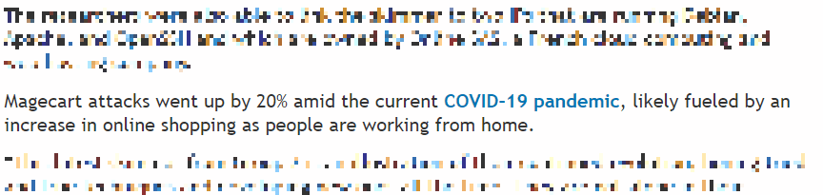
Breaking News!
Magecart Group 7 did again his darkest job with 19 different victim sites identified.
SecurityWeek & RiskIQ April, 06, 2020
https://www.securityweek.com/magecart-hackers-continue-improving-skimmers
Notes:
Magecart is a now long story among the hacker stories on the Internet. They are a little bit old now, but still active, with new form of contamination (no link with Covid, but a little aspect of it regarding this article)

Slide 3
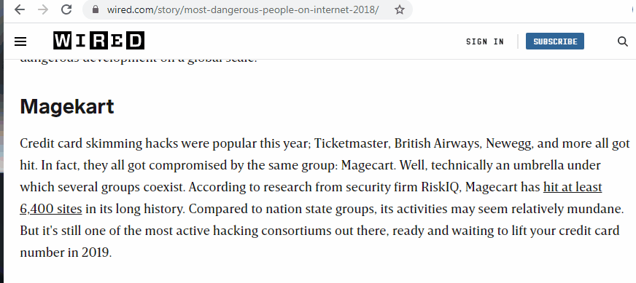
THE MOST DANGEROUS PEOPLE ON THE INTERNET
#8
WIRED, December, 30, 2018
https://www.wired.com/story/most-dangerous-people-on-internet-2018/
Notes:
Even if they did a typo in the name, WIRED classified Magecart as the #8 most dangerous people on the internet in 2018. The skimming technic used in each website is more and more sophisticated, it is also an umbrella under several groups, this is the reason why it was, in 2018, one of the most dangerous people on the Internet.

Slide 4
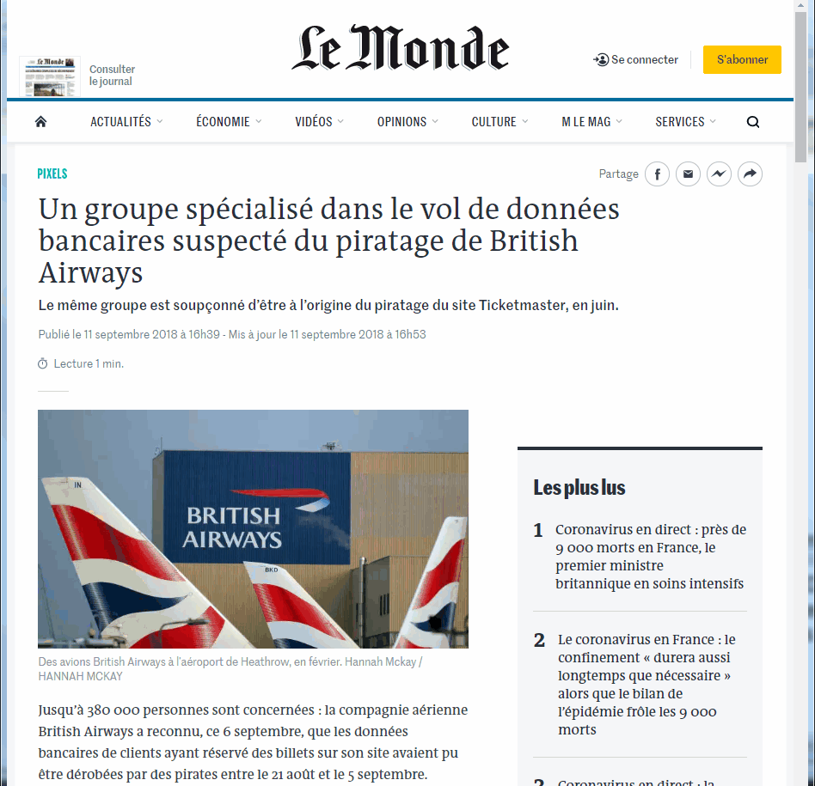
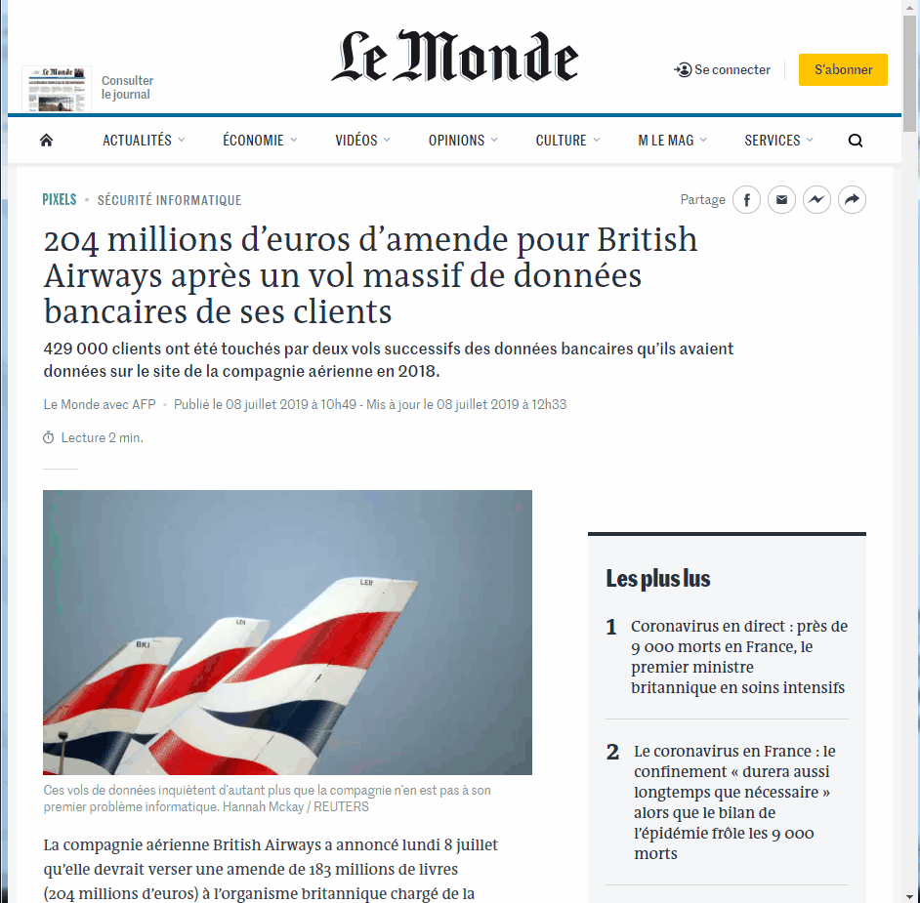
British Airways
September 6th, 2018 British Airways announced being attacked from end of August to beginning of September
244,000 credit card numbers (with CVV) stolen and also customers information like name, address, email
British Airways also announced than another 185,000 customers information were stolen between April 21th and July 28th
The amount of the fine imposed by ICO represents 1,5 % of British Airways turnover in 2017
https://www.lemonde.fr/pixels/article/2018/09/11/un-groupe-specialise-dans-le-vol-de-donnees-bancaires-suspecte-du-piratage-de-british-airways_5353557_4408996.html
https://www.lemonde.fr/pixels/article/2019/07/08/204-millions-d-euros-d-amende-pour-british-airways-apres-un-vol-massif-de-donnees-bancaires-de-ses-clients_5486817_4408996.html
Notes:
The ICO is the british agency in charge of personal data protection.
Elizabeth Denham is the commisionner of the ICO « Lorsqu’on vous confie des données personnelles vous devez les protéger. Ceux qui ne le feront pas seront poursuivis par l’ICO pour vérifier qu’ils ont pris les mesures adéquates »

Slide 5
Who is Magecart ?
Umbrella term given to at least 12 cybercrime groups
Specialized in digital credit card skimmers on compromised e-commerce sites
Singular focus: credit card skimming
Active since 2014 and monitored by RiskIQ since 2015
Magecart Improves with each group and is harder to detect

Slide 6


The Magento effect
Intrinsically connected to one program : Magento.
Inspiring the now-infamous name, which is a combination of “Magento" and "shopping cart.“
3rd party shopping platforms such as Magento and OpenCart, which lots of e-commerce, are the lifeblood of Magecart groups.
Notes:
Magento is written in php, the 1st version was released in 2008, the 2nd one in late 2015, It was acquired by Adobe in 2018 for $1,7 Billions.
https://www.atwix.com/magento/credit-card-numbers-leak/

Slide 7
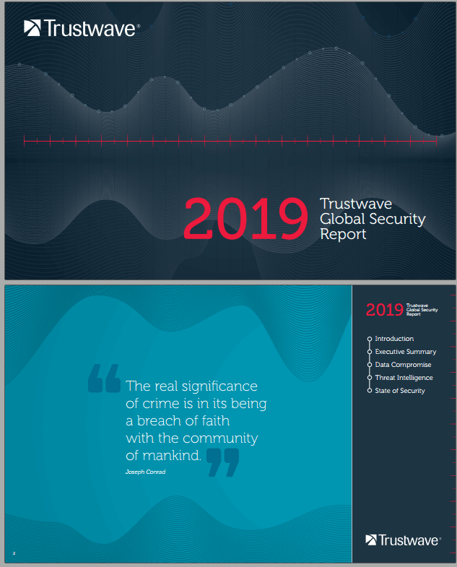
When popularity becomes your weakness
40 % of the compromises were e-commerce sites
85% of compromises e-commerce sites used Magento open-source platform
5 critical vulnerabilities identified in Magento in 2015
In the facts, most systems lacked patches, even for over 12 months
Source : Trustwave
Notes:
There are close to 5000 third-party extensions for Magento in its public marketplace, which can introduce risk. In late 2018, some new vulnerabilities similar to CVE-2016-4010 were affecting approximately 20 Magento extensions,

Slide 8
Magecart – Modus Operandi
Magecart infects websites doing credit card processing via:
Vulnerabilities
3rd party scripts
Consistent preference for larger enterprise-scale companies
Implements JavaScript software to skim personal and credit card data
Uses different levels of sophistication for each script
Exfiltrates data through drop servers or proxies
Source : RiskIQ

Slide 9

Defining the Magecart groups
Magecart is the umbrella name used to describe multiple criminal groups
RiskIQ Classification done regarding unicity of:
Infrastructure
Type of skimmer
Type of e-commerce sites
12 groups identified
Source : RiskIQ
Notes:
Classification done by RiskIQ

Slide 10
Defining the Magecart groups
Group 1 & 2: Start of web based skimming
Group 3: Filtering forms
Group 4: Taking care of begin detected
Group 5: 3rd party compromise
Group 6: Targeting for high volume
Group 7: Proxies for exfiltration
Group 8-12:Magecart Evolving
Source : RiskIQ
Notes:
Classification done by RiskIQ

Slide 11
Defining the Magecart groups
Magecart is the umbrella name used to describe multiple criminal groups
RiskIQ Classification done regarding unicity of:
Infrastructure
Type of skimmer
Type of e-commerce sites
12 groups identified
Source : RiskIQ
Notes:
Classification done by RiskIQ

Slide 12
A typical Magecart attack
An example from an e-commerce standard website
Source : RiskIQ
Notes:
Classification done by RiskIQ

Slide 13
Best practices
TODO
Source : RiskIQ
Notes:
Classification done by RiskIQ

Slide 14

Firewall rules to detect Magecart
Deploying a WAF* such as ModSecurity with a set of rules
SpiderLabs ModSecurity rules released can detect:
Exploitation attempts to e-commerce platforms, e.g. CVE-2019-4010
Requests and responses with know IOCs used by Magecart
Multi-match decoding for pieces of data in skimmer scripts
Different strains of skimmers by using fuzzy hashing
Source : SpiderLab *WAF : Web Application Firewall
Notes:
Classification done by RiskIQ

Slide 15
Magento Security Scanners
TODO
Source : RiskIQ
Notes:
Classification done by RiskIQ

