Slide 1

Presented By:
Jallypally Pavithra
BatchNo: 6138-2021
Center: Bangalore S-Prayas
BANK MANAGEMENT PROJECT

Slide 2
INTRODUCTION
This is a Bank Management tool which can be used to manage activities like creating maintaining a person’s account in a bank. And the system provides the access to the customer to create an account, deposit or withdraw the cash from his/her account, also to view reports of all accounts present. It is a menu driven program and it runs until the user exits.
MAIN MENUS:
Display All
Search By Account
Deposit
Withdrawal
Exit

Slide 3
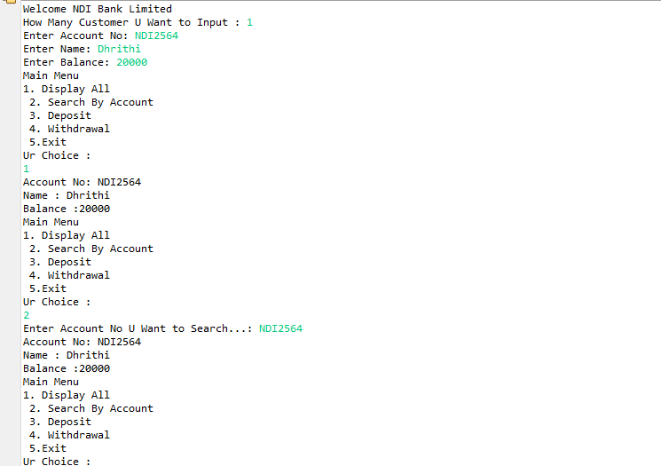
Create an Account
Entering name, accountno, balance
Created account details
Accessing account details by using account number

Slide 4
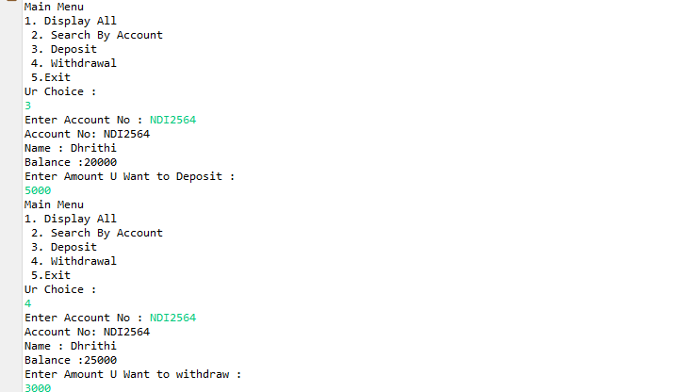
Deposit and Withdraw
Deposit
Withdrawal

Slide 5
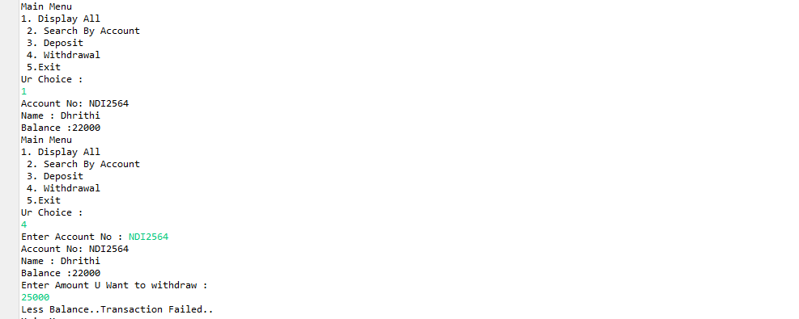
Withdraw
Amount after withdrawal
Withdraw amount>balance

Slide 6
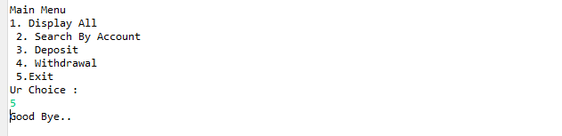
EXIT

Slide 7


