Slide 1

Movie Ticket Booking System
Team Members:
Jalpit Parmar (92300527105 )
Jiya Manek (92300527034)
Vekariya yash (92320527008)
Project Type: ASP.NET

Slide 2
Introduction to Our System
This project is an online Movie Ticket Booking System.It helps users book movie tickets easily from home.Users can see available movies and showtimes, choose seats, and make secure payments.Admins can manage movies, show timings, and bookings.
1
2
User-Friendly Booking
Real-time Information
Easy online ticket booking for movie lovers
Up-to-date movie schedules and seat availability.
3
4
Secure Transactions
Admin Control
Integrated payment gateway for peace of mind.
Full management over content and operations.

Slide 3
Addressing the Challenges: Our Problem Statement
Physical Cinema Visits
Long Queues & Manual Errors
Eliminates the need for users to travel to the cinema just to buy tickets, saving time and effort.
Reduces waiting times and minimises human errors associated with manual booking processes.
Limited Real-time Seat Selection
Decentralised Booking
Provides immediate access to seat maps and real-time availability, ensuring users can choose their preferred seats.
Creates a centralised platform for booking across multiple theatres, offering a broader selection to users.

Slide 4




Project Objectives: Our Vision
Our primary objectives for this Movie Ticket Booking System are rooted in enhancing user convenience, empowering administrators, and ensuring a robust and secure platform for all.
Online Platform Creation
To build an intuitive web-based platform for movie ticket bookings.
Instant Show & Seat Access
To enable users to instantly check available shows and book their preferred seats.
Comprehensive Admin Tools
To provide administrators with efficient tools for managing movies, theatres, and show timings.
User-Centric Experience
To deliver a highly user-friendly and secure booking journey.

Slide 5
Key Features: What Our System Offers
Our Movie Ticket Booking System comes packed with essential features designed to provide a seamless and comprehensive experience for both users and administrators.
For Users:
For Administrators:
User Registration & Login: Personalised access to the system.
Admin Dashboard: Centralised control panel for all management tasks.
Movie Browsing: Filter options by theatre, timing, and language.
Movie Management: Add, edit, or remove movie details.
Real-time Seat Selection: Interactive seat maps for precise booking.
Booking Management: Oversee and manage all user bookings.
Online Payment Integration: Secure and convenient transaction processing.
Showtime & Theatre Management: Efficiently schedule and update show details.

Slide 6




Tools & Technology Stack
Frontend
Backend
Database
HTML, CSS, Bootstrap, JavaScript for responsive and interactive UI.
ASP.NET for server-side logic and database interaction.
MySQL for efficient data storage and retrieval.
Development Environment
Deployment
VS Code for streamlined code development and debugging.
Localhost / Web server for hosting and accessibility.

Slide 7

System Flow: User Journey
User Sign‑up/Login
Browse & Select Showtime
Choose Seats & Confirm
Payment & Store Booking

Slide 8
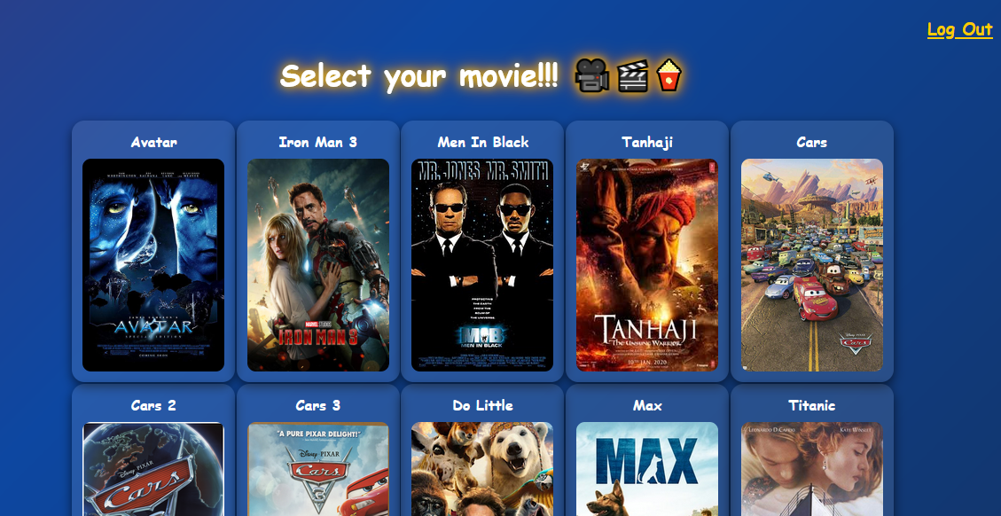
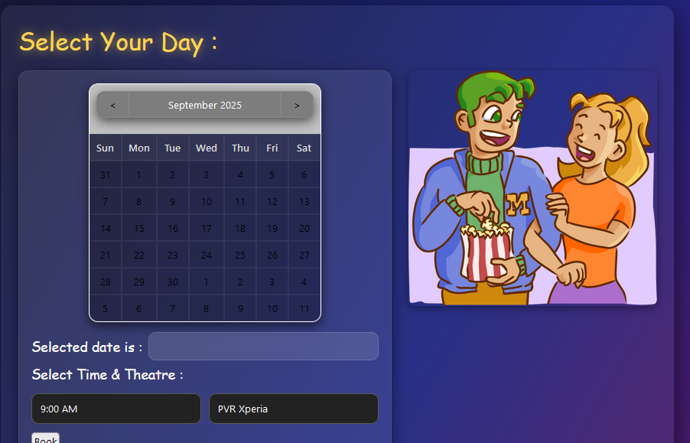
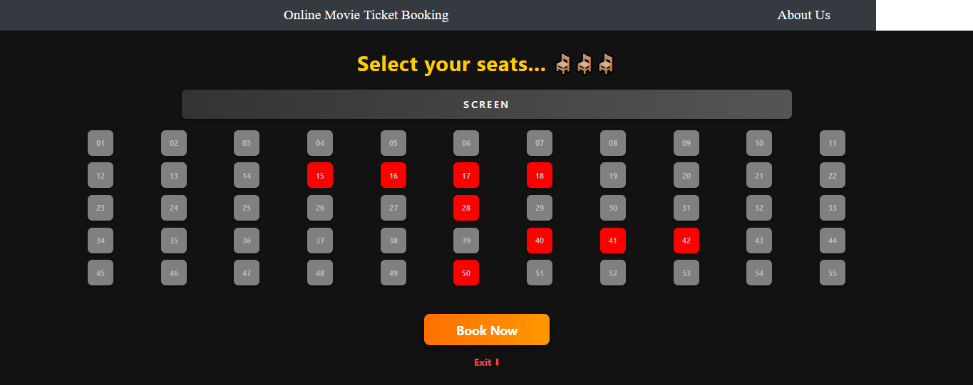
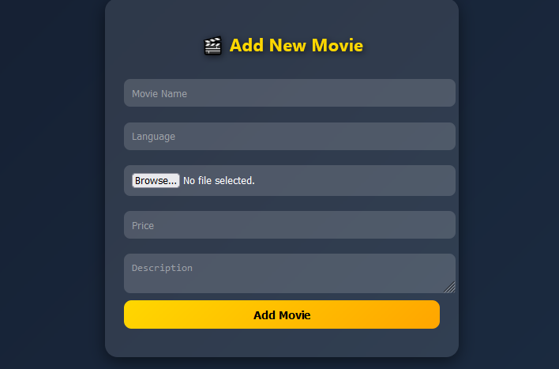
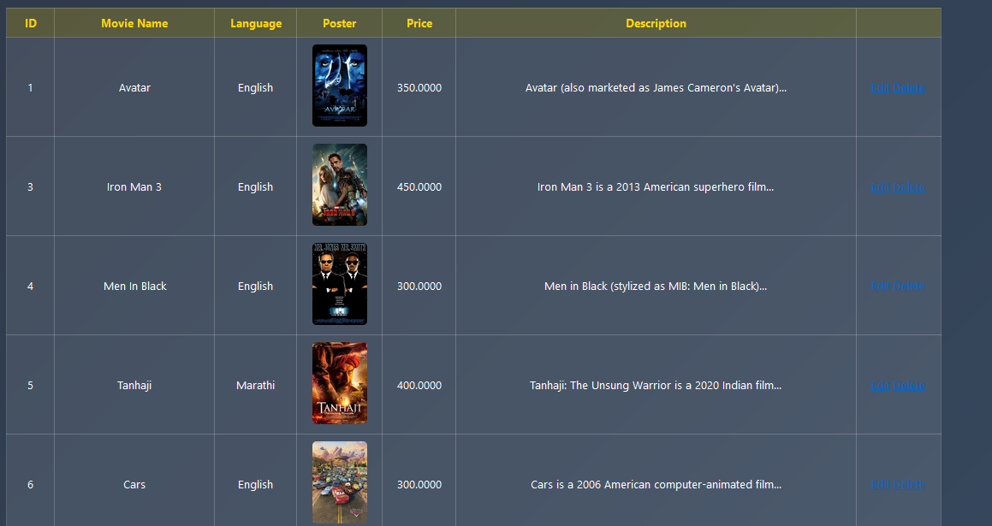
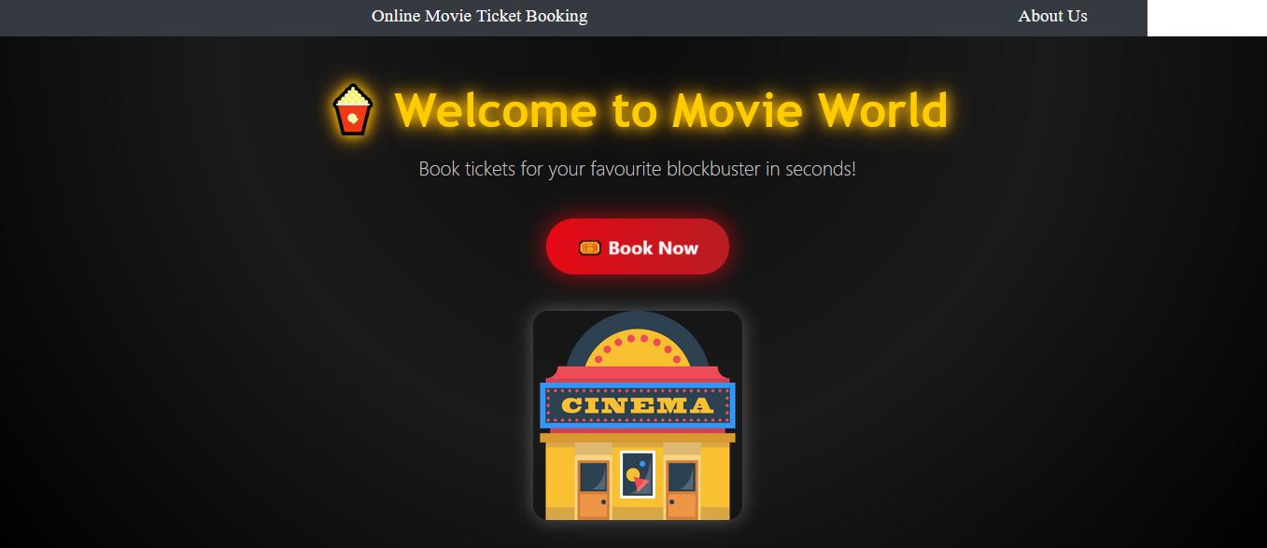
Visualising the Experience: Key Pages

Slide 9

Conclusion: Impact & Future
Key Achievements:
Effortless Booking: Makes movie ticket booking quick and easy.
Reduced Errors: Minimises manual effort and booking mistakes.
Real-time Access: Provides instant seat booking and showtime updates.
Secure Transactions: Ensures safe and reliable payment processing.

Slide 10
Thank You!

