Slide 1
RPV Fixture Fabrication Portal
Jay Gandhi(201506100110138)
Project Guide Mr.Hardik Vyas(Assistant Professor)

Slide 2
Project Definition
The system will provide the facilities to manage the request for its incharge officer.

Slide 3
System Requirement Specification

Slide 4
Purpose
The purpose of this system is to reduce the work load and paper work of the shop incharge and shop head. By using this system the shop incharge and shop head can save the time, reduces cost and use this system any where.

Slide 5
Scope
The shop incharge has to do paper works for managing request for sub contracting manually. The shop incharge no need to seat at single space, they can use this system any where by using of internet. By using this system, it increases to reducing the paper woks. The system will use any where with the use of internet service provider. The system will maintain the time and cost of the shop incharge.

Slide 6
Technology used
Backend :-
Microsoft SQL server 2012
Asp.net with MVC
.NET framework 4.6
Umlet
Frontend :-
Html, css, java script, jQuery, Ajax

Slide 7
Introduction
The Information security management system is the system to manage the request for sub contracting for Saddle and Fixture in the organization. The system is specially made for shop incharge . It is developed the maintain requests and help shop incharge of the organization to reduce paper work and can get reports of the events

Slide 8
System Users
Shop Incharge
Shop head(Planning head)

Slide 9
Functional Requirement
Shop Incharge
The Shop Incharge can generate the new request. New request contain system generated SCR_NO.
The Shop Incharge can upload the multiple documents.
The new request should be generate the by the shop incharge.
The Shop Incharge can update the request before approved.
The Shop Incharge can delete the request before approved. File should be delete on sharepoint

Slide 10
Functional Requirement
The Shop Incharge can view the all request.
The Shop Incharge can download the file manually

Slide 11
Functional Requirement
Shop head
The Shop head can approve the pending request.
The Shop head can manage the role of the system.
The Shop head can export the excel file of all reuquest.

Slide 12
Functional Requirement
Reports should be generated by the system like
Total number of pending request
Total number of approved request
Total number of user(Role Wise)
Export excel file

Slide 13
Non-functional Requirement
Usability
This system provide good enough and proper GUI format with responsive and user friendly.
Security
In this system, login can be possible using web references.

Slide 14
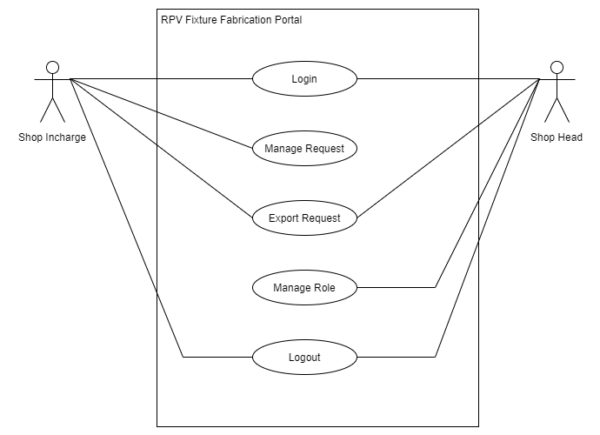
Usecase Diagram

Slide 15
Activity Diagram
Login

Slide 16
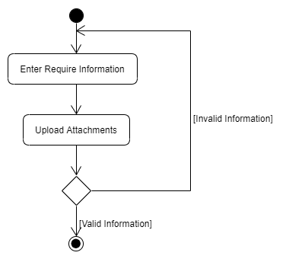
Activity Diagram
Create New Request

Slide 17
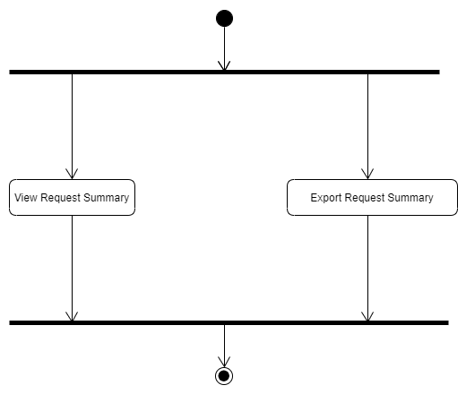
Activity Diagram
View Request

Slide 18
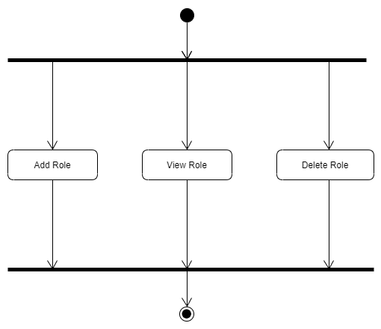
Activity Diagram
Manage Role

Slide 19
Data Dictionary
Tables:-
Tbl_SCR
Tbl_SCR_Master
Tbl_SCR_Role

Slide 20
Data Dictionary
Tbl_SCR
Filed Name | Datatype | Description
SCR_No | Int | Primary Key of the table
Date | Varchar(50) | Date of the request
SC_Type | Varchar(15) | Reuest Type
TypeOfJob | Varchar(50) | Type of job
TypeOfSaddle | Varchar(50) | Type of saddle
TypeOfFixture | Varchar(50) | Type of fixture
ProjectNo | Varchar(50) | Project number for request
ProjectName | Varchar(50) | Project name for request
Department | Varchar(50) | Department for request
CoustomerName | Varchar(50) | Customer name for request
MaterialGrade | Varchar(50) | Material grade for request
Quntity | Int | Quantity for material
FinishWeight | Varchar(50) | Weight of material
MaterialFrom | Varchar(50) | Material from
DetailScopeOfWork | Varchar(50) | Activity wise detail scope of work
PCL_No | Varchar(50) | PCL_No in case there is plate
MaterialAvailable | Varchar(50) | Material Available or not
NDTRequirement | Varchar(50) | NDT Requirement if there is PT or Visual

Slide 21
Data Dictionary
Tbl_SCR (Cont.)
RequiredDate | DateTime | Require date of material
DispatchLocation | Varchar(50) | Loaction for dispatch material
CreatedBy | DateTime | Request created by
CreatedDate | DateTime | Request created on
Status | Varchar(20) | Status of the request
AcknowledgeBy | Varchar(20) | Request Acknowledge By
AcknowledgeOn | DateTime | Request Acknowledge On
AvailableDate | DateTime | Available Date if material is not available

Slide 22
Data Dictionary
Tbl_SCR_Master
Filed Name | Datatype | Description
Id | Int | Primary Key of the table
Type | Varchar(50) | Type Of the Sub request
Value | Varchar(50) | Type Of the Sub request

Slide 23
Data Dictionary
Tbl_SCR_Role
Filed Name | Datatype | Description
Id | Int | Primary Key of the table
Psno | Varchar(50) | Psno of the user
Role | Varchar(50) | Role of the user

Slide 24
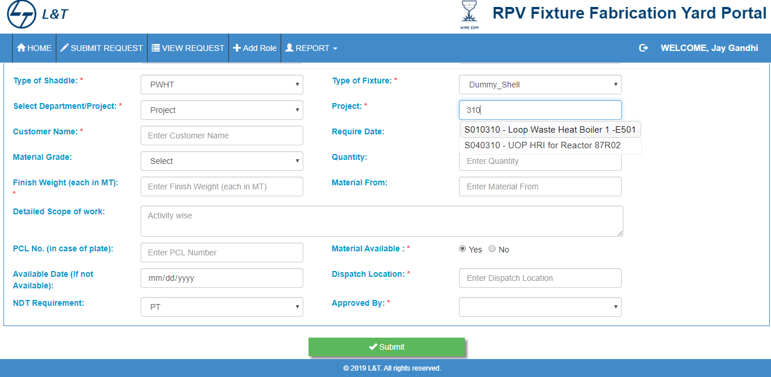
User Interface Design
New Request

Slide 25
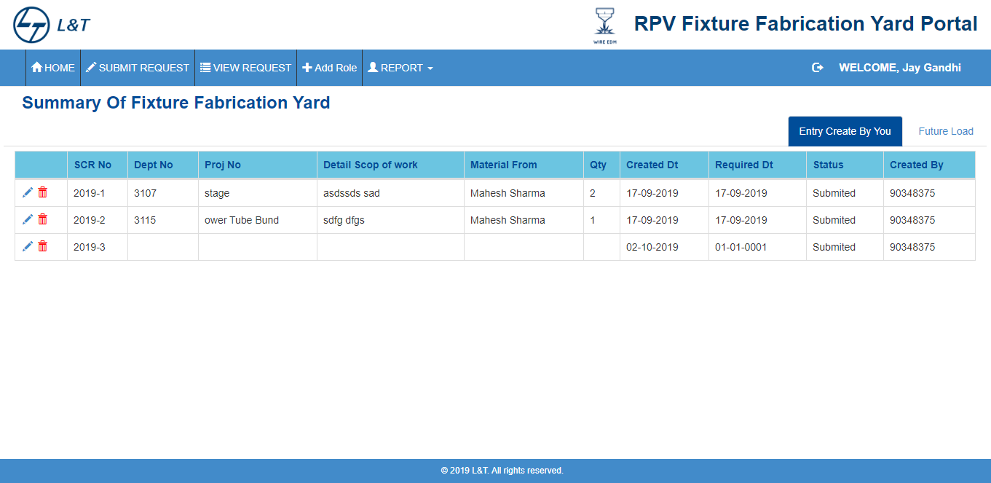
User Interface Design
Request Summary

Slide 26
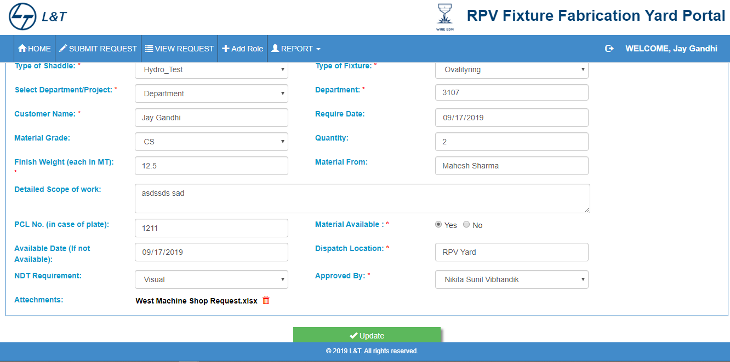
User Interface Design
Update Request

Slide 27
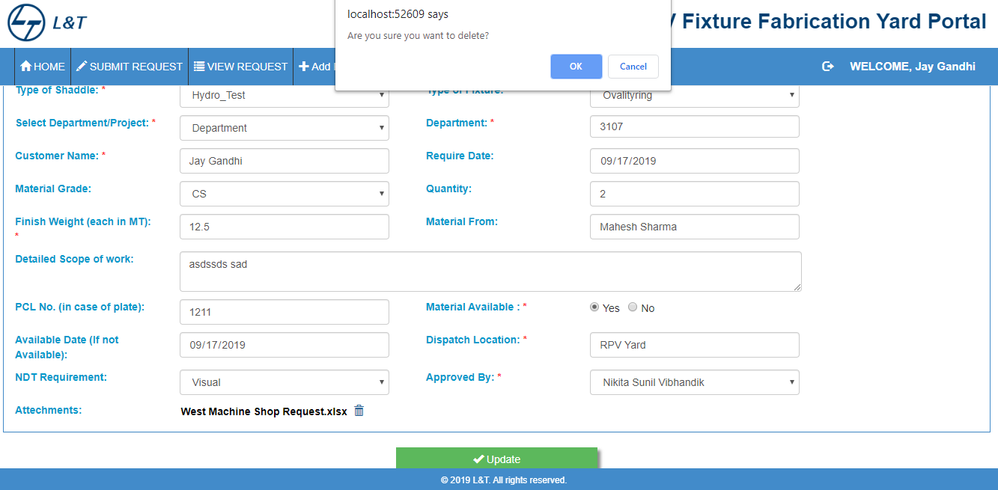
User Interface Design
Delete Request

Slide 28
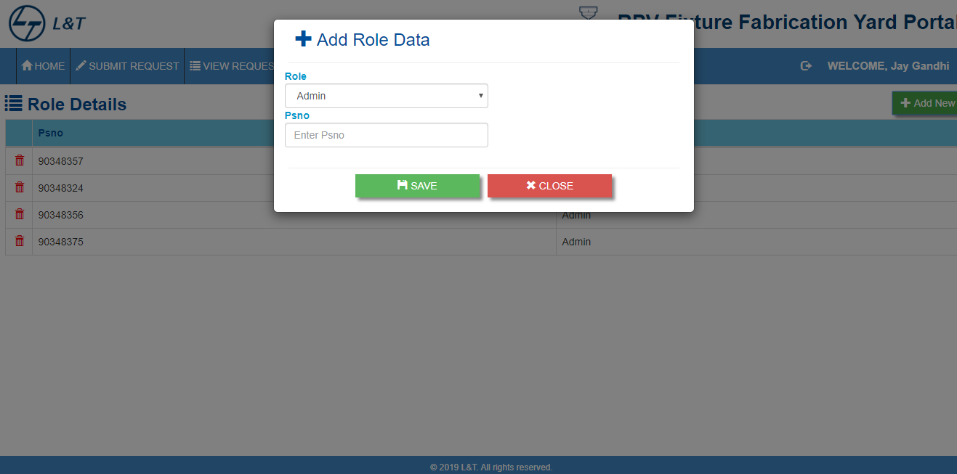
User Interface Design
Add New Role

Slide 29
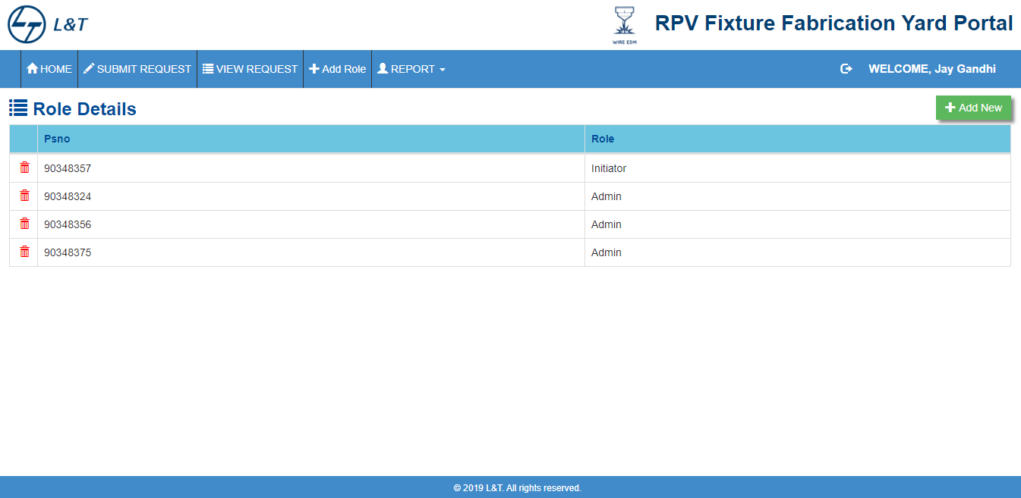
User Interface Design
Role Summary

