Slide 1
Guesthouse Booking & Management System
IT-313
Professor : Saurabh Tiwari
Software Engineering
Mentor : Shrut Shah
Group 6

Slide 2
Group Members
Jay Malaviya (202101048)
Divyam Thaker(202101068)
Ayush Mangroliya (202101073)
Mehul Rawal (202101033)
Dev Changela (202101069)
Jay Parikh (202101066)
Kirtan Mevada(202101012)
Suyash Bhagat (202101085)
Vraj Thakkar (202101090)
Meet Patel(202101045)

Slide 3
Objectives
Understanding both the project’s requirements and the challenges encountered by small guest accommodations.
Effectively handling and managing the project while considering limitations like time and available resources.
Applying various diagrams from the Software Engineering curriculum to enhance understanding of the system's operations.
Creating a complete and operational system for booking and managing guest houses in alignment with specified requirements.
Documenting the progression of activities throughout the project.
Conducting thorough testing to guarantee the system's precise and seamless functionality.

Slide 4
Milestones
Successfully listing down the requirements of the project after a collective effort of the group which involved brainstorming, discussion and constructive criticism.
Designing all the diagrams(use case, activity, sequence, class, etc.) while keeping in mind the requirements of the project.
Slowly but steadily making progress in the development of the system. It was difficult but step by step we kept on moving forward.
Completing the testing of the software for any bugs and failure was also one big tick mark for our project.
Thoroughly documenting the entire process for potential future use and reference.

Slide 5
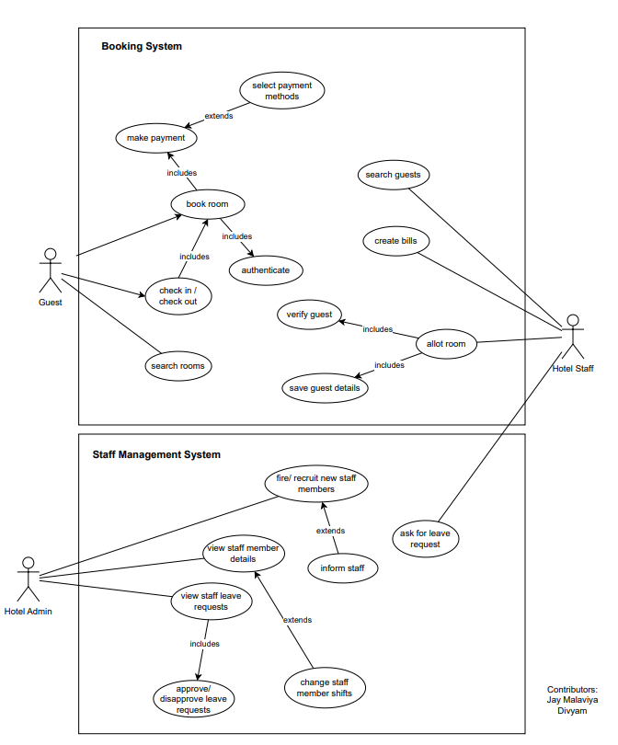
Use Case Diagram

Slide 6
Lessons Learnt While Doing the Project
The importance of planning while developing such systems.
Creative process is chaos. No matter how hard you try, sometimes the process still becomes chaotic. Though the planning does help in controlling the chaos.
Team work is a must in such projects. Without proper coordination from the teammates the project probably would have derailed.
The importance of Software Engineering concepts like UML diagrams, testing, development methodology. Even the activities like brainstorming were so useful. We came up with so many unique ideas while brainstorming.

Slide 7
Achievements
Our biggest achievement is definitely going to be able to develop a system which works given time and resource constraints.
We were able to make the system which met most of the requirements of the projects. Still some things to be implemented but overall happy with the outcome.
The teamwork that we achieved is truly noteworthy. The coordination between the group members was remarkable. Everyone was complementing and helping eachother whenever required.

Slide 8
Mistakes Made During the Project
Not keeping in mind the responsiveness aspect of the webpages while initially making them. We had to work extra hard to make the website responsive later.
Not allocating sufficient time for the final refinements of the website.
Not giving enough time to the testing of the system. We have sufficiently tested the system but still there was some room for improvement.

Slide 9
Rating of Software Artifacts
4/5

Slide 10
Overall Rating Of The Project
8/10

Slide 11
Thanks!

