Slide 1

Data+ Development Programme
James Armitage
GitHub: JamArm99/Grayce-Analysis

Slide 2
Overview – The Data Analysis Process
Identify & Collect
- What questions does this analysis aim to answer?
- Raw data collection
Clean
- Preparing the data for analysis
- Recommendations for data quality improvements
Analyse
- Sales and Region analysis
- Volume and Price trends
- Loyalty customers
Interpret
- Conclusions from the analysis
- Sales strategy proposal
Summary
- What have we learnt?
GitHub: JamArm99/Grayce-Analysis
James Armitage
2

Slide 3
Identify & Collect
GitHub: JamArm99/Grayce-Analysis
James Armitage
3

Slide 4
Questions For This Analysis
Identify
Collect
How effective were the promotions?
- How was sales volume distributed across the
year?
- Are there any transaction price and number of
item trends?
How was the sales volume distributed across the regions?
Do loyalty customers spend more than non-loyalty customers?
At the end of February, data collection is coming from client relationship management (CRM) software.
A database of 15,000+ entries has been randomly sampled to give a data set of 500 values across 2019.
GitHub: JamArm99/Grayce-Analysis
James Armitage
4

Slide 5
Clean
GitHub: JamArm99/Grayce-Analysis
James Armitage
5

Slide 6
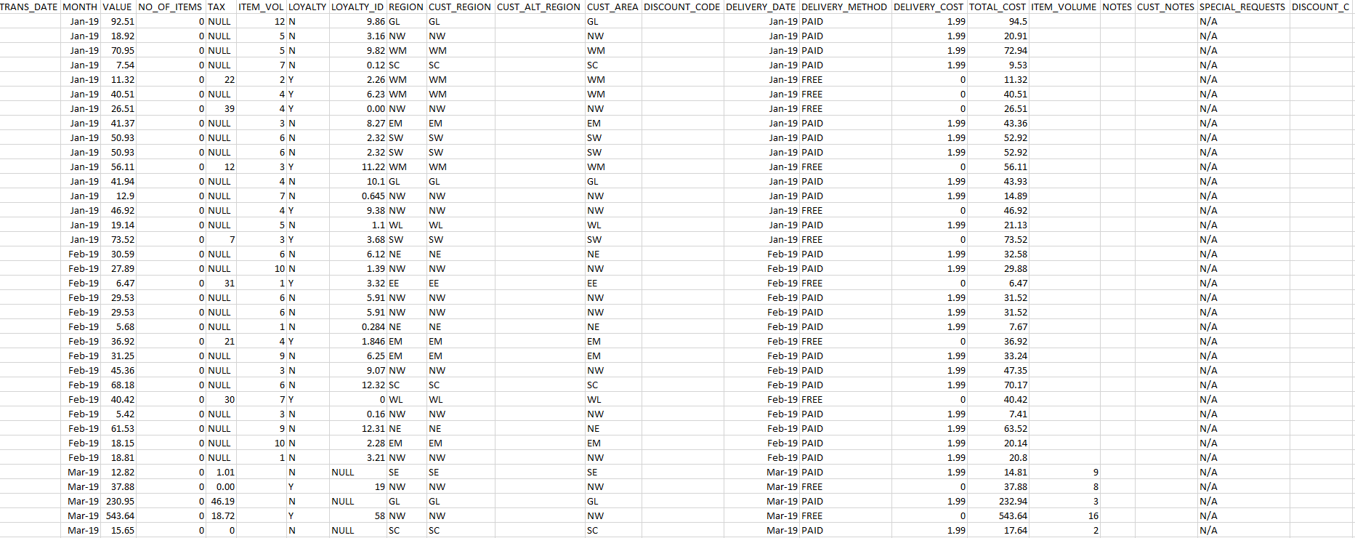
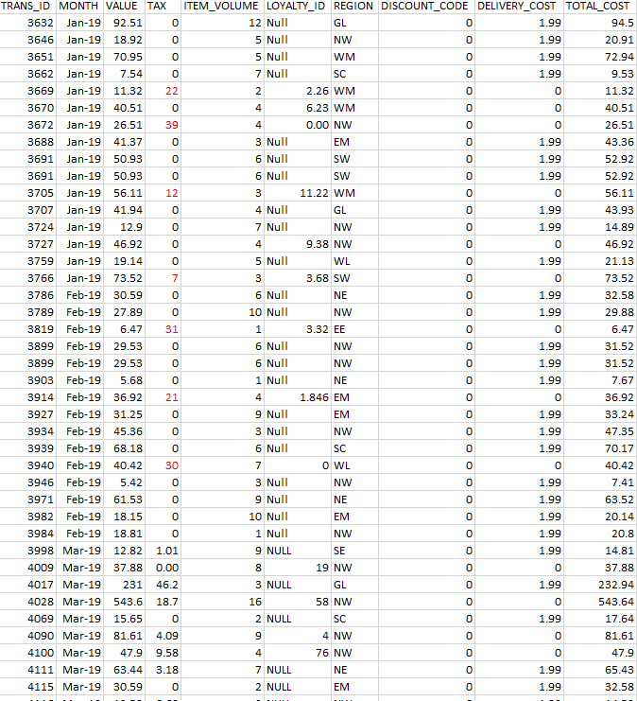
Preparing Data For Analysis
Good data quality is data that is fit for purpose. It can be tested using the DAta Management Association (DAMA) UK data quality dimensions: Completeness, Uniqueness, Consistency, Timeliness, validity and Accuracy.
Database pre-clean
Database post-clean
GitHub: JamArm99/Grayce-Analysis
James Armitage
6

Slide 7
Recommendations For Data Quality
Completeness: All records are complete
- Item volume is split at the CRM integration
Uniqueness: No entry duplication
- Region and customer region
- Customer alternative region
- Discount codes
- Delivery date is duplicate of date
- Loyalty ID and loyalty customer
- Number of items and item volume
Consistency: Value contradictions
- Loyalty and loyalty ID conflict prior to CRM
- No tax either displayed as “NULL” or 0
Validity: Data within correct ranges
- Tax values prior to CRM are unphysical e.g.
Tax > transaction price
GitHub: JamArm99/Grayce-Analysis
James Armitage
7

Slide 8
Analyse
GitHub: JamArm99/Grayce-Analysis
James Armitage
8

Slide 9
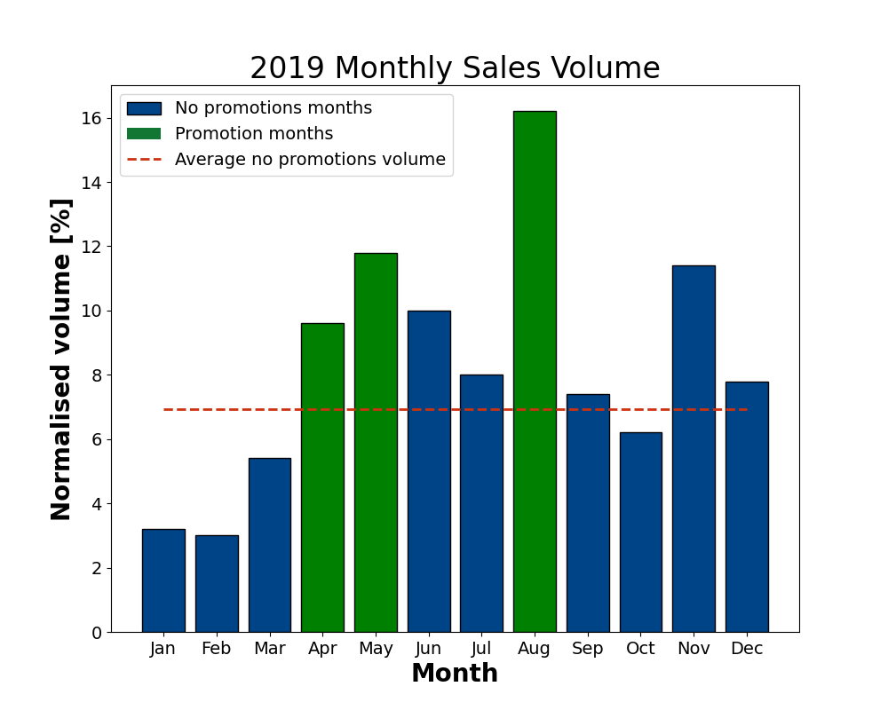
Sales Volume Analysis
Both the spring (national targeted) and summer (London and West Midlands targeted) sales promotions show an increase over baseline volume.
Sales Month | Difference From Baseline [%]
April | 3
May | 5
August | 10
Region targeted sales promotion was more effective than national promotion.
Dual month promotions keep volume less volatile.
GitHub: JamArm99/Grayce-Analysis
James Armitage
9

Slide 10
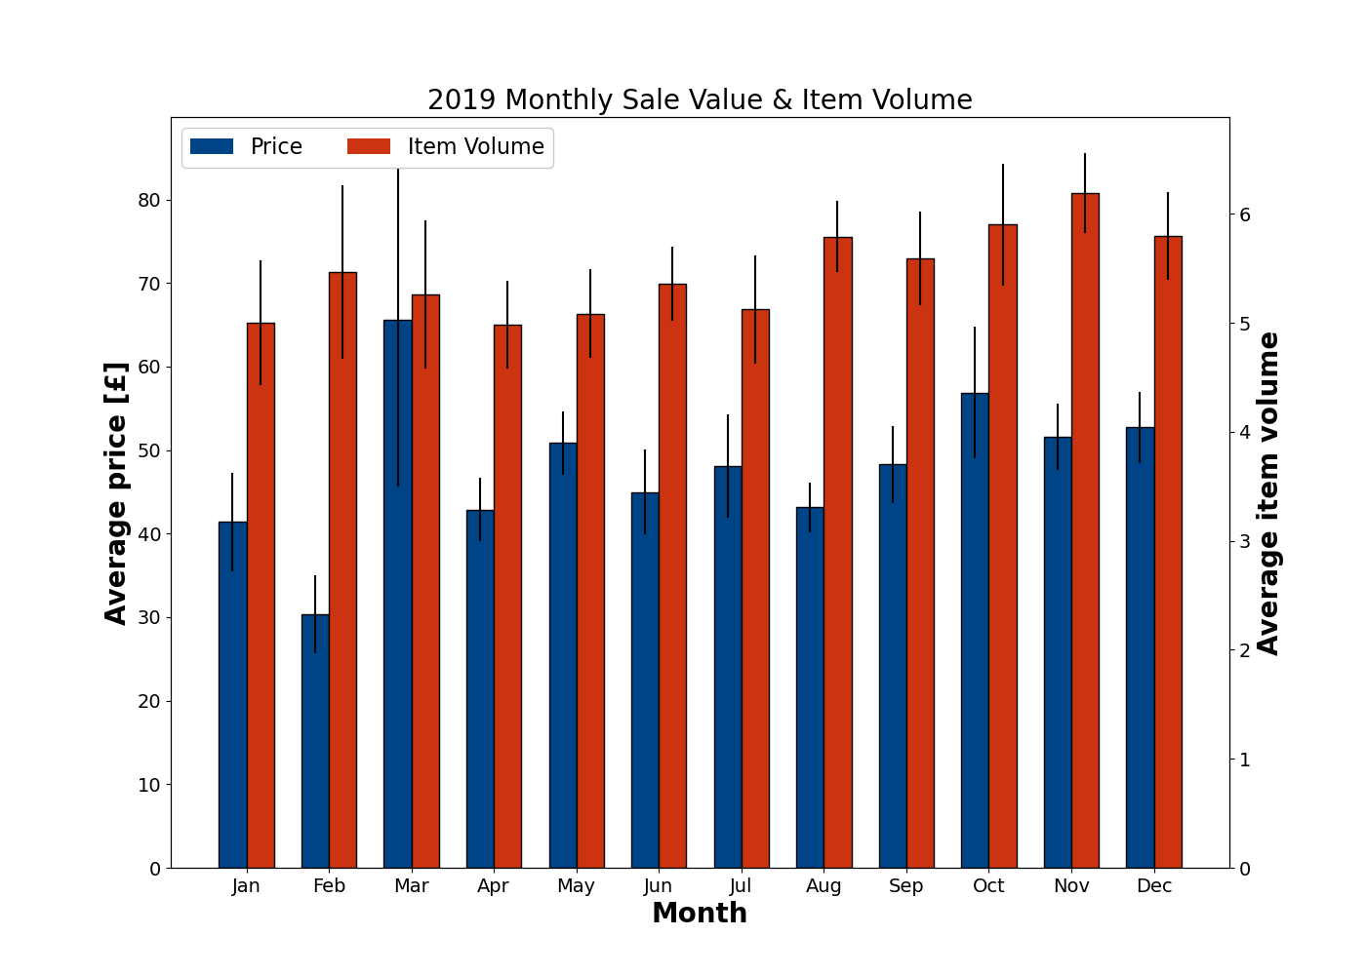
Item Volume & Price Trends
Sales promotions did not affect the number of items in each transaction or the price of each transaction.
No correlation with sales promotions and transaction parameters as the averages remained approximately flat and within statistical errors.
This means that sales promotions were only effective at attracting new customers or existing customers to purchase more frequently.
GitHub: JamArm99/Grayce-Analysis
James Armitage
10

Slide 11
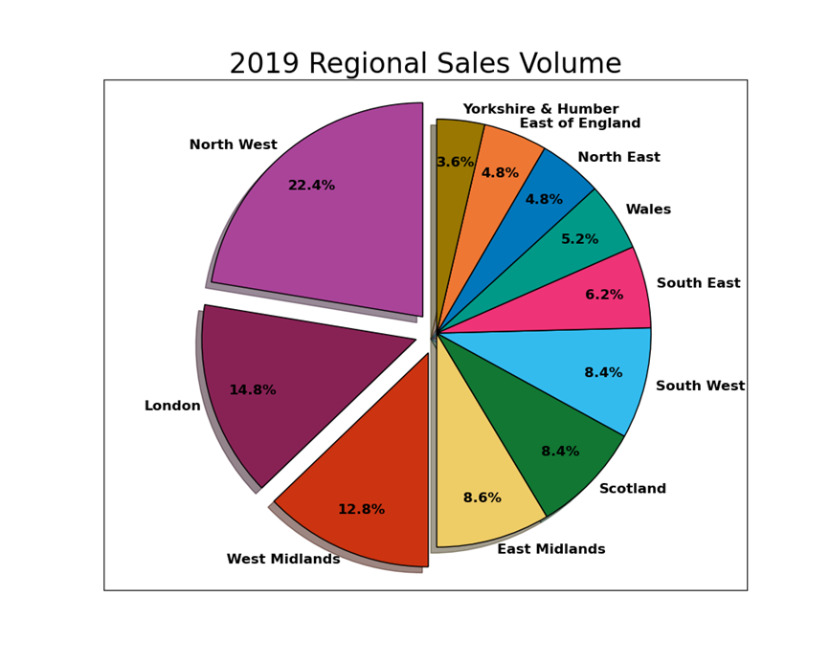
Regional Volume Analysis
Three largest regions for sales volume align with expectations.
- North West is the company’s local region
and prior to expansion it was trading
there.
- London and West Midlands have
experienced successful targeted promotions.
East of England and South East regions express little volume with respect to their population size (potential customers)
GitHub: JamArm99/Grayce-Analysis
James Armitage
11

Slide 12
Loyalty Customers
It was believed that loyalty customers spend more per transaction than non-loyalty customers.
Customer Type | Average price per transaction [£]
Loyalty | 51 ± 3
Non-loyalty | 46 ± 2
Due to the statistical errors on the sample size of 500, it is shown that loyalty customers do not show an increase in average transaction price over non-loyalty customers.
For this reason, a promotion strategy will focus on customer volume and not on customer type.
GitHub: JamArm99/Grayce-Analysis
James Armitage
12

Slide 13
Interpret
GitHub: JamArm99/Grayce-Analysis
James Armitage
13

Slide 14
Sales Strategy Proposal
January and February are below average; therefore, they need a boost to align with other monthly sales numbers. A ‘new year’ Sales promotion targeting the South East and North West would yield a large sales volume.
A sales promotion across July and August for London and East of England is recommended to increase summer sales volume. Evenly spaced promotions give enough cool off from the previous sale and not allowing customers to de-value products if they are reduced constantly.
REGION | POPULATION [June 2021]
South East | 9,217,265
London | 9,002,488
North West | 7,367,456
East England | 6,269,161
Office for National Statistics: Estimates of the population for the UK, England and Wales, Scotland and Northern Ireland
GitHub: JamArm99/Grayce-Analysis
James Armitage
14

Slide 15
Summary
GitHub: JamArm99/Grayce-Analysis
James Armitage
15

Slide 16
What Have We Learnt?
Initial questions
- How effective were the promotions?
- How was the sales volume distributed by region?
- Do loyalty customers spend more than non-loyalty customers?
Recommendations for data quality
- Ensure all records are complete
- Take steps to reduce data duplication/redundancy
- Consistency between data fields
Analysis conclusions
- Region targeted sales performed better than national sales
- Sales promotions did not affect the items per transaction of the
price of transaction
- Loyalty customers on average do not spend more than non-
loyal customers
Sales Strategy
- ‘new year’ sales promotion across
January and February targeted at South
East and North West regions to drive
sales volume.
- Summer sales promotion across July and
August targeting London and East
England regions.
GitHub: JamArm99/Grayce-Analysis
James Armitage
16

Slide 17
Thank you for listening
GitHub: JamArm99/Grayce-Analysis
James Armitage
17

