Slide 1

Project
Andronnikova Anna

Slide 2











Slide 10


Slide 12
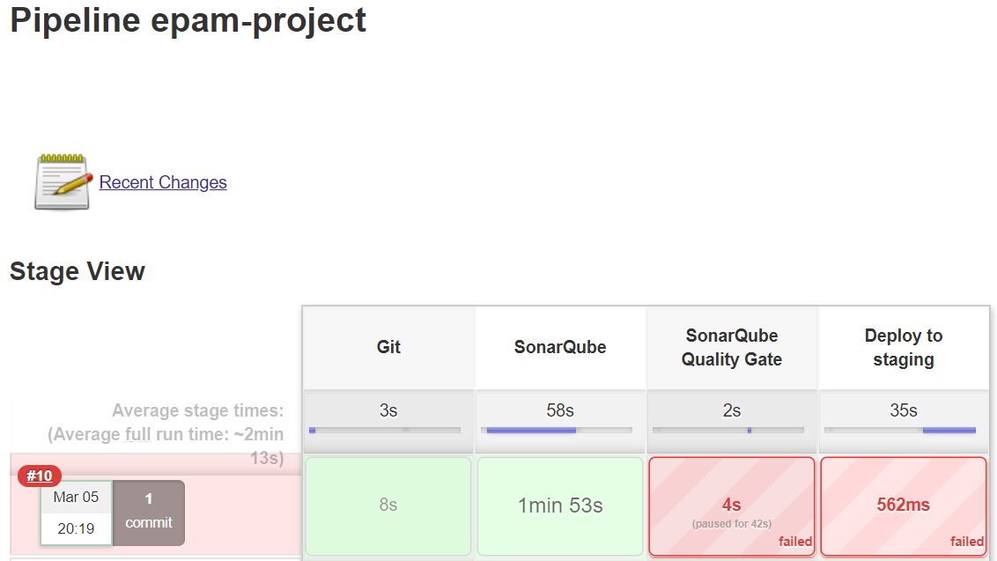
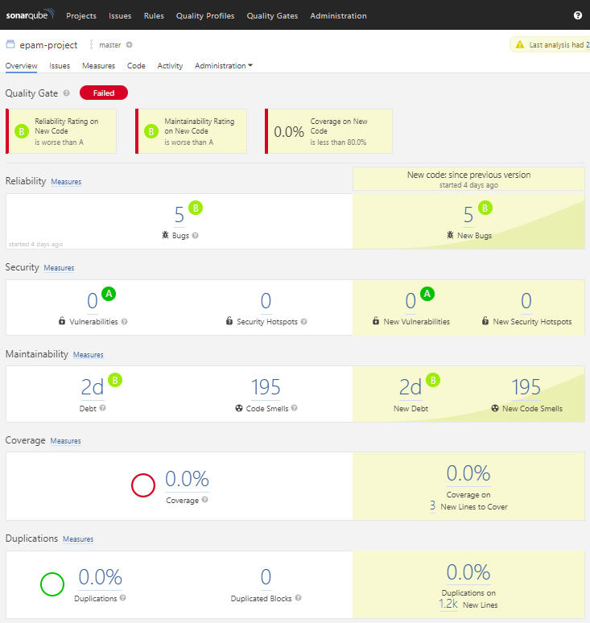

Slide 13


Slide 15
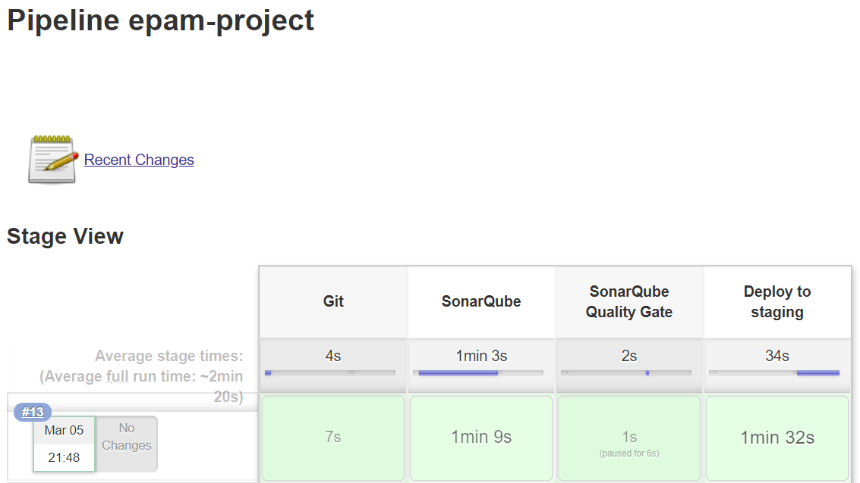
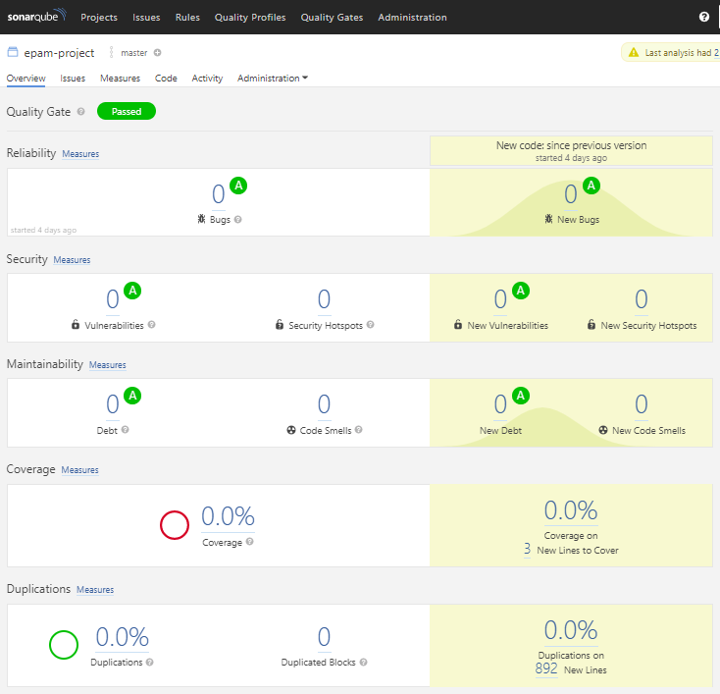

Slide 17


Slide 18
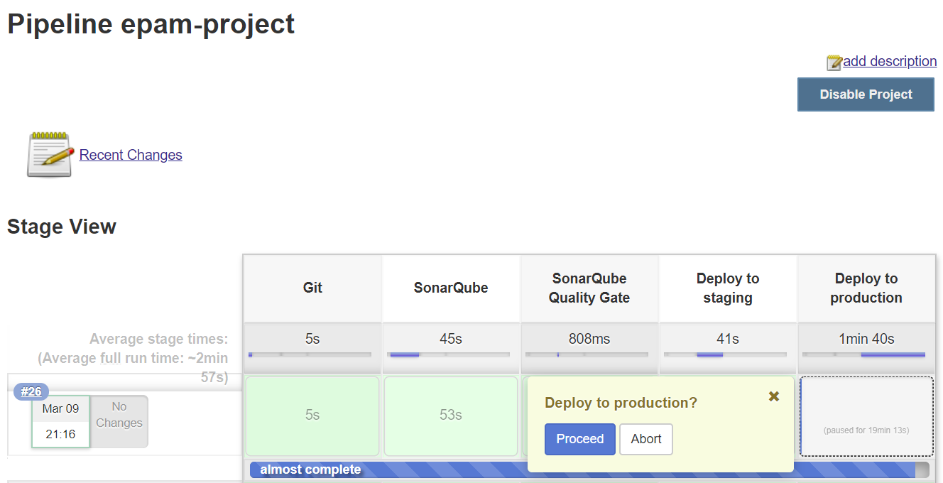

Slide 20


Slide 21
Thnx.

