Slide 1
Insight Impactors
Alistair Simpson Pereira
Blessy Evangeline
Nimesh Kotian
Harshita Jamadade
Shruti Pardesi

Slide 2
User Story Outline

Slide 3
Managing candidate lifecycle from screening to notification, ensuring clear communication and smooth process flow.
Ensuring prompt email confirmations and delivering constructive application feedback to candidates.
Assessing coding proficiency and aligning candidate qualifications with HR needs to recruit skilled Python developers effectively.

Slide 4
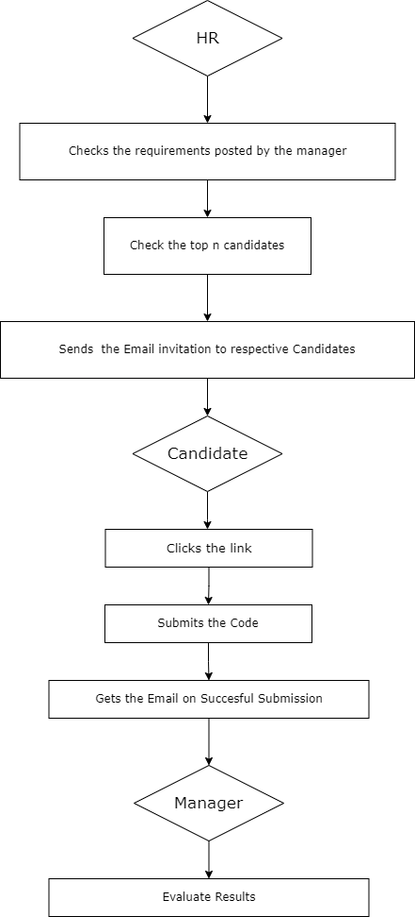
Flow Chart

Slide 5
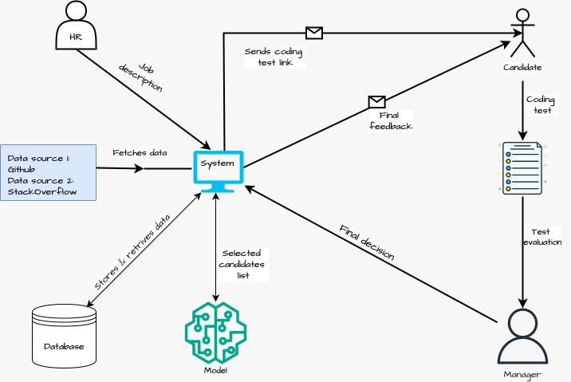
System Architecture

Slide 6
Data Storage

Slide 7

SQLite 3
Simple & Lightweight
Zero Configuration
Compatible
17.08.2024

Slide 8
Future Use Cases

Slide 9
Integration of some other open source compiler for candidate.
Implement different machine learning algorithms for candidate ranking.
Considering MySQL as a potential alternative to SQLite3 for improved scalability and performance.
Integration with other platforms or APIs for fetching data(e.g., Kaggle, Twitter).
17.08.2024
SRH University – Big Data Programming

Slide 10
Thank you!

