Slide 1
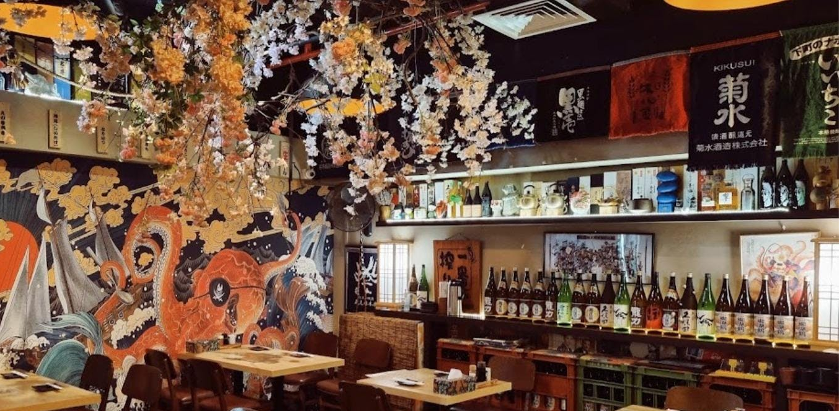


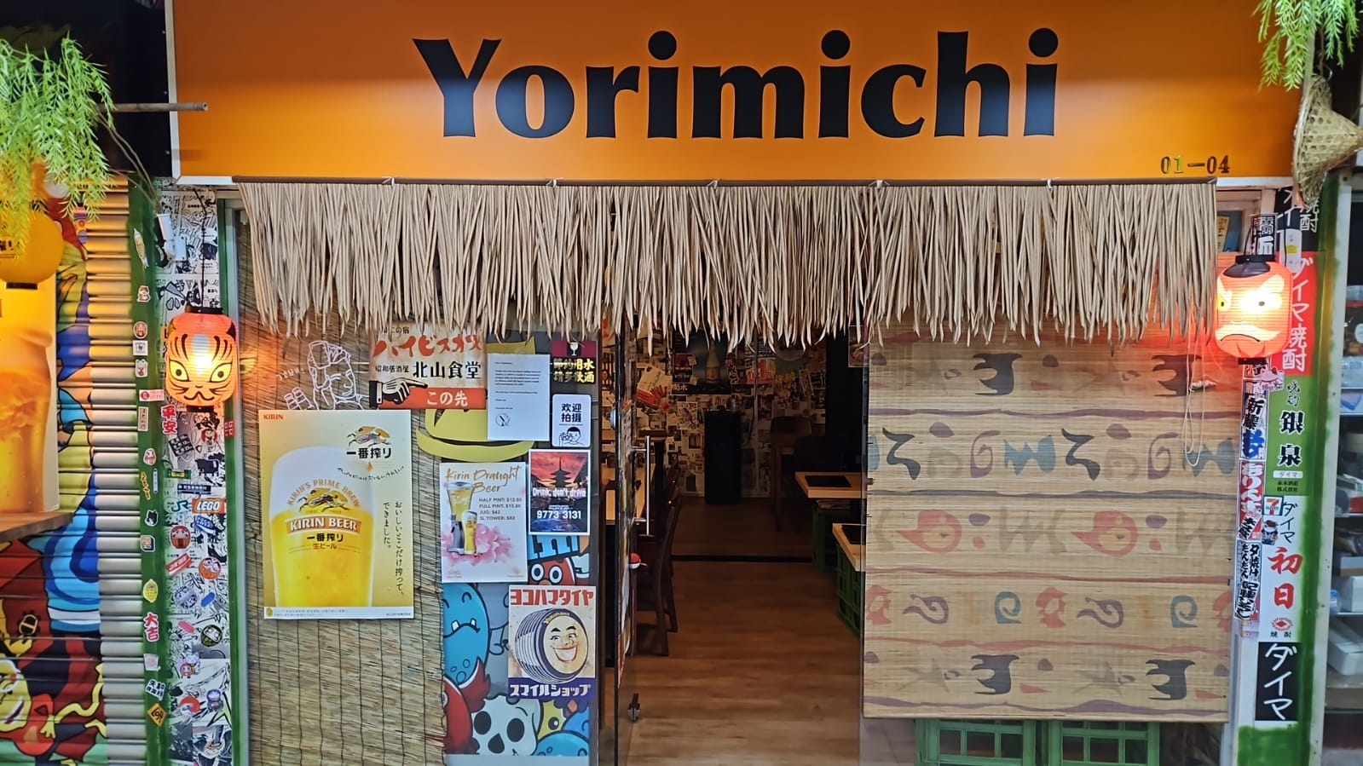
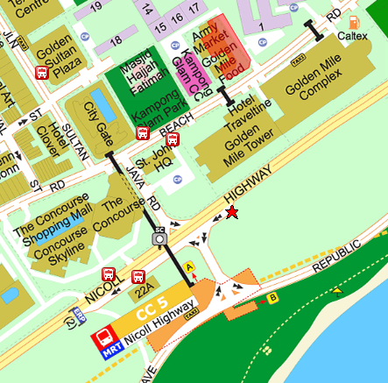
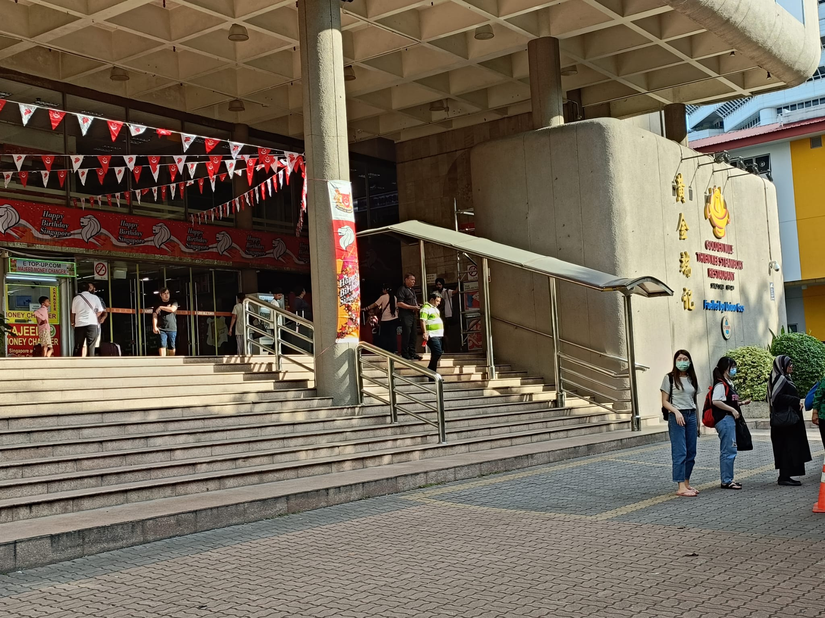
13
AUG
EVENT EMAIL
Ladies, Thank you for being a part of our upcoming Dining in the Dark event! This message serves as a reminder. If you have any specific food requirements, please don't hesitate to inform us, and we will do our best to accommodate them. However, kindly note that we do not serve beef during this event. We look forward to providing you with a unique and memorable experience. See you soon! Date / Time: 06 Aug (Sun) @ 6:00 pm Place: Yorimichi Yakitori Izakaya Address: 6001 Beach Rd, #01-02 GOLDEN MILE TOWER, Singapore 199589 Verification doc: Singpass, driving licence, IC, etc Event registration: Screen shot of ticket. For any issue on the day of the event, you can contact our staff @ 87601459 Below is a guide for those travelling from the train station Thanks, Jamaica G.
Gents, Thank you for being a part of our upcoming Dining in the Dark event! This message serves as a reminder. If you have any specific food requirements, please don't hesitate to inform us, and we will do our best to accommodate them. However, kindly note that we do not serve beef during this event. We look forward to providing you with a unique and memorable experience. See you soon! Please meet our staff (with a sign) at the entrance of the golden mile tower for registration and verification as depicted in the photo. Date / Time: 06 Aug (Sun) @ 6:15 pm Place: Yorimichi Yakitori Izakaya Address: 6001 Beach Rd, #01-02 GOLDEN MILE TOWER, Singapore 199589 Verification doc: Singpass, driving licence, IC, etc Event Registration: Screen shot of ticket. For any issue on the day of the event, you can contact our staff @ 87601459 Below is a guide for those travelling from the train station Thanks, Jamaica G.
INNER SOUL VERSE PRESENTS
DINING
IN THE
DARK
introductory price
$68
Ages:
Ladies: 28-38
Gentlemen: 30-40
When:
13 Aug 2023 (Sun)
6pm to 8pm
Where:
Yorimichi Yakitori Izakaya
@Beach Rd
Price includes 8 course dinner and one-to-one rotation
EVENT MANAGEMENT | Completion
Confirm date and availability of restaurant before creating event
Send event to Eventbrite 28 days in advance
Create promo codes
Create two ticket types (male/female)
Inform participants on Monday and Saturday same week as the event date to remind them and to inform meeting place
Alight at Nicholl Highway MRT.
Take Exit A.
Walk along the bridge.
Look out for the stairs that leads down to St. John HQ.
Walk farther and you would reach Golden Mile Tower.
Gentlemen
Meet at Entrance

Slide 2
Schedule
Event Item
PREP | EVENT | REMARK
4:00 - 5:15 | Setup + Dinner | Setup pipe works + curtains Setup luminous sticks at table edge Check power bank battery Check phones x2 battery Check IR camera Check speakers
6:00-6:15 | Ladies arrival | Play music Check tickets + pass them bottled water sit them in the small room Switch off light to show darkness Close the door before gentlemen enter to view the room
6:15-6:25 | Gents arrival | Wait at the entrance with the signboard Check tickets + pass them bottled water Once ready send them to see the room
DURING | EVENT | REMARK
6:25 – 6:30 | Introduction
6:30 – 7:30 | Rotation | 6 pairs : 9mins 7 pairs: 9 mins 8 pairs: 8mins (1.1x playback speed) 9 pairs: 8mins (1.1x playback speed)
POST | EVENT | REMARK
7:30 – 7:35 | Turn up light + Debrief + thank Xiao Yu | Participant shall gather at the back
7:35 – 7:45 | Drinks + Pack up | Participant continues
ENTRANCE SETUP | Qty | REMARK
Storage Bag | 1
Curtain | 9
Pipe works (25mm JIS K6741) ID: 32mm | 21
Safety pins and clips
ELECTRONICS | Qty | REMARK
Phone (SIM card) | 1 | Check Battery.
Music phone | 1 | Check Battery. intro music, event music, post event music
Phone | 1 | For infra red camera WIFI shall be set to 2.4 dual
Power bank | 1
IR camera | 1
Speakers | 2
MISC | Qty | REMARK
Signboard for meeting place | 1 | For the gentlemen to identify our staff.
Cotton bud | 1 pack
Sampling bottle | 30 bottles
Luminous stick | 1 pack
Disposable spoon | 1 | For dipping luminous liquid
penknife | 1
Masking tape | 1 | In case curtain torn

Slide 3
INTRODUCTION
Thank you for joining us tonight
I’m your host this evening XXX and with me is YYY.
This evening we have X number joining us.
A few important reminders before we start
If you need to get our attention for any reason, such as making a phone call, visiting the restroom, or anything else, simply wave your hands, and we'll be right there to assist you.
Please respect everyone’s privacy of all participants.
Alright, let's go over how the event works. Directly in front of you, you'll notice a luminous stick, which serves as the designated spot for placing the food.
The food has been specially prepared to cater to the event's needs.
You can expect bite-sized treats served on a spoon or stick.
We kindly ask you to handle the food with care, as our previous experience has shown that it's advisable to place your non-master hand under your mouth while eating to prevent any accidental spills onto your clothes.
We will be serving our first dish
ENDING
Ladies and gentlemen, this marks the end of our rotation. We kindly request everyone to remain seated. In just a moment, we will be dimming the lights.
----- go to the switch
Now, without any further delay, it's time for the moment of truth!
----- dim up the lights
Feeling excited? Thank you for being a part of our inaugural event. Hope you enjoyed the food and experience. Above all, a meaningful conversation and connection with fellow guests. Feel free to reach out to us for any feedback and follow us for future events
And with me is Xiaoyu for making today's event possible and unforgettable. As a special way to commemorate this day, Yorimichi has generously sponsored sake for everyone to enjoy.
----- after serving drinks
Cheers everyone. If you decide to return for another gathering, rest assured that the food offerings will be thoughtfully adjusted to provide a slightly different culinary experience. Just to keep things fresh and exciting, so we look forward to surprising you with new and delightful flavors each time you join us.

Slide 4
SETUP
Both sides union
Both sides 5 ways
Extension Rod
Pipe
Upside down setting up
SECURE THIS ROD
TO A CHAIR
Facing door

Slide 6


INNER SOUL VERSE PRESENTS
COMING THIS SEPT
万圣节单身者魔方匹配游戏
Halloween
INNER SOUL VERSE PRESENTS
Game Cube
Singles
Male: 25 - 32
Female: 23 - 30
When
COMING THIS SEPT
Where:
Yorimichi Yakitori
Izayaka
@ Beach Rd
Prices includes:
- Game facilitation
- Food and drinks
快来与同样热爱冒险的单身人士相遇，在阴森恐怖的领域中探寻奇异。在这个鬼屋版中，幽灵般的单身人士聚集在一起，解开谜一般的魔方，寻找灵魂的纽带。在我们的游戏大师指引下，留下难忘的记忆，说不定还会在你身旁找到特别的人。敢不敢来一场恐怖的灵魂匹配之旅？
In this Halloween, where ghostly singles unite to solve enigmatic cubes and find spectral connections. With our Game Masters as your love orchestrators, will leave you with unforgettable memories.
想要来一场不一样的万圣之旅吗？透过游戏大师的“穿针引线”，认识志同道合的朋友，一起寻幽探秘，解开重重谜底。在魔幻的游戏世界里，一同留下难忘的回忆。也许您正等待的那一个特别的他/她会在这一刻相遇？
Chinese edition
Note:
Game will be conducted in simple spoken mandarin
Meet fellow singles who share your love of adventure in the eerie domain. In this Haunted House edition, where ghostly singles unite to solve enigmatic cubes and find spectral connections. With our Game Masters as your love orchestrators, will leave you with unforgettable memories and, who knows, possibly even a special someone by your side.

