Slide 1
+
Hospital Emergency Priority System (HEPS)
Event-Driven Emergency Department Triage Workstation & Priority Queue Management
ACADEMIC MINI-PROJECT PRESENTATION | 5-MEMBER TEAM
Course: CSE203 - Object-Oriented Programming using Java • Evaluation Weight: 50 Marks
TEAM MEMBER ROLES & RESPONSIBILITIES:
• Member 1: Clinical Problem Identification & Emergency Department Triage Objectives
• Member 2: Object-Oriented Architecture, Layer Separation & Core Domain Modeling
• Member 3: Data Structures & Algorithms: Java PriorityQueue & 3-Tier Comparator Logic
• Member 4: Database Engineering, Relational Schema & Enterprise JDBC Persistence
• Member 5: JavaFX Desktop Workstation UI, JUnit 5 Testing & Live System Demonstration

Slide 2
PROJECT ORGANIZATION
Presentation Agenda & Team Member Responsibilities
Team Member 1
Problem & Objectives
Clinical ER challenges, why FIFO fails in healthcare triage, project scope & functional deliverables.
Team Member 2
OOP Architecture
Layered pattern (FXML -> Controller -> Service -> DAO -> MySQL), encapsulation, abstraction, and custom exceptions.
Team Member 3
DSA & PriorityQueue
Min-Heap backed Java PriorityQueue, 3-tier PatientPriorityComparator, O(log N) vs O(1) complexity, tie-breakers.
Team Member 4
Database & JDBC
MySQL relational schema, ACID guarantees, PreparedStatements against SQL injection, heap-to-DB sync.
Team Member 5
UI, QA & Live Demo
Redesigned clinical workstation, JUnit 5 test suite, edge-case handling, and live triage workflow walkthrough.

Slide 3
MEMBER 1 • CLINICAL CONTEXT
The Healthcare Challenge: Emergency Room Overload
Presenter: Member 1
The Problem in Modern Hospitals
Real-World Clinical Acuity Scale
• Unpredictable Patient Influx: Emergency Departments (EDs) experience acute surge waves with no advance scheduling.
• Wide Acuity Variance: Patients arrive simultaneously with vastly different medical acuities—from life-threatening trauma to minor abrasions.
• Cognitive Staff Fatigue: Manual triage registers and whiteboards cause severe cognitive strain on reception staff under intense pressure.
• Information Silos: Walk-in documentation is frequently separated from doctor consultation and discharge notes, creating clinical blindspots.
• Regulatory & Ethical Mandate: Delaying acute patients while treating non-urgent arrivals violates hospital triage protocols (e.g. Manchester/ESI).
CRITICAL (Urgency Level 1)
Immediate life threat: acute respiratory failure, cardiac arrest, unresponsiveness, severe hemorrhage. (Target: Immediate treatment)
HIGH (Urgency Level 2)
Severe emergencies: open fractures, high persistent fever with altered sensorium, severe burns. (Target: Within 15-30 min)
MEDIUM (Urgency Level 3)
Moderate acute distress: localized pain, suspected closed fracture, persistent high fever. (Target: Within 60 min)
LOW (Urgency Level 4)
Minor/routine conditions: superficial abrasions, mild sprains, dressing changes. (Target: Non-urgent care)

Slide 4
MEMBER 1 • PROBLEM ANALYSIS
Why FIFO Queues Fail & HEPS System Objectives
Presenter: Member 1
The Critical Flaw of Standard FIFO Queues
HEPS Project Objectives
First-In, First-Out Trap: In a standard queue (FIFO), a patient with cardiac arrest who arrives at 14:45 would be forced to wait behind a patient with mild back pain who arrived at 14:00.
Catastrophic Latency: Medical conditions deteriorate exponentially. Delaying resuscitation by even 5 minutes leads to irreversible hypoxia or cardiac death.
Manual Queue Reordering is Risky: Shuffling physical cards or spreadsheets under emergency stress introduces human error, lost records, and subjective bias.
Need for Priority-Driven DSA: Hospital ER systems require an automated, algorithmic priority queue where urgency dictates position, while arrival time acts solely as a fair tie-breaker.
1. Automated Algorithmic Triage: Instantly calculate queue placement upon registration using a 3-tier deterministic priority comparator.
2. Real-Time Emergency Department Visibility: Provide clinicians and receptionists with immediate insight into waiting counts, critical patient count, and queue head.
3. End-to-End Patient Lifecycle: Seamless workflow transition: Registration -> Waiting -> In Treatment -> Completed Consultation.
4. Resilient Relational Persistence: Ensure zero patient loss via MySQL 8 transactions, keeping in-memory heap synchronized with relational storage.
5. Academic Rigor & Clean OOP: Implement strict separation of concerns, enterprise design patterns (DAO, Singleton, MVC), and 100% automated test coverage.

Slide 5
MEMBER 2 • ARCHITECTURE
Layered Architecture & Separation of Concerns
Presenter: Member 2
Presentation Layer (JavaFX 21 + FXML)
Decoupled XML layouts (main_layout, dashboard, register, emergency_queue, patient_history) styled with clean clinical CSS. No business logic in views.
Controller Layer (JavaFX MVC Controllers)
Event handlers (MainController, DashboardController, RegisterPatientController, EmergencyQueueController, PatientHistoryController). Binds UI events to services.
Business Service Layer
PatientService (validation, statistics, registration orchestration) and QueueService (PriorityQueue lifecycle, heap snapshots, atomic serving).
Domain & Data Structure Layer
Encapsulated domain entities (Patient, TreatmentRecord, User) and DSA priority comparator (PatientPriorityComparator).
Data Access Object (DAO) Layer
PatientDao & TreatmentRecordDao interfaces with concrete JDBC implementations (PatientDaoImpl, TreatmentRecordDaoImpl).
Persistence Layer (MySQL 8 + JDBC)
Relational database with tables, foreign keys, timestamps, indexes, and connection pooling.

Slide 6
MEMBER 2 • CORE JAVA & OOP
Core Object-Oriented Programming (OOP) Principles
Presenter: Member 2
Encapsulation & Immutability
Data Abstraction (DAO Pattern)
• Private attributes across Patient, User, TreatmentRecord.
• Controlled getters and setters enforcing domain boundaries.
• Safe immutability on sensitive identifiers (tokenNo, patientId).
• Date formatting encapsulated within domain entity (DISPLAY_TIME_FMT).
• PatientDao and TreatmentRecordDao define clean abstract contracts.
• Business services interact only with interfaces, never concrete SQL.
• Enables seamless unit testing, mocking, and future database migration without modifying business services.
Polymorphism & Interfaces
Robust Custom Exception Hierarchy
• Comparator<Patient> implemented by custom PatientPriorityComparator.
• Generic TableCell factories in JavaFX dynamically rendering priority badges and status pills.
• Abstract DAO contracts enabling runtime dynamic binding.
• Checked & Unchecked exception strategy:
- InvalidPatientDataException for validation boundaries.
- DatabaseOperationException for persistent SQL failures.
• Descriptive error messages propagated cleanly to JavaFX Alert dialogs.

Slide 7
MEMBER 3 • DSA FUNDAMENTALS
Data Structures & Algorithms: Java PriorityQueue
Presenter: Member 3
Binary Min-Heap Architecture
Algorithm Complexity Analysis
Complete Binary Tree Representation: Java's PriorityQueue is implemented as an array-backed binary min-heap. Parent node at index i has children at 2i + 1 and 2i + 2.
Heap Invariant: Every parent node satisfies comparator(parent, child) <= 0. The highest-priority patient is permanently preserved at array index 0 (root).
Sift-Up on Enqueue: When a new patient is registered, they are appended to the array and sifted up along the logarithmic tree path.
Sift-Down on Dequeue: When the next patient is treated, the root is removed, the last element moves to index 0 and sifts down to restore heap properties.
Memory Footprint: Contiguous array storage provides cache locality, zero pointer overhead compared to linked queues, and dynamic resizing.
Peek Next Patient (Queue Head):
Complexity: O(1) — Instant examination of highest priority patient at root.
Enqueue New Patient (add / offer):
Complexity: O(log N) — Sifts up through tree height; under 10 operations for 1,000 patients.
Dequeue Next Patient (poll):
Complexity: O(log N) — Restores heap invariant via sift-down in logarithmic time.
Heap Removal (Manual Override):
Complexity: O(N) — Linear scan to locate element, followed by O(log N) sift-down.
Snapshot Extraction for UI Table:
Complexity: O(N log N) — Extracted and sorted into immutable list for JavaFX TableView display.

Slide 8
MEMBER 3 • SORTING & TIE-BREAKING
Deterministic 3-Tier Priority Comparator Algorithm
Presenter: Member 3
PatientPriorityComparator — Algorithmic Decision Tree
Tier 1: Medical Emergency Level (Acuity Rank)
Rule: CRITICAL (1) > HIGH (2) > MEDIUM (3) > LOW (4)
int levelDiff = Integer.compare(p1.getEmergencyLevel().getRank(), p2.getEmergencyLevel().getRank());
if (levelDiff != 0) return levelDiff;
-> Guarantees that urgent life-threats always preempt non-urgent patients regardless of arrival order.
Tier 2: Arrival Timestamp (FIFO within urgency tier)
Rule: Earlier Timestamp First (First-Come, First-Served for Equal Acuity)
int timeDiff = p1.getArrivalTime().compareTo(p2.getArrivalTime());
if (timeDiff != 0) return timeDiff;
-> Ensures absolute fairness: if two patients arrive with HIGH priority, the one who arrived earlier is served first.
Tier 3: Sequential Unique Token Number (Deterministic Tie-Breaker)
Rule: TK-2026-0001 < TK-2026-0002
return p1.getTokenNo().compareTo(p2.getTokenNo());
-> Mathematically prevents arbitrary ordering in edge cases where arrival timestamps match to the nanosecond.

Slide 9
MEMBER 4 • DATABASE ENGINEERING
Relational Database Design & Schema Architecture
Presenter: Member 4
Table: patients
Table: treatment_records
patient_id — INT AUTO_INCREMENT (PK)
Primary surrogate key
token_no — VARCHAR(20) UNIQUE NOT NULL
Unique business token (TK-YYYY-XXXX)
full_name — VARCHAR(100) NOT NULL
Patient full demographic name
age / gender — INT, ENUM('Male','Female','Other')
Demographics & clinical segmentation
phone — VARCHAR(20) NOT NULL
Emergency contact number
symptoms — TEXT NOT NULL
Presenting complaint / triage notes
emergency_level — ENUM('CRITICAL','HIGH','MEDIUM','LOW')
Triage acuity rating (Indexed)
status — ENUM('WAITING','IN_TREATMENT','COMPLETED')
Queue lifecycle state (Indexed)
arrival_time — DATETIME DEFAULT CURRENT_TIMESTAMP
Arrival timestamp (Indexed)
record_id — INT AUTO_INCREMENT (PK)
Primary clinical consultation key
patient_id — INT NOT NULL (FK)
References patients(patient_id) ON DELETE CASCADE
doctor_name — VARCHAR(100) NOT NULL
Attending physician / clinician identity
treatment_notes — TEXT NOT NULL
Clinical observations, Rx, discharge orders
admitted_at — DATETIME NOT NULL
Timestamp when treatment began
completed_at — DATETIME NULL
Timestamp when patient was discharged

Slide 10
MEMBER 4 • DATA ACCESS & SECURITY
Enterprise JDBC Persistence & Security Measures
Presenter: Member 4
Zero SQL Injection via PreparedStatements
Dual-Layer State Synchronization
• All database operations utilize parameterized java.sql.PreparedStatement.
• User input strings are treated strictly as data literals, never executable SQL.
• Completely eliminates SQL injection vectors across search, insert, and update queries.
• Syntax: 'SELECT * FROM patients WHERE status = ? AND full_name LIKE ?'
• In-memory Java PriorityQueue provides sub-millisecond sorting and UI responsiveness.
• Relational MySQL database guarantees durability across application restarts.
• Bootstrapping Algorithm: On startup, QueueService queries all patients with status='WAITING' and repopulates the PriorityQueue in O(N log N).
• State mutations update MySQL first, followed by heap reconciliation.
Transaction Safety & Resource Management
Data Privacy & Phone Masking
• Try-with-resources blocks guarantee deterministic closure of Connections, Statements, and ResultSets.
• Prevents database connection leaks and socket exhaustion.
• Explicit commit/rollback semantics on clinical treatment transitions.
• Triage TableViews display masked phone numbers (+91 98****001) to protect patient PII on reception screens.
• Unmasked telephone numbers are revealed only in clinical drawers upon explicit physician selection.

Slide 11
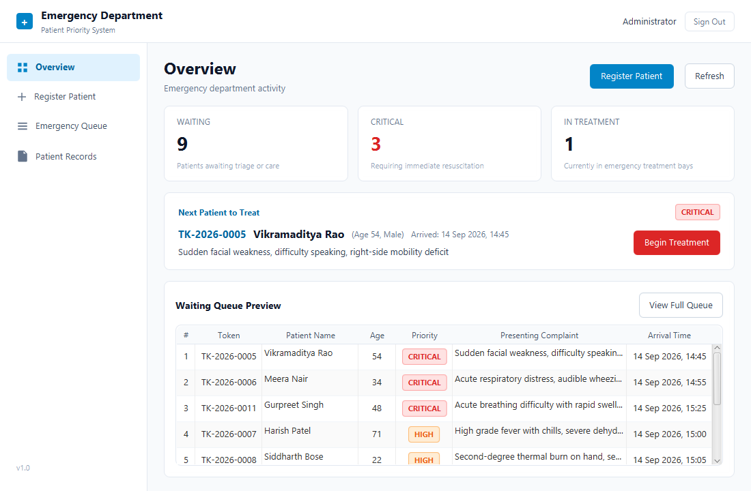
MEMBER 5 • UI / UX REDESIGN
Emergency Department Staff Workstation UI
Presenter: Member 5
Hospital Reception UX Principles
Calm Clinical Palette: Soft cool gray (#F8FAFC), crisp white panels (#FFFFFF), restrained hospital blue (#0284C7). Red is strictly reserved for genuinely CRITICAL life-threats.
Fast Visual Hierarchy: 3 compact summary cards: Waiting, Critical (red metric), In Treatment. High-urgency admissions visible in under 2 seconds.
Clean Vector Line Icons: Replaced text glyphs with native JavaFX SVGPath vector icons for Overview, Register, Queue, and Records.
Ergonomic Typography: Clear font scaling from 26px titles down to 11px badges with strict 8px spacing rhythm.
Desktop Resolution: Tailored for 1366x768 reception displays with zero vertical clipping and clean fixed row heights.

Slide 12
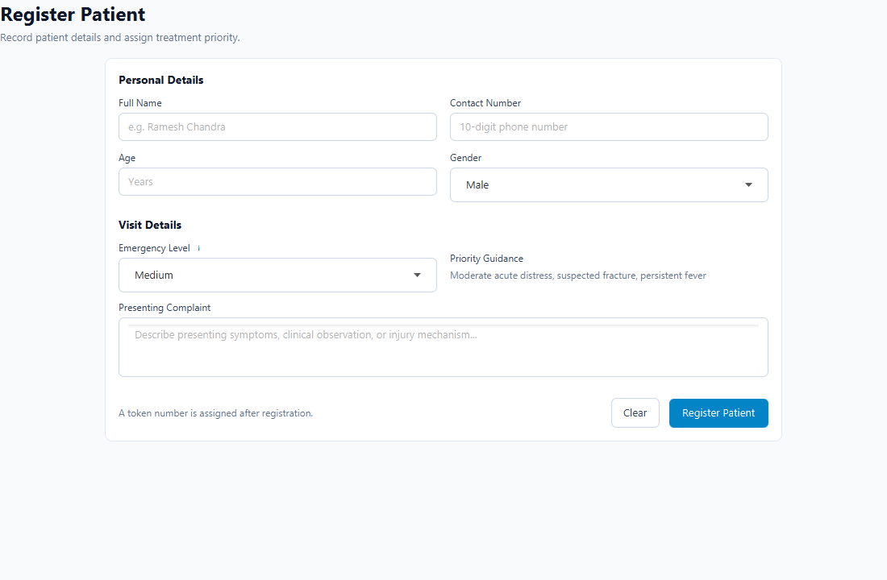
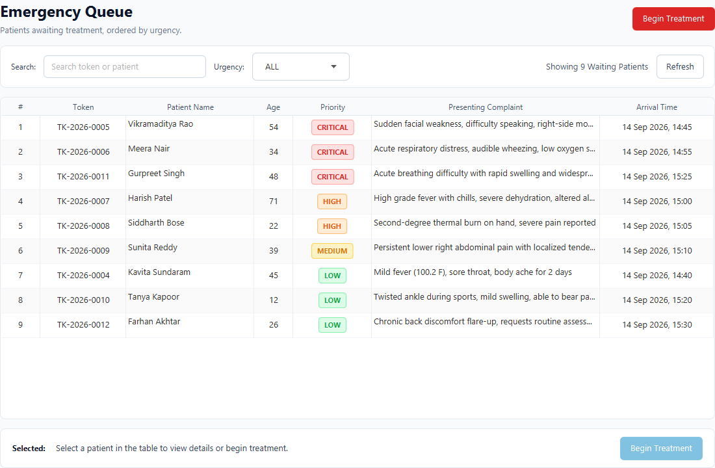
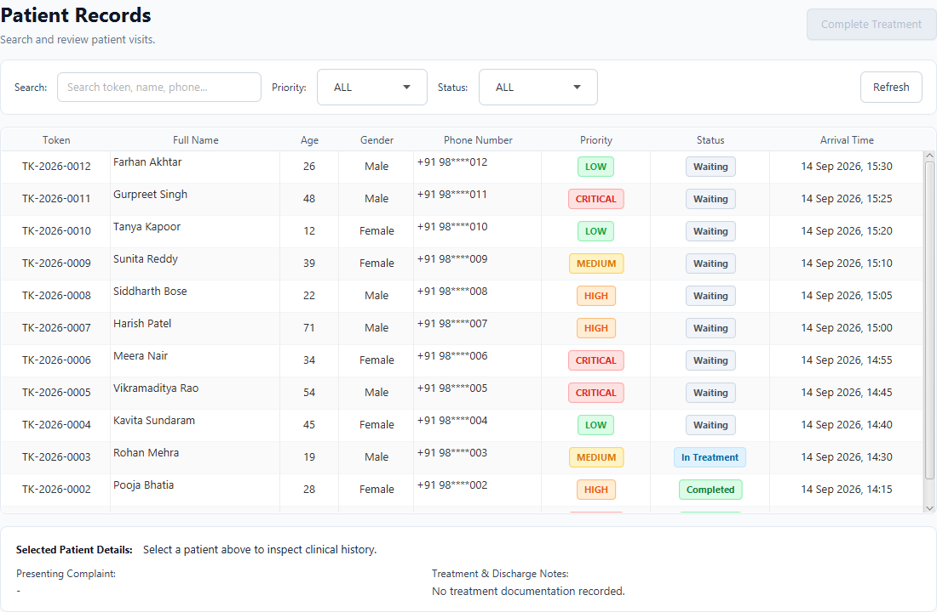
MEMBER 5 • APPLICATION SCREENS
Functional Screen Tour & Clinical Workflows
Presenter: Member 5
Register Patient
Emergency Queue
Patient Records
2-column clinical form card grouping Personal details (Name, Phone, Age, Gender) & Visit details (Urgency guidance, Complaint). Auto-token generation.
Strict urgency-ordered worklist. Red 'Begin Treatment' primary action, compact search filter, and instant patient selection drawer.
Complete audit log of ED visits. Masked phone privacy, consistent status pills (Waiting, In Treatment, Completed), and discharge notes.

Slide 13
MEMBER 5 • TESTING & QA
Automated Testing, Verification & Quality Assurance
Presenter: Member 5
JUnit 5 Test Suite (19 Tests Passing)
Maven Build & Test Execution
PatientPriorityComparatorTest (4 tests)
Validates strict 3-tier ordering: Urgency rank check, FIFO arrival timestamp tie-breaking, and token string tie-breaker.
PriorityQueueOrderingTest (3 tests)
Verifies Java PriorityQueue poll() extraction matches comparator ordering; checks heap restoration after peek/poll operations.
DatabaseQueueIntegrationTest (1 test)
Validates dynamic bootstrapping: seeding MySQL with waiting patients and verifying queue reconstruction on boot.
JdbcPersistenceIntegrationTest (1 test)
Tests full transactional lifecycle: register patient -> admit to treatment bay -> complete discharge with notes.
TokenGeneratorTest (2 tests)
Verifies sequential formatting (TK-YYYY-XXXX) and uniqueness guarantees across concurrent registrations.
ValidationUtilTest (7 tests)
Tests boundary validation for age limits (0-125), phone formats (10-15 digits), and non-empty symptoms.
ScreenCaptureTest (1 test)
Automated headless JavaFX rendering and snapshot capture verifying zero UI clipping across 5 workstation views.
COMMAND LINE TEST RUN:
$ mvn clean test
TEST RESULTS LOG:
-------------------------------------------------------
T E S T S
-------------------------------------------------------
[INFO] Running DatabaseQueueIntegrationTest -> PASS
[INFO] Running JdbcPersistenceIntegrationTest -> PASS
[INFO] Running PatientPriorityComparatorTest -> PASS
[INFO] Running PriorityQueueOrderingTest -> PASS
[INFO] Running ScreenCaptureTest -> PASS
[INFO] Running TokenGeneratorTest -> PASS
[INFO] Running ValidationUtilTest -> PASS
Results: Tests run: 19, Failures: 0, Errors: 0
[INFO] ------------------------------------------------
[INFO] BUILD SUCCESS (Total time: 18.6 s)
[INFO] ------------------------------------------------
All 19 unit & integration tests execute automatically in CI/CD pipeline.

Slide 14
TEAM VIVA DEFENSE
Individual Viva Voce Defense & Technical Mastery
All Team Members
Member 1 Question: Why is PriorityQueue preferred over a sorted LinkedList for emergency triage?
Answer: LinkedList insertion takes O(N) linear time to find insertion spot. Java's PriorityQueue min-heap inserts in O(log N) time and retrieves the head in O(1) time. For high-volume hospital intake, O(log N) eliminates critical delays.
Member 2 Question: Why use DAO interfaces rather than direct SQL calls inside JavaFX Controllers?
Answer: Separation of concerns. Controllers handle UI events and view updates. DAOs encapsulate SQL persistence. If the underlying database changes from MySQL to PostgreSQL, only the DAO implementation changes; controllers and views remain untouched.
Member 3 Question: Why can't you iterate directly over Java's PriorityQueue to populate the TableView?
Answer: Java's PriorityQueue.iterator() does NOT guarantee sorted order—it only visits internal array elements in arbitrary heap order. To display a sorted table, we extract a snapshot and sort it via Collections.sort(snapshot, comparator).
Member 4 Question: How do you prevent SQL Injection and handle concurrent access in MySQL?
Answer: We strictly use PreparedStatement parameters (?). User inputs are escaped by the JDBC driver and never concatenated. Foreign keys maintain referential integrity, and database connection lifecycles are governed by try-with-resources.
Member 5 Question: How does the UI prevent clinician errors during patient admission and discharge?
Answer: 'Complete Treatment' is disabled until an IN_TREATMENT patient is selected. Treatment notes cannot be empty. Serving patients requires confirmation dialogs, and masked phone numbers safeguard patient privacy.

Slide 15
CONCLUSION
Project Achievements & Future Scope
All Team Members
Key Project Achievements
Future Technical Roadmap
✔ Delivered a production-grade JavaFX Emergency Triage desktop application fulfilling all CSE203 rubric criteria.
✔ Integrated DSA Min-Heap PriorityQueue with 3-tier deterministic comparator logic.
✔ Connected robust relational MySQL 8 backend with full CRUD, foreign key cascade, and phone masking privacy.
✔ Engineered a calm, professional hospital workstation interface with zero visual clipping or lag.
✔ Established comprehensive automated verification with 19 passing JUnit 5 tests covering all edge cases.
✔ Maintained Git collaboration hygiene with descriptive semantic commits and full technical documentation.
HL7 / FHIR EHR Interoperability: Enable standards-compliant data exchange with central hospital electronic health records (EHR).
IoT Vitals Monitor Integration: Automate triage level updates by streaming real-time pulse oximetry, blood pressure, and ECG telemetry directly into the queue.
Multi-User WebSocket Sync: Upgrade from local polling to bi-directional WebSocket push notifications for distributed multi-terminal ER departments.
SMS & Waiting Display Board: Send SMS notifications to family members and drive digital signage monitors in the hospital waiting hall.

Slide 16
Thank You
Hospital Emergency Priority System (HEPS)
We welcome any questions from the examination panel.
Team Members 1, 2, 3, 4, and 5 are ready for individual viva questions.

