Slide 1
UJIIndoorLoc Data Analysis
Professors:
Fabrizio Rossi – Giovanni felici
By:
Jamal Alqale – seyed mohammad mousavi nishabouri

Slide 2
DATA SET INFORMATION
University of Jaume
3 Buildings and 20 different users and 25 Android Devices
19937 Training/Reference records
1111 Validation/Test records
Notes:
The UJIIndoorLoc database covers three buildings of University of Jaume I with 4 or more floors and almost 110.000m2. It was created in 2013 by means of more than 20 different users and 25 Android devices.
The database consists of 19937 training/reference records (trainingData.csv file) and 1111 validation/test records (validationData.csv file).

Slide 3
Data set information
529 Attributes
Intensity ranging -104dbm to 0dbm
520 Intensity values
Notes:
The 529 attributes contain the Wi-Fi fingerprint, the coordinates where it was taken, and other useful information. The intensity values are represented as negative integer values ranging -104dBm (extremely poor signal) to 0dbM. The positive value 100 is used to denote when a WAP was not detected. During the database creation, 520 different WAPs were detected. Thus, the Wi-Fi fingerprint is composed by 520 intensity values.

Slide 4
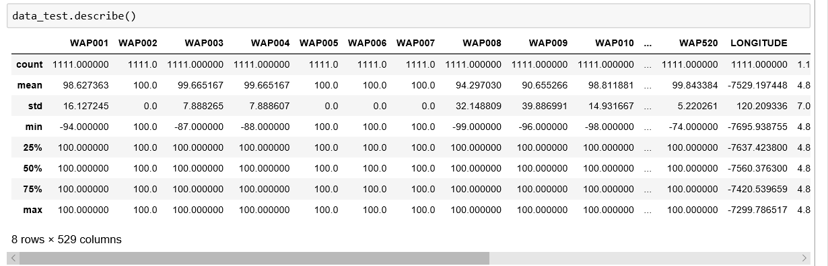
Data set description

Slide 5
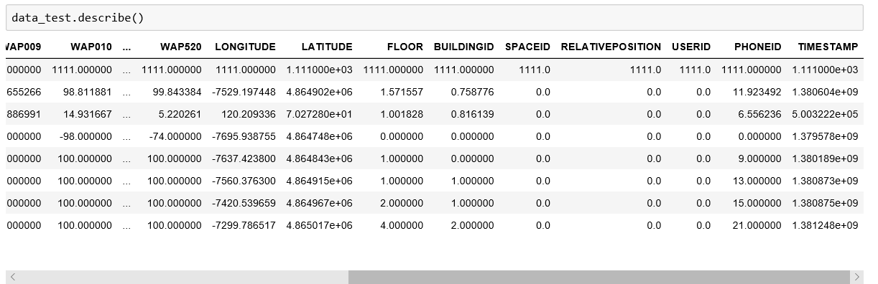
Data set description

Slide 6
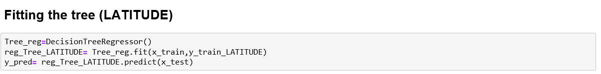
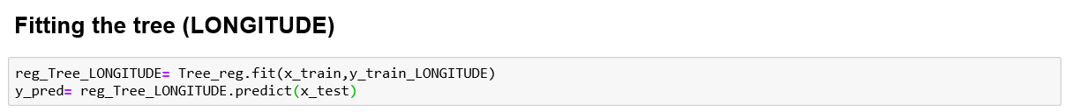
Using regression to predict latitude and longitude

Slide 7
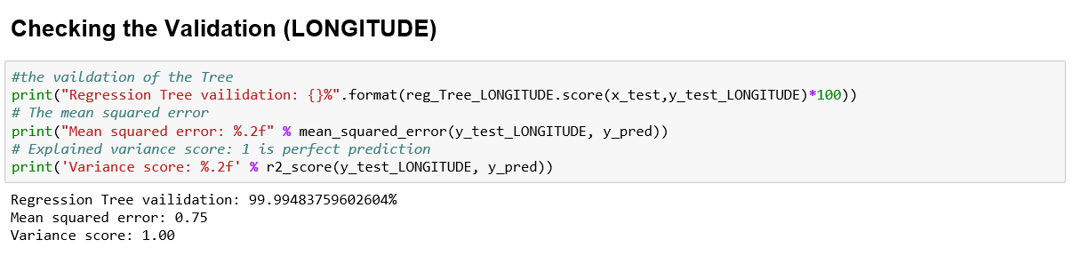
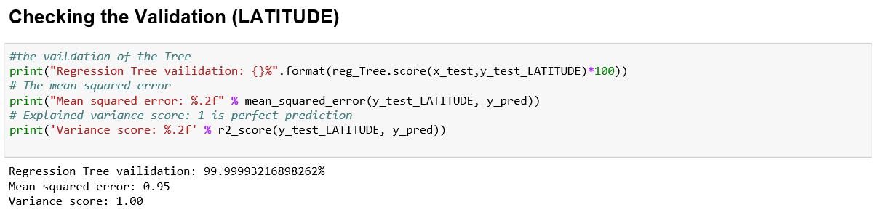
Checking the validation of latitude and longitude

Slide 8
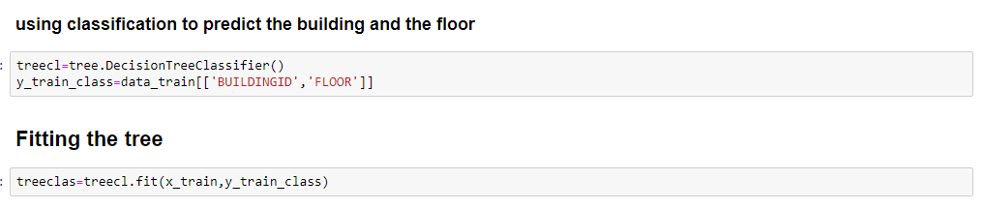
Using classification to predict the building and the floor

Slide 9
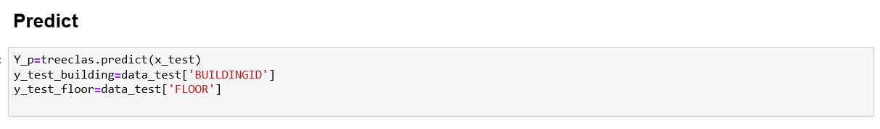
Using classification to predict the building and the floor

Slide 10
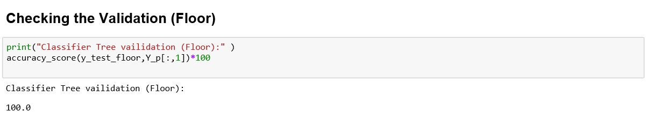
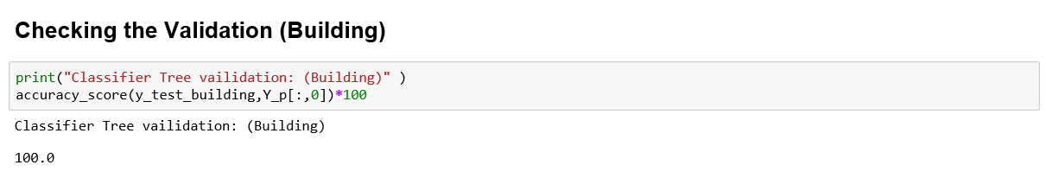
Checking the validation of the floor and the building

Slide 11
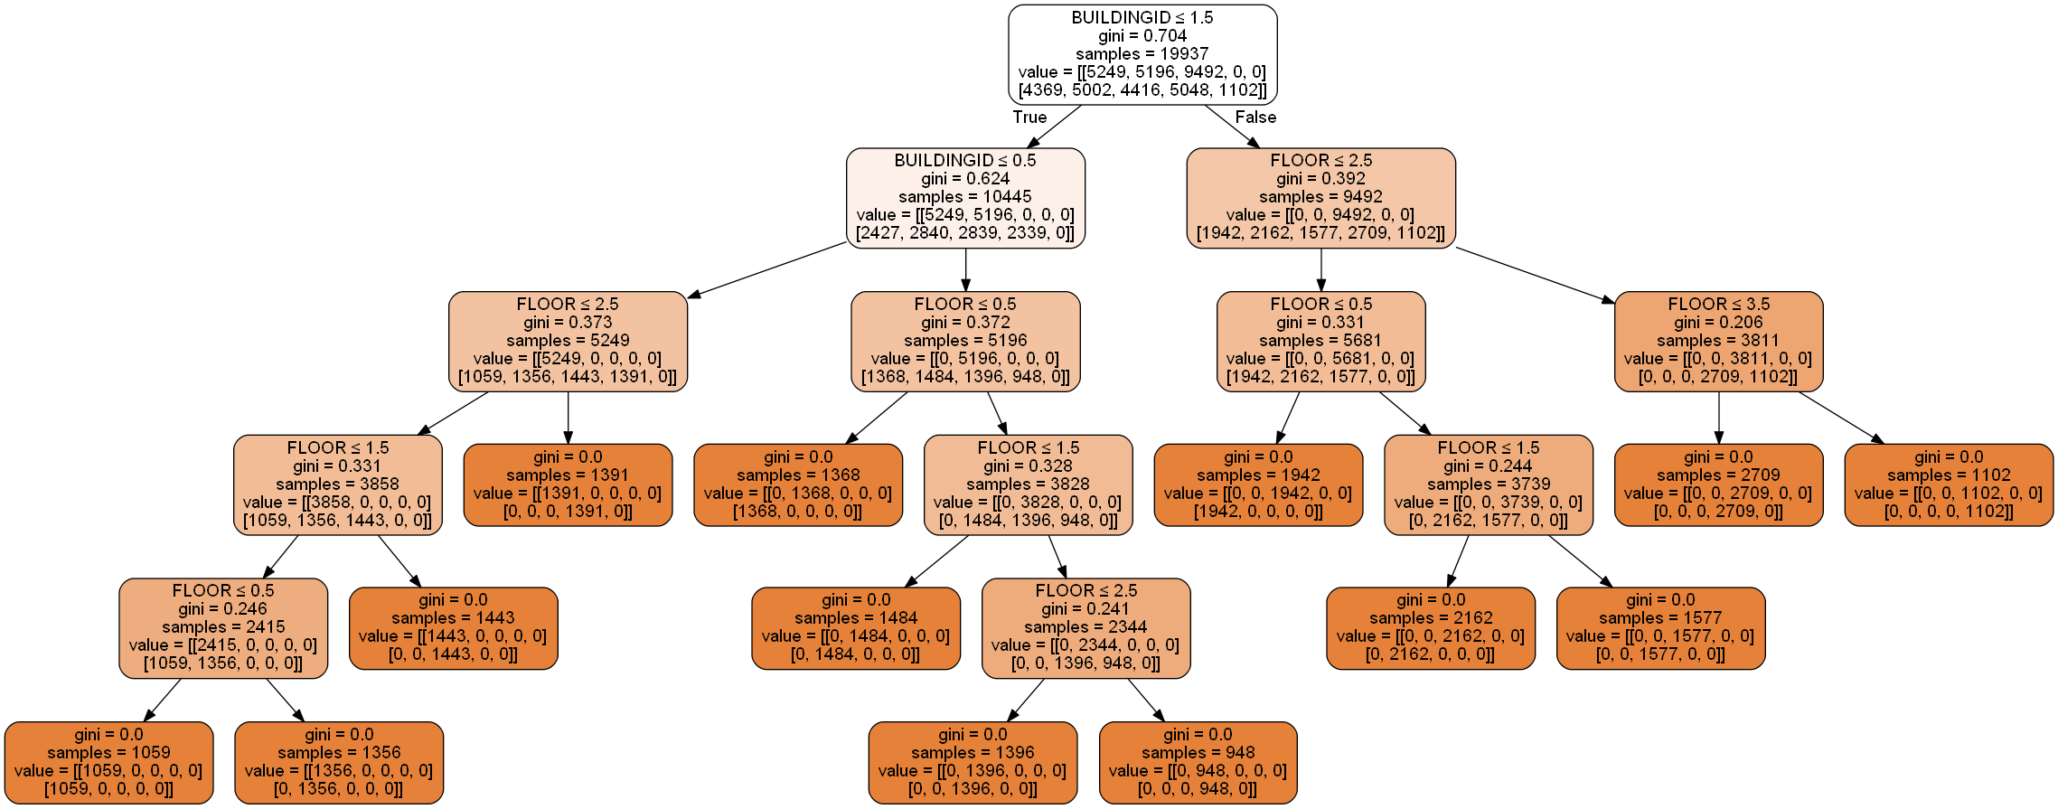
Classification d-tree

Slide 12
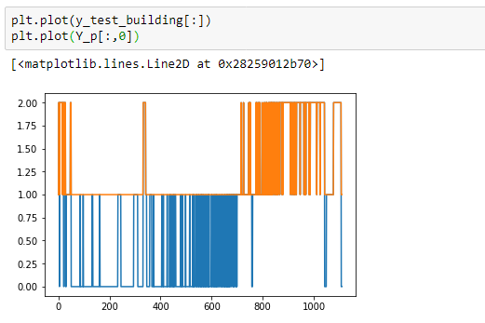

Slide 13
Thank you for your attention

