Slide 1

Lady taxy – new era transport system for women.
Team Name: Zero One. Our team : N.Jamalov, A.Ashirboyev, A.Bozorov.

Slide 2
Why do you need us ?
Crowded people in public transport.
Unfavorable situations for women and girls.
Creating better conditions for women drivers

Slide 3
How do we solve this problems ?
Organization of microbuses
Clients and drivers only women

Slide 4
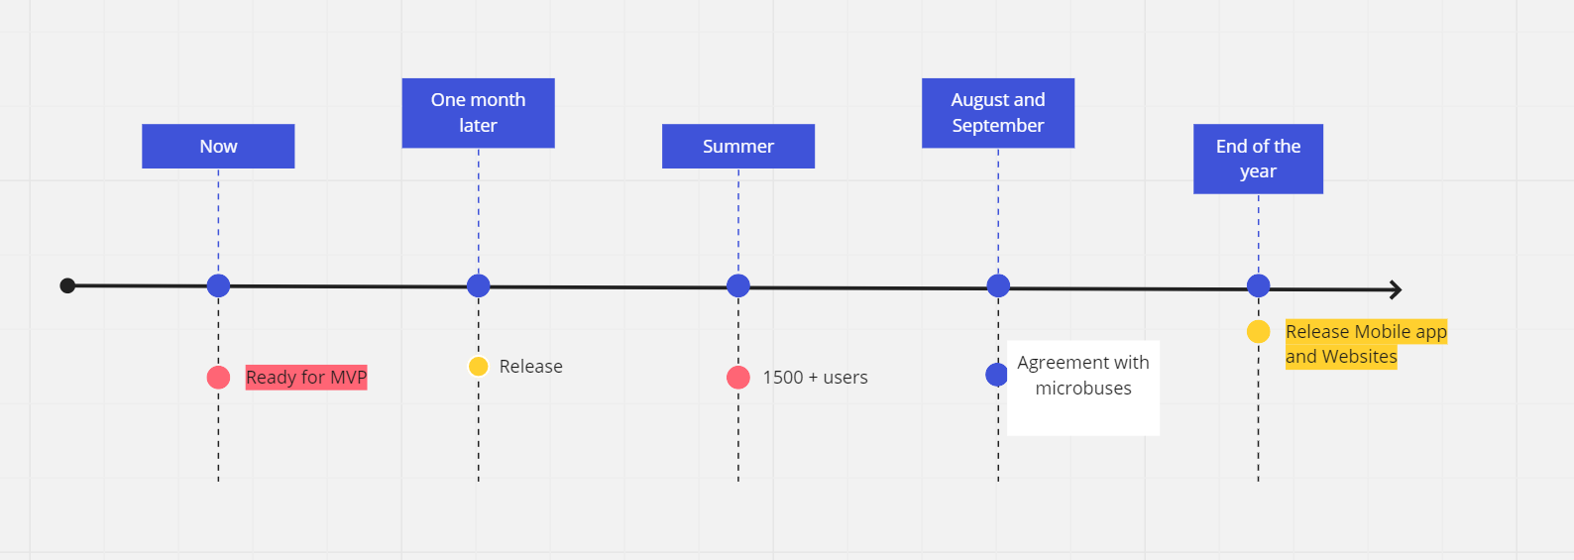
Milestones

Slide 5
