Slide 1
QData
Conversational AI for Secure & Governed Enterprise Data Access
Production Ready
⚡
Enterprise Secure
AIA Data Vertical · Cognizant Technology Solutions
◈
Multi-Agent AI

Slide 2
The Problem
Data is locked behind SQL expertise.
Business Users Blocked
Engineers Bottlenecked
BI Tools Fall Short
No SQL expertise means every data request goes through a data engineer, no matter how simple.
Data teams spend hours on repetitive ad-hoc queries instead of high-value engineering work.
Existing tools require training, have rigid interfaces, and lack intelligent multi-step reasoning.
There is no lightweight, secure, and governable solution that lets users ask data questions in plain English and get accurate, audited answers — without exposing raw infrastructure or compromising data access policies.

Slide 3
The Solution
"Type a question. Get the answer. No SQL. No waiting."
User
"Show me the top 10 customers by revenue this quarter"
QData
Understands intent → Identifies schema → Executes SQL securely → Returns answer
"The top 10 customers by revenue this quarter are: Acme Corp ($2.4M), GlobalTech ($1.9M)..."
Plain English Input
Auto SQL Generation
Governed Access
Full Audit Trail
Built on a fully custom multi-agent architecture — SQL Agent + RAG Agent coordinated by an Orchestrator.

Slide 4
Multi-Agent Architecture
⚙
Orchestrator
Routes queries to right agent
①
SQL Agent ✅ Phase 1 Complete
②
RAG Agent 🔨 Phase 2 — Building
Tools:
Tools:
tool_inspect_source_schema
tool_index_documents
tool_query_source
tool_search_documents
tool_load_source_into_temp
tool_get_document_context
tool_query_temp
tool_list_indexed_docs
tool_list_temp_tables
Each agent has its own loop · own scratchpad · own tools · own LangSmith trace

Slide 5
How It Works
Client side
(Agent could be custom Agent, claude/windsurf/cursor)
Server side
(mcp server)
User Input
Classifier
Router
Orchestrator
Agent Run
Final Answer
Feedback vs Conversation vs Data
Chitchat / Clarify / Data Query
SQL Agent or RAG Agent or both
SQL + RAG tools run independently
Synthesised and returned to user
Plain English question
▶
▶
▶
▶
▶
Router decides the path:
CHITCHAT
CLARIFICATION
DATA QUERY
Responds directly — no agents fired
Asks user for more specific information
Orchestrator routes to SQL Agent, RAG Agent or both

Slide 6
Enterprise Security & Governance
⚙
AST-Level SQL Validation
🔑
JWT Authentication
🛡
Redshift SSO
SQL parsed into syntax tree — INSERT, UPDATE, DELETE, DROP blocked at parse time, not by keywords.
Every MCP request requires signed JWT. HS256 local secret for dev, AWS KMS RS256 for production.
Queries run as the actual user. Redshift natively enforces table and row-level permissions.
📋
Full Audit Trail
🔒
Session Isolation
✓
Structured Output
Every run, every tool call logged in LangSmith with session ID, tools used, and termination reason.
Each conversation gets its own isolated DuckDB sandbox. Temp data wiped automatically on session end.
LLM forced to return Pydantic-validated schema. No prompt injection via malformed JSON possible.

Slide 7
Technical Architecture
Client Layer
Dev vs Production
Intent Classifier · Router · Orchestrator · Responder
↕
Feature
Dev
Prod
Auth Layer
Data Source
CSV+DuckDB
Redshift
JWT Handler · AWS KMS RS256 (prod) · HS256 (dev)
↕
Auth Signing
HS256
KMS RS256
MCP Server
Streamable HTTP · JWT Middleware · Tool Registry
Permissions
Path Guard
Redshift SSO
↕
SQL Agent
SQL Agent
✓
✓
Schema Inspector · Source Query · Temp Loader · Temp Query
↕
RAG Agent
✓
✓
RAG Agent
Document Indexer · Semantic Search · Reranker · Citation Tracker
AST Valid.
✓
✓
↕
LangSmith
✓
✓
Core Layer
AST Validators · Path Guard · DuckDB Runner · Redshift Runner
Switch
ENV=dev
ENV=prod

Slide 8
Agent Intelligence
Live Conversation
Agent Step-by-Step
You:
hi
CHITCHAT → responds directly
Step 1
tool_inspect_source_schema()
Bot:
Hello! How can I help you today?
* Schema: sales → customers, orders
You:
show top 5 customers by revenue
DATA_QUERY → SQL Agent
Step 2
tool_query_source(sql)
Bot:
The top 5 customers are: Acme ($2.4M)...
* SELECT ... FROM sales.customers...
You:
summarise the Q3 report
DATA_QUERY → RAG Agent
Step 3
tool_search_documents(query)
Bot:
Q3 report highlights: Revenue up 12%...
* Q3 report: revenue up 12%...
You:
great thanks
POSITIVE_FEEDBACK → logged
Final
Orchestrator synthesises both results
Bot:
Glad that helped!
* Combined answer returned to user

Slide 9
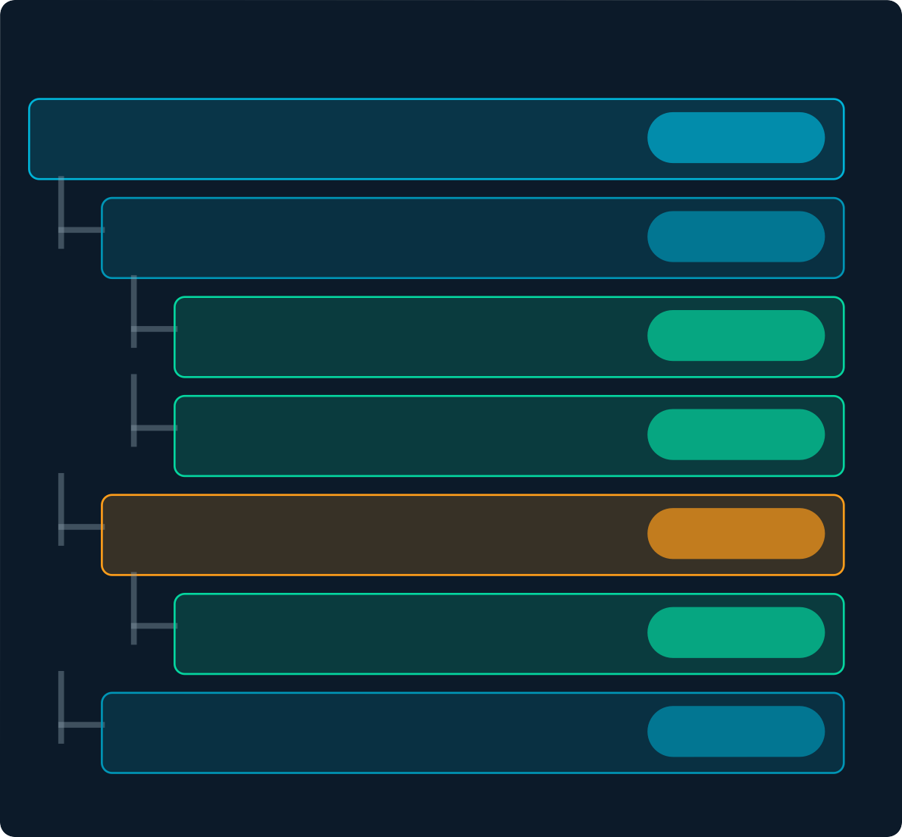
Observability & Audit Trail
LangSmith Trace — Every Run
1
Per-Run Logging
2
Child Run Tracing
Run: qdataagent-turn
chain
Every turn logged with session ID, tools used, steps count, and termination reason.
Each tool call logged as a child run
— full drill-down visibility per agent.
SQL Agent run
agent
tool_inspect_source_schema
tool
tool_query_source
tool
3
User Feedback Scoring
4
Token Usage Tracking
RAG Agent run
agent
Positive scores 1.0, negative 0.0 — tied to run_id for complete traceability.
Input, output, total token counts per run for cost monitoring and optimisation.
tool_search_documents
tool
Final Answer
output

Slide 10
Business Impact
⚡
✓
📋
⚙
Seconds
Ad-hoc request resolution vs days
Zero
SQL expertise needed by users
100%
Queries audited and traceable
Any
Client warehouse deployable instantly
Reusability Across AIA Data Vertical
QData requires minimal configuration change per client — any organisation running Amazon Redshift, Snowflake, or a structured data warehouse can deploy this multi-agent system and immediately enable natural language data access for their teams.

Slide 11





Current Status & Roadmap
Phase 1 — SQL Agent ✅ Complete
Roadmap — Next Phases
✓
Fully working terminal-based agent
Phase 2
RAG Agent 🔨
✓
Amazon Redshift + CSV connectivity
PDF ingestion, semantic chunking, hybrid vector+BM25 search, reranking, citation tracking. Connects as second agent to orchestrator.
✓
Multi-schema dot notation queries
AST-level SQL mutation prevention
Phase 3
Web UI
✓
✓
JWT auth (HS256 dev / KMS RS256 prod)
React chat interface for end users. File upload for CSV and PDFs. REST API via FastAPI app server.
✓
LangSmith audit trail — every run traced
Phase 4
Docker + AWS ECS
✓
Production-grade intent router
Containerised deployment. docker-compose for local. Scalable cloud deployment on ECS.
✓
Structured output — zero hallucinated calls
✓
Session isolation and temp sandbox
Phase 5
Multi-Agent Orchestration
✓
MCP server — tools as HTTP service
Parallel SQL + RAG execution. Cross-domain synthesis. Complex multi-hop analytical workflows.

Slide 12
QData
Conversational AI for Secure & Governed Enterprise Data Access
Submitted under BlueBolt Innovation Program
AIA Data Vertical · Cognizant Technology Solutions · 2026
2
Agents (SQL + RAG)
6+
Security Layers
100%
Production Ready

