Slide 1


TEEGALA KRISHNA REDDY ENGINEERING COLLEGE
Department of Artificial Intelligence and Machine Learning
HEAD OF THE DEPARTMENT PROJECT CO-ORDINATOR
Dr.VADIVELAN NATARAJAN Mrs. K.RENUKA
Professor Assistant professor

Slide 2
DOMIAN-SPECIFIC KNOWLEDGE ASSISTANT WITH TRANSFORMER AND RAG
INTERNAL GUIDE
SANGEETA JAWAR
Asst. Professor
NAME OF THE STUDENTS
Neelam Naveen- 21R91A7344
Rounak Reddy- 21R91A7355
Jamanla Suresh- 22R95A7303

Slide 3
CONTENTS
ABSTRACT
EXISTING SYSTEM
PROPOSED SYSTEM
SOFTWARE REQUIREMENTS
HARDWARE REQUIREMENTS
ARCHITECTURE
MODULE
UML DIAGRAM
OUTPUT SCREEN
CONCLUSION
REFERENCE

Slide 4
ABSTRACT
This project focuses on creating a generative model specifically for the medical field, designed to answer questions about particular diseases. We are utilizing a Retrieval-Augmented Generation (RAG) system for data retrieval, while leveraging a large language model (LLM) based on the Transformer architecture to generate responses. The dataset we are using for this purpose can be found on Kaggle: [LayoutLMdataset](https://www.kaggle.com/datasets/jpmiller/layoutlm). The system will retrieve relevant medical information and generate accurate, disease-specific responses, making it a cutting-edge tool for medical professionals and researchers.

Slide 5
EXISTING SYSTEM:
Traditional medical information systems operate using static databases and predefined queries, which limits their ability to dynamically generate personalized responses to medical queries. Healthcare professionals often have to manually sift through extensive records and databases to find relevant information, making the process time-consuming and inefficient. These systems struggle to handle real-time, context-specific information retrieval and do not easily adapt to new medical knowledge without manual updates. Additionally, they lack the ability to generate specific responses to disease-related questions, highlighting the need for advanced AI-driven systems that can deliver accurate, real-time, and disease-specific information seamlessly.
Drawback or Limitations:
Domain specific and Task specific.
Complex hardware requirments and Time consuming.

Slide 6
PROPOSED SYSTEM:
The project aims to develop an intelligent medical assistant using a Generative Model designed to answer disease-specific queries. The proposed system incorporates two key components:
Retrieval-Augmented Generation (RAG) System:Retrieves relevant medical information from extensive databases and datasets. Efficient data retrieval using RAG ensures the system has access to the most accurate and up-to-date information about diseases.
Large Language Model (LLM) with Transformer Architecture:
Powered by a Transformer-based LLM, the system processes the retrieved data to generate precise and context-aware responses to disease-related questions. This approach enhances the quality of responses, making them tailored to specific medical queries.
Advantages:
Accurate disease-specific information retrieval
Supports healthcare professionals' decision-making

Slide 7
SOFTWARE REQUIREMENTS
Operating System - Windows
Web Browser - Chrome and Brave.
Technologies:
Frontend - React JS
Backend - Node JS
Database - MySQL
Integration - Open API
Development Environment :
Visual Studio Code(IDE)
Anoconda(Jupiter notbook)

Slide 8
HARDWARE REQUIREMENTS
• Server-Side Requirements:
◦ VPS( Virtual Private Server )for Hosting.
◦ Internet Connection
• Client-Side Requirements:
◦ Devices: Compatible with desktop computers, laptops, smartphones, and tablets

Slide 9
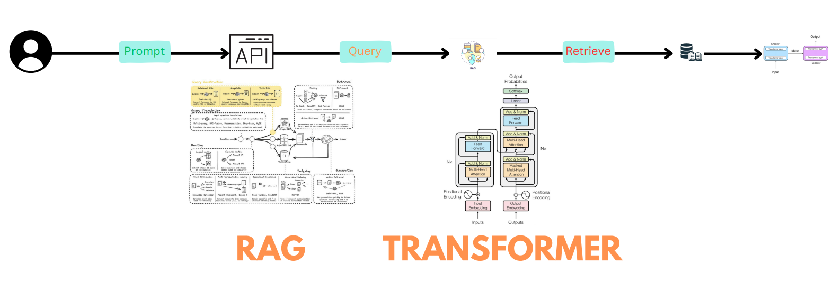
ARCHITECTURE

Slide 10
MODULE
User Interface (UI) Module
API Module
RAG Model Module
Knowledge Base Module
Transformer Module

Slide 11
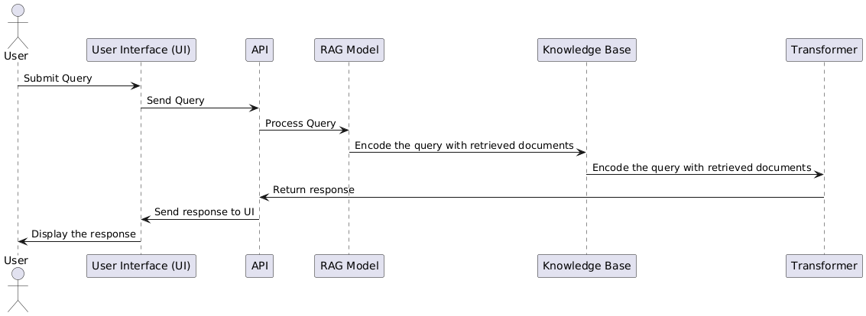
SEQUENCE

Slide 12
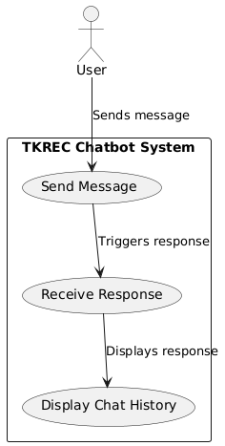
Usecase Diagram

Slide 13
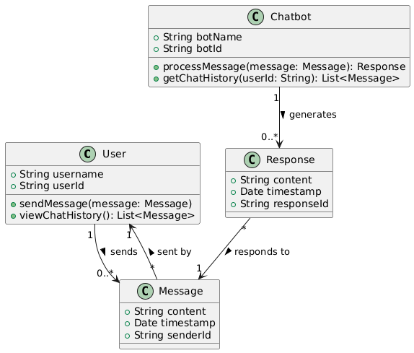
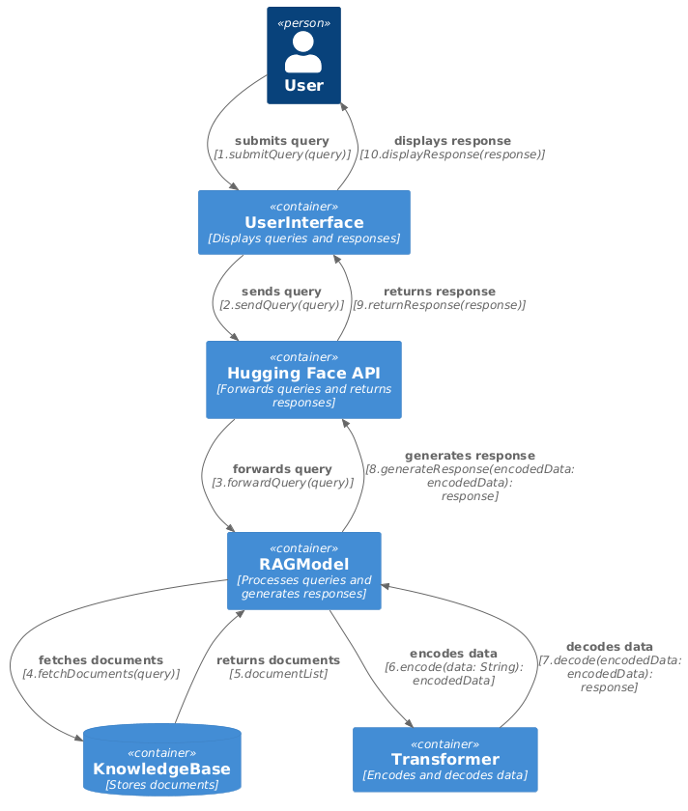
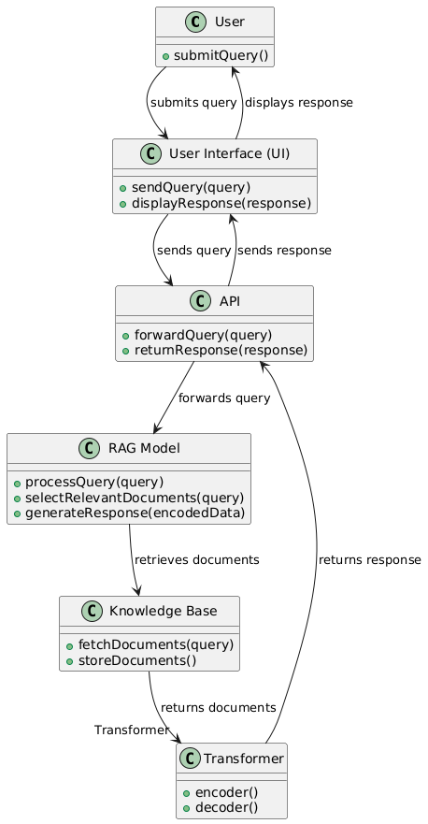
CLASS DIAGRAM

Slide 14
COLLABORATION

Slide 15
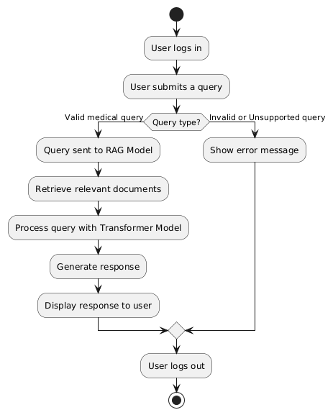
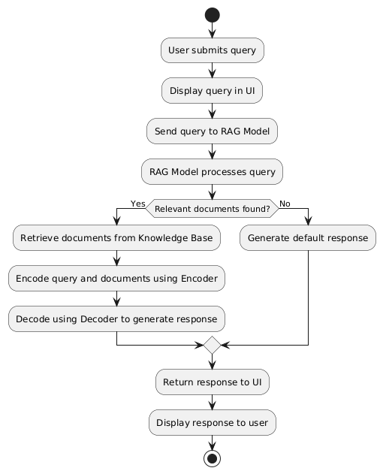
ACTIVITY DIAGRAM

Slide 16
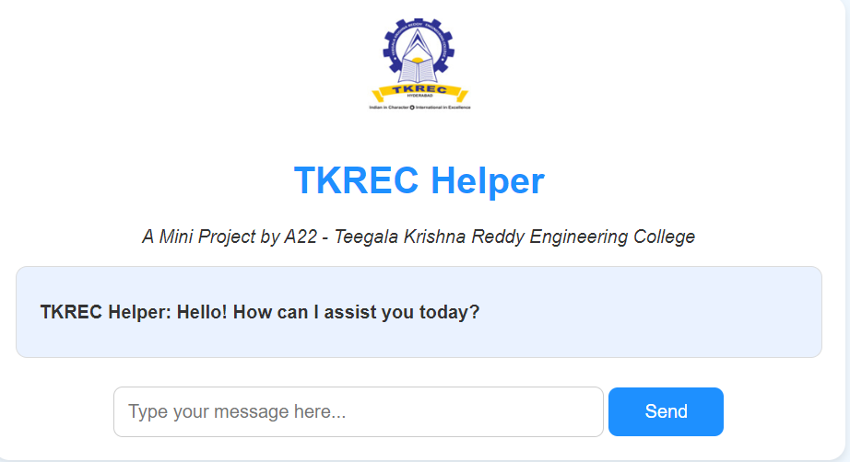
OUTPUT SCREEN

Slide 17
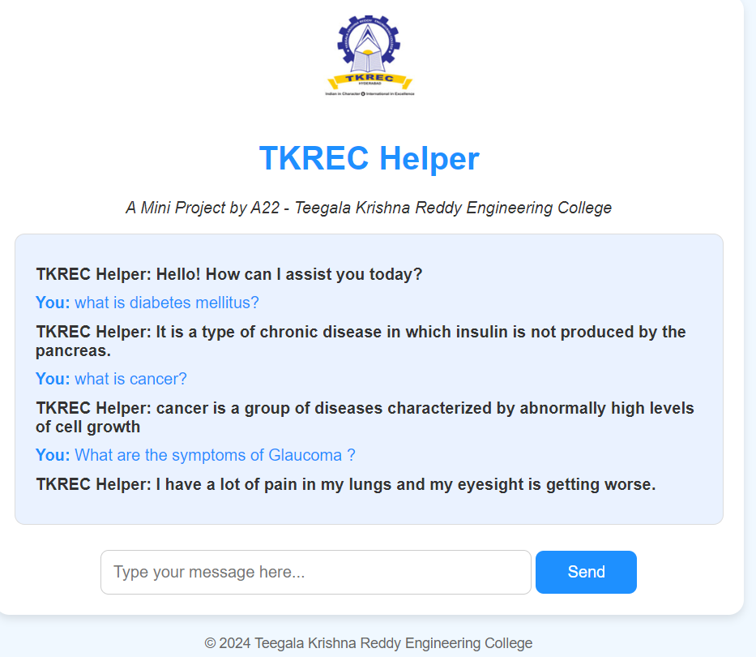

Slide 18
CONCLUSION
The integration of a Retrieval-Augmented Generation (RAG) system and a Transformer-based LLM presents a revolutionary approach to medical information retrieval and response generation. Traditional systems fall short in providing real-time, personalized answers to disease-specific queries, often relying on outdated methods that are time-consuming and inefficient. By combining RAG with advanced AI models, our system will address these limitations, delivering precise, context-aware responses that are valuable for medical professionals and researchers alike. Utilizing the LayoutLM dataset enhances the model’s ability to extract and process structured medical data, ensuring accurate retrieval. This innovative solution has the potential to significantly improve the way medical information is accessed and applied, ultimately supporting better healthcare decisions and accelerating research. With continuous advancements in AI, this system represents the future of medical knowledge management, offering both efficiency and accuracy in answering complex, disease-specific queries..

Slide 19
REFERENCE
https://www.w3schools.com/html/default.asp
https://www.youtube.com/watch?v=jan07glo
https://www.youtube.com/watch?v=1tgZo2tpK44
https://www.youtube.com/watch?v=MqDehUoMk-E

Slide 20
THANK YOU

