Slide 1

FINAL YEAR PROJECT
IDENTIFY ORCHESTRATED
SOCIAL MEDIA POST
BY: FOO KHAI LIANG
19034966

Slide 2

TABLE OF CONTENTS
01
02
03
OBJECTIVES / PROBLEM
BACKGROUND/METHODOLOGY
FINDINGS
04
05
Q&A
DEMO

Slide 3
DISCLAIMER
The following project is for educational purposese only and have no affilication to any political parties, government and non-govermental bodies.

Slide 4

WHAT IS ORCHESTRATE POST
Team, or well thought out plan behind a post.
Strategic plan, design, & publish on specific goal
Content Creation - post to resonate with target audience
Timing – target highest traffic

Slide 5


TYPE OF ORCHESTRATE POST
Centralized
Automated
Community
From single entity centrally coordinate all aspect of content
Use of management tool or A.I, on scheduling post or automate response
Leverage on like-minded group with dedicated followers to create traffic.

Slide 6
OBJECTIVES
01
02
Understand and find narrative with unsupervised machine learning model.
Use supervised machine learning model to classified post from orchestrated and organic.

Slide 7
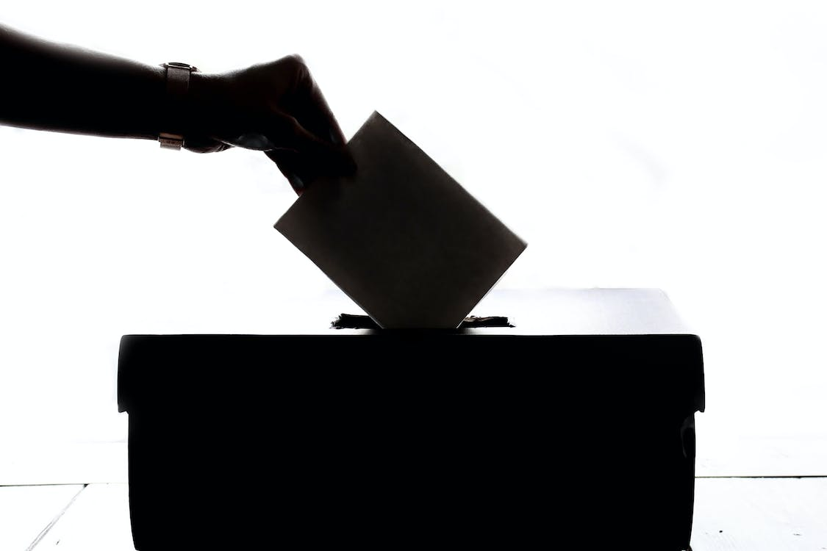
Problem statement
Social media becoming more integrated.
Hot-spot for content manipulation & disinformation.
Disinformation on political opinion
Complex, Volume of data
Rapid advancement of AI mimic human
Evolving strategies on organization coordinated effort.

Slide 8
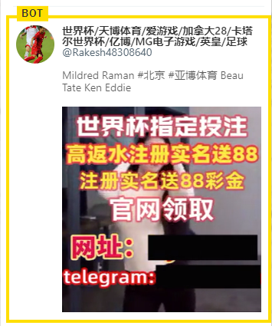
Background understanding
November 2022
China Zero Covid Policy
White Paper Protest
Video Protest in China
Video of Civil servant mismanagement.
Lots of orchestrated bot post
Ads on online gambling, pornography sites.
[1]

Slide 9
METHODOLOGY

Slide 10

Methodology – Data collection
Twiter Developer API (tweepy)
November 2022
“CCP”
“tweets”, “dates”, “retweets”, “likes”

Slide 11
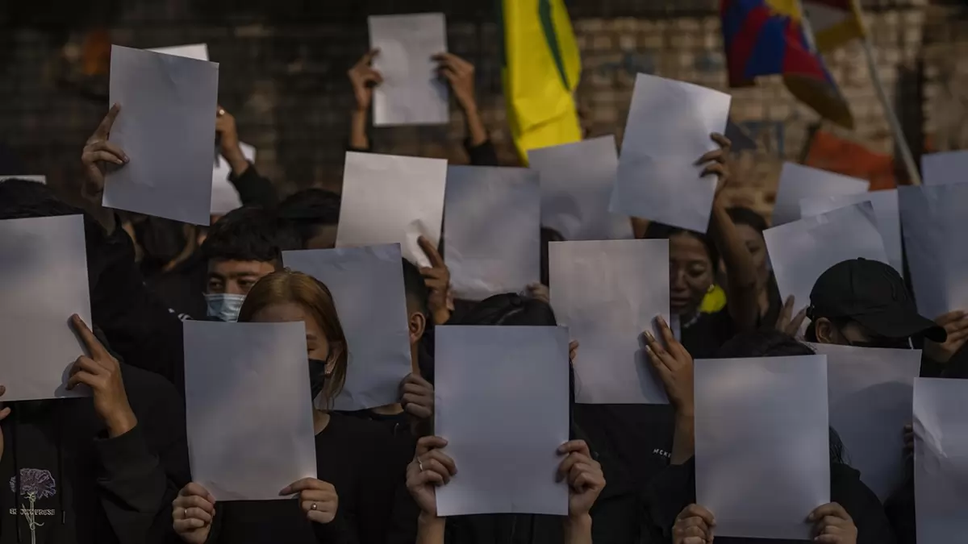
Methodology – Manual Annotate
5 Thousand tweets
1 as “Orchestrated”
0 as “Non-Orchestrated”
Domain Knowledge, e.g., News
Recurring pattern
Writing Style, Keywords

Slide 12
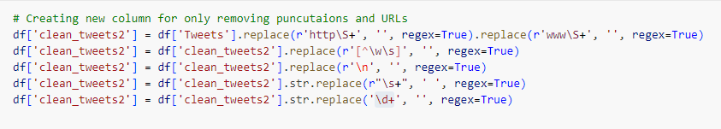
Methodology – Data Preparation
Regex
Punctuation
URLs
Special characters (White space)
Numeric

Slide 13
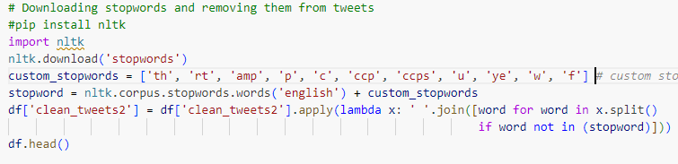
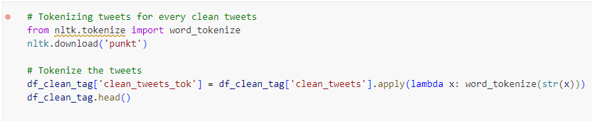
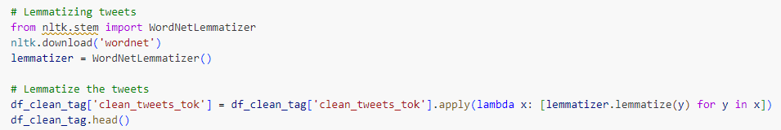
Methodology – Feature Engineering
NLTK
Stop-word removal
Tokenization
Lemmatization
Count Vectorizer

Slide 14
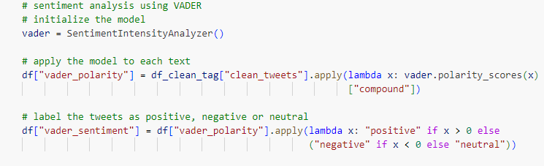
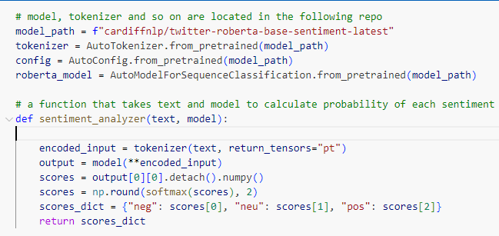
Methodology – Sentiment Polarity
VADER, Twitter-RoBERTa
Python package, Hugging Face
Using existing pre-processing (V)
Pre-process, tag user & https (TR)
Tokenizer, encoding

Slide 15
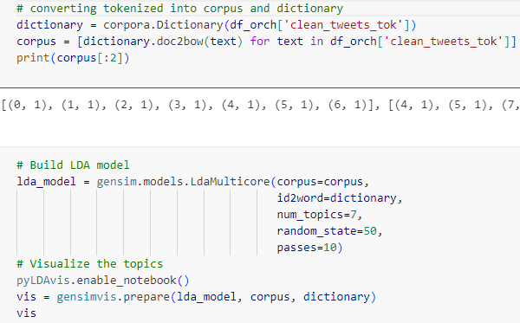
Methodology – Topic Modelliing
LDA (Latent Dirichlet Allocation)
Apply sentiment
Number of topic = 7
Random state = 50
Passes = 10

Slide 16
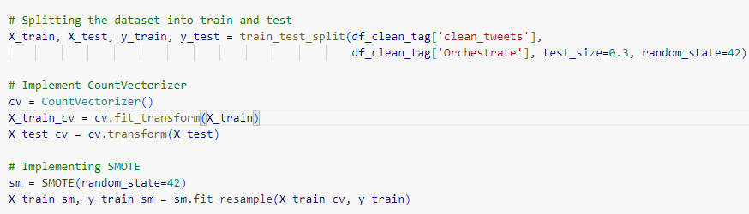
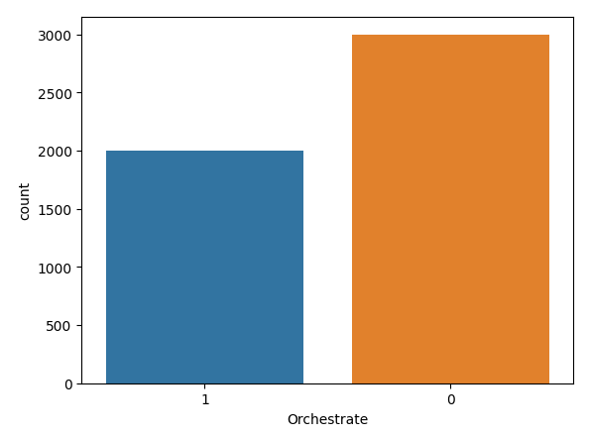
Methodology – Classfication
Train 70%, Test 30%
Random state 42
Use SMOTE to under sample data
Logistic Regression
SVM
Naïve Bayes
K-NN
Random Forest
Ensembled Model (Top 3 Model)

Slide 17
FINDINGS

Slide 18
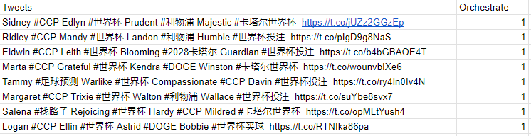
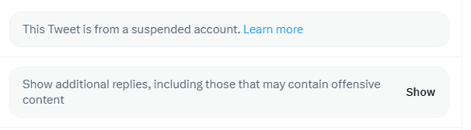
Findings – Manual Method
Keyword: “世界杯” (World Cup)
Ads Online Gambling
Start English name
Hashtag
Positive words

Slide 19
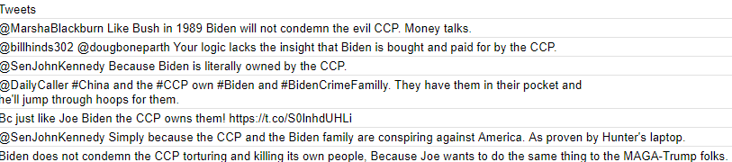
Findings – Manual Method
Keyword: “Biden”
Associate with CCP
“own”, “brought”,

Slide 20
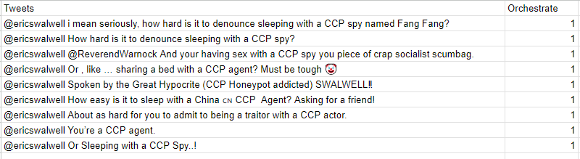
Findings – Manual Method
Keyword: “ericswalwell”
Former Congressman
Democrat Party
Accuse of having mistress
Spy from China
“sleeping”, “traitor”, “sex”

Slide 21
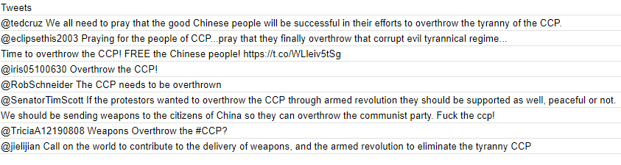
Findings – Manual Method
Keyword: “Overthrow”
Common Pattern
“Pray”, “armed”, “weapon”

Slide 22
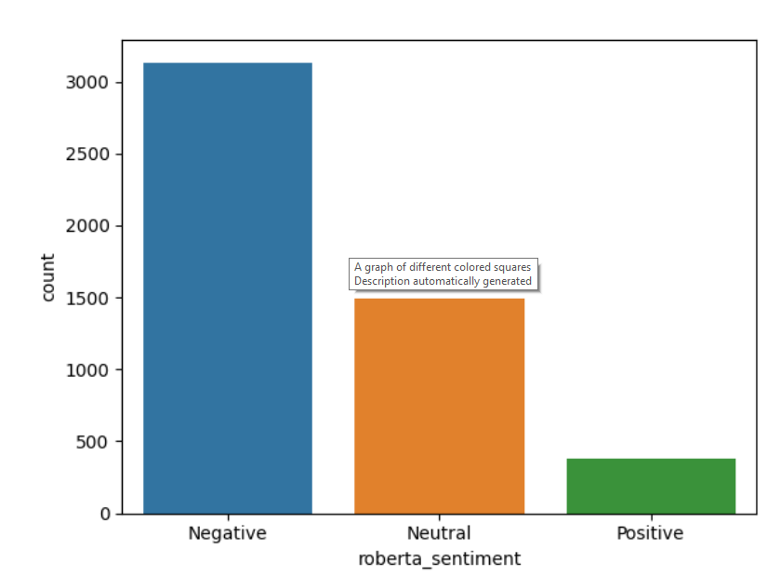
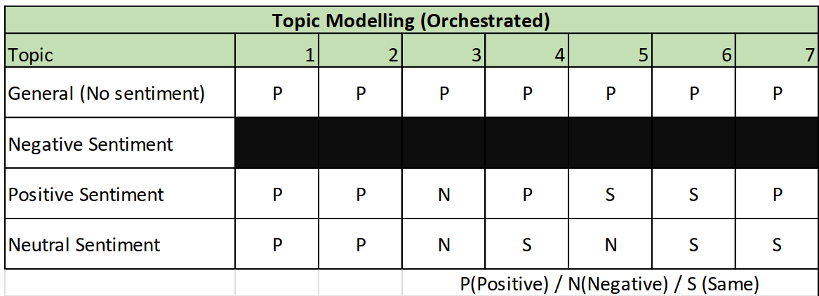
Findings – Topic Modelling
Negative sentiment: Similar topic as general
Positive sentiment: 1 negative unable to create narrative, 2 same topic
Neutral sentiment: 2 negative unable to create narrative, 3 same topic
Unbalance data , Topic Cluster Intersect

Slide 23
Findings – Classification
Best model: Ensembled Model (Naïve Bayes, SVM, Logistic Regression)
Worst performing model: K-Nearest Neighbour

Slide 24
Findings – Classification - SMOTE
Best model: Naïve Bayes
Worst Model: K-Nearest Neighbour

Slide 25
DEMO

Slide 26
THANK YOU FOR LISTENING

Slide 27
Q&A

Slide 28
References
[1] Stuart A. Thompson, Muyi Xiao, Ishaan Jhaveri, and Paul Mozur, “How Bots Pushing Adult Content Drowned Out Chinese Protest Tweets,” New York Times, Dec. 19, 2022. [Online]. Available: https://www.nytimes.com/interactive/2022/12/19/technology/twitterbots-china-protests-elon-musk.html

