Slide 1
IAPR special project
Nicolas Furrer
Claire Meyer
Philipp Schuler

Slide 2
Image segmentation : strategy
  Color HSV separation :
    Red -> arrow (robot)
    Blue and black -> digits and math operators
Morphology to clean up
Connected component (region growing) for tracking
=> (x,y) robot position
Morphology to fuse unique chars in unique objects
Contours and bounding boxes to isolate chars
Range to discriminate
Inertia axes for redressing (mod 180°)
MNIST normalization
CNN / custom classification
=> Characters (x,y) positions and
classifications (list)
At each frame :
Robot-chars distance discrimination => formula
If character is ‘=‘ sign => formula result
Info display on the frame

Slide 3
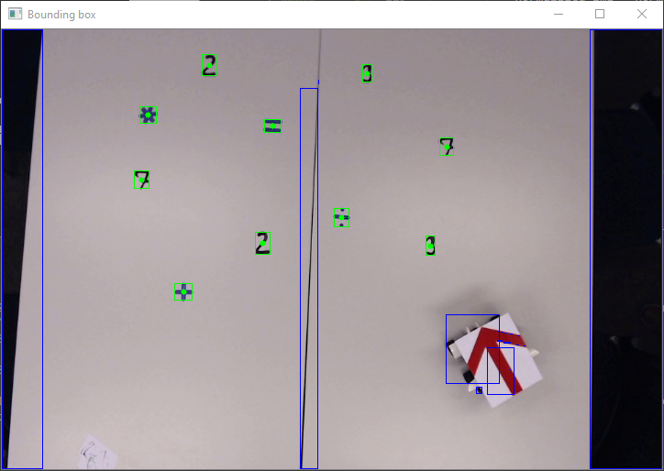
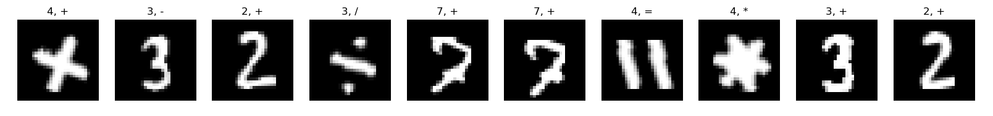
Image segmentation : results

Slide 4
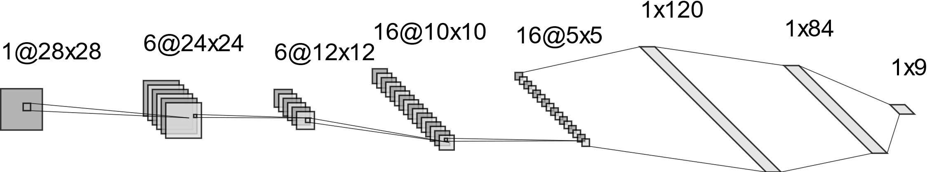
OCR : strategy
Digits :
CNN based on LeNet-5
Training on MNIST with 0° and 180°
Math operators :
Criteria :
  Numbers of contours
    3 => ‘/’
    2 => ‘=‘
  Width / height ratio of single contour :
    < 2 => ‘-’
  Fourrier descriptor (4th one)
    < 0.1 => ‘*’
    > 0.1 => ‘+’
conv (5,5)
max pool (2,2)
conv (3,3)
max pool (2,2)
FC
FC
FC

Slide 5
OCR : results
Digits :
98% accuracy on MNIST (0° and 180°)
100% accuracy on the 6 digits of the provided video
Has little statistical significance for generalization to other videos
Math operators :
100% accuracy on the 4 math operators of the provided video
Has little significance for generalization to other videos
Differentiation : Alternating between the two of them because we know we start with digit.

