Slide 1
D
FAT32 Analyzation
and File Recovery
– – Presented by Group 2
Notes:
打招呼 hello
today

Slide 2
D
Team member
郭灵灵 Lingling Guo
Programming
李浚哲 Junzhe Li
PowerPoint
屈亮亮 Liangliang Qu
Find material
蔡嘉豪 Jiahao Cai
Solve problem
Notes:
介绍小组成员 stand up
我为我的团队感到骄傲 也为我们团队的作品感到骄傲
I’m very proud of my team ,of our team work.

Slide 3
D
Three Things:
Function
What does it use for.
Usage
How do we use it.
Problems
How do we overcome them.

Slide 4
D
Function
– – what can we analyze ?
Master Boot Record
Partition table
Starting CHS Address
Partition Type
Ending CHS Address
Starting LBA Address
Size in sectors
…
Notes:
或许你会问我 我们是怎么得到这些数据的
You may ask me how do we analyze it
File
LBA很重要 可以用来找VBR

Slide 5
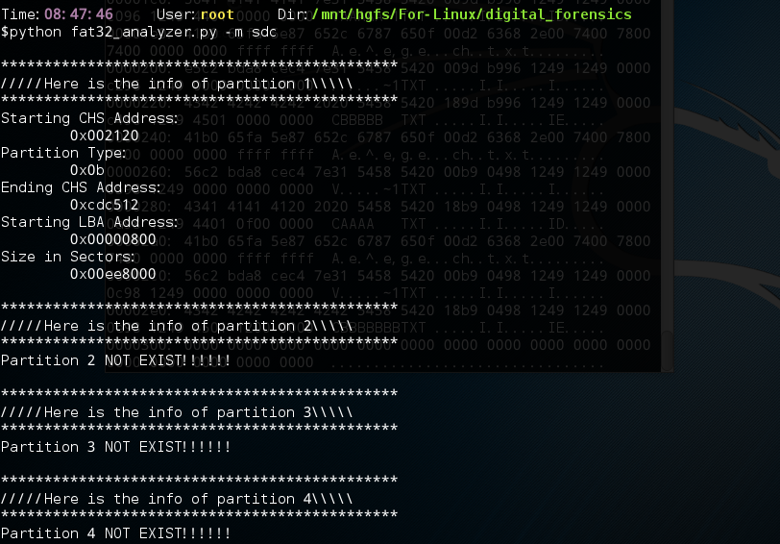
D
Usage:
Python fat32_analyzer.py –m [device]
Notes:
参数 M 代表 MBR 还需加上设备名称
在屏幕上找关键信息 LBA 告诉大家LBA是用来找到VBR的
2048 in decimal

Slide 6
Function
– – what can we analyze ?
D
2. Volume Boot Record
Bytes per sector
Sectors per cluster
Size in sectors of reserved area
Number of FATs
Sectors of one FAT area
Cluster where root directory can be found
…
Notes:
黄色的部分很重要 因为它们能帮助我们找到root directory

Slide 7
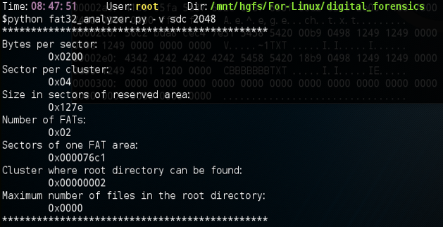
D
Usage:
Python fat32_analyzer.py –v [device] [sectors to skip]
Notes:
参数 v 代表 VBR 还需加上设备名称与要跳过的sectors

Slide 8
Function
– – what can we analyze ?
D
3. Root directory
Filename
Create Day
Access Day
First cluster address
Notes:
怎么解析文件名是个难题
会在后面有具体的讨论
怎么decode date ,we will discuss later
it’s optional ,depends on the time

Slide 9
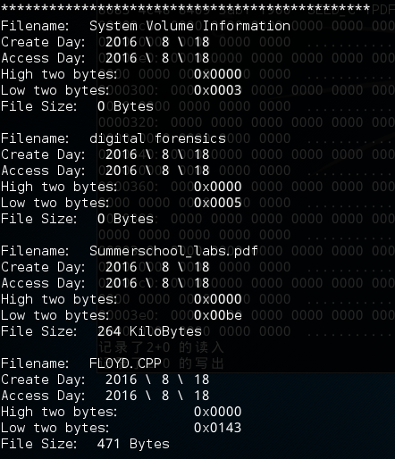
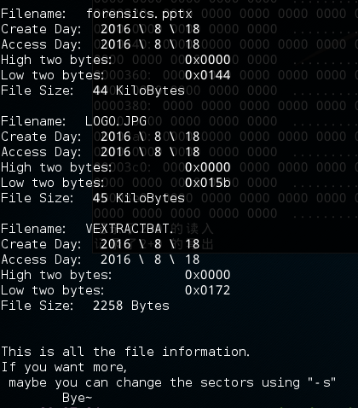
Usage:
Python fat32_analyzer.py –a [device]
Python fat32_analyzer –s [sectors]
D
Notes:
我需要提一下 S 参数的作用
因为根目录可能很大 所有的文件都读出来可能太多
我选择让用户自己改变要读的扇区数
右下角的 cute Bye

Slide 10
Function
– – we can also recover files
D
Usage:
Python fat32_analyzer.py –r [device]
Notes:
最后一个功能
我们可以恢复被删除的文件
你们可以看到 r 代表 recover

Slide 11
D
Demonstration Time

Slide 12
D
Problem list
How to read long file name ?
How to recover files ?
How to decode date ? (if we have time)
Notes:
现在我们开始讨论一些难以处理的问题
或许有点难懂

Slide 13
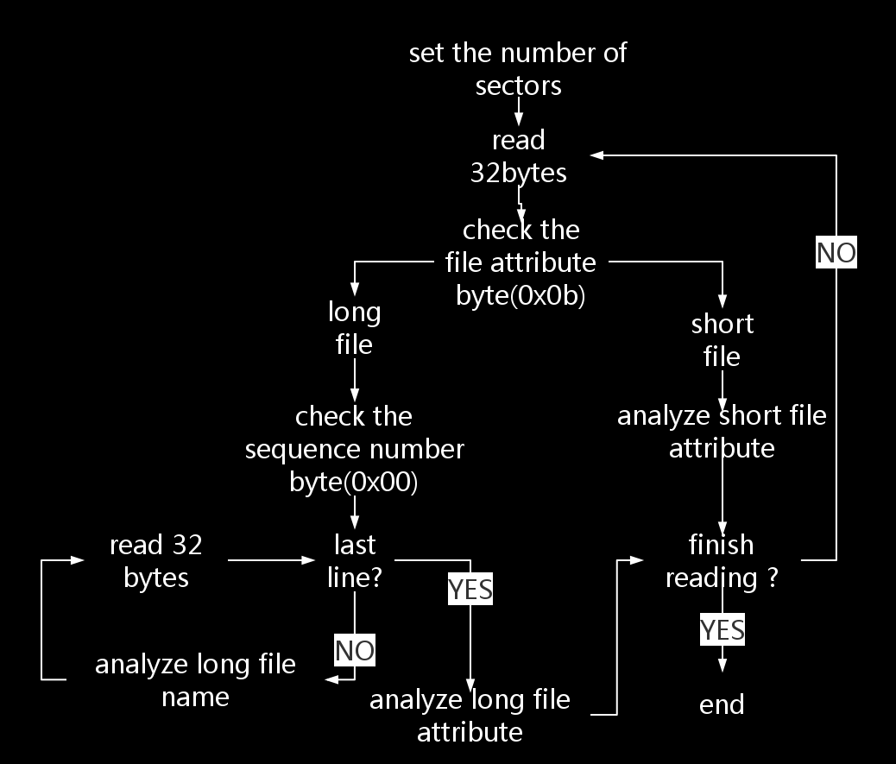
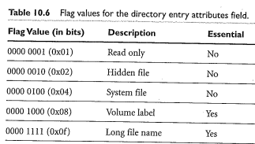

How to read
long file name ?
D
Notes:
解释文件属性 在0x0b位置如果是0x0f
文件第一行的第一个字节 Sequence number
But 短文件就容易很多 因为它只占一行

Slide 14
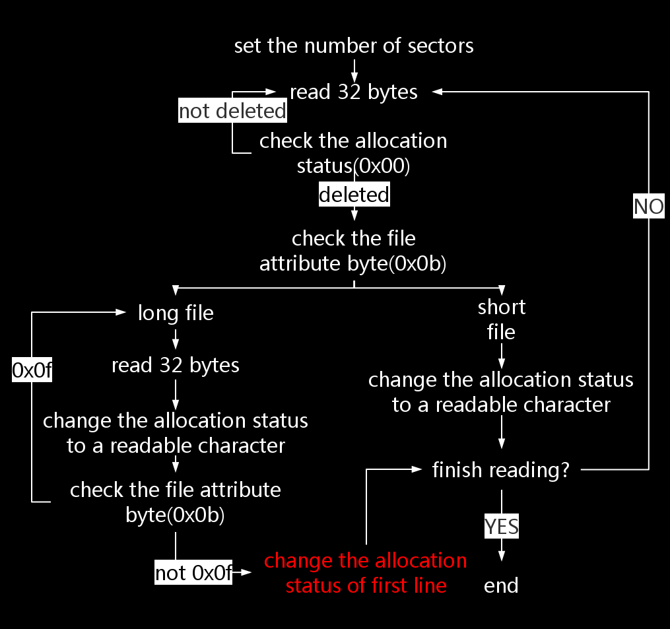
2. How to
recover files ?
D
Notes:
FAT32 文件删除的实质就是改变第一个字节
为什么直接再读32字节是安全的
最后一行不再是0x0f

Slide 15

D
3. How to decode date ?
For example,
data = [73,18]
def analyze_date(data):
date_array = data[0] * 0x100 + data[1]
year = date_array >> 9
month = (date_array & 0b0000000111100000) >> 5
day = (date_array & 0b0000000000011111)
Output: [36, 8, 18]
Year = 1980 + 36 = 2016 Month = 8 Day = 18

Slide 16
Thank you

