Slide 1

Vexing Vulnerabilities in Web Applications
LIS4774 - Information Security
Instructor: Dr. Metcalfe
Team Name: CyberAlligator (Team A)
Team Members: Mehmet Ozmen, Jordan Northup, Joshua France, Adam MacDougall, Joshua Flashman, Matteo van Zwieten, Jamel Douglas, Aiden Talavera

Slide 2
Agenda
Significance
Research Environment / Network Topology
Study Framework
Analysis and Solutions
Lessons Learned and Conclusion

Slide 3
Significance in Vulnerabilities
Identifying and understanding the vulnerabilities of user input that are exploited in systems destroying confidentiality.
Attackers using unsecure text queries to enter bash like script to obtain system information.
A Classification of SQL Injection Attacks and Countermeasures
Addressed the problem of SQL Injection Attacks
Using SQl Injections through User input is one of the main attacks they talk about through their paper
This is done to extract or modify data, avoid detection, and bypass authentication
Testing and comparing web vulnerability scanning tools for SQL injection and XSS attacks
Discussed how widespread vulnerabilities on websites and how attacks can occur
By testing with multiple scanners then using sample injections on detected vulnerabilities, there is a high success rate of patching most vulnerabilities

Slide 4
Significance in Countermeasures
Identifying solutions and countermeasures to make it more difficult for threat agents to get information out of systems.
Testing our countermeasures, we were able to achieve better system integrity, confidentiality, and availability.
DNS Pharming through PHP Injection: Attack Scenario and Investigation
Discussed PHP Injection attacks being used on unsanitized input streams
Suggested mitigation strategies
Sanitization of input
Reduction of privileges
Cross-Site Scripting Prevention with Dynamic Data Tainting and Static Analysis
Discussion of Knuth-Morris-Pratt (KMP) string match algorithm’s use in detecting XSS attacks & SQL Injections
Uses filter() function to detect malicious code
Perl’s taint mode can also be used to track tained data
Proxies can also be used to analyze all HTTP traffic and filter malicious data

Slide 5
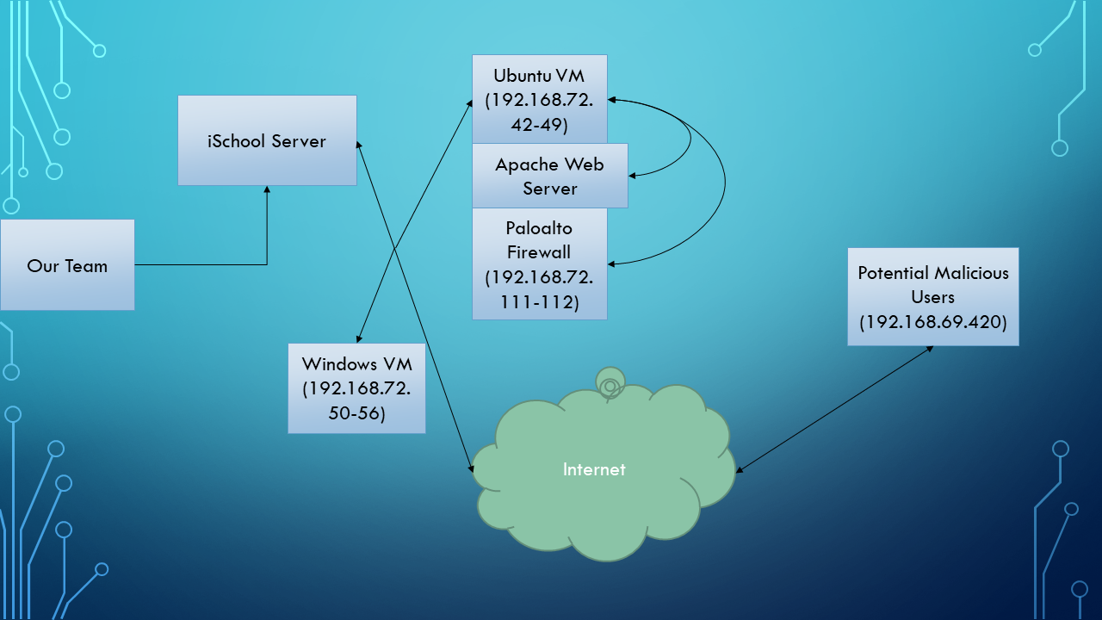
Network Topology / Research Environment

Slide 6
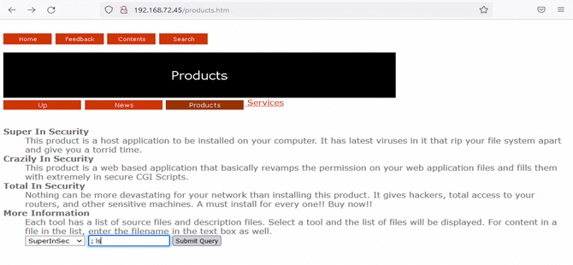
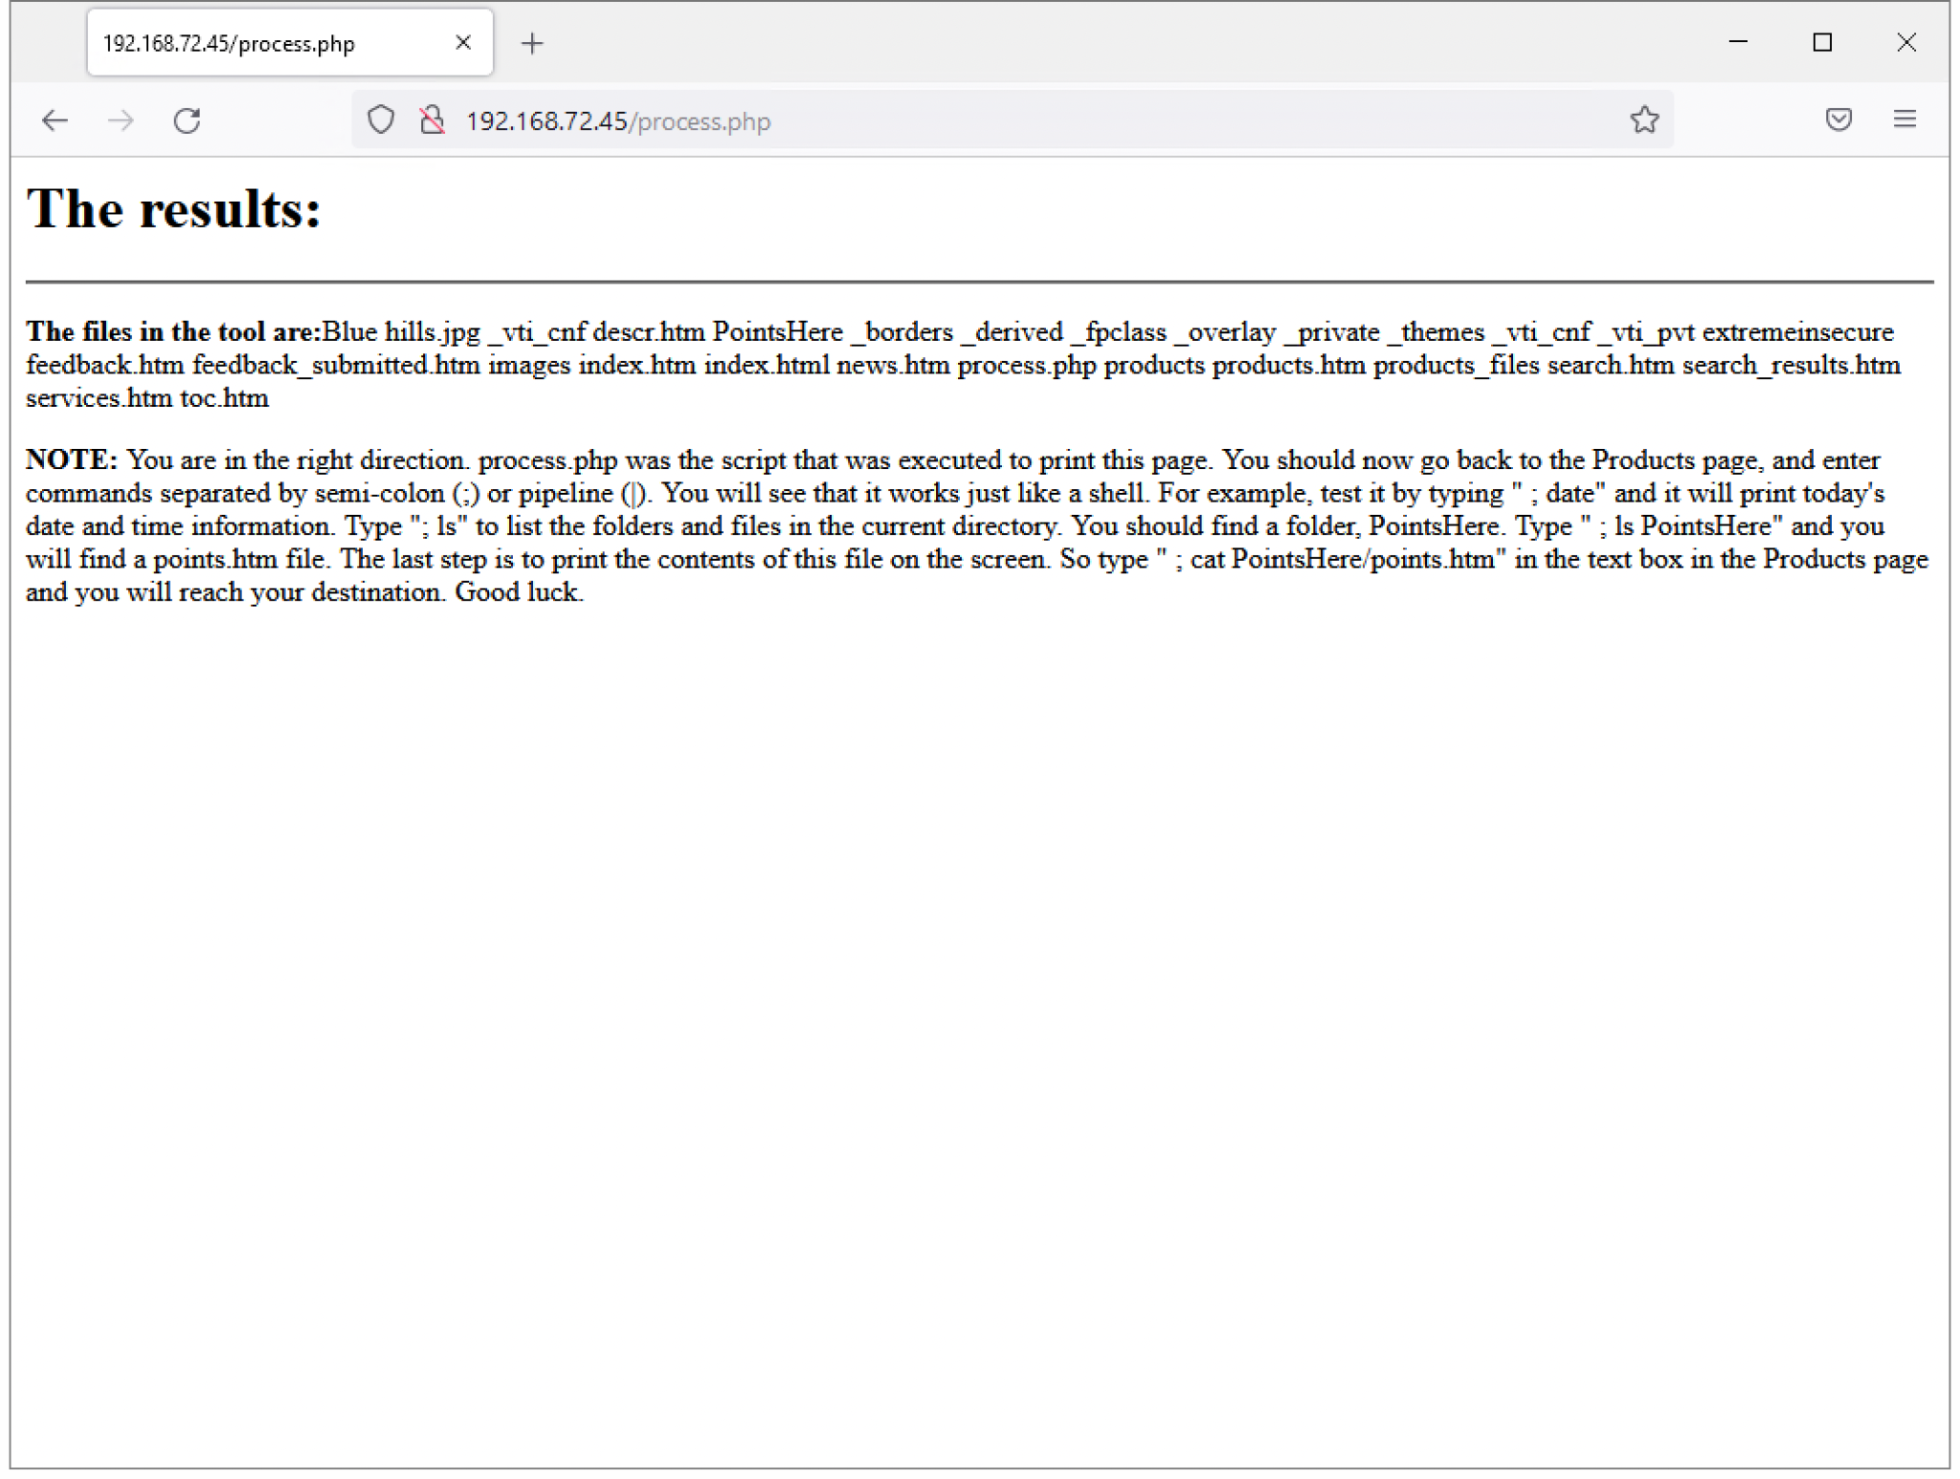
Study Framework: Injection
Part A consisted of setting up a web application server of an unsecure website that has an attack vector of injection. Specifically PHP injection was the main focal point of Part A. Command line code could be injected into a text query box to take advantage of vulnerabilities allowing for loss of confidentiality, availability, and integrity within the system. This compromises both the server itself and the users. The goal was to identify the threat and with any luck find a solution or at least mitigate it.
Injecting into a query box
Confidentiality compromised

Slide 7
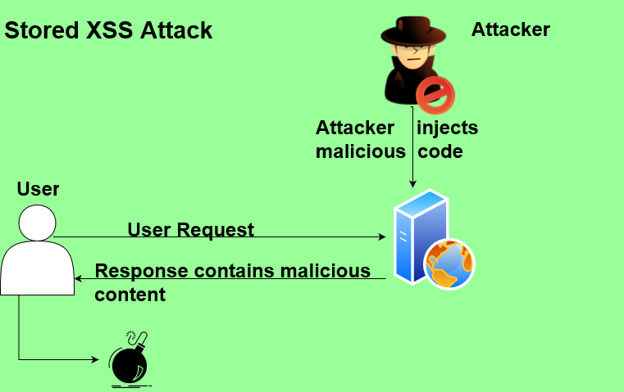
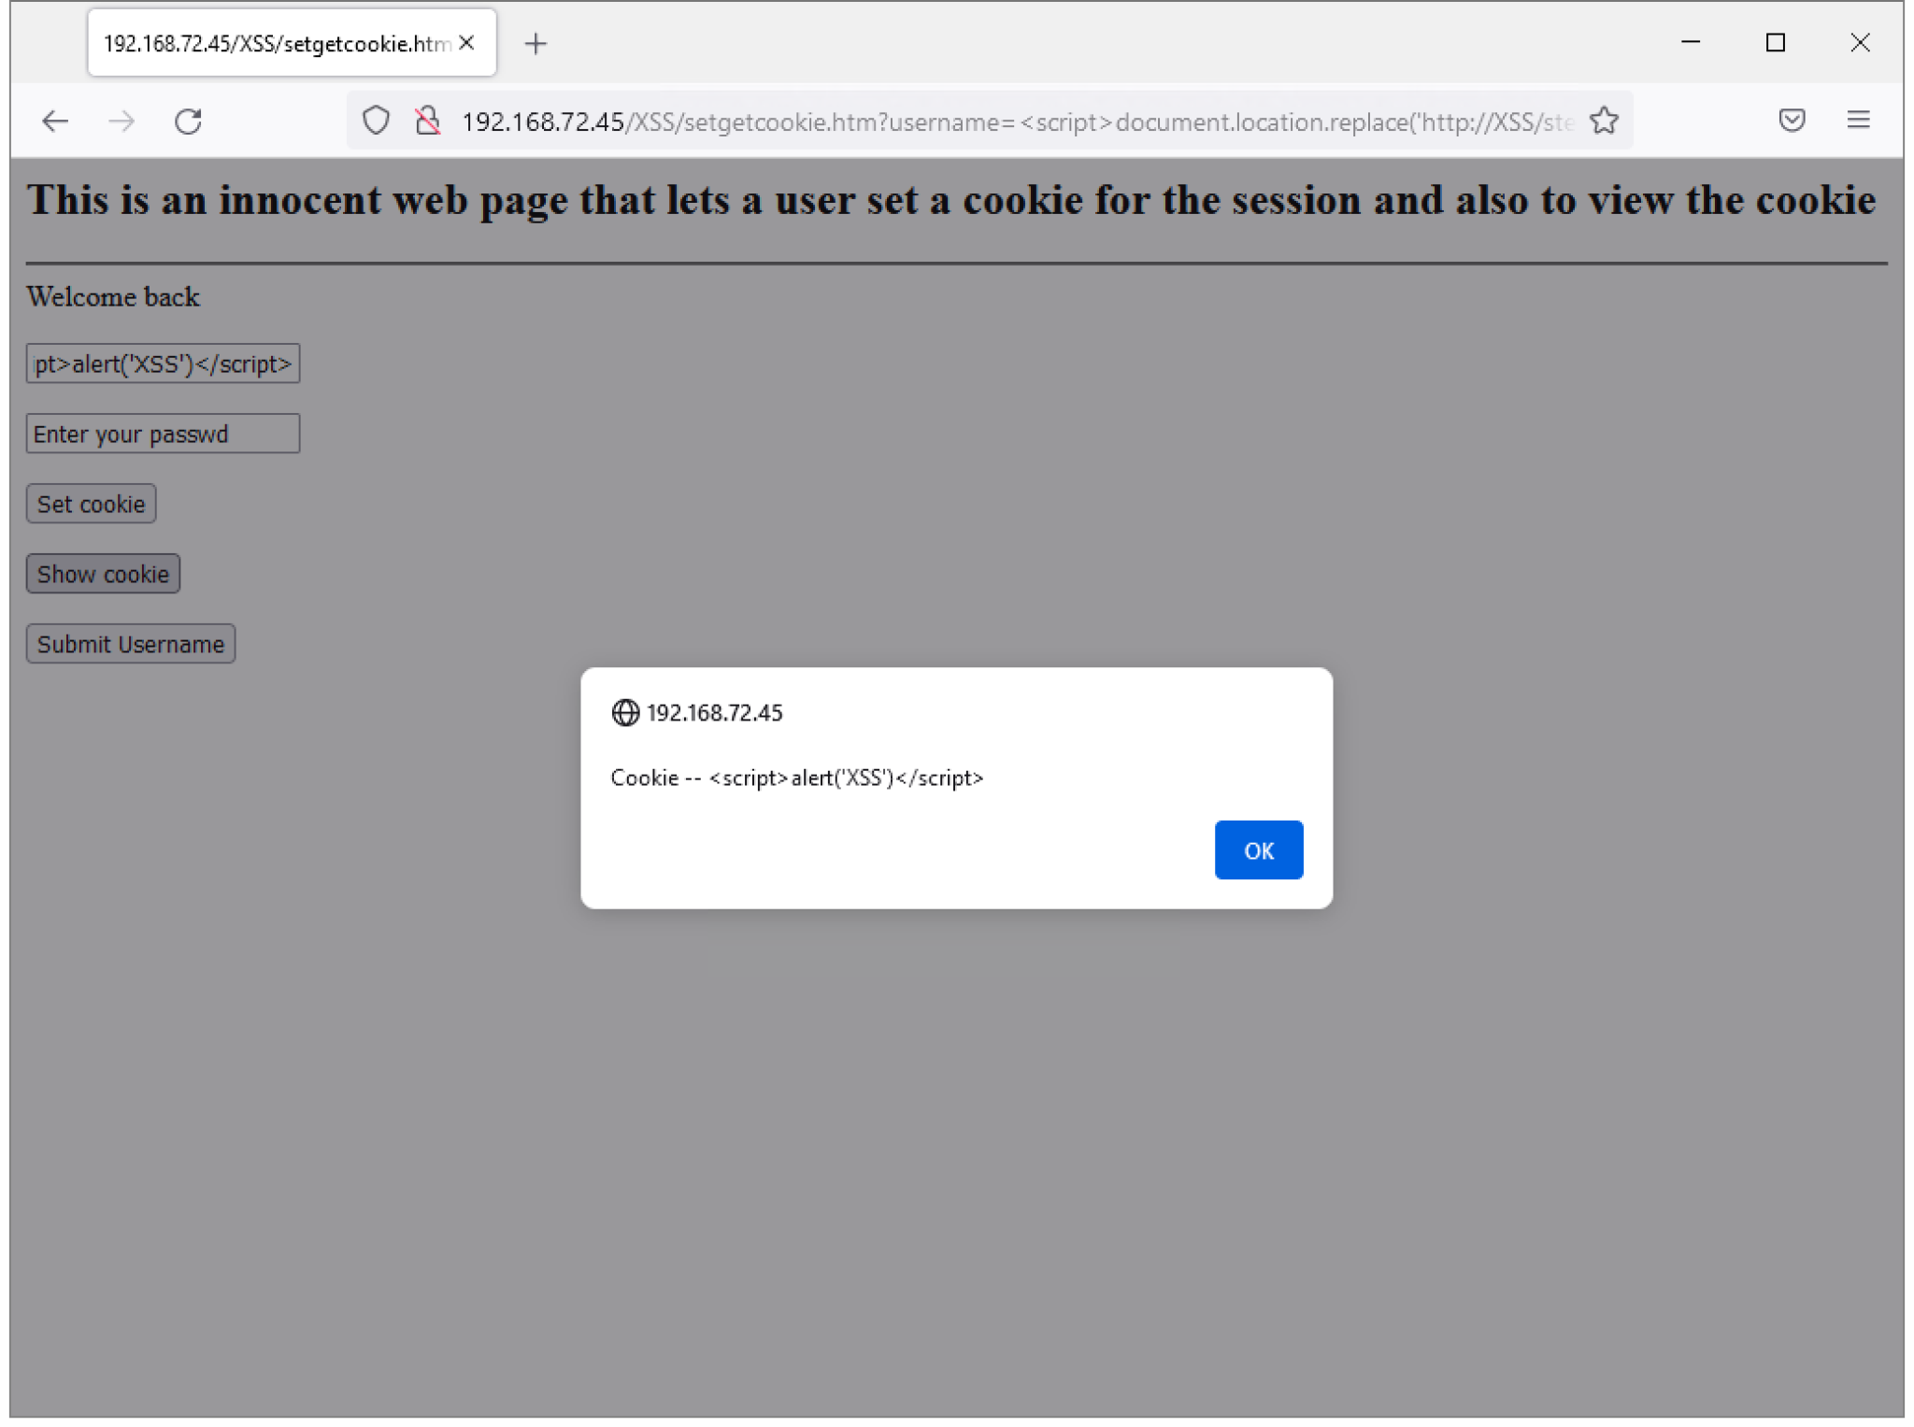
Study Framework: Cross Site Scripting
Part B consisted of creating and executing a server environment that was susceptible to cross site scripting attacks. The goal behind this was to try to execute a cross site scripting attack on the server. Then analyze the problem through the use of ingenuity and other assisted tools. This was to try to coax out an solution to cross site scripting being a vulnerability within the server.
Stored XSS Attack
XSS popup executed
There are stored and reflected XSS attacks. The figure above is a stored XSS attack which is persistent in the system.

Slide 8
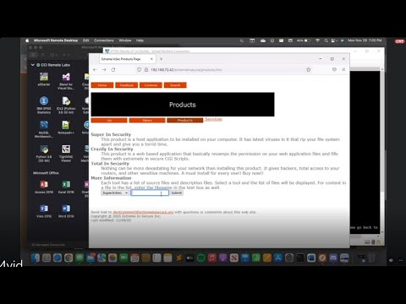
Analysis and Solutions
To build our analysis, we ran manual and automatic web application security scanners. We were able to identify multiple command injection vulnerabilities through faulty PHP codes, XSS vulnerabilities as well as path traversal and file injection vulnerabilities.
Most of these vulnerabilities were due to using file system calls and unsanitized user inputs. To be secure, file system calls should not be used when taking input from a user. Every time user input is taken into the application, input validation should be put in place to make code viable and more secured.

Slide 9
Analysis and Solutions
Input Validation: recognizing malicious code by checking input against a set of criteria
Can be a…
Blacklist: input is checked against a set of illegal inputs, and discarded if it matches
Whitelist: only allows input that is checked against criteria that is known to be clean
Input Sanitization: ‘cleaning’ inputs of malicious code by removing any illegal characters while preserving the original content
Escaping Metacharacters: identifying and telling the code interpreter to ignore any characters that have a special meaning in the code while keeping the output to the user the same
PHP functions to avoid when taking user input:
system()
passthru()
show_source()
exec()
shell_exec()
proc_open()
popen()
curl_exec()
curl_multi_exec()
parse_ini_file()

Slide 10
Lesson Learned, Conclusions, and Future Work
PHP injections and cross-site scripting attacks are very common amongst the known network strafes. They are quite easy to understand, but are immensely grueling to successfully defend against.
After the analysis of the network topology, it was concluded how threats could initially gain access to a network. Through the use of a vulnerability scanner, our team was able to point out multiple solutions to combat the vulnerabilities, reduce overall damage, and prevent them from happening in the first place.
Future work could be done to increase the effectiveness of the already known security measures, or begin the development of defensive systems that are more accurate and are almost impenetrable.

