Slide 1
ACME Transportation
James Clay, Seloke Fabiao, Susan Mani

Slide 2
Overview
Planning
Design Decisions
Coding
System Outputs

Slide 3
Planning
Team development
Continuous development
Issue resolution
Regular commits after achieving set milestones
Rapid development

Slide 4
Design Decisions
Rounding of numbers to 4 digits to match total distance
First and last row of at_distance_eta.csv is excluded
First row of at_power_sensors.csv is excluded
Power supply values never exceed 1
Early warning system is a print function (no file record)

Slide 5
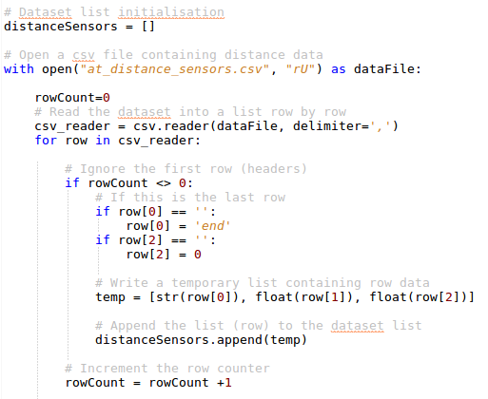
Coding: Import data
List Object was used
Excludes first and last line
Appends into distanceSensors[]

Slide 6
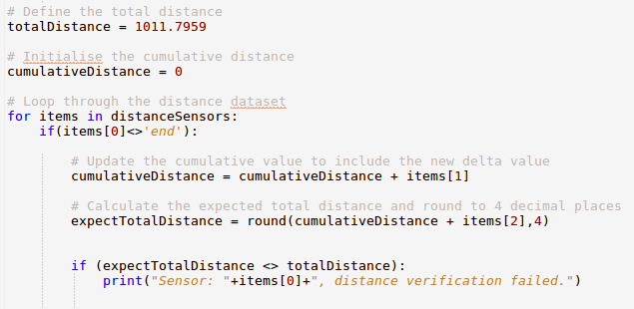
Coding: Confirm Thato’s belief that distances are correct
Cumulatively sum the distance travelled on each loop
Add cumulative total to distance remaining
Compare cumulative total to totalDistance and print if not equal

