Slide 1
=sum(antics)
James Ashley
Rebekah Callari-Kaczmarczyk
Rohan Patel
Ted Phillips
Morgan Spencer
Scot Wilson

Slide 2
Project description
Newspapers are notoriously biased, and are commonly criticized for always focusing on sensational or negative topics rather than providing more balanced reporting. This suggests that the language used in news articles is not neutral. We were interested in exploring this by analyzing two specific aspects of the language used in news articles covering a politically charged topic in the US: immigration
The two linguistic aspects focused on in this analysis are
Sentiment of the article headlines
The frequency of relevant bigrams
Building on our prior projects, we examine the sentiment of newspaper headlines and bigrams of both newspaper headlines and full length articles.

Slide 3
DATA COLLECTION AND ANALYSIS
LIBRARIES
Python
Flask
NLTK
pandas
PyMongo
re
spaCy
JavaScript
DataTables
D3-cloud
D3
Plotly
WEB DESIGN
Bootstrap
Bootswatch
Colorgorical
Article Metadata
Full Text
Analysis
NewsAPI
Topic: Immigration
Newspaper3k
URL’s from NewsAPI
Sentiment (NLTK Vader)
Bigrams (NLTK)
Notes:
DATA COLLECTION
We started by collecting metadata on articles discussing immigration using NewsAPI. We then webscraped the full text of these articles with Newspaper3k.
DATA ANALYSIS
Two corpora were created: headlines and complete text. We determined the most frequent bigrams using NLTK and then filtered these using a custom function. NLTK Vader was used to classify the sentiment of the article headlines but not of the full text since Vader was trained on social media text.

Slide 4
APP ARCHITECTURE
MongoDB
Sentiment Analysis
Bigrams
Flask API
JavaScript
Plots (Plotly, D3, D3-Cloud)
Filters (PyMongo)
Keywords (NLTK)
Notes:
FLASK API
A total of 5 types of flask api routes were created.
News Sources: This route returns a list of all news sources in the database.
Sentiment Scores: This route returns the raw data and can be filtered by news source.
Sentiment Counts: This route returns the total number of occurrences of each sentiment category. This route can be filtered by news source.
Keywords: This route pulls the headlines from the database and then determines and returns the top 50 most frequent words. This route can be filtered by news source.
Bigrams: This route returns the headline or full text bigrams.
JAVASCRIPT
The api calls were performed in Javascript in order to access the data for visualization.

Slide 5
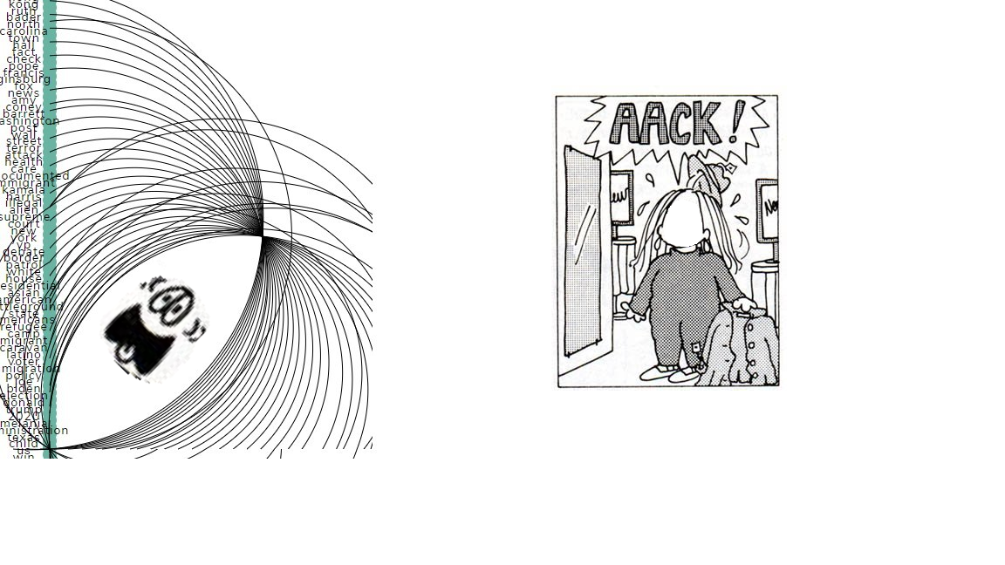
Insights and Key Takeaways
Full text of articles is a lot of data
Optimization vs. dynamic updating
D3 is HARD

Slide 6
Thank you

Slide 7
appendix

Slide 8
References
Chaithra, V. D. (2019). Hybrid approach: naive bayes and sentiment VADER for analyzing sentiment of mobile unboxing video comments. International Journal of Electrical and Computer Engineering (IJECE), 9(5), 4452-4459.
Davies, Mark. (2016-) Corpus of News on the Web (NOW): 10 billion words from 20 countries, updated every day. Available online at https://www.english-corpora.org/now/.
Gilbert, C. H. E., & Hutto, E. (2014, June). Vader: A parsimonious rule-based model for sentiment analysis of social media text. In Eighth International Conference on Weblogs and Social Media (ICWSM-14). Available at (20/04/16) http://comp.social.gatech.edu/papers/icwsm14.vader.hutto.pdf (Vol. 81, p. 82).
Martin, B. & Koufos, N. (2020). Sentiment analysis on Reddit news headlines with Python’s Natural Language Toolkit (NLTK). Learn Data Science. https://www.learndatasci.com/tutorials/sentiment-analysis-reddit-headlines-pythons-nltk/.
Pew Research Center (2014). “Wave 1 American trends panel: Mar 19, 2014-Apr 29, 2014.” Washington, D.C. https://www.journalism.org/2014/10/21/political-polarization-media-habits/.
Gramazio, Connor C. and Laidlaw, David H. and Schloss, Karen B. (2017). Colorgorical: creating discriminable and preferable color palettes for information visualization. *IEEE Transactions on Visualization and Computer Graphics*

Slide 9
Next steps
Additional questions to be asked if had more time/resources
More accurate sentiment analysis
Named-entity recognition
Further exploration of full text of articles

Slide 10
Intro & Description – Morgan, 60
Collections & Architecture – Rebekah, 90
- 3 API calls, does analysis in API call
Site
Home page – James, 30
Domains – Ted, 90
Keywords – Rohan, 60
Data – Scot, 30s
Insights/takeaways – Rebekah, 60

