Slide 1
=sum(antics)
James Ashley
Rebekah Callari-Kaczmarczyk
Rohan Patel
Scot Wilson
our Website: https://tinyurl.com/sumantics

Slide 2
Project description
Newspapers are notoriously biased and are commonly criticized for always focusing on sensational or negative topics rather than providing more balanced reporting. This suggests that the language used in news articles is not neutral. We were interested in exploring the language used in news articles covering a politically charged topic in the US: immigration
We examined the relationship between sentiment and:
News source
News source bias
What is sentiment?
Sentiment is the negative/positive emotion of a text.

Slide 3
Project Overview
Data Collection
NewsAPI and Newspaper3K
Sentiment ratings
Data Analysis
Exploratory data analysis
News source, news source bias, and sentiment
Sentiment Classification
Text preprocessing
Supervised machine learning models
Full Stack Application
Heroku App
MongoDB w/ Flask API
Notes:
Data Collection
Data Analysis
Sentiment Classification though Machine Learning
Full Stack Application

Slide 4
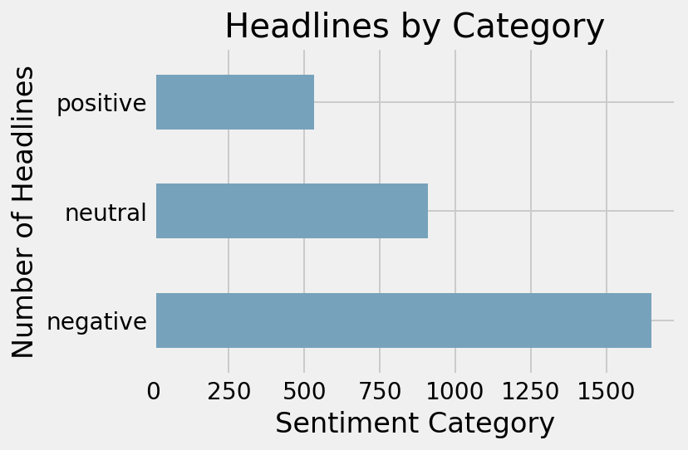
Dataset
3,094 articles published Sept. – Dec. 2020
9 news sources w/ Pew Research Center bias ratings

Slide 5
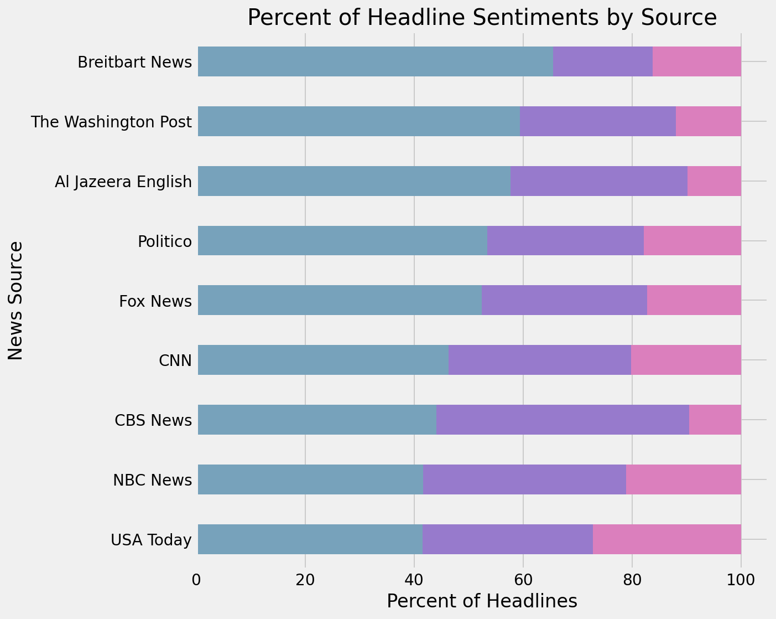
Sentiment By News Source
% Negative
% Neutral
% Positive

Slide 6
Major Findings
Headlines are dominated by current events
Significant relationship exists between news source and sentiment category
More bias (left or right) leads to more negative sentiment
Sentiment doesn’t tell us everything:
Breitbart: Migrant Who Tried to Set Bus Full of Children on Fire Expressed Hatred of Italians in Revealed Video
Al Jazeera: Rohingya refugees are being ignored

Slide 7
Machine Learning: Text Preprocessing
Tokenization
Stop Words Removal
Lemmatization
Hashing
TF-IDF
80/20 Training/Testing
Notes:
Tokenize (NLTK RegexpTokenizer)
Tag for POS (NLTK)
Lemmatize w/ POS tag to increase accuracy (NLTK WordNet Lemmatizer)
One hot encode newspaper source (Pandas)
Export to JSON
Upload to Github
Hashing (pySpark)
TF-IDF (pySpark)
70/30 testing/training split

Slide 8
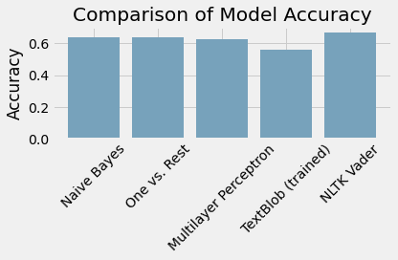
Machine Learning Models (pySpark)
Notes:
Our models: Naïve bayes, one vs. rest, multilayer perceptron
Accuracy b/w 0.63 and 0.64
Other Models
Textblob (NaiveBayes Classifier, trained, 80/20 split): accuracy 0.56
NLTK Vader: accuracy 0.68

Slide 9
App Architecture
MongoDB
Sentiment Analysis
Bigrams
Flask API
JavaScript
Plots (Plotly, D3, D3-Cloud)
Filters (PyMongo)
Keywords (NLTK)

Slide 10
Key Takeaways
Open source/free resources are limited.
More data is needed for more accurate machine learning models.
Exploring meaning is complex.
Sentiment (polarity) is only part of the picture.
Alternatives: named entity recognition, emotion analysis, sentiment (subjectivity/objectivity)

Slide 11
appendix

Slide 12
References
Chaithra, V. D. (2019). Hybrid approach: Naive bayes and sentiment VADER for analyzing sentiment of mobile unboxing video comments. International Journal of Electrical and Computer Engineering (IJECE), 9(5), 4452-4459.
Gilbert, C. H. E., & Hutto, E. (2014, June). Vader: A parsimonious rule-based model for sentiment analysis of social media text. In Eighth International Conference on Weblogs and Social Media (ICWSM-14). Available at (20/04/16) http://comp.social.gatech.edu/papers/icwsm14.vader.hutto.pdf (Vol. 81, p. 82).
Jabeen, H. (2018). Stemming and lemmatization in Python. Datacamp. https://www.datacamp.com/community/tutorials/stemming-lemmatization-python
Stratis, K. (2020). Use sentiment analysis with Python to classify movie reviews. Real Python. https://realpython.com/sentiment-analysis-python/

Slide 13
What questions do you have for us?
Many thanks to our other team members: Ted Phillips and Morgan Spencer.
Check out our website: https://tinyurl.com/sumantics

Slide 14
Intro – Rohan
Description – Rohan
Project Overview – Rohan
Dataset – James
Sentiment by News Source – James
Major Findings – James
ML Text Preprocessing – RCK
ML Models – RCK
App Architecture – Scot
Key Takeaways – Scot
References/Q&A – Scot

