Slide 1
=sum(antics)
James Ashley
Rebekah Callari-Kaczmarczyk
Rohan Patel
Ted Phillips
Morgan Spencer
Scot Wilson

Slide 2
Six months ago we asked….
Are biased newspapers more negative?

Slide 3
Project description
Newspapers are notoriously biased, and are commonly criticized for always focusing on sensational or negative topics rather than providing more balanced reporting. This suggests that the language used in news articles is not neutral. We were interested in exploring the language used in news articles covering a politically charged topic in the US: immigration
We looked for a relationship between sentiment and
News source
News source bias

Slide 4
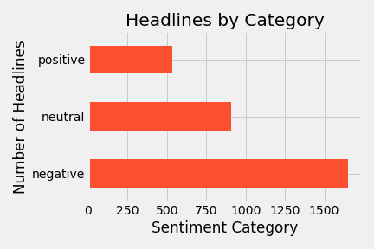
Sentiment Classification
All headlines were rated for sentiment by a person.
Ratings breakdown

Slide 5
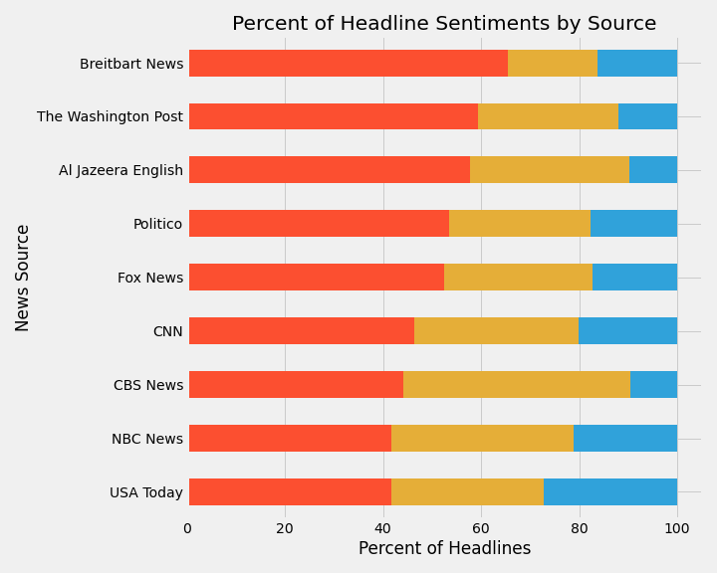
Sentiment By News Source

Slide 6
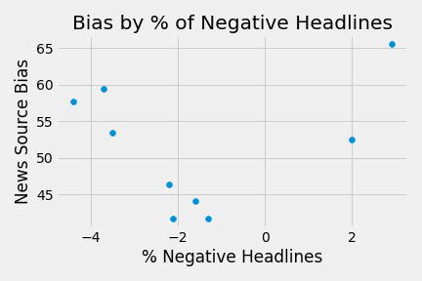
Sentiment and Bias

Slide 7
Take Away From Analysis
More bias leads to more negative sentiment
Breitbart: Migrant Who Tried to Set Bus Full of Children on Fire Expressed Hatred of Italians in Revealed Video
Al Jazeera: Rohingya refugees are being ignored
Drawback: sentiment score by hand is time consuming
By a round of applause, how many of you have classified a language database by hand?

Slide 8
Machine Learning: Text Preprocessing
Tokenization
Stop Words Removal
Lemmatization
Hashing
TF-IDF
80/20 Testing/Training
Notes:
Tokenize (NLTK RegexpTokenizer)
Tag for POS (NLTK)
Lemmatize w/ POS tag to increase accuracy (NLTK WordNet Lemmatizer)
One hot encode newspaper source (Pandas)
Export to JSON
Upload to Github
Hashing (pySpark)
TF-IDF (pySpark)
70/30 testing/training split

Slide 9
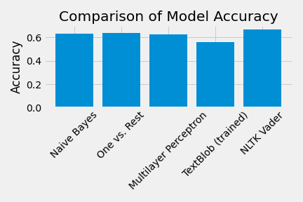
Machine Learning Models (pySpark)
Notes:
NaiveBayes Classifier (our model)
Extremely inaccurate with news source feature
Best model: only feature is TF-IDF, accuracy 0.55
OnevsRest with Logistic Regression Classifier
Extremely inaccurate with news source feature
Best model: only feature is TF-IDF, accuracy 0.60
Multilayer Perceptron Classifier
Other Models
Textblob (untrained): accuracy 0.0
Textblob (NaiveBayes Classifier, trained, 80/20 split): accuracy 0.56
NLTK Vader: accuracy 0.68

Slide 10

Imagination
Reality
Dataset size - need more training data
Limited time for customizing features
Sentiment dictionary

Slide 11
appendix

Slide 12
References
NLTK - Naive Bayes: https://www.digitalocean.com/community/tutorials/how-to-perform-sentiment-analysis-in-python-3-using-the-natural-language-toolkit-nltk
General Overview/spaCy:
https://realpython.com/sentiment-analysis-python/
SKLearn: https://stackabuse.com/python-for-nlp-sentiment-analysis-with-scikit-learn/
SKLearn (no preprocessing - straight bag of words, binary classification): https://towardsdatascience.com/a-beginners-guide-to-sentiment-analysis-in-python-95e354ea84f6
SKLearn (whole series - simple to complicated): https://towardsdatascience.com/sentiment-analysis-with-python-part-1-5ce197074184
Deep Learning (TensorFlow, Keras, sklearn): https://curiousily.com/posts/sentiment-analysis-with-tensorflow-2-and-keras-using-python/
SKLearn/spaCy: https://medium.com/dev-genius/training-an-ml-model-for-sentiment-analysis-in-python-63b6b8c68792
NLTK (bag of words vs TF-IDF) and SKLearn: https://www.analyticsvidhya.com/blog/2018/07/hands-on-sentiment-analysis-dataset-python/
Using NLTK in PySpark: https://docs.anaconda.com/anaconda-cluster/howto/spark-nltk/

Slide 13
Intro - Morgan
Description - Morgan
Classification - Scott
Sentiment my news source - James
Sentiment by bias - Ted
Take away - Rohan
ML TEXT PROCESSING - Rebekah
ML models – Rebekah part deux
Imagination/reality - Scott

