Slide 1
Does tone really get lost in text?
Rebekah Callari-Kaczmarczyk
Scot Wilson
James Ashley
Ted Phillips
Rohan Patel
Morgan Spencer

Slide 2
Project description
Evaluate the emotional strength of US English news headlines related to immigration using artificial intelligence (Vader by NLTK) to determine positive/negative emotion.
Research Questions
What is the general sentiment of US English newspaper headlines on immigration?
Which keywords are associated with negative or positive sentiment?

Slide 3
Breakdown of Tasks
Pull down and store headlines and newspaper metadata from the News API with four keywords:
immigration
immigrant(s)
migrant(s)
refugee(s)
Clean and sort data
Perform sentiment analysis of headlines using NLTK’s Vader
Determine bins for negative/neutral/positive ratings
Perform keyword analysis using NLTK
Notes:
What is sentiment analysis? Evaluation of positive/negative emotion conveyed through text
Pull down and store headlines and newspaper metadata from the News API with four keywords:
Only searching domains available in Pew Research Center
Searching keywords in news article
Sort by relevance
Clean and sort data
Removed news sources with low results

Slide 4
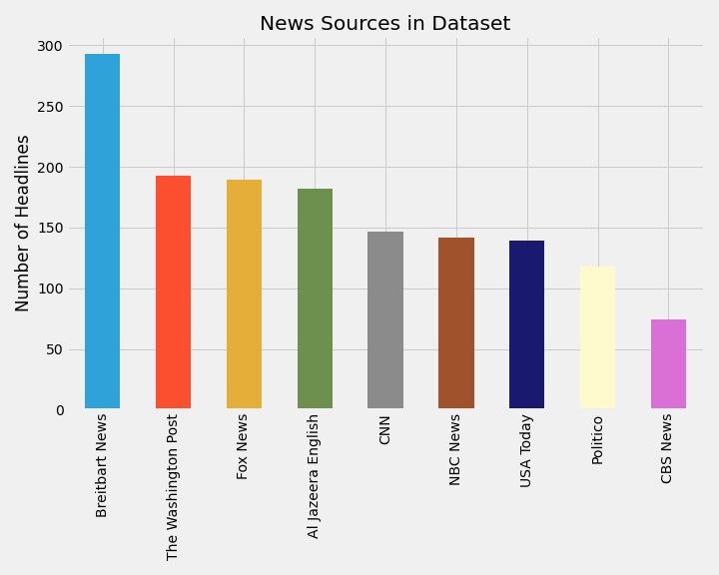
Insights
Data set
Total number of headlines
1,477
Total number of sources
9
Date range
9/9/2020 – 10/14/2020
Notes:
How did we choose the sources? Pew research, political bias

Slide 5
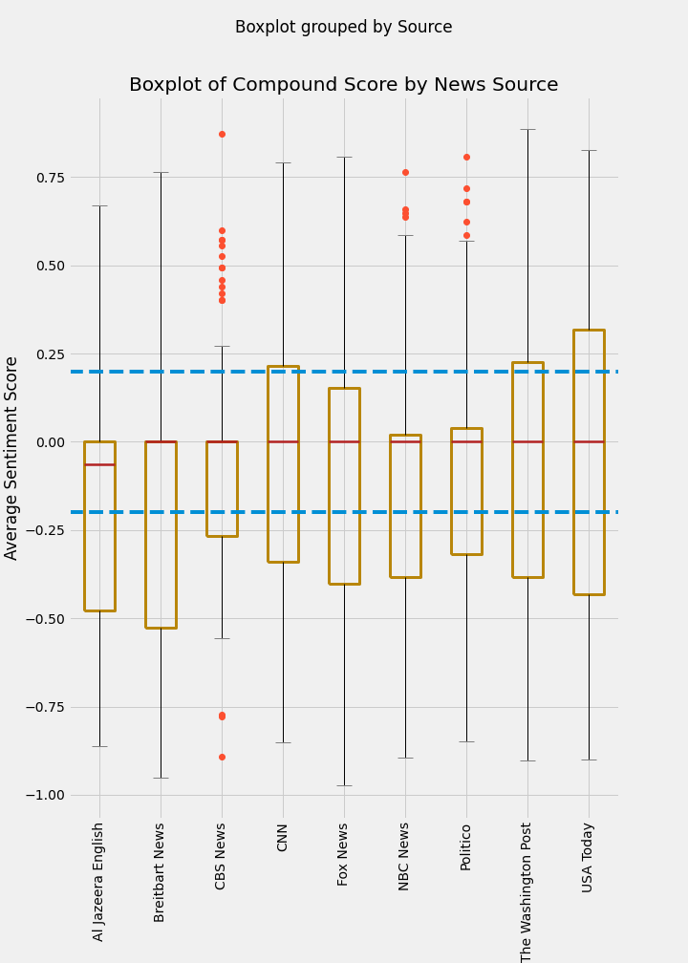
Insights
Notes:
Descriptive stats
Median is close to 0
0 is neutral
Threshold is -.2 to .2
Vast majority of scores are neutral

Slide 6
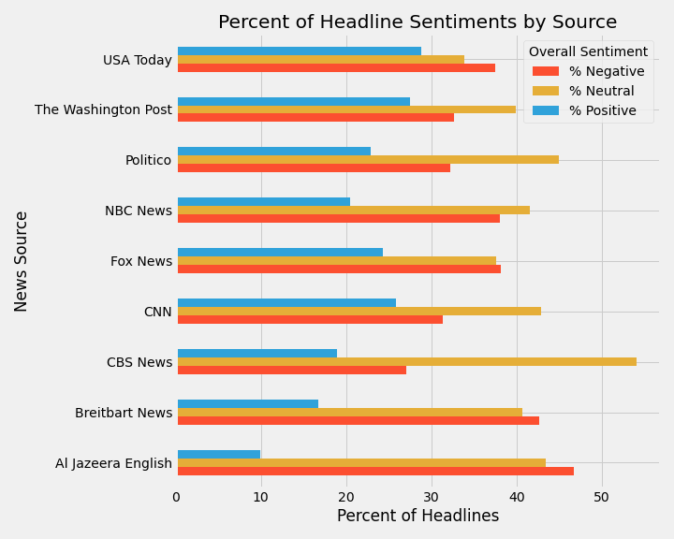
Insights
Example headlines
Nigerian Pleads Guilty to Murdering Mackenzie Lueck, Avoids Death Penalty
Score: -.94 (negative emotion), Published by Breitbart
University of Alabama trustees vote to rename hall that honored 'ardent white supremacist’
Score: .82 (positive emotion), Published by USA Today
Bins for data:
-1.0 to -0.2 = negative -0.2 to 0.2 = neutral 0.2 to 1 = positive

Slide 7
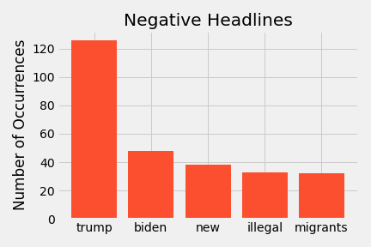
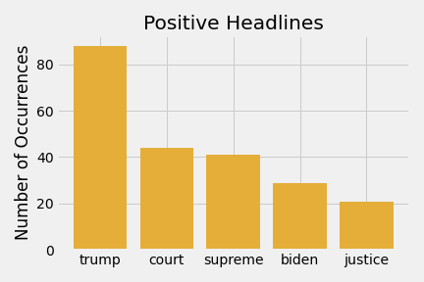
Most frequent words
Notes:
Top word used in positive/negative headlines

Slide 8
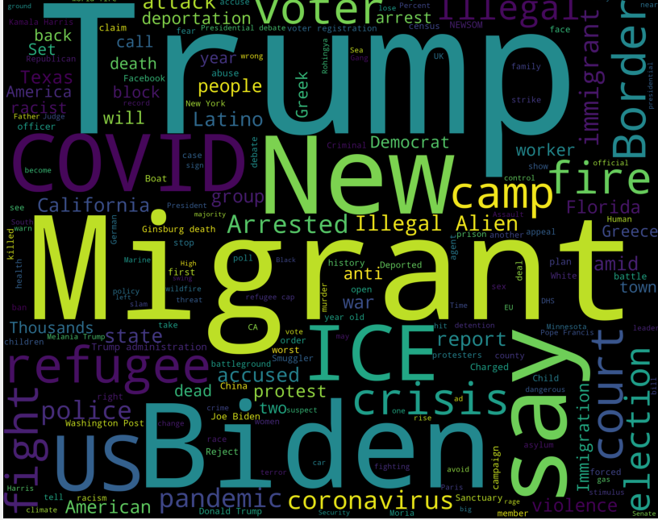
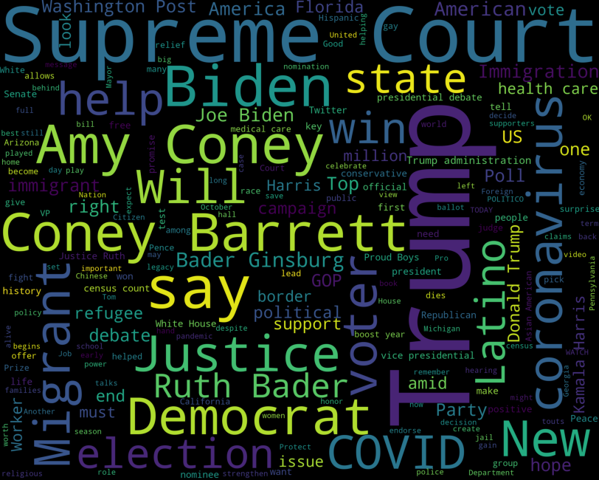
The bigger picture
Negative
Positive

Slide 9
Key takeaways
Key findings
Breitbart/Al Jazeera seem to use most negative sentiment
Negative/Positive headlines seem to have different topics
Challenges
NLTK Vader
NewsAPI
Additional questions to be asked if had more time/resources
Perform emotional analysis
Add to dataset monthly
Customize the sentiment analysis
Look at influence of political bias
Notes:
Challenges
Sentiment scoring is not customized – NLTK Vader was trained on social media
NewsAPI limits access to sources- data, first page of results, etc
Use the political bias data in future analysis

Slide 10
Can you guess the sentiment of these titles?
Bader Ginsburg, Supreme Court justice and legal pioneer for gender equality, dies at 87
Mackenzie Lueck’s killer pleads guilty to aggravated murder, will avoid death penalty

Slide 11
Can you guess the sentiment of these titles?
Bader Ginsburg, Supreme Court justice and legal pioneer for gender equality, dies at 87
The Washington Post, Score: .81
Mackenzie Lueck’s killer pleads guilty to aggravated murder, will avoid death penalty
Fox News, Score: -.97

Slide 12
appendix

Slide 13
References
Chaithra, V. D. (2019). Hybrid approach: naive bayes and sentiment VADER for analyzing sentiment of mobile unboxing video comments. International Journal of Electrical and Computer Engineering (IJECE), 9(5), 4452-4459.
Davies, Mark. (2016-) Corpus of News on the Web (NOW): 10 billion words from 20 countries, updated every day. Available online at https://www.english-corpora.org/now/.
Gilbert, C. H. E., & Hutto, E. (2014, June). Vader: A parsimonious rule-based model for sentiment analysis of social media text. In Eighth International Conference on Weblogs and Social Media (ICWSM-14). Available at (20/04/16) http://comp.social.gatech.edu/papers/icwsm14.vader.hutto.pdf (Vol. 81, p. 82).
Martin, B. & Koufos, N. (2020). Sentiment analysis on Reddit news headlines with Python’s Natural Language Toolkit (NLTK). Learn Data Science. https://www.learndatasci.com/tutorials/sentiment-analysis-reddit-headlines-pythons-nltk/.
Pew Research Center (2014). “Wave 1 American trends panel: Mar 19, 2014-Apr 29, 2014.” Washington, D.C. https://www.journalism.org/2014/10/21/political-polarization-media-habits/.

Slide 14
Links
Check out the repository here

