Slide 1
Does tone really get lost in text
Rebekah Callari-Kaczmarczyk
Scot Wilson
James Ashley
Ted Phillips
Rohan Patel
Morgan Spencer

Slide 2
Project description
Evaluate the emotional strength of US news headlines in English by creating a database of them and use artificial intelligence (Vader by NLTK) to determine positive/negative sentiment of headlines relating to immigration.
Research Questions to Answer(needs updating)
What is the general sentiment of US English newspaper headlines on immigration?
Which topics are associated with negative or positive sentiment
What is the sentiment of conservative vs. liberal English newspaper headlines in the US?

Slide 3
Breakdown of Tasks
Pull down and store headlines and newspaper metadata from the News API with four keywords:
immigration
immigrant(s)
migrant(s)
refugee(s)
Clean and sort data
Perform sentiment analysis using NLTK’s Vader
Determine bins for negative/neutral/positive ratings
Perform keyword analysis
Notes:
Pull down and store headlines and newspaper metadata from the News API with four keywords:
Only searching domains available in Pew Research Center
Searching keywords in news article
Sort by relevance
Clean and sort data
Removed news sources with low results

Slide 4
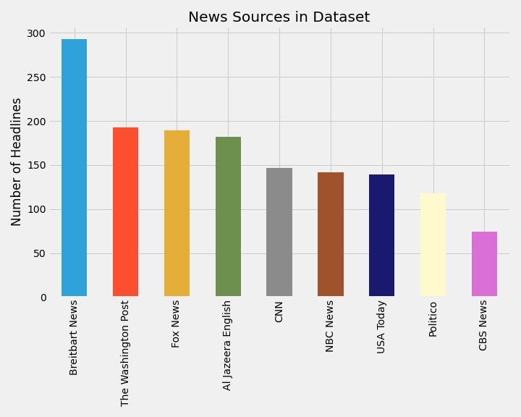
Insights
Describe data set
Total number of data points
How we chose these 9 sources

Slide 5
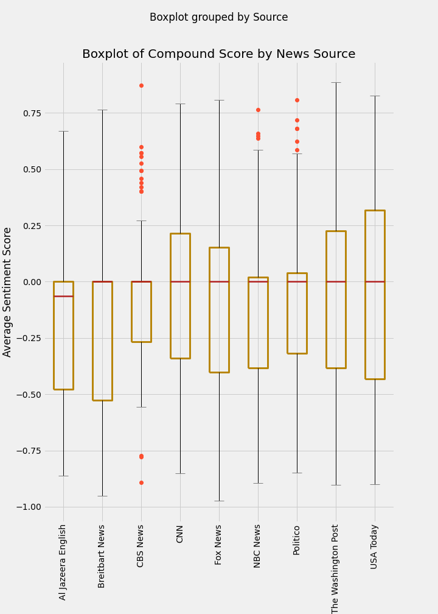
Insights
What is sentiment analysis? Emotion conveyed through text
Descriptive stats
Box plot explanation
Something interesting to draw ppls attention to

Slide 6
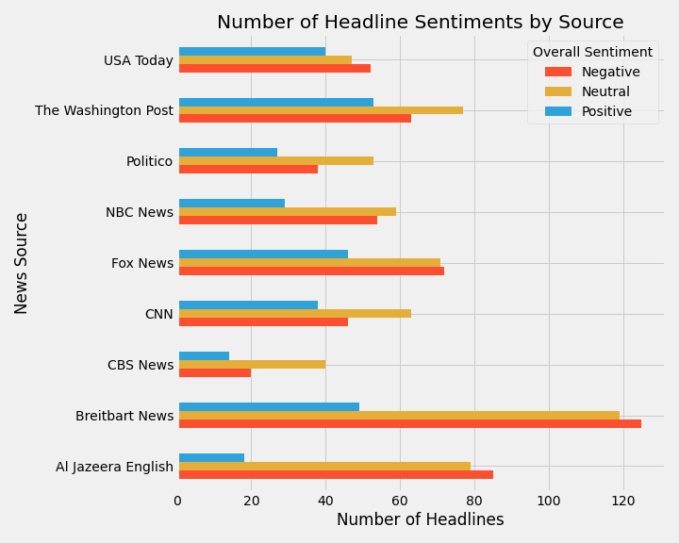
Insights
Example headlines
Nigerian Pleads Guilty to Murdering Mackenzie Lueck, Avoids Death Penalty
Score: -.94 (negative emotion), Published by Breitbart
University of Alabama trustees vote to rename hall that honored 'ardent white supremacist’
Score: .82 (Positive), Published by USA Today
Can you guess the sentiment of these titles?
Bader Ginsburg, Supreme Court justice and legal pioneer for gender equality, dies at 87
Mackenzie Lueck’s killer pleads guilty to aggravated murder, will avoid death penalty
Bins for data:
-1.0 to -0.2 = negative -0.2 to 0.2 = neutral 0.2 - 1 = positive
Notes:
The Washington Post - Ruth Bader Ginsburg, Supreme Court justice and legal pioneer for gender equality, dies at 87, 0.8176
Fox News - Mackenzie Lueckâ’s killer pleads guilty to aggravated murder, will avoid death penalty: reports, -0.9744

Slide 7
Can you guess the sentiment of these titles?
Bader Ginsburg, Supreme Court justice and legal pioneer for gender equality, dies at 87
Mackenzie Lueck’s killer pleads guilty to aggravated murder, will avoid death penalty
If we have time, might be a fun way of engaging the audience…

Slide 8
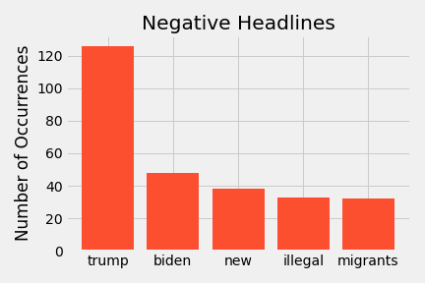
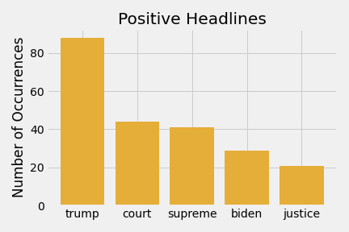
Most frequent words
Notes:
Top word used in positive/negative headlines

Slide 9
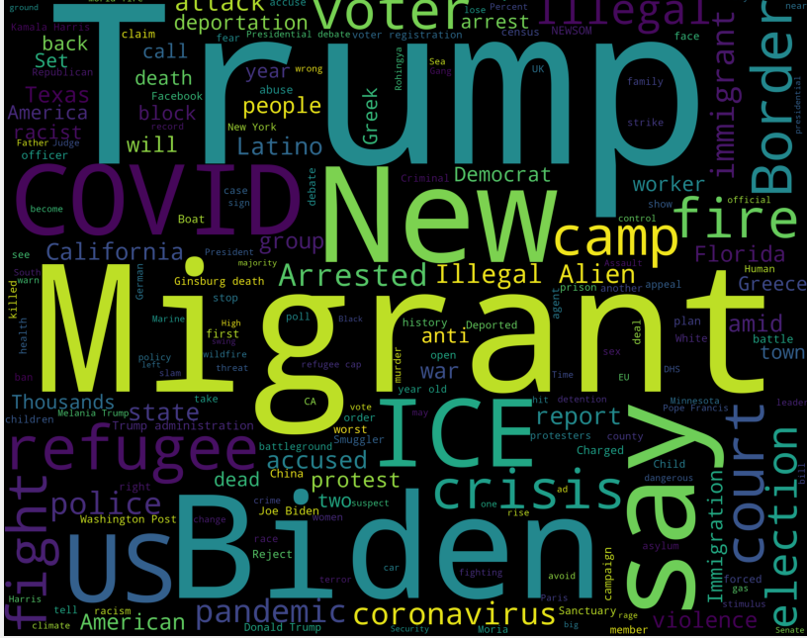
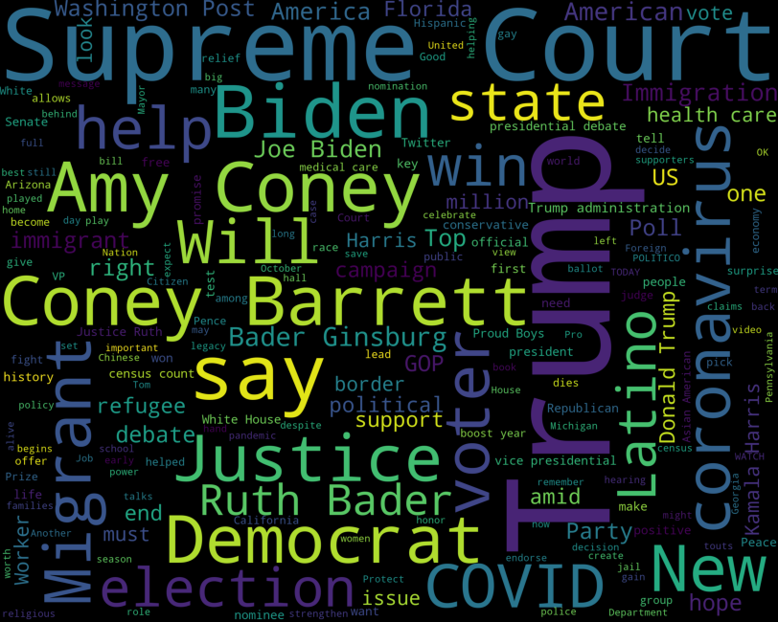
The bigger picture
Negative
Positive

Slide 10
Key takeaways
Key findings
Britebart/Aljezera seem to use most extreme language
Seem to be writing for a specific population of readers
Negative/Positive headlines seem to have different topics with some overlap
Topics seem to change over time based on current events
Challenges
Sentiment scoring is not customized – NLTK Vader was trained on social media
NewsAPI limits access to sources
Additional questions to be asked if had more time/resources
Emotional analysis – what’s behind the extremity of the language used
Look at body of the articles instead of headline
Looking more into differences in publishers and authors
Customizing the sentiment analysis
Add to dataset monthly to observe impact of current events
Notes:
Challenges
Sentiment scoring is not customized – NLTK Vader was trained on social media
NewsAPI limits access to sources- data, first page of results, etc

Slide 11
appendix

Slide 12
References
News headlines in English published in the US
NewsAPI - author, title, domain, url, headline, first 200 words https://newsapi.org/
Conservative/Liberal Bias of NewsPapers https://www.journalism.org/2014/10/21/political-polarization-media-habits/

Slide 13
Interesting things found along the way
Check out the repository here

