Slide 1
Does tone really get lost in text
Rebekah Callari-Kaczmarczyk
Scot Wilson
James Ashley
Ted Phillips
Rohan Patel
Morgan Spencer

Slide 2
Project description
In this project we created a database of newspaper headlines across 9 different sources using News API and evaluated the emotional strength of the headlines using NLTK’s Vader to determine their sentiment related to specific keywords. We will be looking at how different newspapers on the left/right bias spectrum represent immigrants. (slim down)
Time frame, dates
What is sentiment analysis: Emotion conveyed through text
Research Questions to Answer(needs updating)
What is the general sentiment of US English newspaper headlines on immigration?
Which topics are associated with negative or positive sentiment
What is the sentiment of conservative vs. liberal English newspaper headlines in the US?

Slide 3
Breakdown of Tasks
Pull down and store headlines and newspaper metadata from the News API with four keywords:
immigration
immigrant(s)
migrant(s)
refugee(s)
Clean and sort data
Create numerical representation of conservative vs. liberal news sources
Perform sentiment analysis using NLTK’s Vader
Determined bins for negative/neutral/positive ratings
Performed keyword analysis
TENSE
Notes:
Pull down and store headlines and newspaper metadata from the News API with four keywords:
Only searching domains available in Pew Research Center
Searching keywords in news article
Sort by relevance
Clean and sort data
Removed news sources with low results

Slide 4
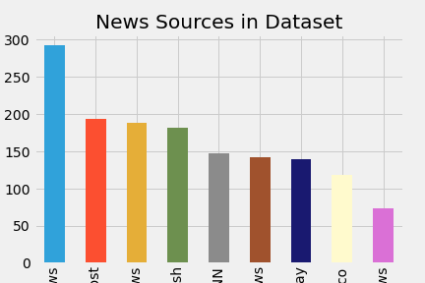
Insights
Describe data set
Need to fix titles in image
Need summary stats table

Slide 5
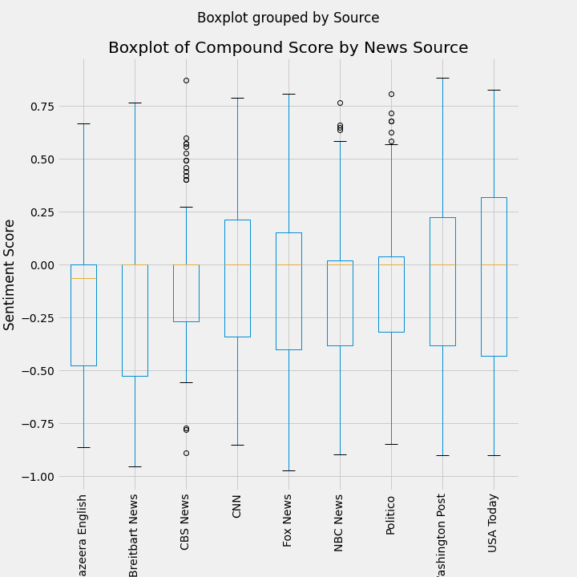
Insights
Descriptive stats
“Ugly” table from notebook

Slide 6
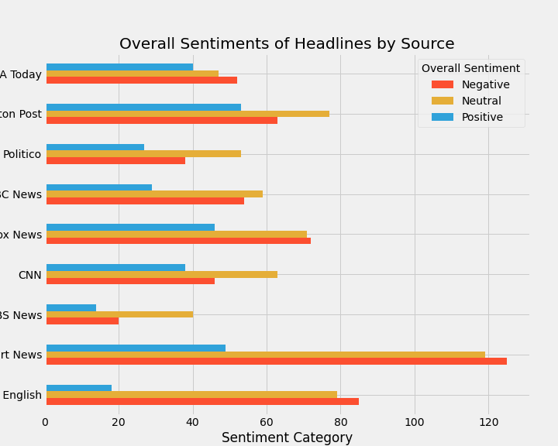
Insights
Count of positive/negative/neutral per news source
Need to determine talking points:
Could be extreme language, could be extreme view point
Example of positive/negative title
Bins for data:
-1.0 to -0.2 = negative
-0.2 to 0.2 = neutral
0.2 - 1 = positive

Slide 7
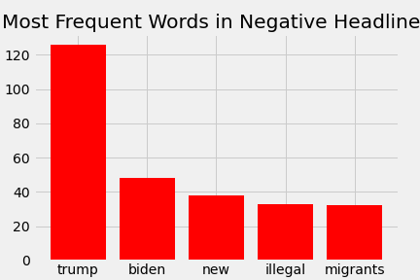
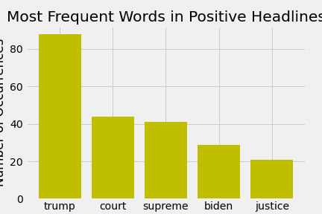
Most frequent words
Notes:
Top word used in positive/negative headlines

Slide 8
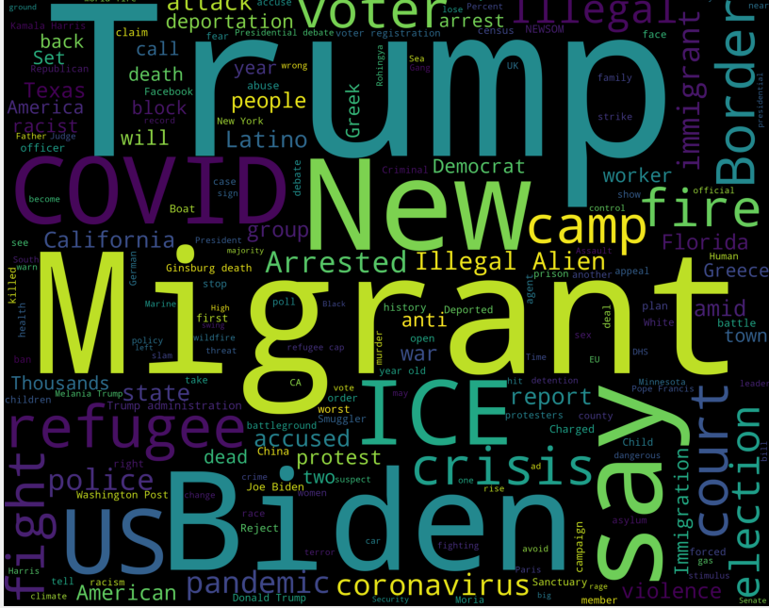
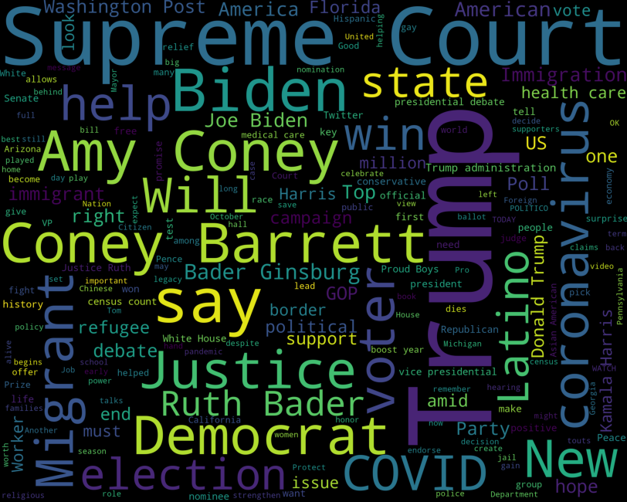
The bigger picture
Negative
Positive

Slide 9
Key takeaways
Key findings
Britebart/Aljezera seem to use most extreme language
Seem to be writing for a specific population of readers
Negative/Positive headlines seem to have different topics with some overlap
Topics seem to change over time based on current events
Challenges
Sentiment scoring is not customized – NLTK Vader was trained on social media
NewsAPI limits access to sources
Additional questions to be asked if had more time/resources
Emotional analysis – what’s behind the extremity of the language used
Look at body of the articles instead of headline
Looking more into differences in publishers and authors
Customizing the sentiment analysis
Add to dataset monthly to observe impact of current events
Notes:
Challenges
Sentiment scoring is not customized – NLTK Vader was trained on social media
NewsAPI limits access to sources- data, first page of results, etc

Slide 10
appendix

Slide 11
References

Slide 12
Interesting things found along the way
Check out the repository here

