Slide 1
Greater Manchester Food Security Action Network

Slide 2
Towards our 12-month Action Plans

Slide 3
Ending Holiday Hunger
Improving the offer for 11-16 year old’s, including sustaining the Emergency Food Card Offer

Slide 4
Ending Holiday Hunger
Supporting the HAF programme across GM to be more co-produced with children and young people model for delivery

Slide 5
Ending Holiday Hunger
Ensuring all children and young people in GM have fun with food during the school holidays

Slide 6

Healthy Start Taskforce
3 Key Actions:
Action 1: Education/Awareness (spreading knowledge of the scheme amongst professionals and support services)
Action 2: Campaigning and Lobbying (reaching recipients directly and working with the NHS BSA to address issues)
Action 3:Handholding (recognising groups who may have difficulty with the new arrangement and identifying support mechanisms)

Slide 7
Quarter 1 Actions – preparing for the change over
Education/Awareness | Lobbying | Handholding
Created matrix of key family support agencies in each borough | Early Day Motion (automatic enrolment) - contacted MPs in region to ask them to support | Flyers/Posters etc. distributed to groups across GM
Presented to key support groups across GM on new digital scheme (Startwell, Early Years, Food Networks, Midwives) | Worked with Sustain on a letter to Sajid Javid requesting a delay to the process | Detailed training notes on sign up to new scheme created and provided to contacts across boroughs
Designed training slides and flyers for distribution | Collated issues arising and raised them directly with NHS | Sign up schemes in place led by Manchester Central Foodbank (at MRI) and Bread and Butter (GM)
 | Freedom of Information Request | Referral route agreed with GM CAB so that complex cases can be supported

Slide 8
Healthy Start Taskforce – where are we today?
The paper voucher scheme is due to stop on 31 March replaced by the new digital scheme. Everyone has to reapply
Data is not yet available for the new scheme but it appears that there are still many beneficiaries who have not transferred over – they will lose their vouchers from 1 April
There have been on-going issues with the tech making sign up difficult creating more barriers
Priority is to continue promoting the scheme to get everyone signed over as quickly as possible
Aim remains to raise take up from the 60% prior

Slide 9
Doing more for those that miss out.
Accessibility

Slide 10
Doing more for those that miss out.
Affordability

Slide 11
Doing more for those that miss out.
Useability

Slide 12
National and Regional Updates
Rev Ian Rutherford – Chair of the GMFSAN
Elaine Morgan - GMCA

Slide 13
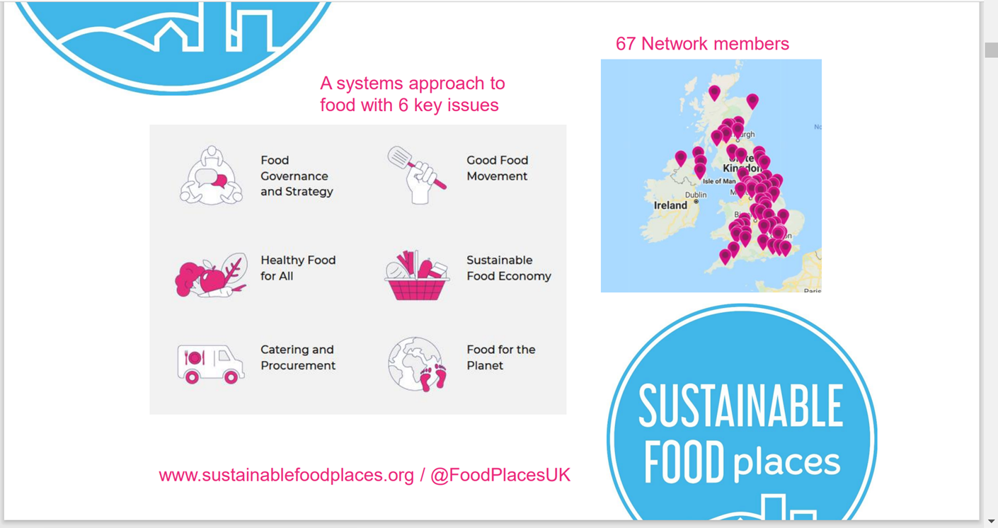

Slide 14
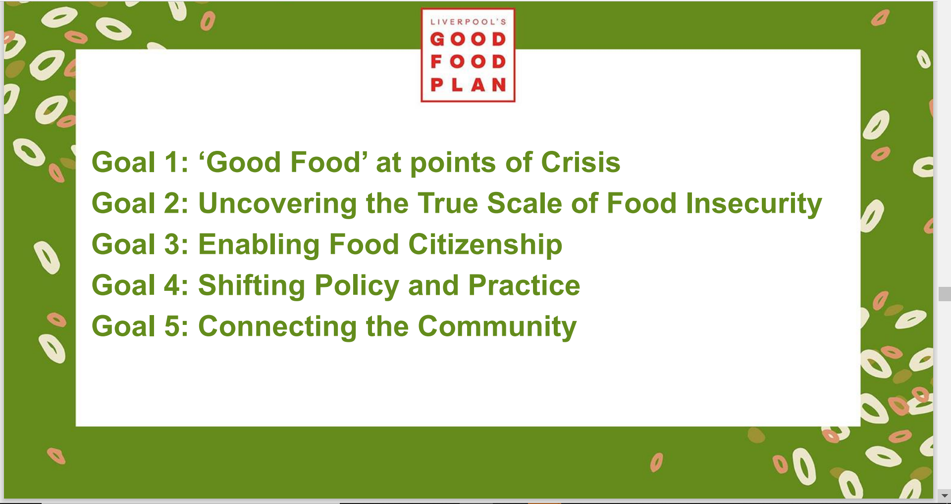

Slide 15
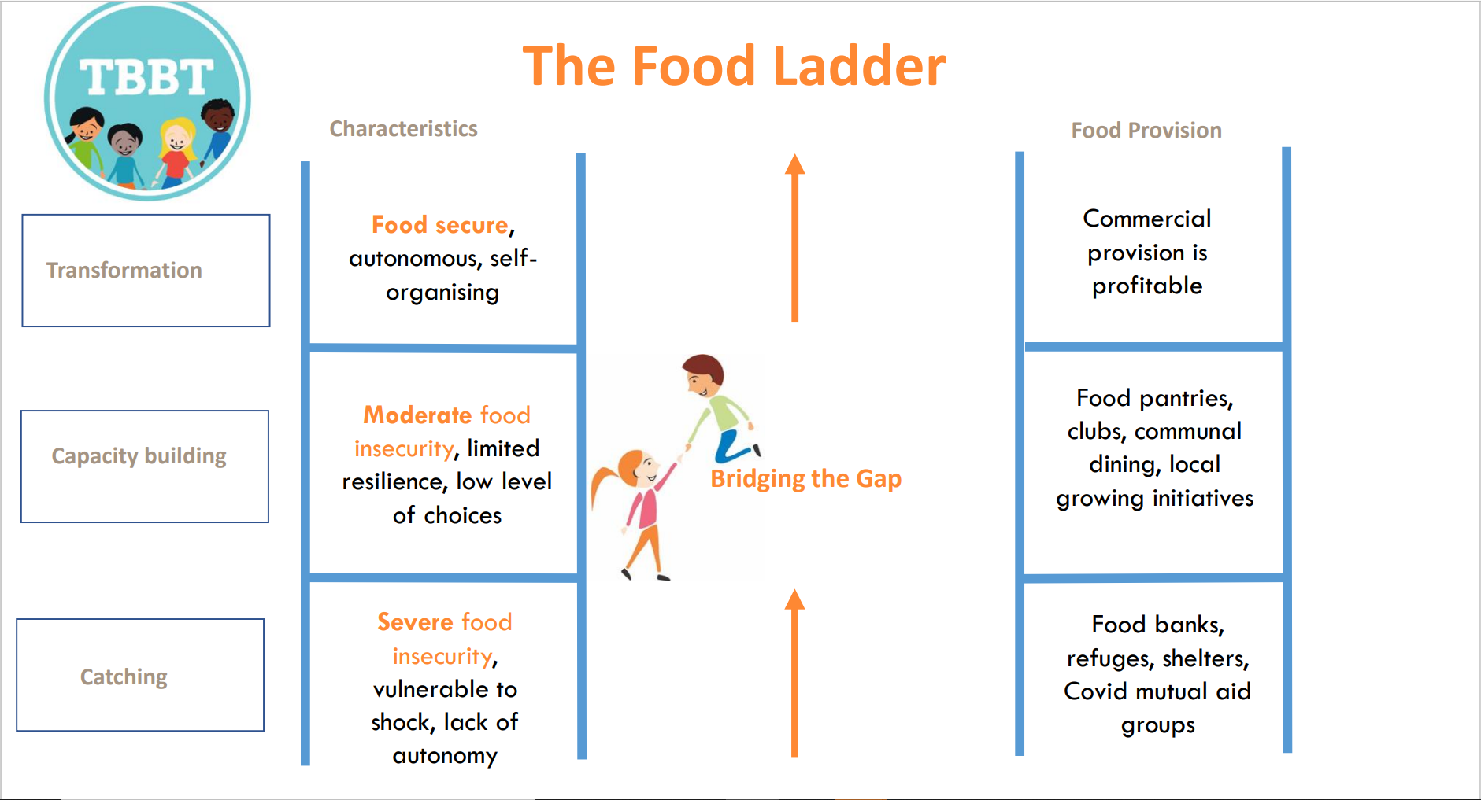

Slide 16
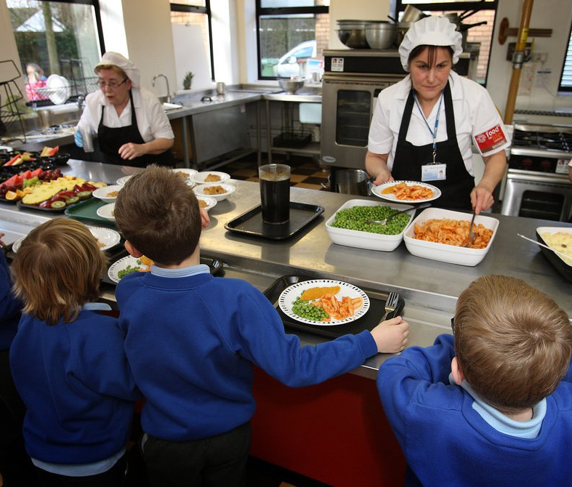

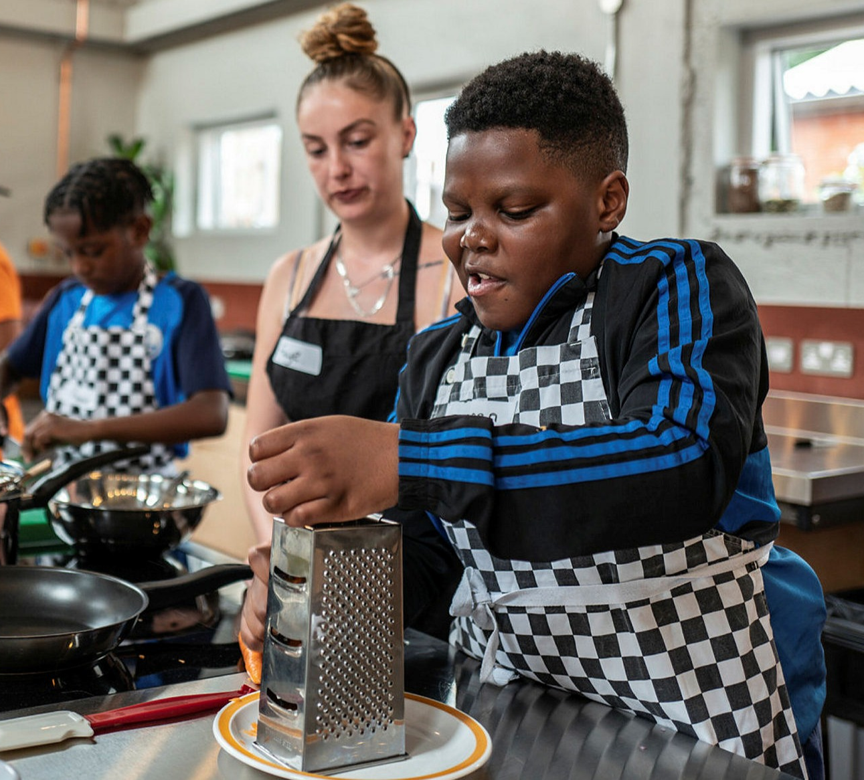
Bite Back
Bite Back have established a National Food Youth Board who lead on National campaigns . They are keen to expand their regional Food Youth Boards to 4 other areas in 2022 one of which they hope will be Greater Manchester. CYP will have the opportunity to identify their own 12-month priorities and the Bite Back team will support them to develop their ideas. They have assured us that they will connect into GM Youth Combined Authority, Youth Voice North West & GM Food Security Action Network. This aligns with the GM CYP Plan and priorities around food and healthy weight.
Bite Back have also just opened applications for their fully funded School Food Champions programme which we are promoting with schools across GM. Successful schools will receive support from Bite Back to train teachers to run a one-year programme for KS3, equipping young people to make their school food healthier.

Slide 17

We have been successful in our application as the GM Food Security Action Network to become a member of FoodShift 2030. This is an EU Horizon 2020 research & innovation programme.
It aims to launch an ambitious, innovative citizen-led transition of the food system across Europe to ensure citizens have access to safe, healthy, nutritious food whilst reducing our Carbon Footprint.
Benefits include participation in the establishment of a FoodShift enabler Lab; pairing with a European ‘frontrunner city’; Peer learning network events; opportunity for exchanges visit with paired city.

