Slide 1

Thank you for joining the Greater Manchester Food Security Action Network
Please TURN OFF YOUR CAMERA and ensure your microphone has automatically been MUTED in order to help us manage the call and anonymity with the meeting being recorded and published to our website.
Example:

Slide 2

Food Security – Framework for Action
MISSION
END FOOD INSECURITY IN GREATER MANCHESTER with an initial focus on
VCSE Sector
Faith Groups
Education
Food Industry
Social Innovation
Housing
SECTORS
Environment
Local Government
Health
Digital & Media
Businesses
Transport
Increasing uptake of Healthy Start Vouchers
Ending Holiday Hunger
Doing more for those that just miss out
TASKFORCE GROUPS

Slide 3
Components of the GM Food Security Action Network
.n
GM Food Security Action Network Chair Rev Ian Rutherford
The full action network meets on a quarterly basis, it has an open invitation and provides a space to bring everyone together working to tackle food insecurity in Greater Manchester, with a priority focus on ensuring no child should go hungry.
Ending Holiday Hunger Task Group Co-chairs Beth Myring, Dave Bagley and Nadine Travers
Focus of initial activity on: 1. Improving the offer for 12-16 year olds (including sustaining the Emergency Food Card Offer) 2. Developing a longer term plan for HAF, ensuring it’s accessible to a wider cohort of CYP, design and commission through co-production with CYP 3. Provision for Children and Young People when HAF is not available.
Uptake of Health Start Vouchers Task Group Co-chairs Katie Merrick, Jane Partington and Katya Pursall
Focus on driving up the uptake of Healthy Start Vouchers among eligible families. To achieve this the group will focus on: Education/Awareness - spreading knowledge of the scheme amongst professionals & support services, Campaigning and Lobbying - reaching recipients directly and working with the NHS BSA to address issues, and ‘Handholding’ - recognising groups who may have difficulty with the new arrangement and identifying support mechanisms.
Doing More For Those That Miss Out Task Group Co-chairs Lily Axworthy, Lesley Lancelot and Gemma Foxcroft
Focus on providing more help, support and advice to those that do not meet the eligibility criteria for Free School Meals. The priorities for this group are looking at Income Maximisation and Food affordability, accessibility and useability with the next steps being the creation of working groups for each focus to enable quicker action and the right people to be ‘at the table’.
Core Coordination Group
The Core Coordination Group will provide an inclusive and coordinated approach to understanding and responding to food insecurity in GM. The group is made up of the chair of the action network, the co-chairs of each of the Task Groups and officers from GMCA.
Ending Holiday Hunger
Task Group
.1
Core Coordination Group
GM Food Security Action Network
.2
.3
Increasing uptake of Healthy Start Vouchers Task Group
Doing more for those that just miss out
Task Group

Slide 4
Greater Manchester Food Security Action Network
A MESSAGE FROM THE MAYOR OF GREATER MANCHESTER, ANDY BURNHAM

Slide 5
Greater Manchester Food Security Action Network
UPDATES FROM OUR 3 TASK GROUPS

Slide 6
Ending Holiday Hunger Task Group
3 KEY ACTIONS
01
02
03
Developing a longer term plan for HAF ensuring it’s accessible to a wider group of CYP, designed and commission through co-production with then
Building provision for Children and Young People when Holiday Activity and Food is not available
Improving the offer for 12-16 year olds including sustaining the Emergency Food Card Offer

Slide 7
Uptake of Healthy Start Vouchers Task Group
3 KEY ACTIONS
01
02
03
Education & Awareness Spreading knowledge of the scheme amongst professionals and support services
Campaigning and Lobbying Reaching recipients directly and working with the NHS BSA to address issues
‘Handholding’
Recognising groups who may have difficulty with the new arrangement and identifying support mechanisms
We will know we are making a difference through:
Data showing an improvement in take-up rates across GM
Evidence of increased awareness through our networks

Slide 8
Doing More for Those That Miss Out Task Group
2 KEY AREAS OF FOCUS
01
02
Next Actions
Create a working group for each focus
Establish who else needs to be ‘at the table’
Income Maximisation
Food affordability, accessibility and useability

Slide 9
Greater Manchester Food Security Action Network
MEASURING OUTCOMES

Slide 10
Greater Manchester Food Security Action Network
INTERVIEW WITH SAINSBURYS

Slide 11
Greater Manchester Food Security Action Network
GROWING THE NETWORK

Slide 12

Why a Focus on ‘Food Security’ in GM?
Climate &
Environment
Bio Diversity
Crops &
Livestock
Processing,
Markets
& Trade
Demand,
Diets,
Nutrition
The ‘Food System’
+ Economics
+ Politics
+ Environment
= Complex & Complicated
Loss & Waste
Food Security,
Access &
Availability

Slide 13




Slide 14
Food Security – Framework for Action
MISSION
END FOOD INSECURITY IN GREATER MANCHESTER with an initial focus on
VCSE Sector
Faith Groups
Education
Food Industry
Social Innovation
Housing
SECTORS
Environment
Local Government
Health
Digital & Media
Businesses
Transport
Increasing uptake of Healthy Start Vouchers
Ending Holiday Hunger
Doing more for those that just miss out
TASKFORCE GROUPS

Slide 15
Components of the GM Food Security Action Network
.n
GM Food Security Action Network Chair Rev Ian Rutherford
The full action network meets on a quarterly basis, it has an open invitation and provides a space to bring everyone together working to tackle food insecurity in Greater Manchester, with a priority focus on ensuring no child should go hungry.
Ending Holiday Hunger Task Group Co-chairs Beth Myring, Dave Bagley and Nadine Travers
Focus of initial activity on: 1. Improving the offer for 12-16 year olds (including sustaining the Emergency Food Card Offer) 2. Developing a longer term plan for HAF, ensuring it’s accessible to a wider cohort of CYP, design and commission through co-production with CYP 3. Provision for Children and Young People when HAF is not available.
Uptake of Health Start Vouchers Task Group Co-chairs Katie Merrick, Jane Partington and Katya Pursall
Focus on driving up the uptake of Healthy Start Vouchers among eligible families. To achieve this the group will focus on: Education/Awareness - spreading knowledge of the scheme amongst professionals & support services, Campaigning and Lobbying - reaching recipients directly and working with the NHS BSA to address issues, and ‘Handholding’ - recognising groups who may have difficulty with the new arrangement and identifying support mechanisms.
Doing More For Those That Miss Out Task Group Co-chairs Lily Axworthy, Lesley Lancelot and Gemma Foxcroft
Focus on providing more help, support and advice to those that do not meet the eligibility criteria for Free School Meals. The priorities for this group are looking at Income Maximisation and Food affordability, accessibility and useability with the next steps being the creation of working groups for each focus to enable quicker action and the right people to be ‘at the table’.
Core Coordination Group
The Core Coordination Group will provide an inclusive and coordinated approach to understanding and responding to food insecurity in GM. The group is made up of the chair of the action network, the co-chairs of each of the Task Groups and officers from GMCA.
Ending Holiday Hunger
Task Group
.1
Core Coordination Group
GM Food Security Action Network
.2
.3
Increasing uptake of Healthy Start Vouchers Task Group
Doing more for those that just miss out
Task Group

Slide 16
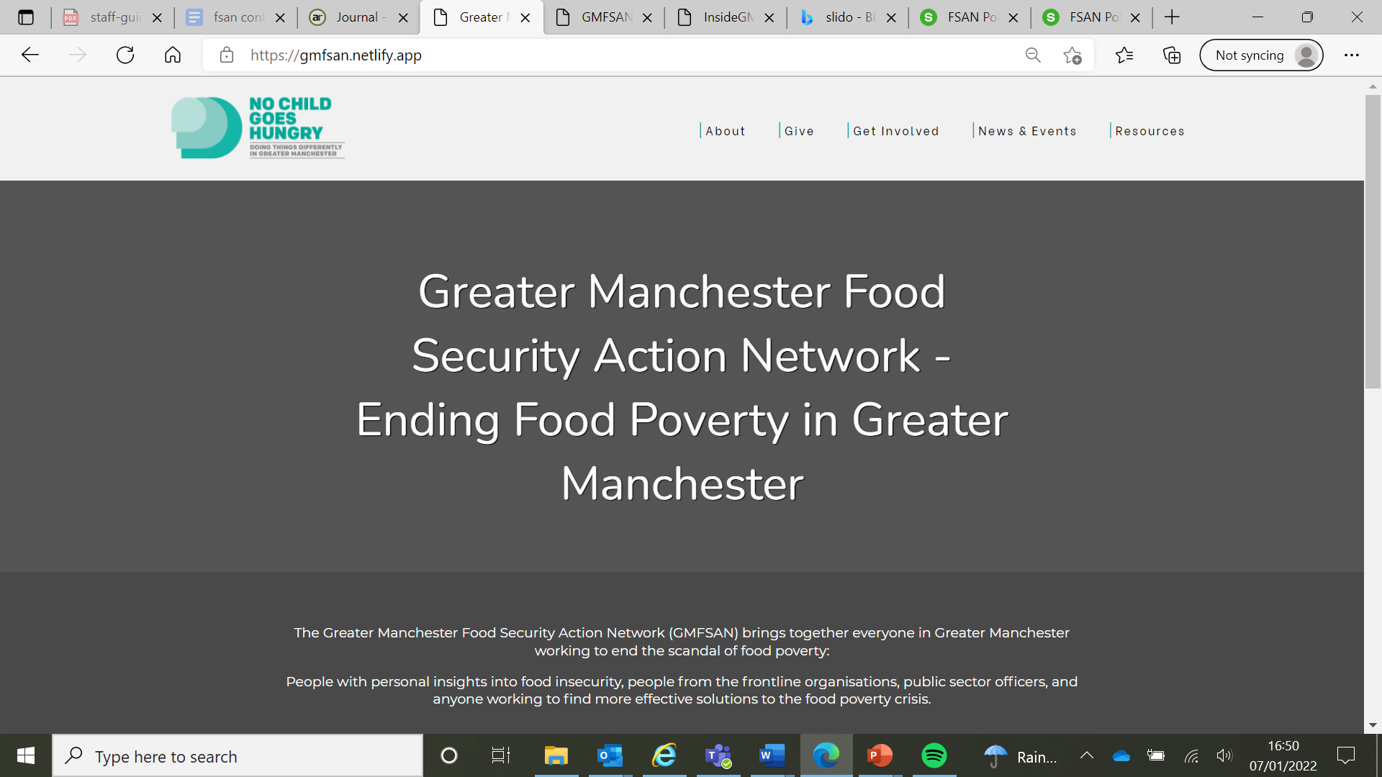
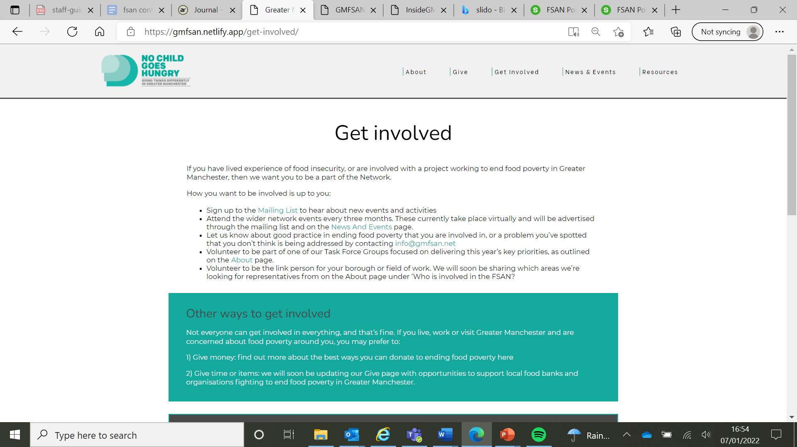
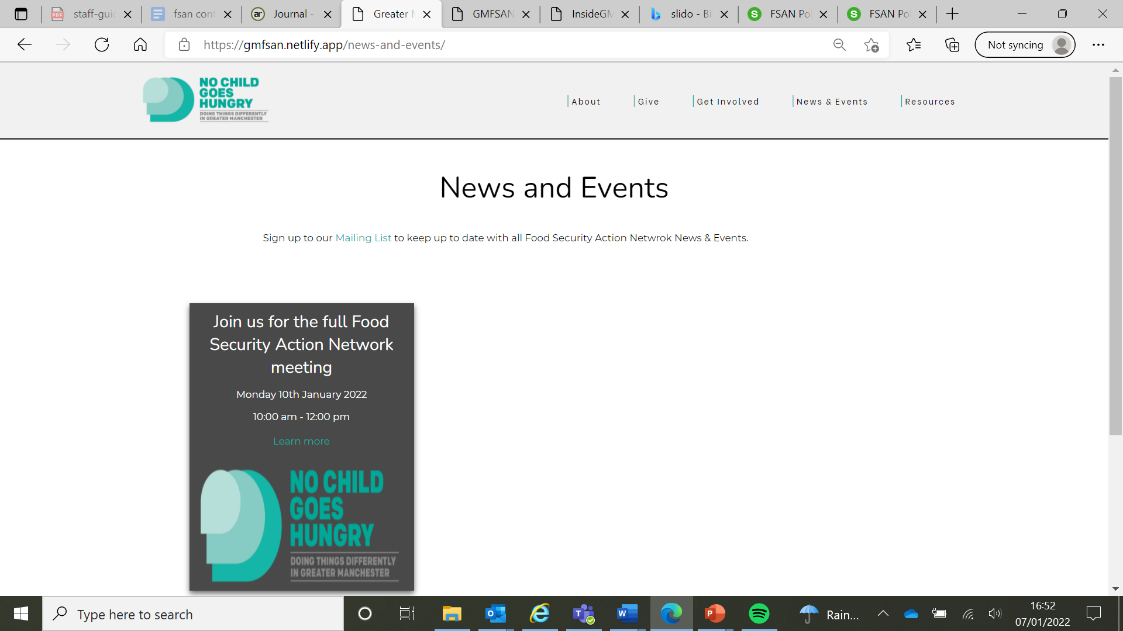
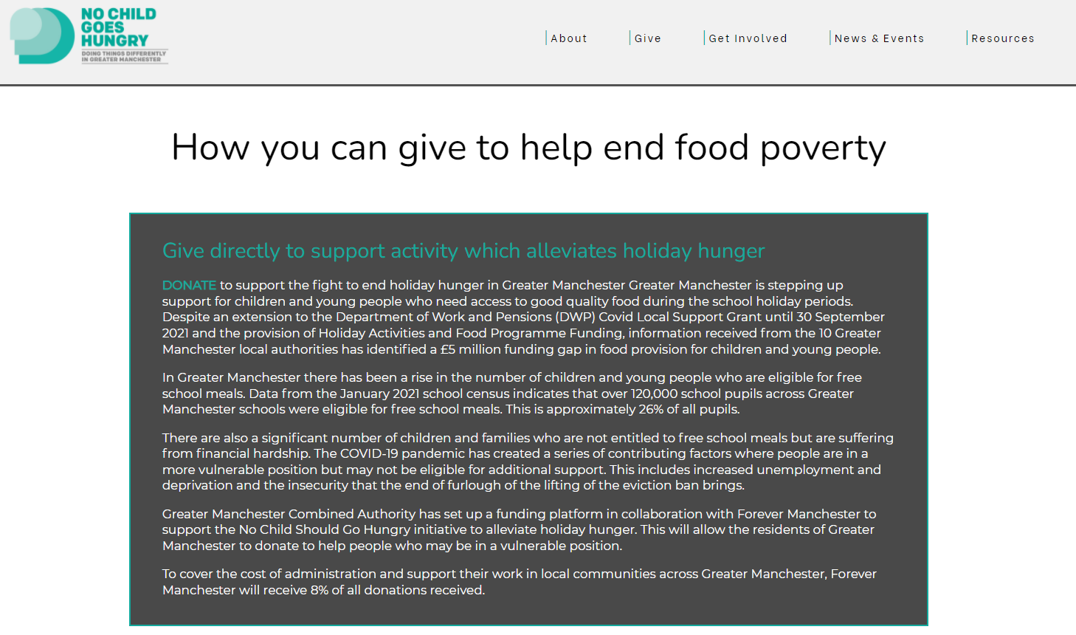

Slide 17
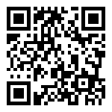
Slido Poll
Which Greater Manchester borough do you work within?
Which part of the system do you work within?
Join at
slido.com
#258 749

Slide 18
Ending Holiday Hunger Task Group
3 KEY ACTIONS
01
02
03
Developing a longer term plan for HAF ensuring it’s accessible to a wider group of CYP, designed and commission through co-production with then
Building provision for Children and Young People when Holiday Activity and Food is not available
Improving the offer for 12-16 year olds including sustaining the Emergency Food Card Offer

Slide 19
Uptake of Healthy Start Vouchers Task Group
3 KEY ACTIONS
01
02
03
Education & Awareness Spreading knowledge of the scheme amongst professionals and support services
Campaigning and Lobbying Reaching recipients directly and working with the NHS BSA to address issues
‘Handholding’
Recognising groups who may have difficulty with the new arrangement and identifying support mechanisms
We will know we are making a difference through:
Data showing an improvement in take-up rates across GM
Evidence of increased awareness through our networks

Slide 20
Doing More for Those That Miss Out Task Group
2 KEY AREAS OF FOCUS
01
02
Next Actions
Create a working group for each focus
Establish who else needs to be ‘at the table’
Income Maximisation
Food affordability, accessibility and useability

